Slide 1
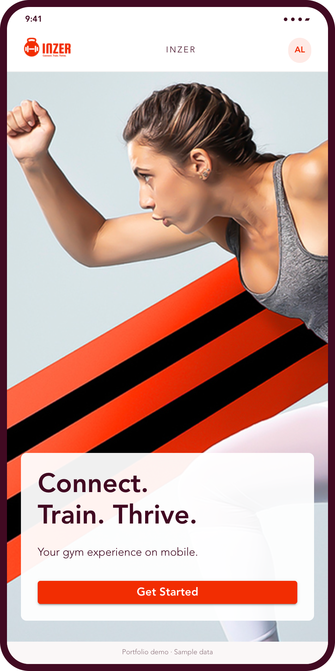
INZER / MOBILE PORTFOLIO
01
INZER
A gym experience
designed for mobile
Member onboarding, workout tracking
and gym community
Khalid Sohaib
Mobile web / PWA. Adapted screens with sample data.
Notes:
Cover artwork: src/app/images/GymAppMobileView.png and inzr.png. Introductory composition adapted for portfolio.
Source: local datics/gym-app-frontend develop snapshot d502bdbe92f09ac07935f6aa84ffbd7815f46a3e. These are staged UI renders. Backend services and account actions were not executed.

Slide 2
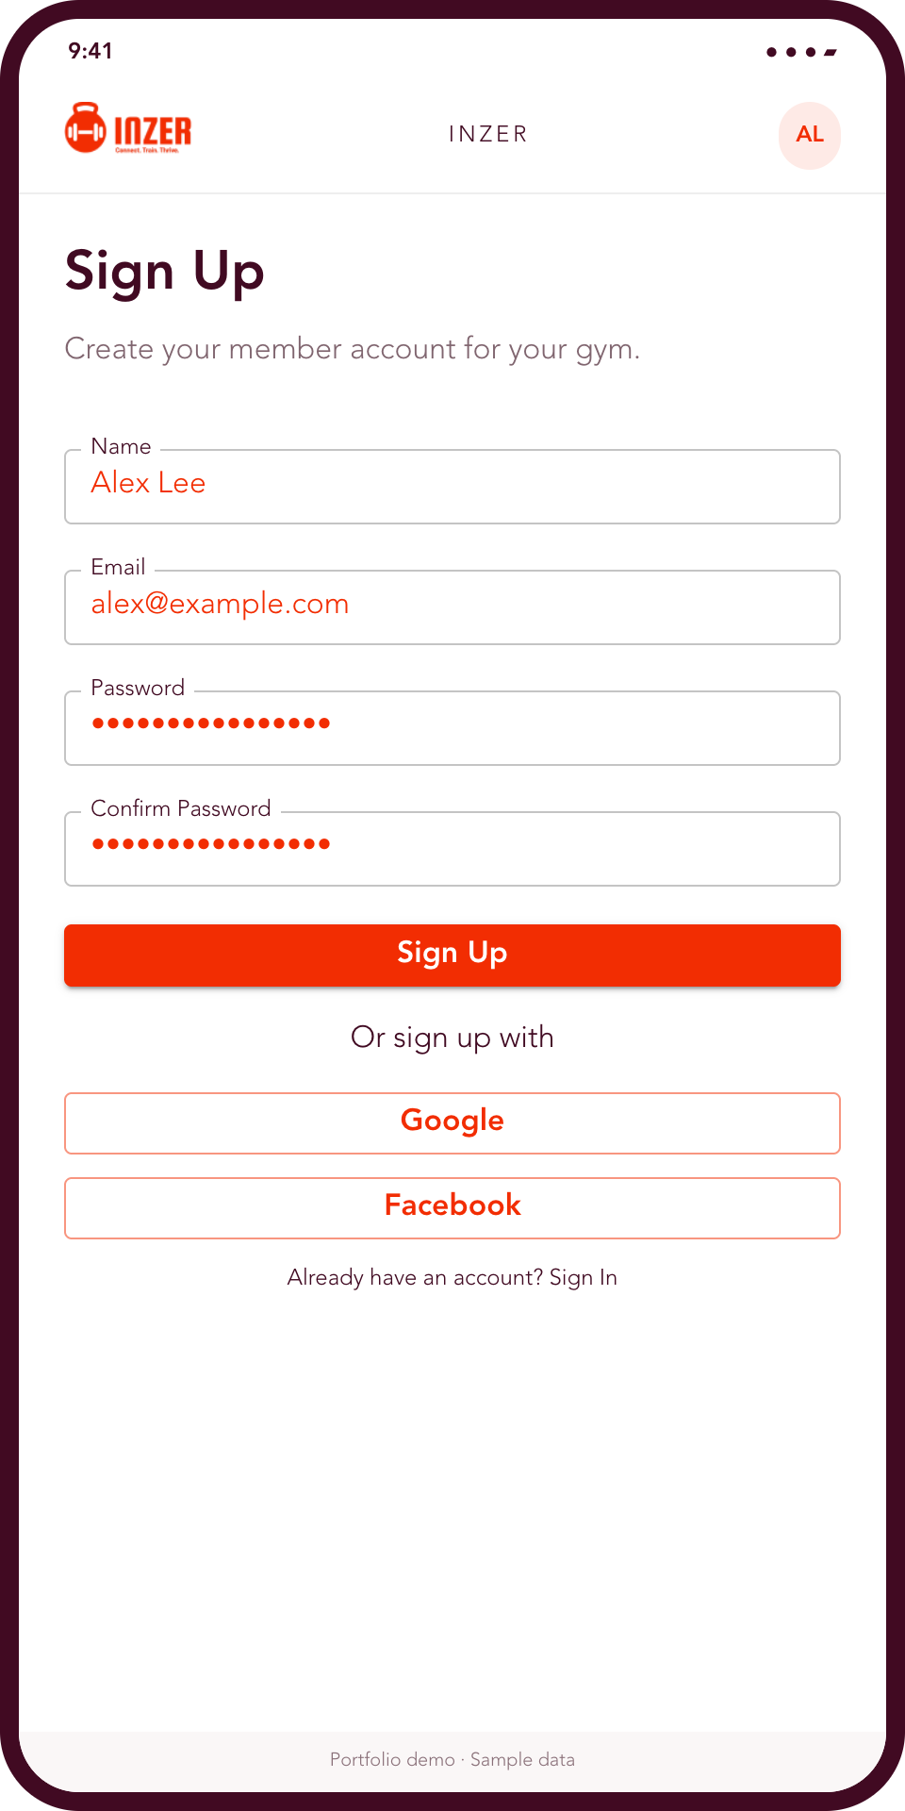
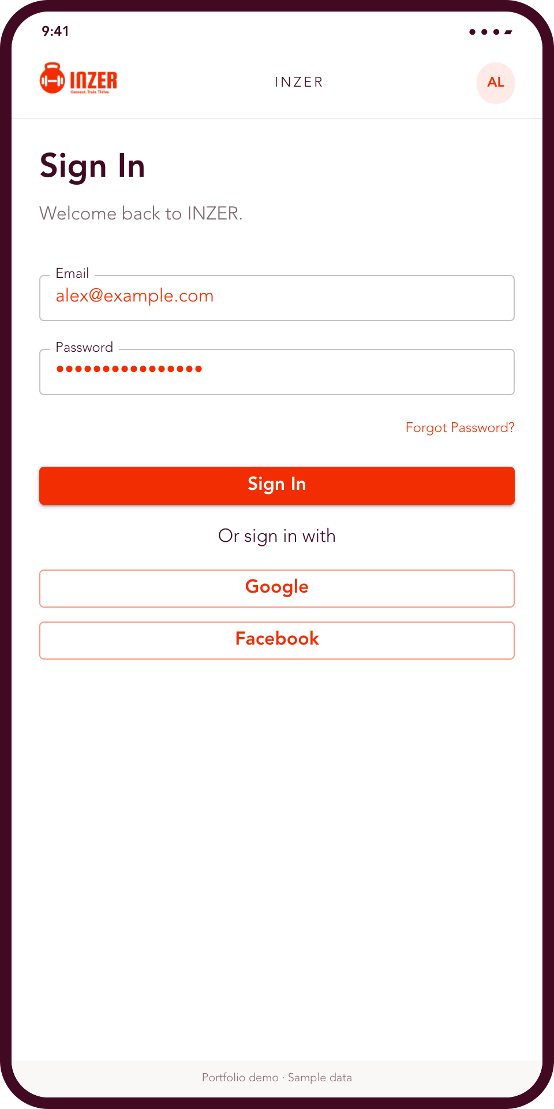
INZER / MOBILE PORTFOLIO
02
Signup and sign-in
Members create an account for their gym, then sign in to access their workouts.
Email and password
Google and Facebook options
Khalid Sohaib
Mobile web / PWA. Adapted screens with sample data.
Notes:
Source: src/app/components/pages/signup/index.jsx and src/app/containers/signup/index.jsx, plus pages/userLogin/index.jsx. Form fields and social options are source based, reconstructed with Material UI for the deck. Signup requires gym branch or machine context and returns to sign-in on success. This flow does not invent mandatory email verification.
Source: local datics/gym-app-frontend develop snapshot d502bdbe92f09ac07935f6aa84ffbd7815f46a3e. These are staged UI renders. Backend services and account actions were not executed.

Slide 3
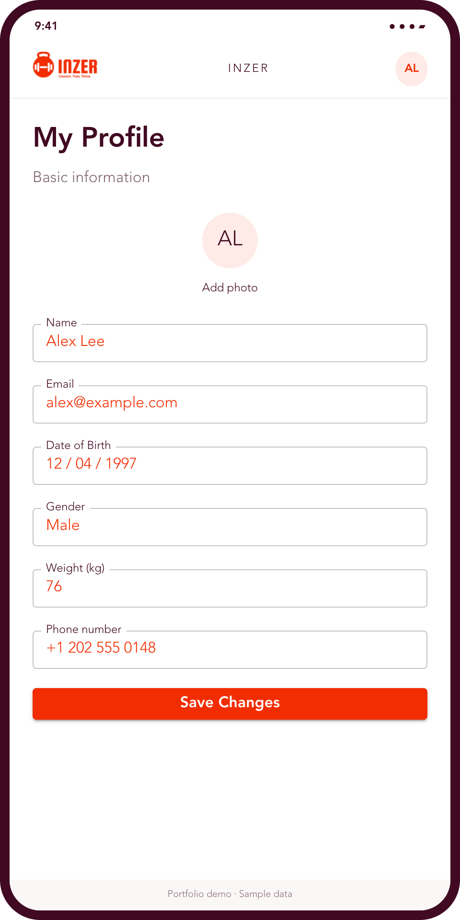
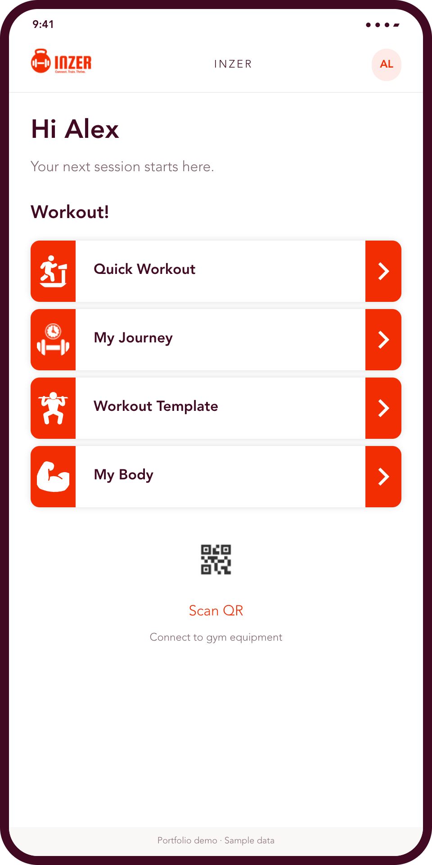
INZER / MOBILE PORTFOLIO
03
Profile and home
Members manage their personal details and choose their next training activity.
Quick workouts and saved plans
QR access to gym equipment
Khalid Sohaib
Mobile web / PWA. Adapted screens with sample data.
Notes:
Source: pages/profileForm/index.jsx, pages/users/mainMenu/index.jsx, pages/users/yourWorkRecords/index.jsx. Profile is an available member task, not claimed to be a mandatory onboarding gate. Home combines source navigation with adapted presentation framing. MainMenuCard is reused directly.
Source: local datics/gym-app-frontend develop snapshot d502bdbe92f09ac07935f6aa84ffbd7815f46a3e. These are staged UI renders. Backend services and account actions were not executed.

Slide 4
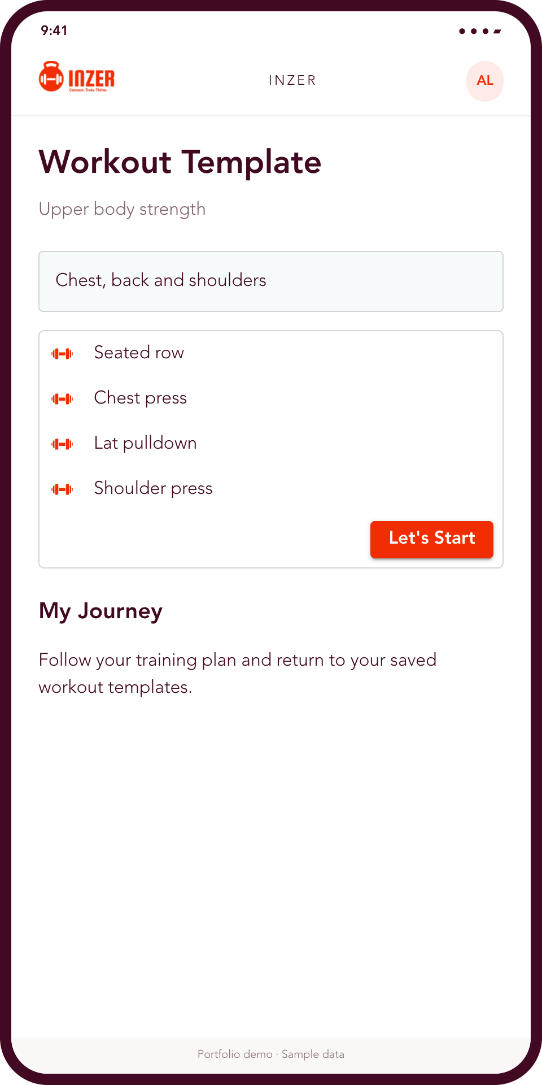
INZER / MOBILE PORTFOLIO
04
Workout planning
Saved templates organise exercises into a repeatable session.
Review the exercise list before starting.
Return to a personal training journey.
Khalid Sohaib
Mobile web / PWA. Adapted screens with sample data.
Notes:
Source component directly reused: src/app/components/workoutJourneyCards/workoutTemplateCard.jsx. Supporting routes: user/workout-journey and user/workrecord-templates. Exercise names are illustrative.
Source: local datics/gym-app-frontend develop snapshot d502bdbe92f09ac07935f6aa84ffbd7815f46a3e. These are staged UI renders. Backend services and account actions were not executed.

Slide 5
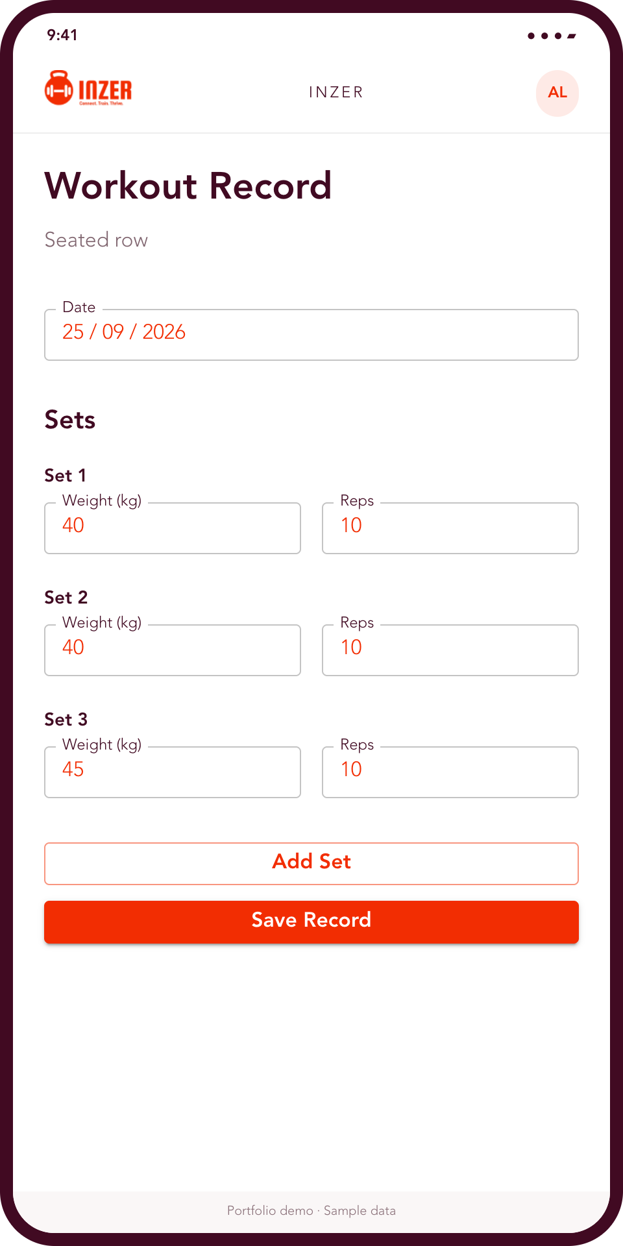
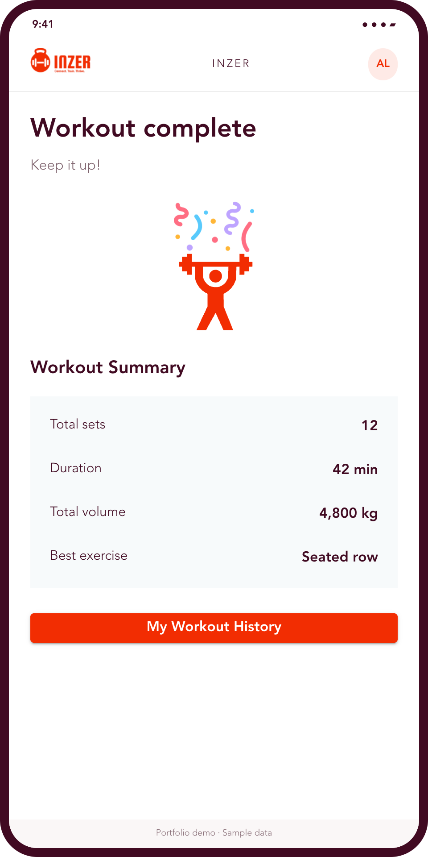
INZER / MOBILE PORTFOLIO
05
Logging and completion
Members record weight and reps for each set, then review a session summary.
Set-by-set entry
Duration and total volume
Workout history
Khalid Sohaib
Mobile web / PWA. Adapted screens with sample data.
Notes:
Sources: pages/users/exerciseWorkoutRecords/addRecord/index.jsx, pages/congratulationScreen/index.jsx and components/workOutSummary. Fields and summary reconstructed for mobile presentation. All sets, durations and volume values are fictional examples. They do not represent measured user activity or product performance.
Source: local datics/gym-app-frontend develop snapshot d502bdbe92f09ac07935f6aa84ffbd7815f46a3e. These are staged UI renders. Backend services and account actions were not executed.

Slide 6
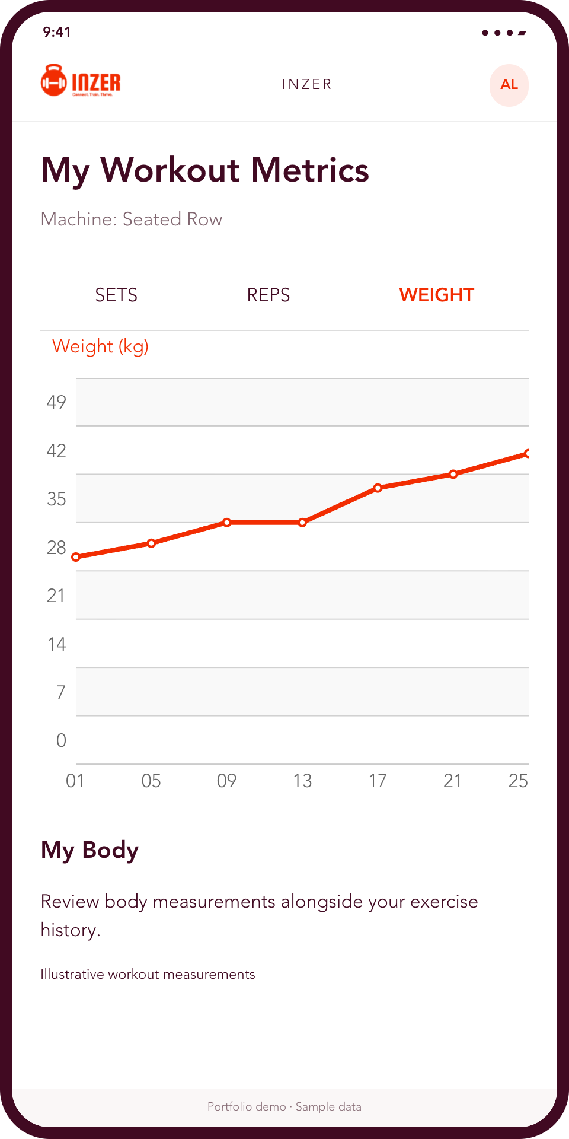
INZER / MOBILE PORTFOLIO
06
Progress over time
Exercise history makes training progress visible across sessions.
Sets, reps and weight views
Body measurements
Khalid Sohaib
Mobile web / PWA. Adapted screens with sample data.
Notes:
Source reused directly: pages/users/workoutMetrics/LinearGraph.jsx. Also referenced pages/users/bodyMeasurements and workoutHistory. Chart is part of a UI screenshot, not an analytical chart. Sample weights span 30 to 45 kg, and do not claim real outcomes.
Source: local datics/gym-app-frontend develop snapshot d502bdbe92f09ac07935f6aa84ffbd7815f46a3e. These are staged UI renders. Backend services and account actions were not executed.

Slide 7
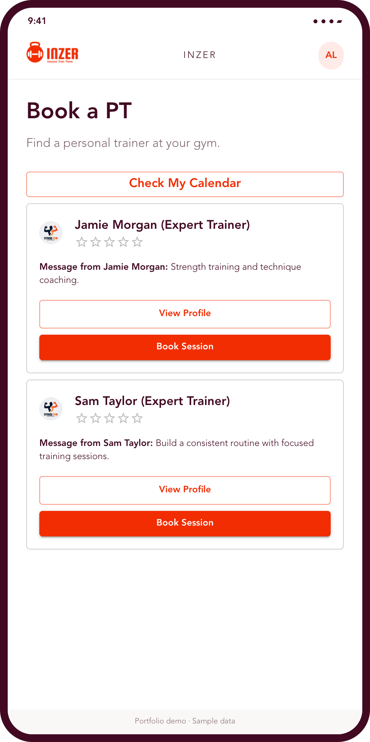
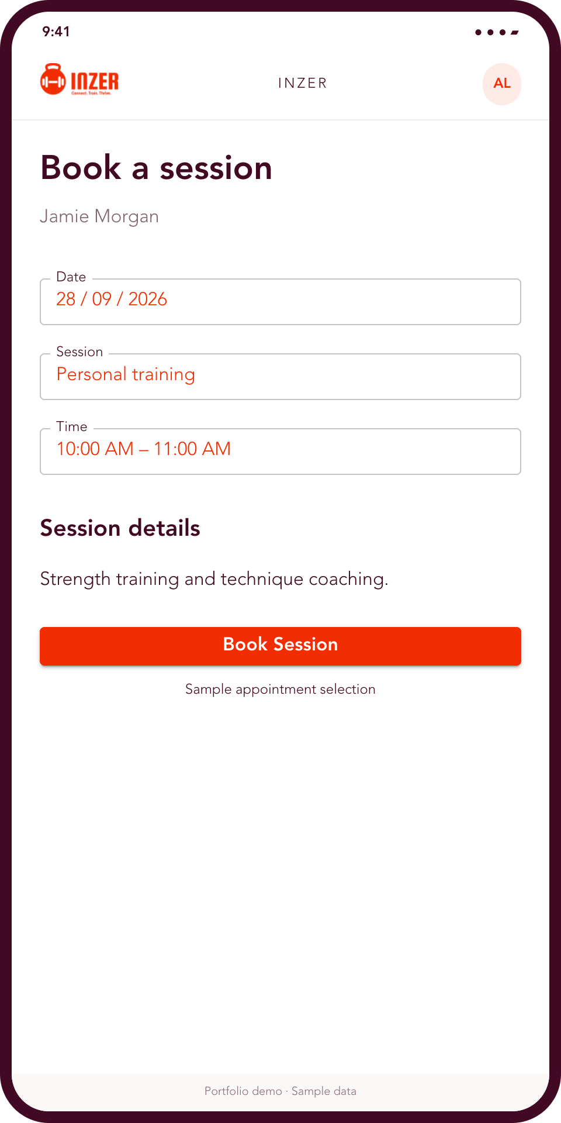
INZER / MOBILE PORTFOLIO
07
Personal training
Members browse trainers and choose a session time.
Trainer profiles
Session selection
Personal calendar
Khalid Sohaib
Mobile web / PWA. Adapted screens with sample data.
Notes:
Source directly reused: pages/users/bookAPT/ptCard.jsx. Related route: /user/book-pt/book-session/:id. Booking form is a source-informed illustration of date and time selection, not a booking confirmation. Trainers and appointments are fictional.
Source: local datics/gym-app-frontend develop snapshot d502bdbe92f09ac07935f6aa84ffbd7815f46a3e. These are staged UI renders. Backend services and account actions were not executed.

Slide 8
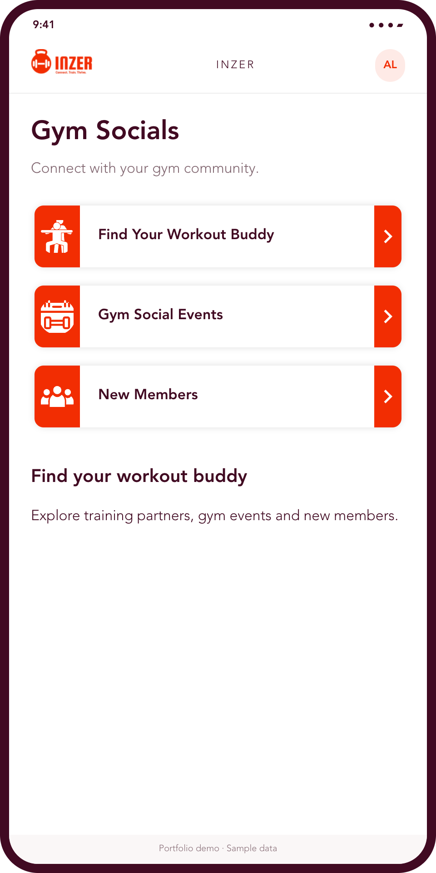
INZER / MOBILE PORTFOLIO
08
Gym community
Social features keep the member experience connected to the gym.
Find a workout buddy
Explore gym events
Meet new members
Khalid Sohaib
Mobile web / PWA. Adapted screens with sample data.
Notes:
Source reused directly: pages/users/gymSocials/index.jsx and its MainMenuCard. Source routes include workout-buddy, social-events and new-members. Descriptive copy is adapted for this portfolio.
Source: local datics/gym-app-frontend develop snapshot d502bdbe92f09ac07935f6aa84ffbd7815f46a3e. These are staged UI renders. Backend services and account actions were not executed.

Slide 9
INZER / MOBILE PORTFOLIO
09
Engineering contribution
Khalid Sohaib
Technology
React application development
PWA installability and offline support
Real-time updates with WebSockets
Social authentication and UI refactoring
React and Material UI
React Query
Socket.IO
Vite and PWA tooling
Presented as a mobile web app / PWA
Khalid Sohaib
Mobile web / PWA. Adapted screens with sample data.
Notes:
Engineering contributions come from the user-supplied Khalid Sohaib _ Resume-RN.pdf, Gym Management SaaS section: React application maintenance, WebSocket updates, PWA conversion with offline support and installability, social authentication, component refactoring and admin interfaces. Stack evidence from repository package.json. Do not infer sole ownership of the product or claim that this React web repository is a native React Native app.
Source: local datics/gym-app-frontend develop snapshot d502bdbe92f09ac07935f6aa84ffbd7815f46a3e. These are staged UI renders. Backend services and account actions were not executed.

