Slide 1
CSE 713: Paper review presentation
Group No- 06
Face recognition from image patches using an ensemble of CNN-local mesh pattern networks
Submitted by- Submitted to
17301018 Khadija-Tul-Kobra Annajiat Alim Rasel
16101036 Md Khalid Syffulla
21166010 Shanuma Afrin Meghla
21266035 Khairun Nahar
21266027 Sumaiya Ismail
18101137 Sheikh Samiul Huda
18101153 Syed Abrar Imam
22166005 Shovan Kanti Mondal

Slide 2
Abstract
The aim of this paper is to recognise a face using an ensemble of convolutional neural network trained on original and texturat feature maps from image patches.
Dividing the whole face into small patches,textural feature map image and original patches are fed to the two pre-trained ResNet50 networks and by the two networks’ majority voting ensemble technique final labels are gained.
The proposed system achieves an accuracy of 98.05%.

Slide 3
Introduction
Public biometric recognition has become more challenging after the Covid-19 outbreak. Researchers from previous years have come up with different models and techniques like RGB-YCbCr colour model with kNN classifier, Gabor filters etc.
But with the development of deep learning techniques different techniques using CNN has been published.
Deep framework with a set of CNNs and stacked auto encoders gives accuracy of 99.0%
CNN-SVM system
CNN and LBP fusion based face recognition
Optimal CNN architecture using genetic algorithm

Slide 4
It has been noticed that combination of different feature descriptors with CNN is giving better accuracy. So ResNet50 pre-trained on ImageNet is used here,where the image patches are enhanced using local mesh pattern(LMeP).

Slide 5
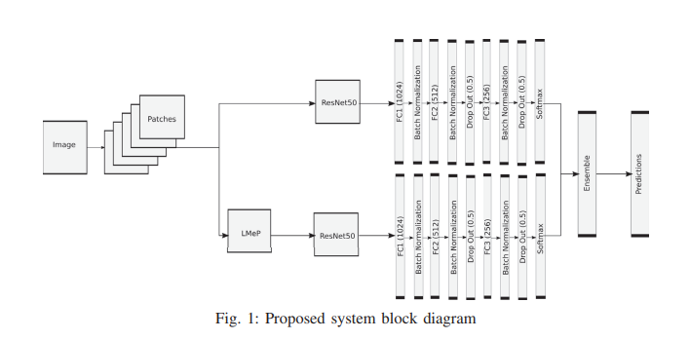
Proposed Method
Pre-trained ResNet50

Slide 6
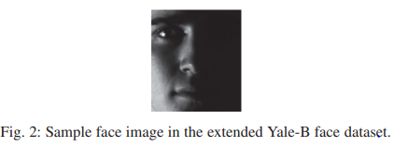
Image Dataset
Yale-B face dataset

Slide 7
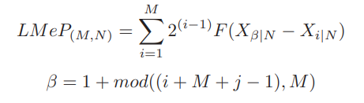
Local mesh pattern
Local Binary Pattern.
Gives an 8-bit number and is converted to its corresponding decimal value for replacing the center pixel.
A modified LBP feature descriptor is the LMeP descriptor.
The value of LMeP is calculated based on the correlation between the neighbors of a neighborhood.
LMeP Equation-

Slide 8
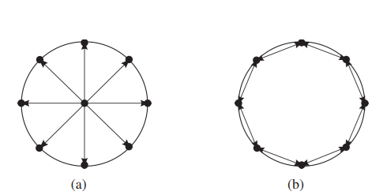
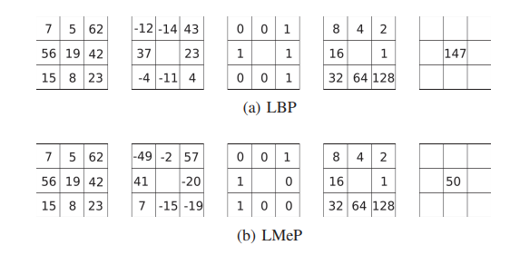
Local mesh pattern
Correlation between pixels in the neighborhood is taken.
LMeP provides more reliable features as compared to LBP.
Fig- 1: Circular pattern of (a) LBP (b) LmeP Fig- 2: Example of LBP and LMeP

Slide 9

Convolutional Neural Network:
Deep Learning Algorithm
Preprocessing comparatively lower than other classification algorithms.
ResNet50:
Variant of ResNet model
Train ultra deep neural networks
MobileNet:
Portable CNN architecture
ImageNet:
An image databse.

Slide 10
Vanishing Gradient: More layers using certain activation function added to neural networks, the gradients of the loss function approaches zero. Degradation Problem: When the network depth increases , accuracy gets saturated , then degrades rapidly.

Slide 11
Fully Connected Layers: All the inputs from one layer are connected to every activation unit of the next layer. Epoch: One complete pass through the training data.

Slide 12
Over fitting: A modeling error in statistics that occurs when a function is too closely aligned to a limited set of data points. Dropout Layers: Technique to prevent over fitting.

Slide 13
Softmax Activation : An activation function that turns a vector of k real values into a vector of k real values that sum to 1.

Slide 14
Ensemble
Techniques that create multiple models
An effort to achieve better predictive performance
Strategically generated and combined to solve a particular computational intelligence problem.
There are several techniques of ensemble:
Majority voting
Bagging
Boosting
Stacking

Slide 15
Majority voting
Multiple models are used to make predictions for each data point
Predictions by each model are considered as a ‘vote’
Majority of the models are used as the final prediction
The result of max voting would be something like this:
Colleague 1 colleague 2 colleague 3 colleague 4 colleague 5 final rating 5 5 4 4 4 4

Slide 16
Bagging
Combining the results of multiple models (for instance, all decision trees) to get a generalized result
Multiple subsets are created from the original dataset, selecting observations with replacement
Base model (weak model) is created on each of subsets
Final predictions are determined by combining the predictions from all the models

Slide 17
Boosting
A sequential process, where each subsequent model attempts to correct the errors of the previous model
Succeeding models are dependent on the previous model
Boosting algorithm combines a number of weak learners to form a strong learner
Each model actually boosts the performance of the ensemble

Slide 18
Stacking
Uses predictions from multiple models (for example decision tree, knn or svm) to build a new model
Used for making predictions on the test set.
In this paper, Majority voting technique is used.

Slide 19
Results and Discussion
For recognition, 33 people and 65 images are evaluated
For training and testing, a total of 10725 patches are used.
MobileNet and ResNet50 are the networks where the image patches are used.
LBP and LMeP descriptors are applied to the patches separately to examine the performance of textural pictures in the classification process.

Slide 20
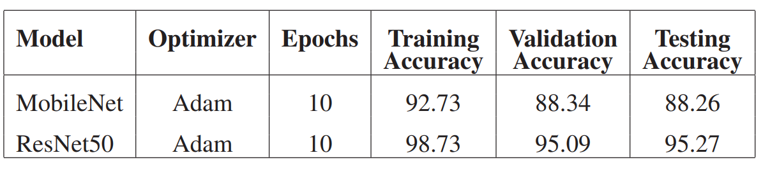
Results and Discussion (continued)

Slide 21
Conclusion
Importance of face recognitions:
Improved public safety
Aviation and transport
Access and authentication
Retail
Faster processing and seamless integration
Accuracy of 98.05%

