Slide 1


Slide 2

Dairy Drop
Database Management System or Web Design and Development
CS519
Associate Degree Program (ADP)

Slide 3
Introduction
Khalid usman
Group Id: BC230412534

Slide 4

INTRODUCTION OF PROJECT
Dairy Drop is an innovative web-based e-commerce platform that enables customers to easily browse, order, and receive fresh dairy products while providing admins with efficient management of products, orders, and payments

Slide 6
Functional Requirements Non Functional requirements
< A. Functional Requirements
User Account Management
Users can register, log in, and log out securely.
Users can update their profile information, delivery addresses, and view order history.
Admins can manage all registered users and control their access levels.
Product Management (Admin/Producer)
Admins or producers can add, edit, or remove products.
Products are organized into categories like milk, yogurt, cheese, butter, cream, and others.
Each product includes details such as price, nutritional facts, shelf life, description, and images.
Product Browsing and Search
Customers can view product lists and detailed product pages.
Filters for price, category, brand, and nutritional content are available to simplify product selection.
Shopping Cart and Checkout
Customers can add or remove products, update quantities, and view total costs in the shopping cart.
Checkout process captures delivery details and confirms orders for processing.

Slide 7
Payment Options
Cash-on-Delivery (COD) is available for all orders.
Customers receive order confirmation after placing an order.
Order Tracking
Customers can track the status of their orders (Pending, Packed, Out for Delivery, Delivered).
Admins can update order statuses and manage deliveries efficiently.
Reviews and Ratings
Customers can provide feedback and rate purchased products.
Admins can manage reviews, removing inappropriate content when necessary.

Slide 8
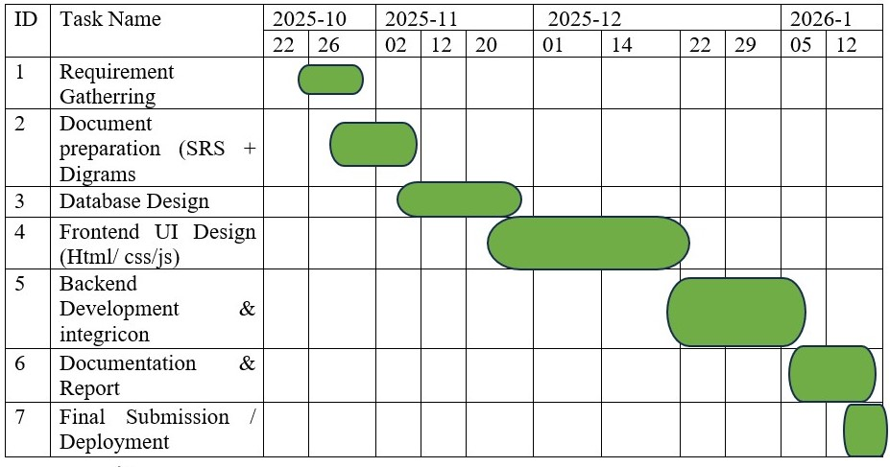
Project Schedule

Slide 9
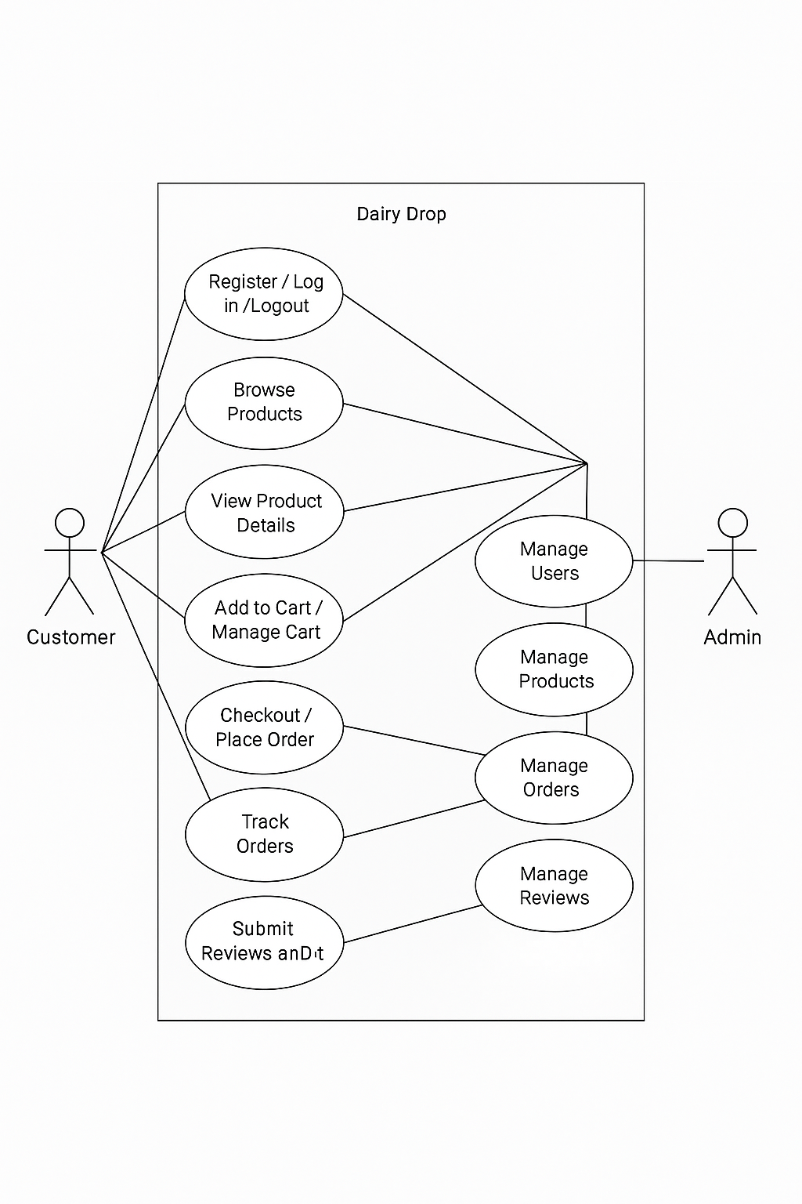
Use Case Diagram

Slide 10
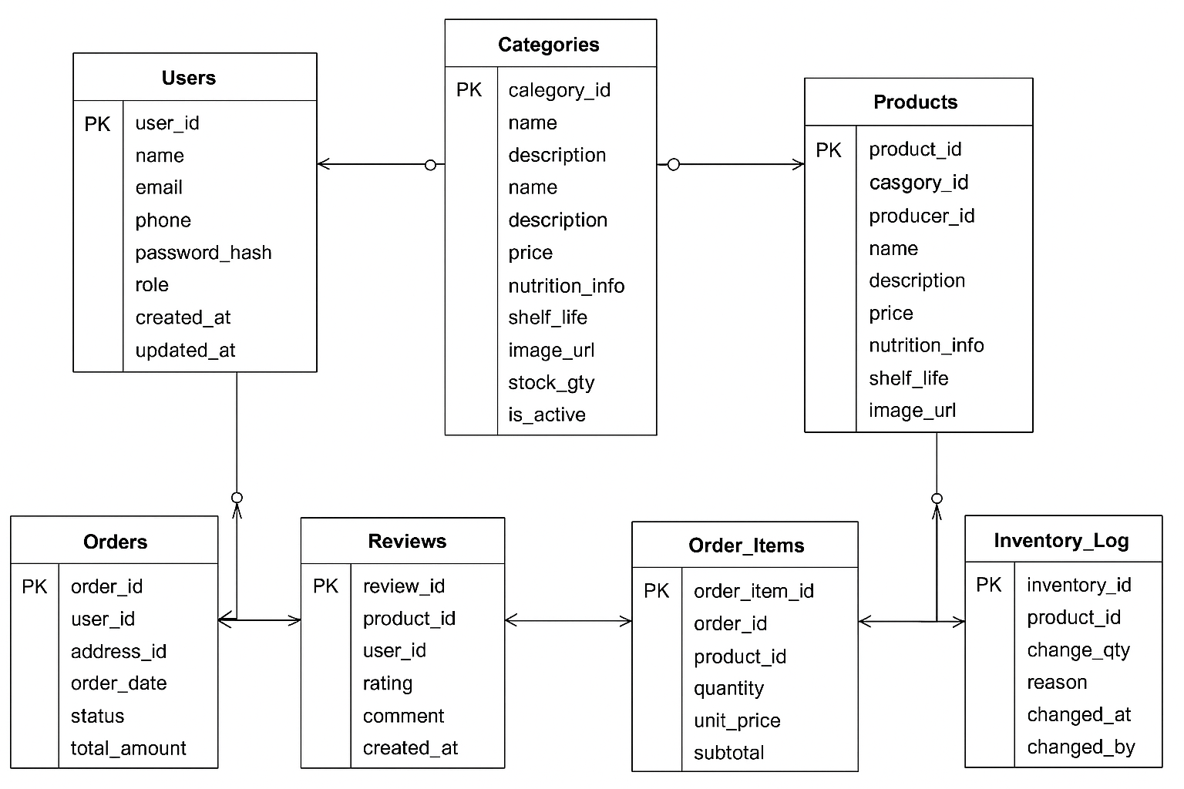
Entity-Relationship Diagram

Slide 11
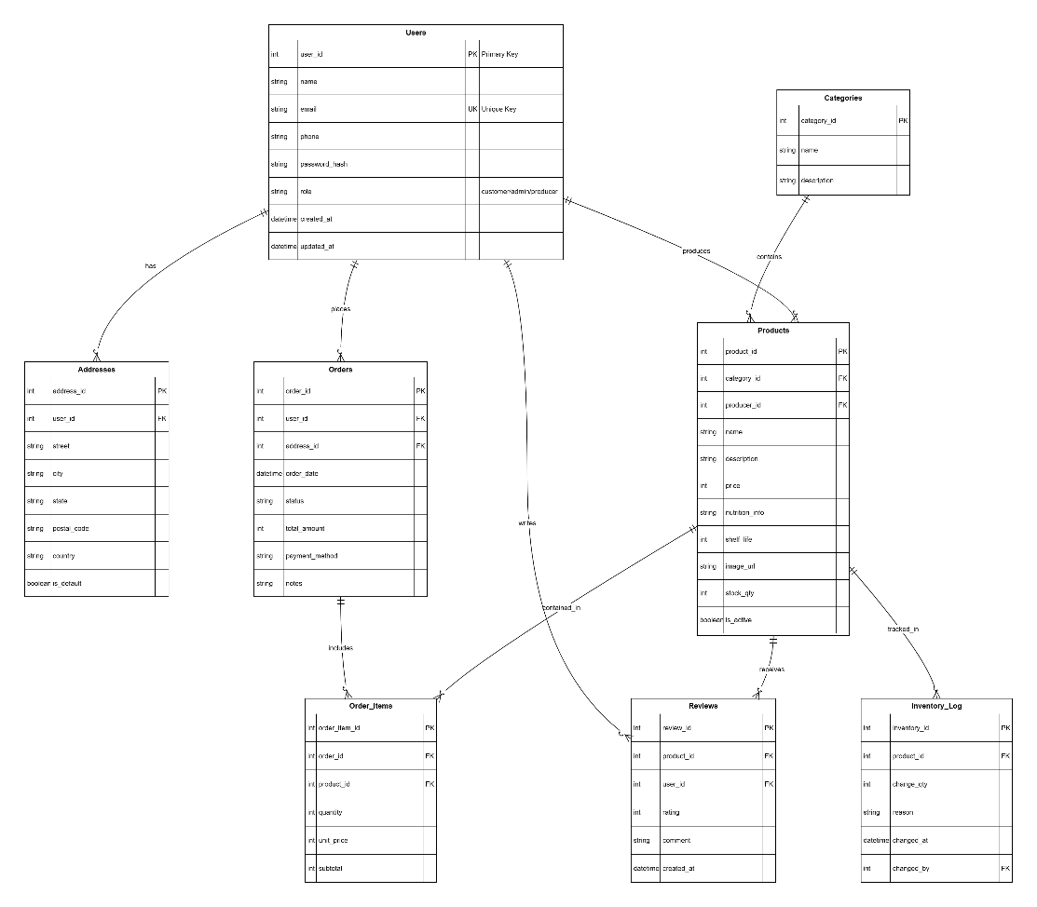
Relational Schema

Slide 12
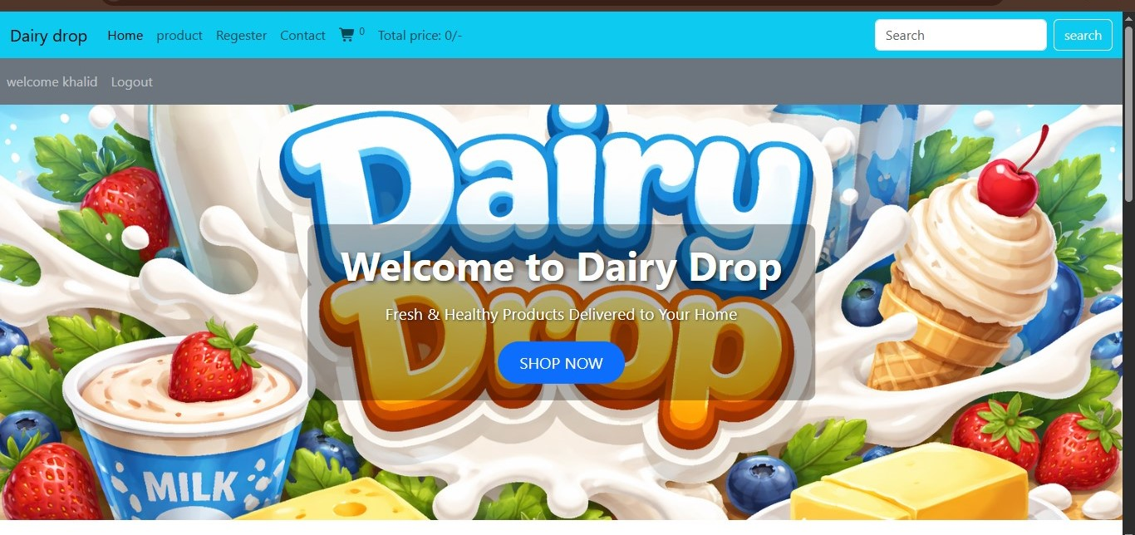
User Interfaces

Slide 13
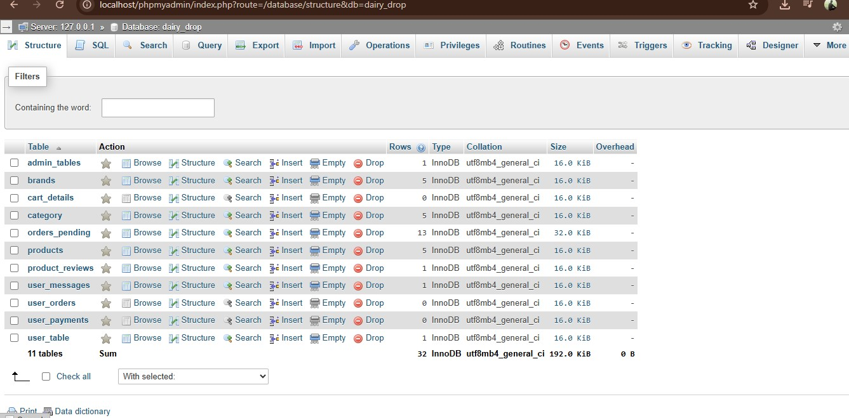
Results
Provide here the screen shots of results which are generated after applying database queries.

Slide 14
Tools
Vs code
Xamp for database

Slide 15
Thank you

