Slide 1

Churn prediction

Slide 2
content
1- What is Churn?
2- What are Churn Segments?

Slide 3
About the data set
Customers who left within the last month – the column is called Churn
Services that each customer has signed up for – phone, multiple lines, internet, online security, online backup, device protection, tech support, and streaming TV and movies
Customer account information – how long they’ve been a customer, contract, payment method, paperless billing, monthly charges, and total charges
Demographic info about customers – gender, age range, and if they have partners and dependents

Slide 4
Types of services
Services
Phone Services
Internet Services
Multiple Lines
Online Security
Device Protection
Tech Support
Online Backup
StreamingTV
StreamingMovies

Slide 5
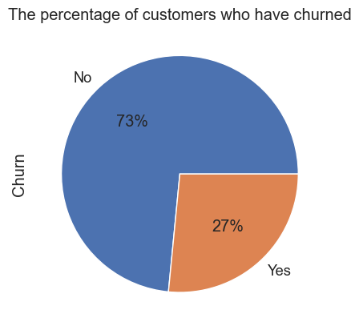
The churn precentage

Slide 6
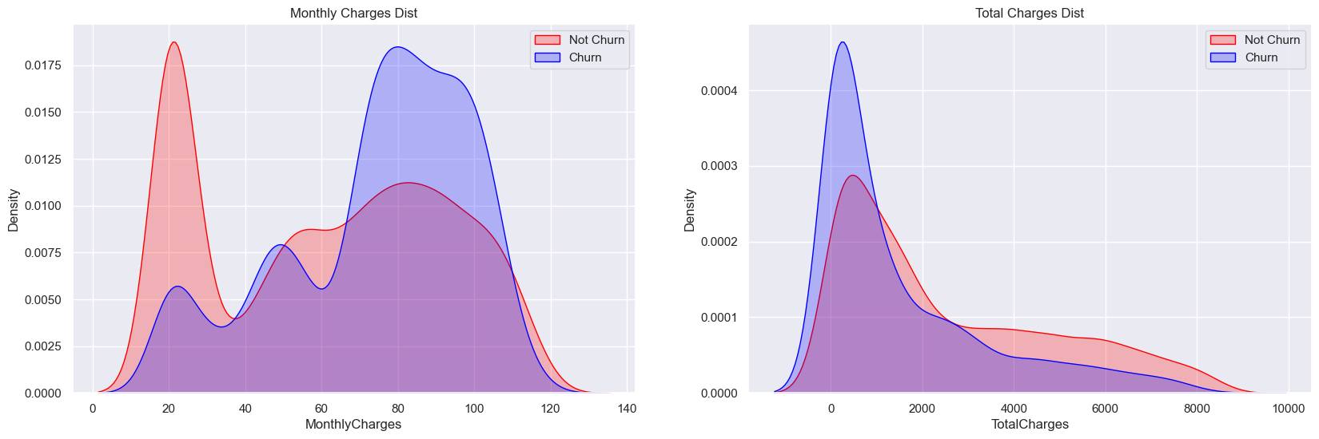
Monthly chargers and total charges

Slide 7
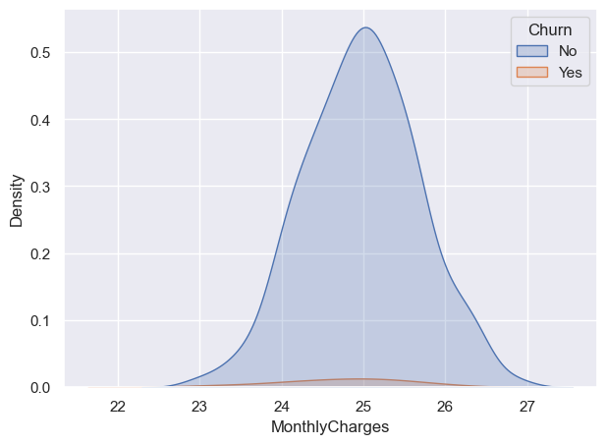
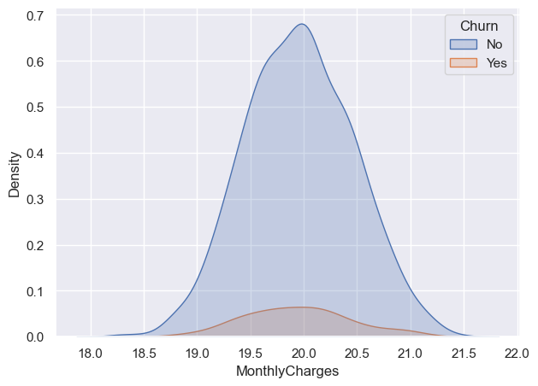
Monthly charges for no service customers
Customers have multiple lines
The people who are doesn't have internet services and no MultipleLines, just have Phone services
Customers have only Phone Services

Slide 8
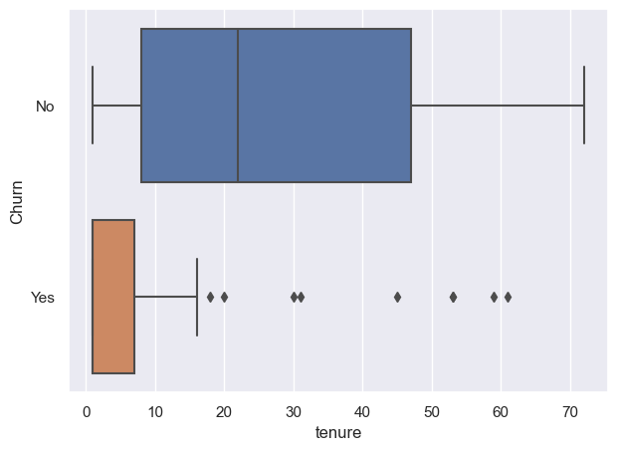
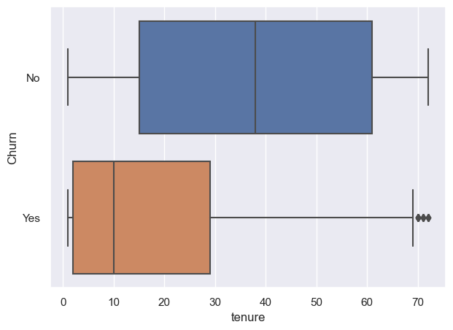
No service customer tenure
Customers have only Phone Services

Slide 9
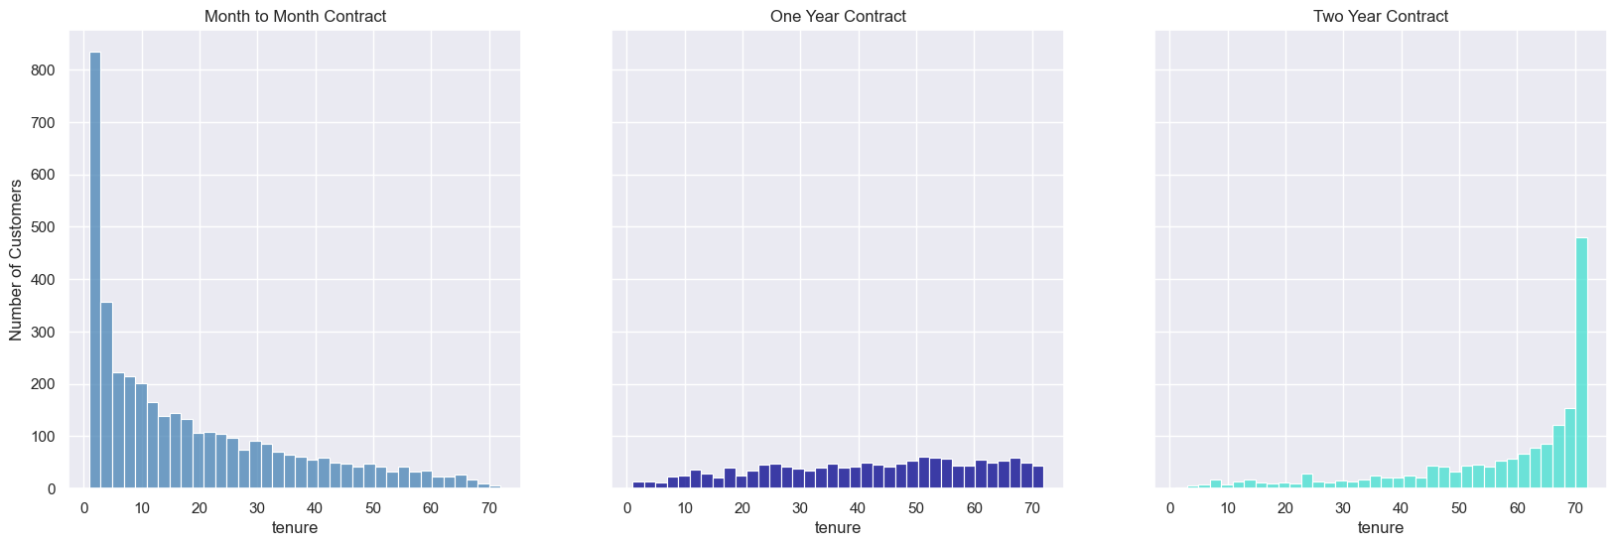
Tenure ( how long they’ve been a customer )

Slide 10
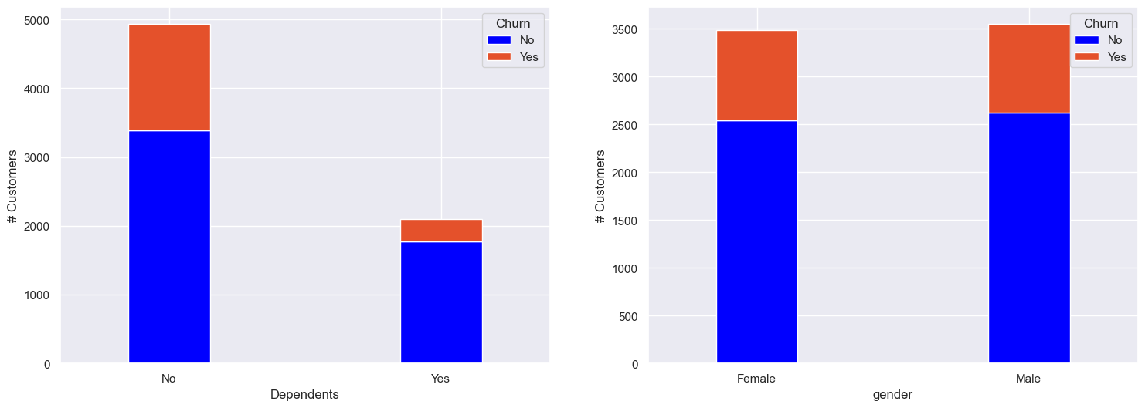
Demographic with churn

Slide 11
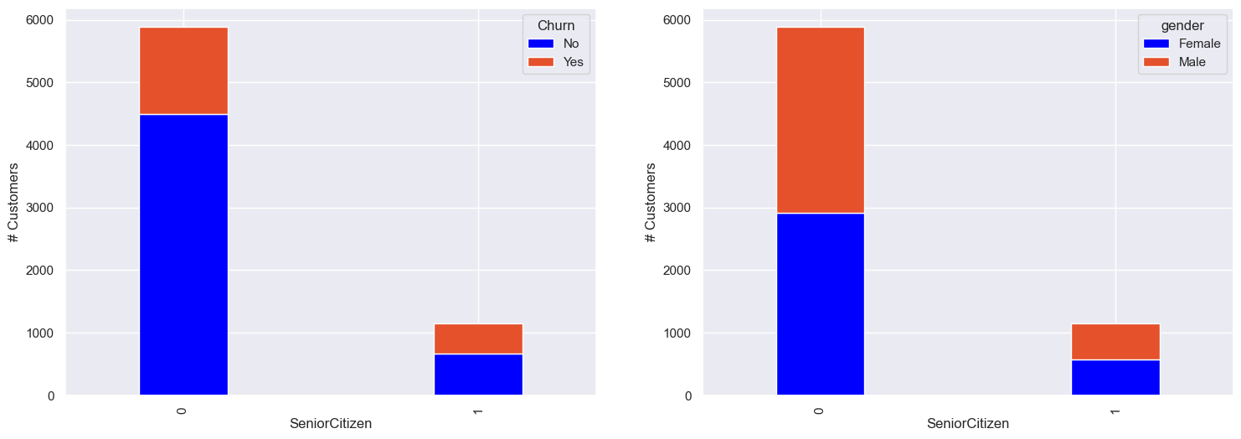
Senior Citizen

Slide 12
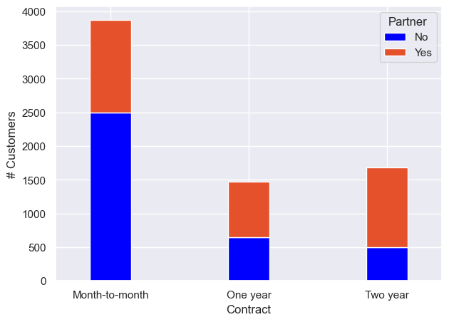
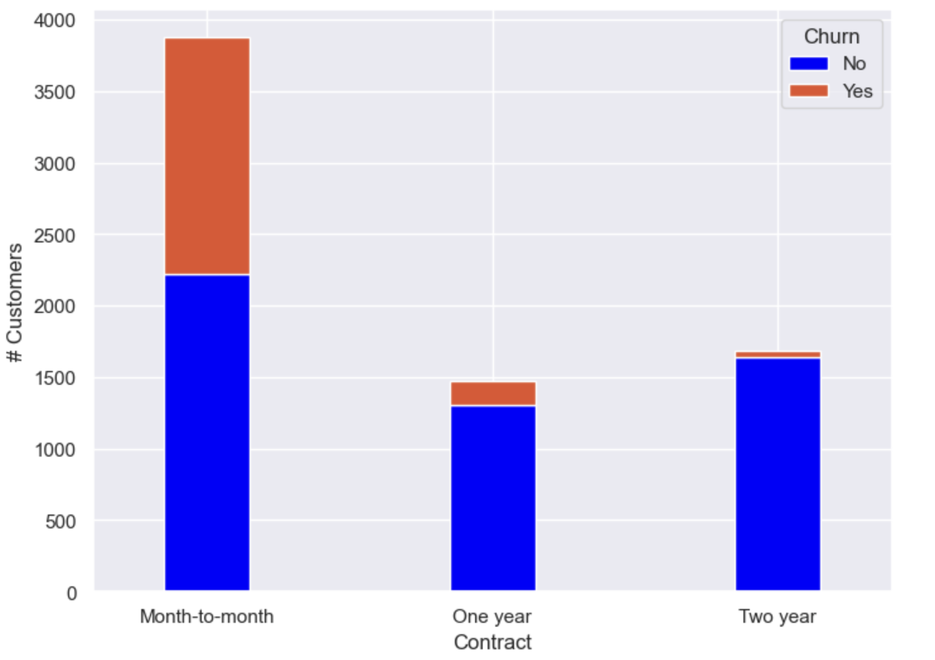
Contract type
we notice that most churners have a contract month-to-month.

Slide 13
Internet and phone services

Slide 14
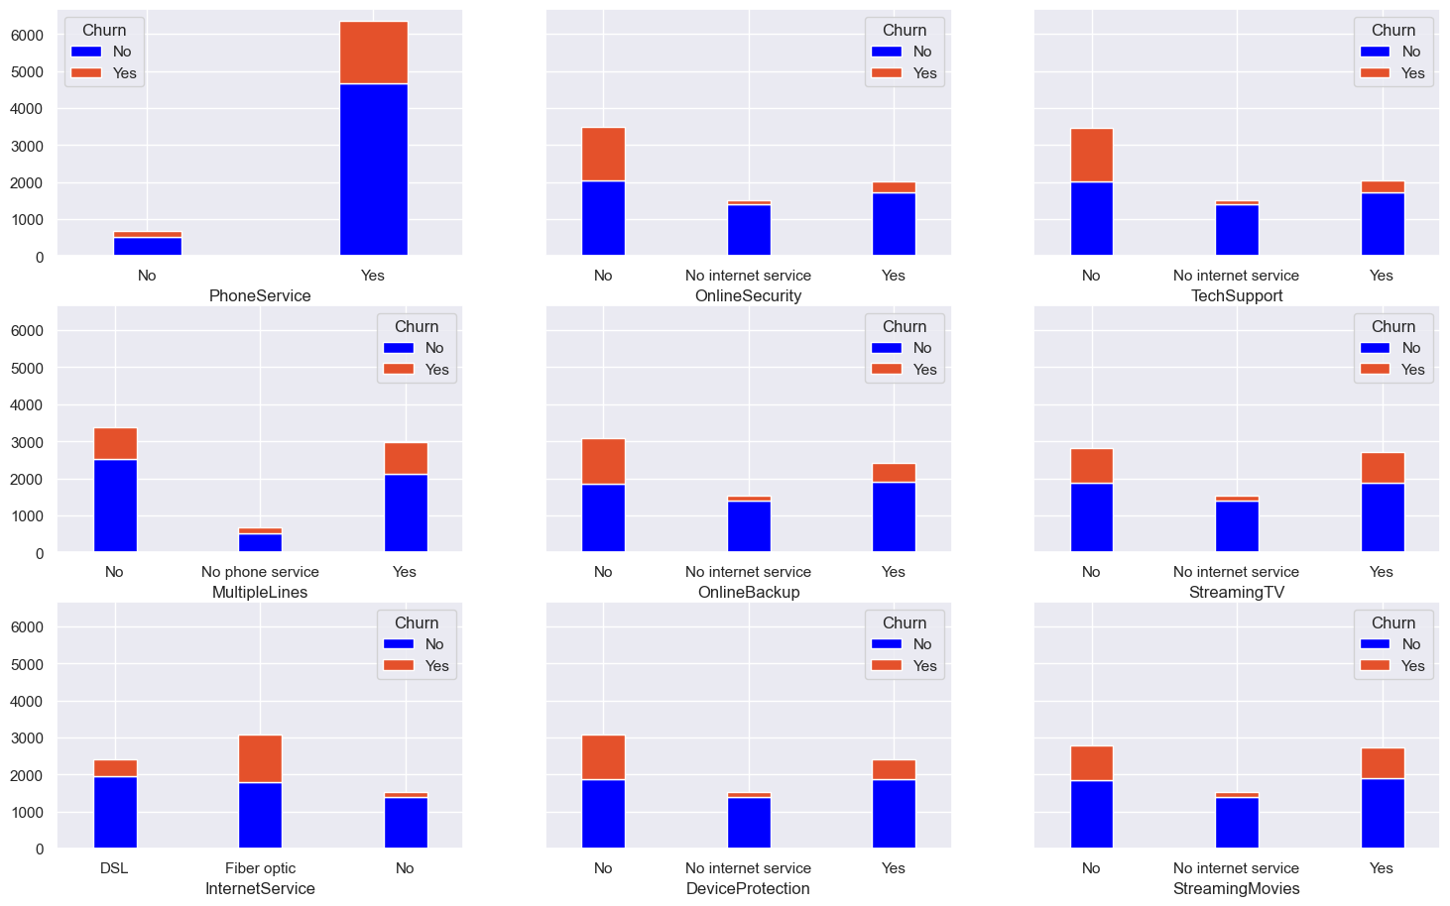

Slide 15
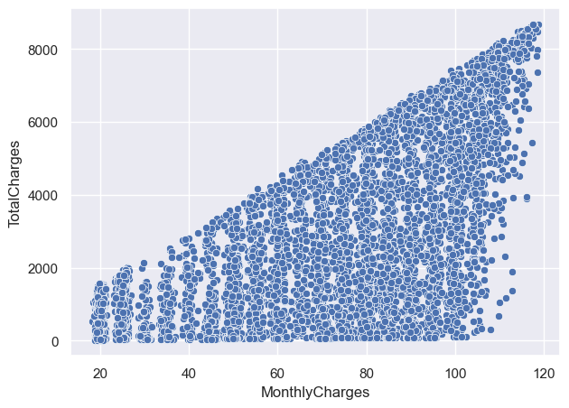
Monthly and total charges
We notice there is a positive correlation between them.

Slide 16
Contract type with services

Slide 17
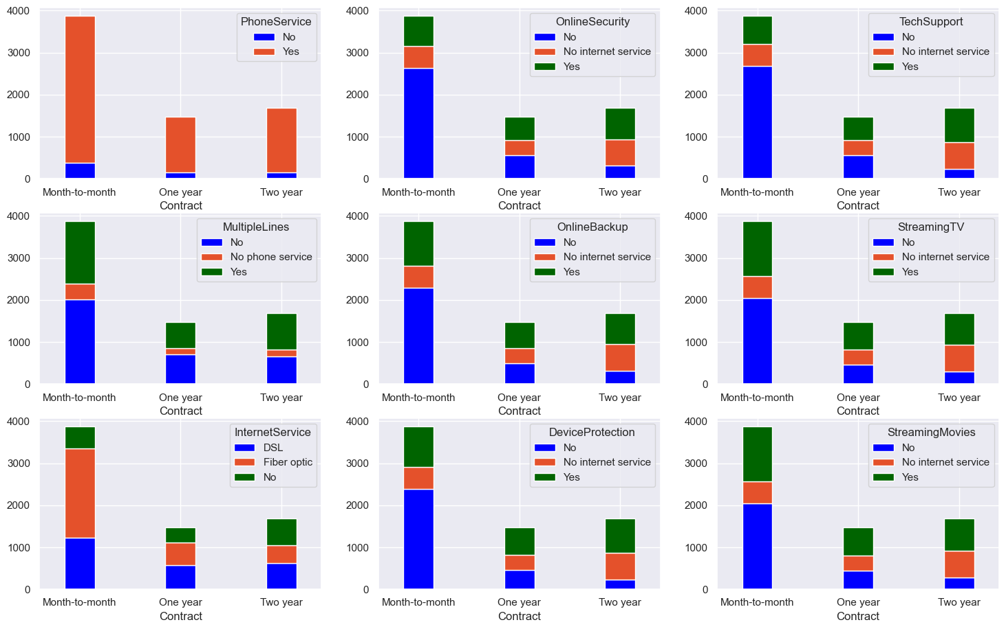

Slide 18
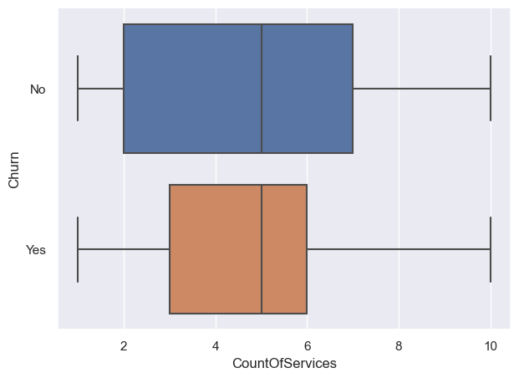
Count of services
We notice that the customers has count of services from 3 to 6 are likely to churn

Slide 19
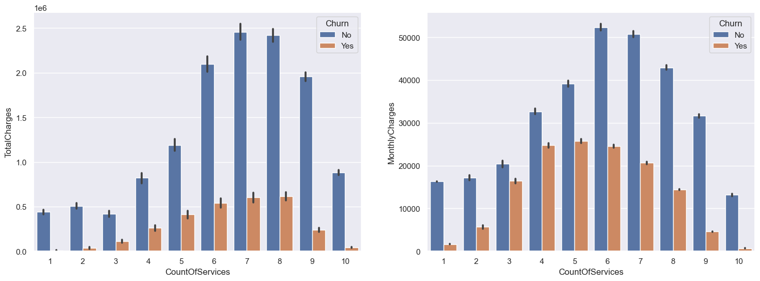
Count of services with monthly and total charges

Slide 20
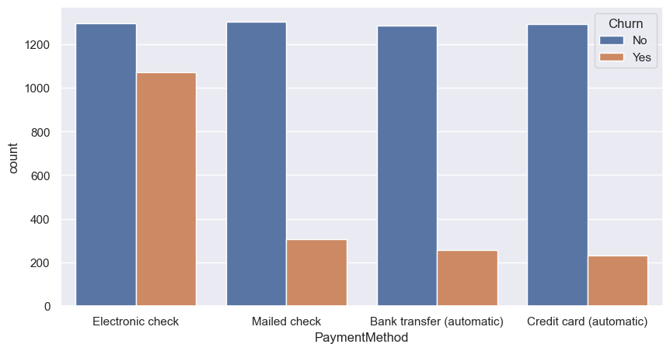
Payment method with churn
We notice here the churners make an Electronic check , let's see why ?

Slide 21
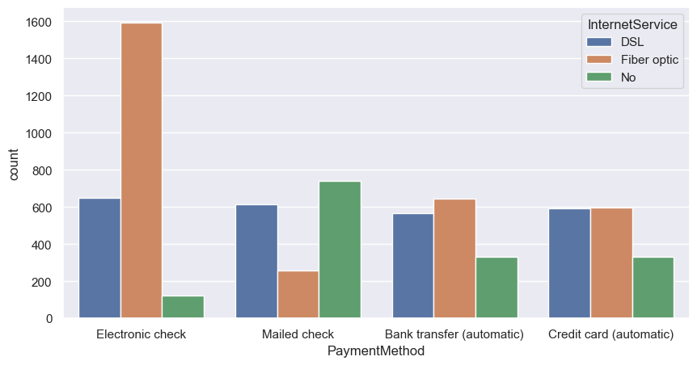
Payment method with internet services
Most of them make a Fiper optic service

Slide 22
Model building

Slide 23
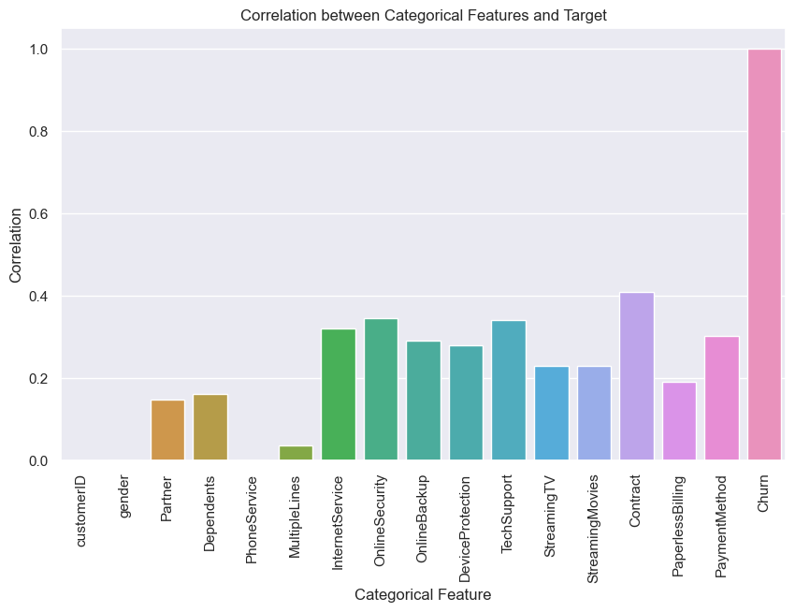
Correlation between the target and categorical values

Slide 24
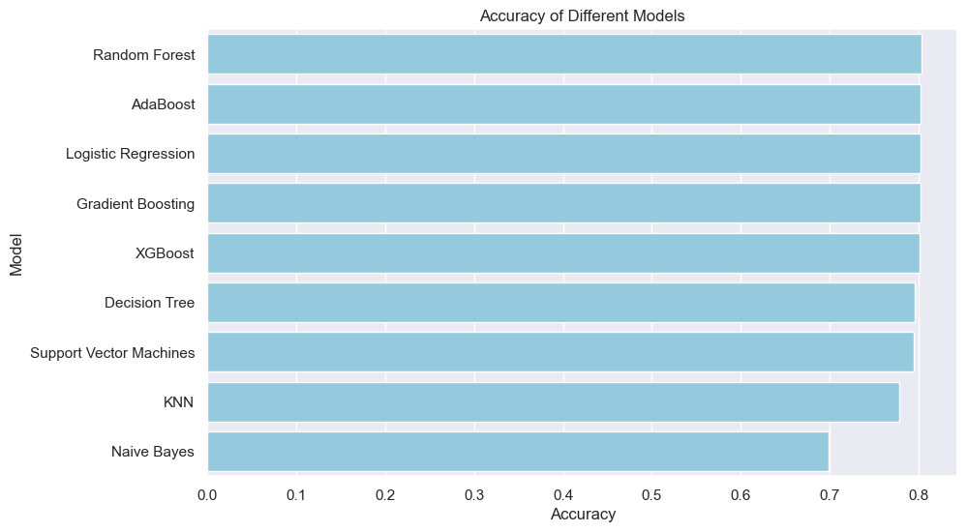
Cross Validation and hyper parameters tuning and model selection

Slide 25
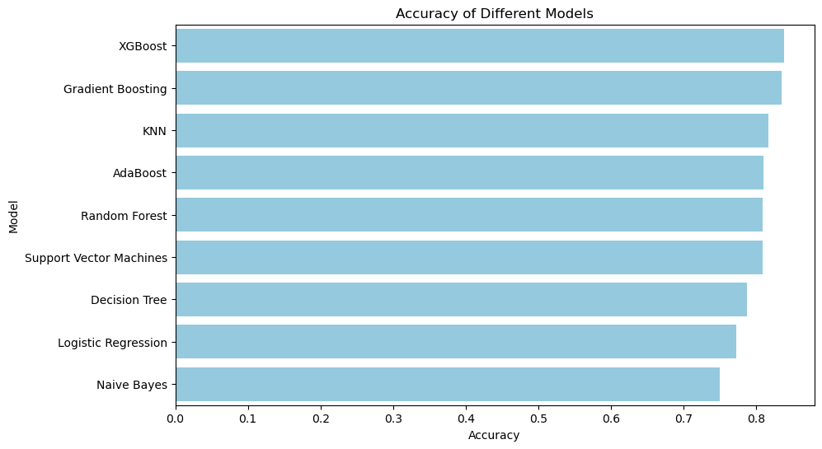
applying sMOte to solve imbalanced classes problem

Slide 26
Thank you for listening ☺ happy deployment

