Slide 1
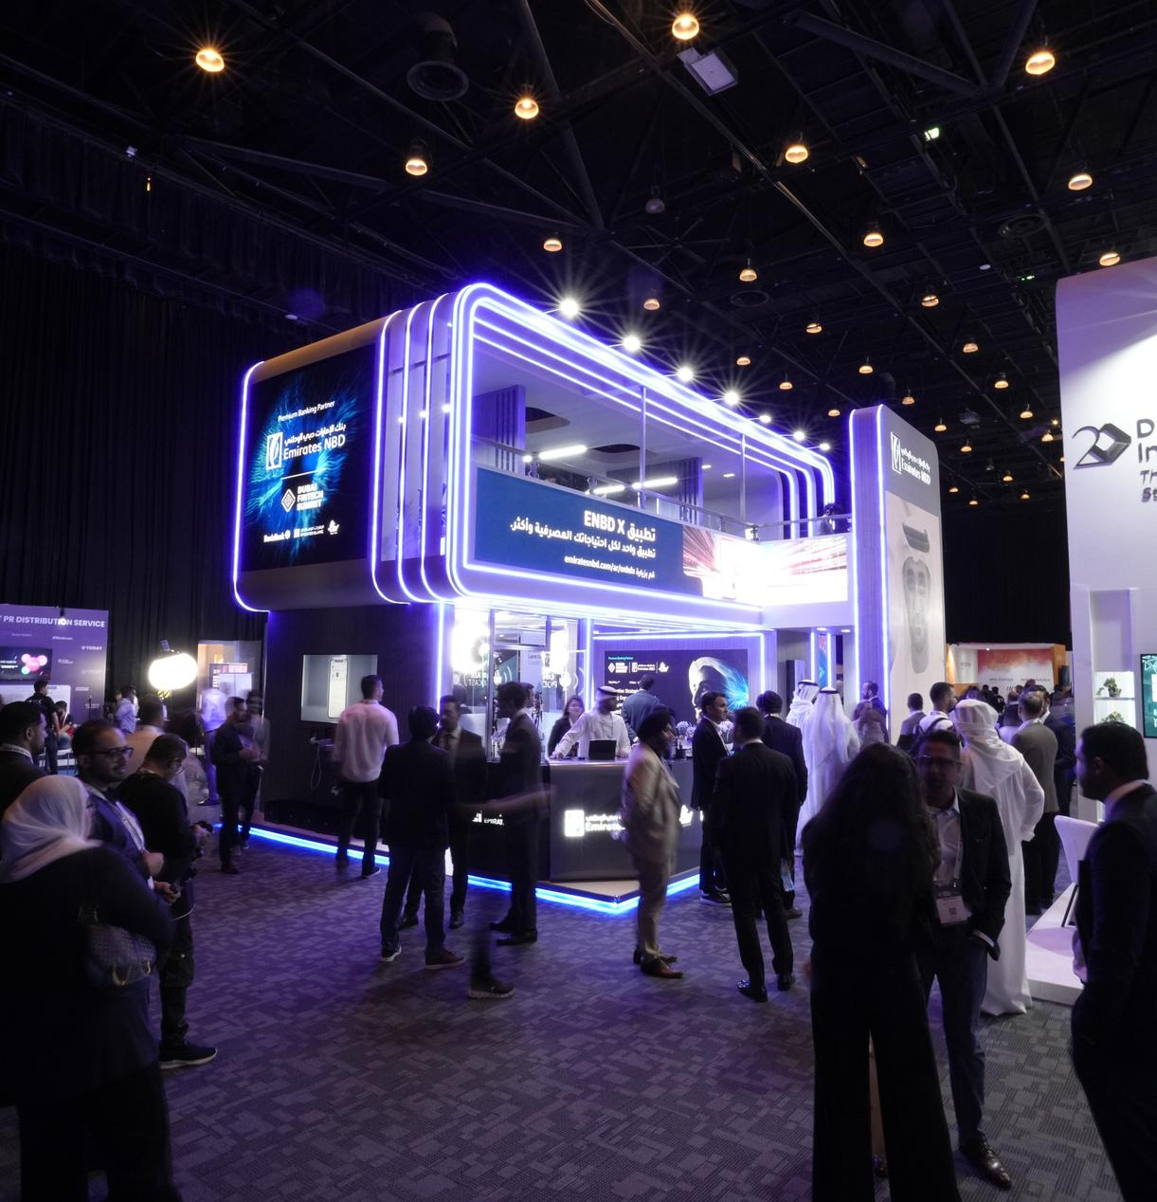

CELEBRATING 10 YEARS OF IMPACT
CONNECTING BUSINESSES WITH OPPORTUNITIES
Powering Global Innovation Through High-Impact Business Events
Corporate Profile | Est. 2016 | www.tresconglobal.com

Slide 2
01. WHO WE ARE
Your Partner for Accelerating Business Growth
Trescon is a pioneering force in the global business events and services sector. We facilitate key strategic connections that accelerate the adoption of emerging tech and promote international business expansion.
OUR VISION
To be the ultimate global catalyst for emerging technologies and inclusive business leadership.
We bridge capital, policy, and innovation to build the sustainable digital economy of tomorrow.
Global Presence
Headquartered in Dubai, with a powerful footprint in Bengaluru, Doha, Mauritius, Mangalore, and Manipal to connect local ecosystems globally.
Proven Scale
Hosting over 250,000+ delegates, 3,000+ speakers, and 3,500+ tech investors across more than 500+ executed events since 2016.
The Ecosystem
A curated trust network uniting 10,000+ private enterprises, 50+ government entities, policy-makers, start-ups, and media partners.

Slide 3
02. WHY TRESCON
The Strategic Edge for Reaching Decision-Makers
Proven C-Suite Reach
We bring together senior decision-makers, CXOs, and founders with active investment mandates.
Government Alignment
Direct collaborations with 50+ government ministries, departments, and public regulators globally.
Emerging Tech Focus
Specialized platform building in AI, Web3, Blockchain, Cybersecurity, Cloud, FinTech, and Green Tech.
Vast Global Scale
Broad international reach with delegates, partners, and exhibitors representing 120+ countries.
Capital Matchmaking
Direct facilitation of start-up deal-flow, connecting founders with 3,500+ active venture capitalists.
360° Management
Fully integrated capability from curation and content production to database outreach, PR, and logistics.

Slide 4
03. GLOBAL IMPACT IN NUMBERS
Scale, Connections, and Global Credibility
500+
Events Executed
From highly targeted roundtables to 10k+ attendee summits.
250,000+
Attendees Hosted
Engaging senior executives, tech pioneers, and buyers.
1M+
Connections Facilitated
High-value business matches across global platforms.
120+
Countries Represented
A truly global footprint across continents.
250+
Global Team Members
Dedicated professionals in our international offices.
3,000+
Speakers Featured
Policy-makers, global visionaries, and tech experts.
3,500+
Investors Engaged
Venture capital, angel networks, HNWIs, and funds.
5,000+
Exhibitors Showcased
Pioneering tech solution providers showing on stage.
100+
Govt Partnerships
Served or collaborated with governments worldwide.
500+
Association/Media Partners
Alliances amplifying our global reach and marketing.

Slide 5
04. WHAT WE DO
Three Integrated Event and Business Pillars
Signature Events
Summits, Conferences & Expos
Highly renowned tech events crafted for C-level executives and global solution providers to connect, share knowledge, and discover key commercial trends. Includes leading series like the World AI Show, World Blockchain Summit, World Cloud Show, CARE, and Dubai FinTech Summit.
Managed B2B Events
Curation & Turnkey Management
End-to-end turnkey services to manage partner-led events or launch new ones. We drive concept creation, speaker curation, operations, database marketing, database building, and PR. Examples include Bengaluru Skill Summit (with Govt) and Dubai FinTech Summit (with DIFC).
Bespoke Events
Targeted Account Matchmaking
Highly customized B2B engagements designed to drive concrete deal-flow and pipeline. Includes structured VIP Roundtables, Boardrooms, Roadshows, and closed-door bootcamps connecting tech vendors directly with pre-qualified buyers.
SUPPORTING PILLAR: EDUCATION & TRAINING | Upskilling & Capacity Building
Empowering professionals and teams through half-day upskilling workshops, full-day intensive bootcamps, and multi-day corporate training programs.

Slide 6
05. INDUSTRIES WE TRANSFORM
Driving Innovation Across Key Tech and Economic Verticals
Artificial Intelligence
Accelerating Commercial AI adoption, scaling models, and public sector governance strategies.
Web3 & Blockchain
Longest-running series exploring decentralized tech, digital assets, and sovereign infrastructure.
Cybersecurity
Empowering CISOs to protect complex enterprise operations against new-age digital threats.
Cloud Computing
Exploring enterprise virtualization, hybrid multi-cloud systems, and data center optimization.
Customer Experience
Reimagining consumer journeys, digital-first engagement, and post-purchase loyalty systems.
Fintech & Payments
Connecting global banking pioneers, ethical finance regulators, and digital payment systems.
Sustainability
Fostering partnerships in climate action, renewable energy investments, and green economies.
Smart Manufacturing
Empowering heavy industries with Industry 4.0 adoption, automation, and smart factory tools.
Digital & Skill Economy
Aligning government departments with tech academies to upskill regional talent forces.

Slide 7
06. OUR GLOBAL PORTFOLIO
Market-Leading Event Brands Crafted for C-Level Audiences
AI & EMERGING TECH
WEB3 & DIGITAL ASSETS
WORLD AI SHOW Connecting global AI researchers, enterprise developers, and ministers. DUBAI AI FESTIVAL Enabling digital economies and startup ecosystems.
WORLD BLOCKCHAIN SUMMIT World's longest-running Web3 series connecting builders and funds. REG3 SUMMIT Focusing on government-led Web3 compliance and sandbox standards.
FINTECH & CX
CYBERSECURITY & CLOUD
DUBAI FINTECH SUMMIT Managed for DIFC, driving cross-border economic growth. WORLD CX SUMMIT Reimagining customer journeys, enterprise marketing, and loyalty.
WORLD CYBER SECURITY SUMMIT Focused platform for CISOs to address new-age cybersecurity threats. WORLD CLOUD SHOW Enterprise cloud, data, and virtualization summits.

Slide 8
07. BUSINESS IMPACT & VALUE CREATION
Fostering Economic Growth, Deals, and Technology Adoption
FACILITATING INVESTMENTS
Bridging Startups & Capital
Connecting tech founders directly with global VC firms, corporate funds, and angel syndicates. Providing curated deal-flow sessions, fast-pitch tracks, and private matchmaking that shorten funding lifecycles and drive global tech adoption.
DRIVING TECH ADOPTION
Enterprise Transformation
Enabling Fortune 500 enterprises and medium companies to explore, pilot, and deploy emerging technologies. We demystify complex systems (AI, Cloud, Cybersecurity) to speed up implementation.
PUBLIC-PRIVATE PARTNERSHIPS
Aligning Regulators & Tech
Working with over 50+ government entities and regulators to establish sandbox frameworks, upskill talent forces, and create policies that foster inclusive tech leadership and digital transformation.
STIMULATING LOCAL ECONOMIES
Inbound Tourism & Business
Our large-scale international summits draw thousands of high-spending business tourists. We stimulate local hospitality, generate employment, and open regional corridors to foreign direct investment.

Slide 9
08. GOVERNMENT & ENTERPRISE TRUST
The Public-Private Trust Ecosystem Curation
Strategic Advisory Board
Guiding Our Vision and Quality Standards
Our advisory board includes distinguished regional leaders who shape our agendas, ensure policy alignment, and maintain high standards of curation: • DR. EESA MOHAMMED AL BASTAKI – President of the University of Dubai. • ENGR. MANSOUR ABDUL LATIF AL OBAID – ICT Committee Chairman. • LAILA AL HADHRAMI – Emerging Tech Pioneer.
High-Level Diplomatic Engagement
Facilitating Regional Tech Policy Alignments
We regularly host and facilitate interactions with key state policy makers, enabling cross-border partnerships: • SHRI DEVENDRA FADNAVIS – Hon. Chief Minister of Maharashtra. • DR. AVINASH RAMTOHUL – Hon. Minister of Information Technology, Communication and Innovation, Mauritius. • Host regulators including DIFC and Dubai AI Campus.
VVIP and Corporate Alignment
Bridging Private Innovation with Public Curation
We coordinate end-to-end VVIP protocols, ensuring state leaders and corporate CEOs align on key economic transformation strategies. This trust ecosystem enables us to run highly compliant Sandboxes, FinTech forums, and Cyber Security Summits with direct state support.

Slide 10
09. TRUSTED BY GLOBAL INSTITUTIONS
Clients, Regulators, and Strategic Partners Network
GOVERNMENTS & REGULATORS
ENTERPRISE & TECH VENDORS
DIFC
KSDC
KSDA
Dubai AI Campus
Microsoft
Oracle
AWS
Huawei
Govt of Maharashtra
Ministry of IT, Mauritius
Doha Digital Sandboxes
Palo Alto
IBM
Cisco
Salesforce
SAP
Google Cloud
Dell
Snowflake
Fortinet
CrowdStrike
Accenture
Deloitte
INVESTORS & VENTURE CAPITAL
MEDIA & ASSOCIATIONS
Binance Labs
Sovereign Wealth Funds
Dubai Future District
Antler
Bloomberg
Forbes ME
MIT Tech Review
Coindesk
Sequoia Capital
SoftBank
MEVP
Angel Networks
Fintech Association
CNBC Arabia
Global Blockchain Council
Futurists Board
HNWIs
Wired ME

Slide 11
10. CASE STUDIES & SUCCESS STORIES
Delivering Measurable Commercial and Policy Outcomes
Dubai FinTech Summit
Partner: DIFC (Dubai)
PROBLEM:
Elevate Dubai to a top-5 global fintech capital.
APPROACH:
Curate a highly strategic international FinTech summit focusing on digital commerce and VC deal-flow.
OUTCOME:
Over 10,000+ C-level delegates hosted, drawing major investment corridors to Dubai and securing massive media coverage.
Bengaluru Skill Summit
Partner: KSDC & KSDA (Govt)
PROBLEM:
Upskill regional youth forces and connect them with international employers.
APPROACH:
Build a unified public-private forum with the state skill development department.
OUTCOME:
Facilitated direct cross-border talent alignments, including partnerships with Germany's cultural and technology delegation.
World AI Show
Partner: Enterprise Tech (Global)
PROBLEM:
Enterprise buyers struggling to identify pre-qualified commercial AI solutions.
APPROACH:
Launch high-impact regional AI shows (e.g. Jakarta, Dubai) with pre-matched B2B matchmaking.
OUTCOME:
Rapid AI procurement cycles, direct regulatory sandboxes, and highly active investor pitching.

Slide 12
11. WHAT INDUSTRY LEADERS SAY
Voices of Trust and Impact Across Our Global Network
"
"
"
It was an absolute pleasure to work with the Trescon team. The platform’s outstanding quality and the team’s professionalism and enthusiasm were truly commendable.
— Enterprise CXO Partner
Signature Tech Summit Sponsor
Trescon’s efforts, well-structured organization, follow-up efforts, and accommodative approach are exceptional. They bridge public targets and private solutions seamlessly.
— Government Department Head
Skill Development & Policy Sponsor
Dubai FinTech Summit has been fantastic - the content, the speakers, everyone absolutely superb. It has been a real success for our regional market expansion.
— Global Technology Director
FinTech Solution Provider

Slide 13
12. WHY PARTNER WITH TRESCON
Unlocking Commercial Opportunities, Policy Access, and Brand Value
Direct Market Access
Accelerated Regional Entry
Establish instant credibility and build local pipelines in high-growth tech corridors: Middle East, Africa, India, and Southeast Asia. We provide direct pathways to enterprise buyers, startup founders, and local distributors.
High-ROI Lead Generation
Prequalified B2B Matchmaking
Bypass traditional cold outreach. Connect directly with decision-makers who have active mandates to procure technology or deploy capital. Includes closed-door roundtables and pre-matched boardroom sessions.
Sovereign and Government Access
Regulatory Alignments
Align your brand with major national tech initiatives, sandboxes, and smart state programs. Share the stage directly with regional ministers, regulators, and policy makers to shape future business landscapes.

Slide 14
13. LOOKING AHEAD
Evolving the Global Innovation and Tech Ecosystem
Ecosystem Builder
Moving Beyond Events
Evolving from a business event organizer into a long-term commercial ecosystem builder. We are establishing dedicated business accelerators and venture bridging platforms that facilitate ongoing cross-border technology adoption and startup investment flow.
Global Expansion
Connecting New Corridors
Expanding our footprint into new rapid-growth technology markets, including Central Europe, Northern Africa, and South America, while deepening our existing leadership in the Middle East and Southeast Asia.
Climate & CARE Expo
Accelerating Green Technology
Scaling up the Climate Action & Renewable Energy (CARE) Expo 2025 to become the premier global platform for policy alignment and technology integration in renewable energy, circular economy, and ESG compliance.

Slide 15
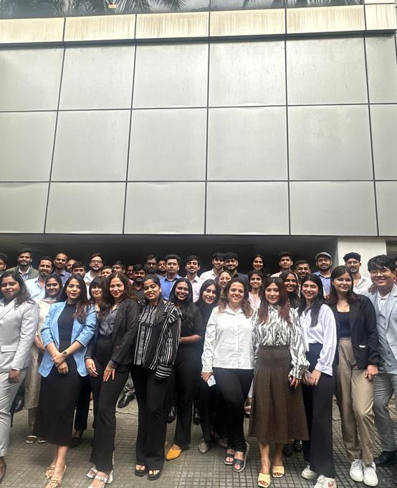
LET'S SHAPE THE FUTURE OF BUSINESS, TOGETHER.
Get in touch to explore global partnership and sponsorship opportunities.
GLOBAL HEADQUARTERS
Office 806, 1st Floor, Liberty House, DIFC, Dubai, UAE
Phone: (+971) 4 454 9859 | info@tresconglobal.com
INTERNATIONAL OFFICES
• BENGALURU, INDIA (Pragati Business District) • DOHA, QATAR (360nautica) • PORT LOUIS, MAURITIUS (Liberty House) • MANGALORE & MANIPAL, INDIA
www.tresconglobal.com | Celebrating 10 Years of Excellence

