Slide 1

03. CONCEPT A THE DATA MONUMENT
250k+
ATTENDEES ENGAGED
Senior executives, enterprise buyers, and sovereign delegates.
1M+
CONNECTIONS CURATED
We facilitate strategic connections across global corridors, uniting enterprise buyers, policymakers, and private capital.
3,500+
ACTIVE INVESTORS
VC funds, sovereign wealth, and private family offices.
120+
COUNTRIES
Connecting international tech ecosystems on a global scale.

Slide 2
03. CONCEPT B THE COORDINATE INFOGRAPHIC
250k+
GLOBAL ATTENDEES
Uniting enterprise decision-makers and technology innovators.
3,500+
ACTIVE INVESTORS
VC funds, sovereign wealth, and private family offices.
500+
EXECUTED SUMMITS
Summets curating cross-border tech corridors.
120+
COUNTRIES
Scale of international diplomatic and commercial reach.

Slide 3
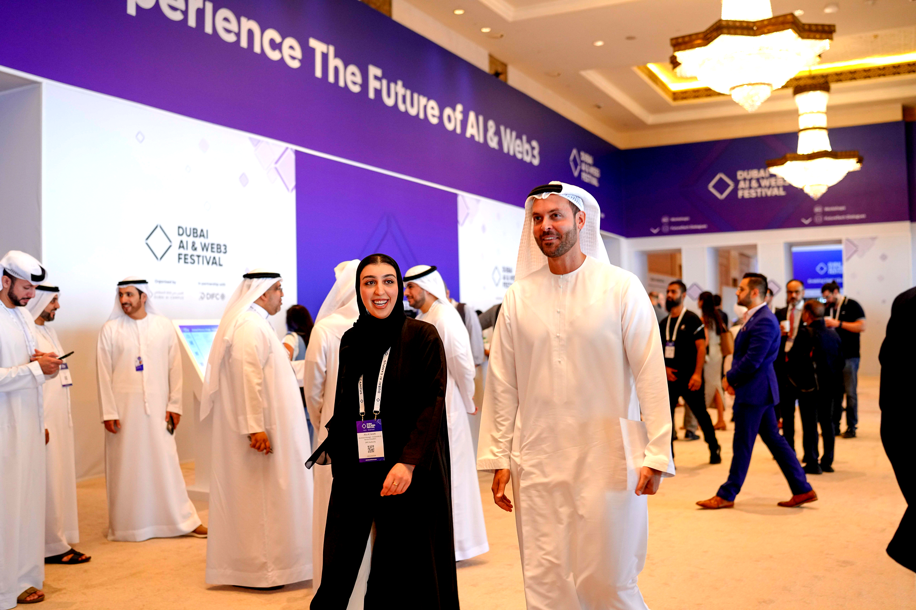
03. CONCEPT C THE CINEMATIC NARRATIVE
1M+
CONNECTIONS
High-value business matches across global platforms.
250k+
ATTENDEES
Engaging senior executives and enterprise buyers.
3.5k+
INVESTORS
Venture capital and sovereign wealth networks.

