Slide 1
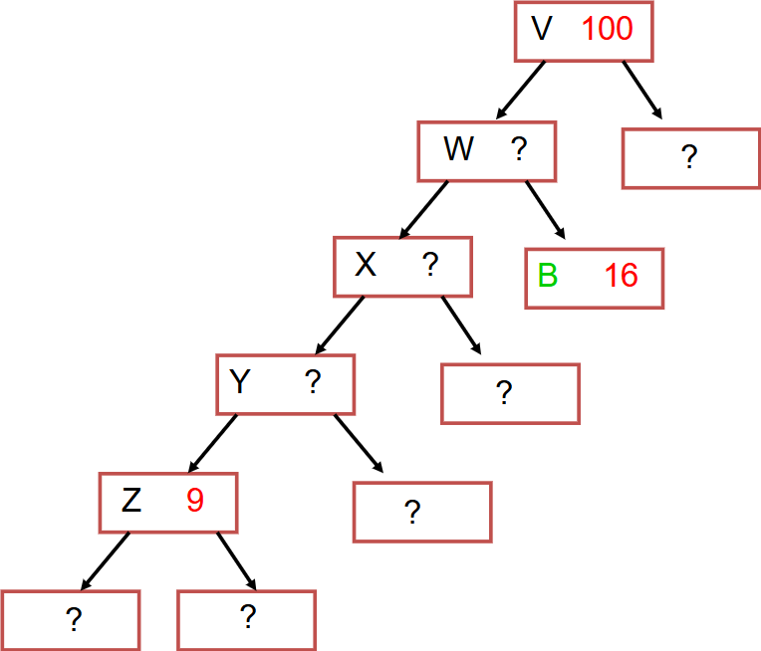
The Huffman coding algorithm can find the optimal prefix binary codes for the following symbols, given their frequencies:
Apply Huffman coding algorithm using the data above to answer the following questions:
Symbol | A | B | C | D | E | F
Frequency | 14 | 16 | 4 | 5 | 6 | 55
1. fill the missing parts of the tree below
2. In the tree above, what is the order by which the internal nodes (V, W, X, Y, Z) were created?
3. Assuming left equals 0 and right equals 1, fill the table below with the binary code for each symbol
Symbol | Binary Code
A
B
C
D
E
F

Slide 2
A tailor is facing a difficult optimization problem and needs your help. The tailor has total of n square meters of expensive cloth. The tailor has a catalog of m products, where each product i requires c_{i} square meters of the expensive cloth and provide p_{i} of profits. The tailor wants to know how many pieces to produce from each product in the catalog in order to maximize his profits while not requiring more than the n square meters of the available cloth
Which of the algorithms we studied can be applied to this problem?
Explain your answer by explaining how to map the tailor problem to the problem we studied and identify what are the main differences if any.
Trace the algorithm by filling the corresponding dynamic programming structure

Slide 3
int compute1( int n ) {
int result;
int a = 0, b = 1;
for(int i = 0; i < n; i++){
a = a + i;
}
for(int j = 1; j < n; j++) {
b = b * j;
}
result = a * b;
return result;
}

Slide 4
int compute2( int[] a ) {
int n = a.length;
int result = 0;
for(int i = 0; i < n; i++){
for(int j = 1; j < n; j++) {
result = result + a[ i ] * a[ j ];
}
}
return result;
}

Slide 5
int compute3( int[] a, int start, int finish ) {
int n = a.length;
int result = 0;
if( finish > start ) {
int n = finish - start;
int mid = n / 2 + start;
result = compute3( a , start , mid )
+ compute3( a , mid, finish )
+ a[ mid ];
}
return result;
}

