Slide 1
Let us solve some problems!

Slide 2
Given list of grades for every student
Student id, course id, grade
Study plan
List of core courses (specific courses student needs to take)
List of electives
For each elective, list of specific courses that student can choose from to satisfy an elective
Example: see excel sheet
Given student id + study plan → find remaining modules
Design an algorithm
What is the time complexity?

Slide 3
given list of stock prices, P, find the maximum possible profit:
buy at time i, sell at time j such that i < j and
profit = prices[j] - prices[ i ] is maximized
Examples
input = {10,5,2,9,1} → output = 7
input = {10,5,2,9,11} → output = 9
input = {1,10,5,2,9,11} → output = 10

Slide 4
A robot navigates through two different paths represented as sequences of directions (Up, Down, Left, Right).
Your task is to determine how similar the paths are to optimize future navigation.
Task Steps:
Represent robot paths as sequences of directional moves.
Discuss (in detail) how longest common subsequence can be used to solve this problem.
Use this information to evaluate path similarity and suggest optimizations.
Reflection:
What is the limitations/downsides of this solution?

Slide 5
Exercise in thinking
How to detect collisions in games!

Slide 6
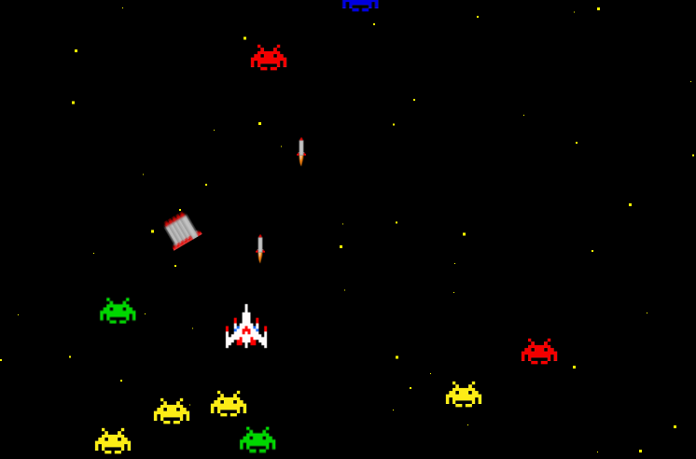
Motivating example
In games, we usually want to detect collisions
Between objects, projectiles, etc.

Slide 7
Main problem: thinking time
How to detect if a ship collided with any other ship?
General idea?
Break to smaller/simpler problems
First main problem: how to detect if two ships collided

Slide 8
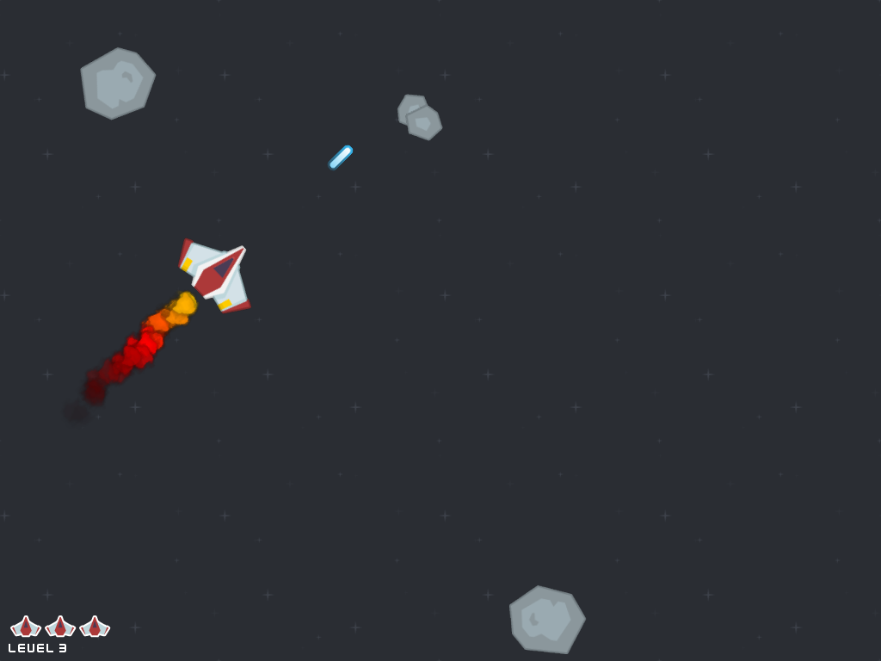
How to detect collision between two objects?
Simplification:
approximate each object with a circle
Collision = two circles intersect
But how to detect this?
What you studied in geometry comes into play
Geometry is essential in computer graphics

Slide 9
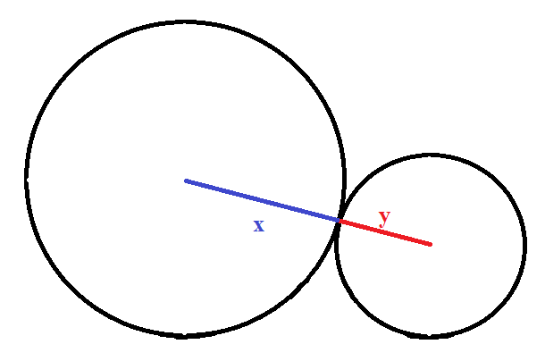
How to detect if two circles intersected?
For each circle we know the center (r,c) and the radius w
When two circles are touching
Away from each other
Intersected

Slide 10
Real exercise
Write an algorithm
for detecting if a ship collided with any other object
What is the complexity?
How can you make it more efficient?
Can we narrow down the objects we check?

