Slide 1

Long Travel Bus Reservation

Slide 2
Group 4
Group member :
Nguyễn Sơn Trường – Team Leader – 60466
Nguyễn Lương Hải – Member – 60335
Nguyễn Thị Bích Trâm – Member – 60156
Nguyễn Ngọc Sơn – Member – 60409
Supervisor :
Kiều Trọng Khánh

Slide 3
Contents
Problem
Solution
Main Functions
Technologies
Summary
Demo
Q&A

Slide 4

Problem
With a large amount of passengers and journeys in a day, apparently bus operators will be overloaded by setting schedule, managing their vehicles and selling tickets. Their customers will be frustrated by having to wait for hours to buy a ticket to get home.

Slide 5
Problem
Notes:
The needs of travelling is raising these days. Based on statistics from Mien Dong Bus Station of Ho Chi Minh City website (http://www.benxemiendong.com.vn/ ), in 2010:
Average number of bus departures in a day is about 1,124. On holidays it can raise to 2,000.
Average number of passengers in a day is 23,000 and 62,000 on holidays.

Slide 6
Solution
- A system needs to be established which takes care of booking system, journey scheduling and managing vehicles to reduce human effort on operating and managing.
- The system will be hosted on the web, which provides easy access for customer to use the booking services. Customer can have their own account for viewing their transaction history. Scheduling and managing services are available for authorized staffs only.

Slide 7
Main Functions
Search for journey
Booking
Scheduling
Vehicles Management
Fare
User Management

Slide 8
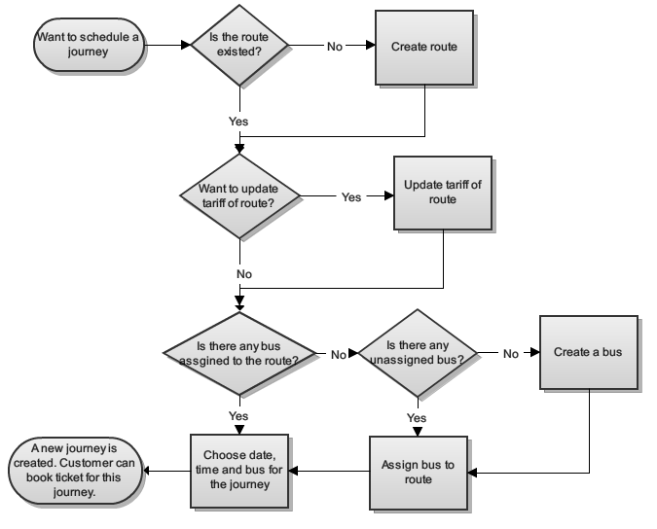
System Flow

Slide 9
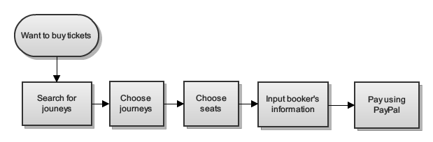
Booking Flow

Slide 10
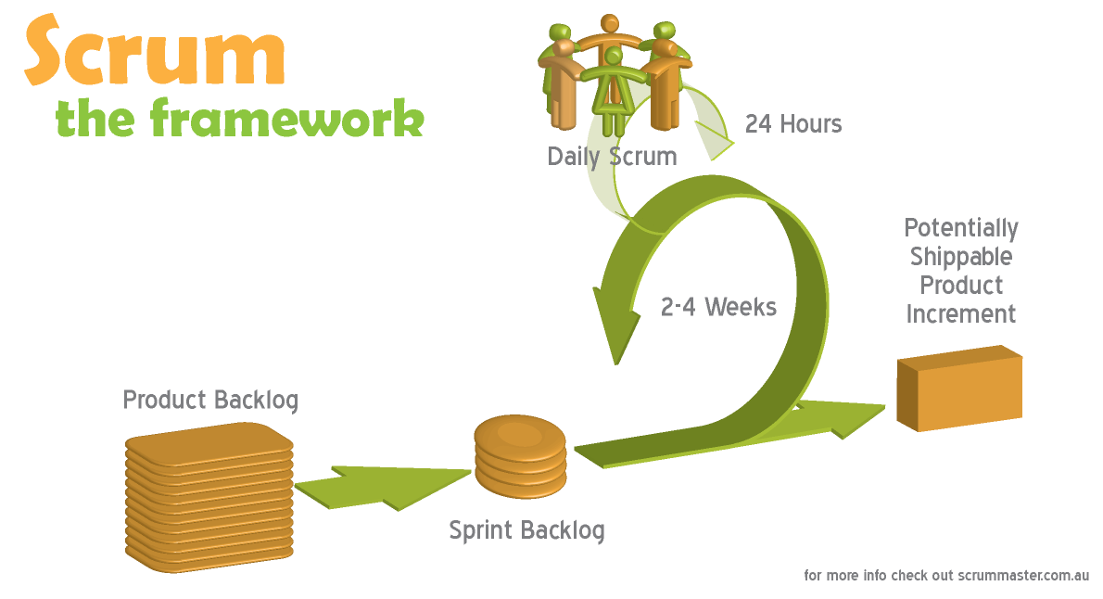
Software Process Model

Slide 11





Tools And Techniques
Tools :
Eclipse Indigo
Tomcat 6.0.26
Mysql Server 5.5
Google Code
Tortoise SVN

Slide 12












Tools And Techniques
Techniques :

Slide 13
Summary
Accomplishments:
Developed a system for booking long travel bus ‘s ticket.
Manage, scheduling for bus.
Payment with Paypal.
Future plan:
Continue developing.
Improve performance, security.
Improve system as user friendly as possible.
Integrate more payment methods

Slide 14
Demo

Slide 15
Thanks for your listening
Q&A

