Slide 1

Long Travel Bus Reservation
Group member :
Nguyễn Sơn Trường – Team Leader – 60466
Nguyễn Lương Hải – Member – 60335
Nguyễn Thị Bích Trâm – Member – 60156
Nguyễn Ngọc Sơn – Member – 60409
Supervisor :
Kiều Trọng Khánh

Slide 2
Contents
Problem
Solution
Main Functions
Technologies
Summary
Demo
Q&A

Slide 3
Problem
*statistic in 2010 from http://www.benxemiendong.com.vn/
Notes:
The needs of travelling is raising these days. Based on statistics from Mien Dong Bus Station of Ho Chi Minh City website (http://www.benxemiendong.com.vn/ ), in 2010:
Average number of bus departures in a day is about 1,124. On holidays it can raise to 2,000.
Average number of passengers in a day is 23,000 and 62,000 on holidays.

Slide 4

Problem
With a large amount of passengers and journeys in a day, apparently bus operators will be overloaded by setting schedule, managing their vehicles and selling tickets. Their customers will be frustrated by having to wait for hours to buy a ticket to get home.

Slide 5
Solution
- A system needs to be established which takes care of booking system, journey scheduling and managing vehicles to reduce human effort on operating and managing.
- The system will be hosted on the web, which provides easy access for customer to use the booking services. Customer can have their own account for viewing their transaction history. Scheduling and managing services are available for authorized staffs only.

Slide 6
Main Functions
Search for journey
Booking
Scheduling
Vehicles management
Fare
User management

Slide 7
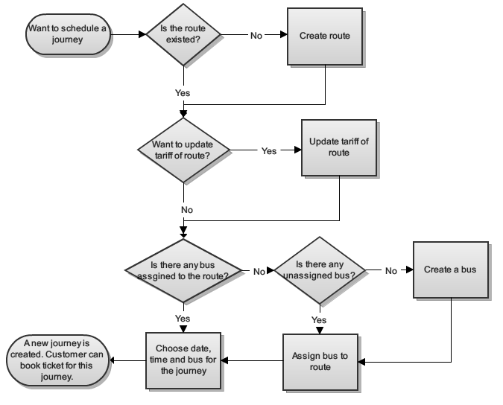
System Flow

Slide 8
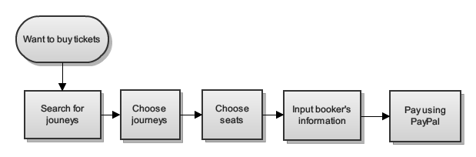
Booking Flow

Slide 9
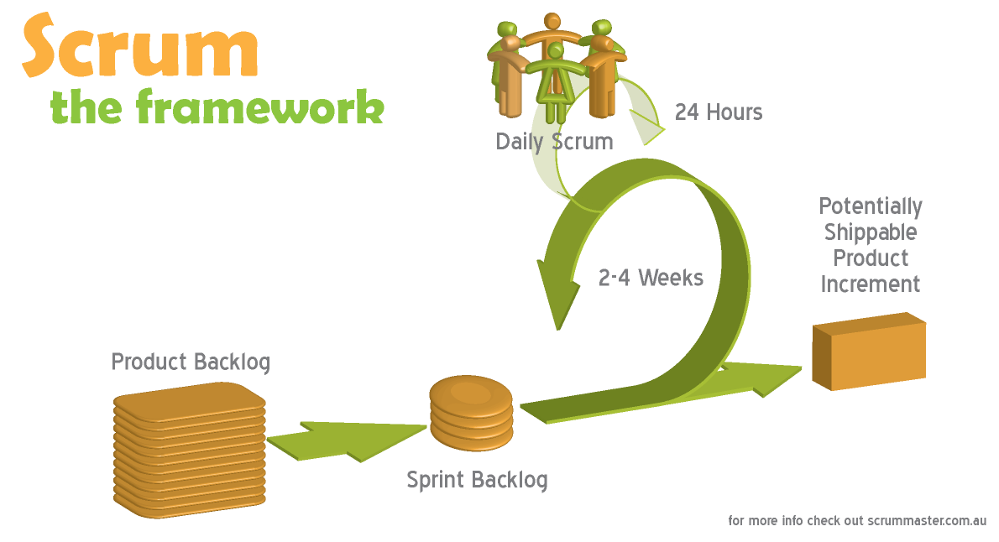
Software Process Model

Slide 10





Tools And Techniques
Tools :
Eclipse Indigo
Tomcat 6.0.26
Mysql Server 5.5
Google Code
Tortoise SVN

Slide 11












Tools And Techniques
Techniques :

Slide 12
Demo

Slide 13
Summary
Advantages
Customer can book for tickets easily and choose the seats they want.
Manage, scheduling for bus.
Payment with PayPal.
Disadvantages
Staff have to schedule for each journey.
Support only one online payment method.
User cannot change tickets or change seats in past reservation

Slide 14
Summary
Future plan
Auto-schedule for each route, bus in a fixed time.
Integrate more online payment methods (Bảo Kim, Ngân Lượng)
Support user to change tickets or seats.
Improve system performance.
Improve system as user friendly as possible.

Slide 15
Thanks for your listening
Q&A

