Slide 1

AI IN HEALTHCARE · CASE PRESENTATION
Smart Patient
Flow.
TODAY
200 min
WITH SMART PATIENT FLOW
45 min
An AI-assisted hospital workflow that cuts a patient’s visit from about 200 minutes to about 45 — while doctors stay in charge of every medical decision.
Presented by Faraz
Notes:
Assalam o Alaikum. Aaj main ek AI-assisted hospital workflow present karunga jiska naam hai "Smart Patient Flow". Aam hospital mein ek patient ko taqreeban 200 minute lag jate hain. Is workflow se ye time taqreeban 45 minute reh jata hai. Sab se important baat: har medical faisla doctor hi karega, AI sirf kaam tez karta hai.

Slide 2




01 · THE PROBLEM
Patients spend hours. Doctors see them for minutes.
15 / 200
01
minutes of a typical visit are spent with the doctor. The rest is waiting.
Long queues at every step: registration, triage, doctor, lab.
Everything happens one after another, never together.
Doctors lose time on paperwork instead of patients.
Times are illustrative estimates for a routine OPD visit needing one blood test, not measured hospital data.
SMART PATIENT FLOW · 02
Notes:
Pehle problem samajhte hain. Aam hospital mein 200 minute mein se sirf 15 minute patient doctor ke saath hota hai. Baqi 185 minute lines, forms aur intezar mein chale jate hain. Wajah ye hai ke har kaam ek ke baad ek hota hai: pehle registration, phir triage, phir doctor, phir lab, phir dobara doctor. Ye numbers andaze hain, asal hospital data nahi.

Slide 3



02 · THE TASK
What the hospital asked for
“A hospital wants to reduce patient waiting times. Design a simple AI-assisted workflow and explain how it can improve efficiency and patient management. Include one step where AI automates decision-making and one where human doctors are required.”
02
Reduce waiting time
One AI decision step
One human-doctor step
Get patients through faster and manage them better.
A step where AI decides on its own, without waiting for a person.
A step AI must never take over: the doctor decides.
SMART PATIENT FLOW · 03
Notes:
Ye hamara question hai. Hospital ne teen cheezen maangi hain: waiting time kam karna, ek step jahan AI khud decision le, aur ek step jahan human doctor zaroori ho. Poori presentation mein main dikhaunga ke hamara workflow teeno cheezen kaise poori karta hai.

Slide 4

03 · FOUR AI ANSWERS COMPARED
Four AIs, four approaches
BEST STARTING POINT
ChatGPT
Arena 1
Arena 2
Z.ai
Simple & clear
Detailed, 7 steps
Zero-wait pipeline
Balanced & realistic
+ Easy to follow; covers both required steps.
+ Strong scheduling and paperwork automation.
+ Runs tests while the patient waits: fastest idea.
+ Staff forecasting, emergency alerts, learning loop.
– Tests and discharge still happen the old way.
– Mislabels its AI step; tests still wait until after the doctor.
– No human check on AI, no staff planning for busy days.
– Leaves out privacy and a backup plan.
118 min
81 min
45 min
47 min
Estimated time per patient on a normal day.
SMART PATIENT FLOW · 04
Notes:
Maine same question chaar AI tools ko diya: ChatGPT, Arena ke do models aur Z.ai. ChatGPT simple tha lekin purana tareeqa zyada tha. Arena 1 detailed tha lekin us mein ek labelling ki ghalti thi. Arena 2 sab se tez idea tha lekin us mein safety check nahi tha. Z.ai sab se balanced tha, is liye maine usay base banaya aur baqi teeno ki achi cheezen us mein shamil kin.

Slide 5
04 · TIME COMPARISON
Minutes per patient, model by model
THE WINNER
Enhanced version
Ties for fastest on a normal day (45 min).
Holds up best on busy days (55 min).
Arena 2 is fast too, but jumps to 95 min when the hospital is busy.
Illustrative estimates for comparison, not measured hospital data.
SMART PATIENT FLOW · 05
Notes:
Ye chart har model ka time dikhata hai. Gold bar normal din hai aur grey bar rush wala din. Normal din par Arena 2 aur hamara Enhanced version dono 45 minute par hain. Lekin rush wale din Arena 2 95 minute tak chala jata hai kyun ke us mein staff ki advance planning nahi hai. Enhanced version rush mein bhi sirf 55 minute leta hai.

Slide 6

05 · THE BIG IDEA
AI takes the queue. Doctors take the care.
AI handles
Doctors handle
Fast, repetitive, rule-based work
Judgement, responsibility, people
Forecasting patient numbers
Sorting patients by urgency
Scheduling doctors & rooms
Paperwork, reminders, follow-up
Examining the patient
Making the diagnosis
Deciding the treatment
Talking with the patient
SMART PATIENT FLOW · 06
Notes:
Poore workflow ka asal idea ek line mein hai: AI queue sambhalta hai, doctor care karta hai. Jo kaam tez, repetitive aur rules par chalte hain, jaise sorting, scheduling aur paperwork, wo AI karta hai. Jo kaam judgement aur zimmedari maangte hain, jaise diagnosis aur treatment, wo sirf doctor karta hai.

Slide 7
06 · THE ENHANCED WORKFLOW
Eight steps, one smooth flow
BEFORE ARRIVAL
IN HOSPITAL · ≈ 45 MIN
AFTER
★ AI DECIDES
★ DOCTOR
1
2
3
4
5
6
7
8
Predictive planning
Pre-arrival intake
Check-in
AI triage & queue
Tests run in parallel
Doctor consultation
Fast discharge
Follow-up & learning
0 min
0 min
2 min
< 1 min
30 min
10 min
3 min
after visit
Teal = AI step Gold = human doctor Grey = patient or staff
SMART PATIENT FLOW · 07
Notes:
Ye poora workflow ek nazar mein hai: 8 steps. Pehle do steps patient ke aane se pehle hote hain, is liye hospital mein un ka time zero hai. Step 3 se 7 tak hospital ke andar taqreeban 45 minute lagte hain. Step 8 patient ke jane ke baad hota hai. Step 4 mein AI decision leta hai aur step 6 mein doctor, yahi hamari do requirements hain.

Slide 8



STEPS 1–2 · BEFORE ARRIVAL
The work starts before the patient arrives
STEP 1
STEP 2
Predictive Planning
Pre-Arrival Intake
1–2
AI looks at past visits, the season (e.g. dengue season) and disease trends to predict how many patients will come.
The patient enters symptoms and history on an app or WhatsApp from home.
Why it helps: Right number of doctors on duty, so the queue never builds.
Why it helps: No forms to fill at the hospital.
Human check: Management approves the roster.
Human check: Help desk fills it in for patients without a smartphone.
Time spent in hospital: 0 min
SMART PATIENT FLOW · 08
Notes:
Step 1 aur 2 patient ke aane se pehle hote hain. Step 1 mein AI purane data aur season ko dekh kar batata hai ke kal kitne patient aayenge, taake utne hi doctor duty par hon. Roster management approve karti hai. Step 2 mein patient ghar se hi app ya WhatsApp par apni details bhar deta hai. Jis ke paas smartphone nahi, us ki help desk madad karta hai. Hospital mein in dono ka time zero hai.

Slide 9




STEPS 3–4 · ★ AI MAKES THE DECISION
AI decides who goes first
Example: how the AI sorts patients
The AI also decides:
STEP 3 · 2 MIN
Quick check-in
EMERGENCY
Chest pain
Queue position
Forms are already filled.
Seen immediately
4
Which doctor
URGENT
High fever
STEP 4 · < 1 MIN
Seen soon
AI Triage & Smart Queue
Which room
ROUTINE
Mild rash
The AI decides on its own. No one has to wait for a triage nurse.
Next normal slot
Wait time sent to phone
SMART PATIENT FLOW · 09
Notes:
Ye hamara pehla required step hai: jahan AI khud decision leta hai. Patient 2 minute mein check-in karta hai kyun ke form pehle se bhara hua hai. Phir AI ek minute se kam mein faisla karta hai ke patient Emergency hai, Urgent hai ya Routine. Misaal: chest pain wala foran, high fever wala jaldi, aur halka rash wala normal line mein. AI queue position, doctor, room bhi decide karta hai aur patient ke phone par wait time bhej deta hai.

Slide 10





SAFETY RAIL
AI decides, but never alone
Staff can override
Any nurse or doctor can change the AI’s decision at any time.
Emergency, or is the AI not sure?
YES
A nurse or doctor takes over instantly
Priority keeps updating
If symptoms get worse while waiting, the AI moves the patient up.
NO
Checked every month
Wrong decisions are reviewed so the AI gets better.
Normal flow continues
SMART PATIENT FLOW · 10
Notes:
AI decision leta hai lekin kabhi akela nahi. Agar case emergency hai, ya AI ko yaqeen nahi, to foran nurse ya doctor case sambhal leta hai. Warna normal flow chalta rehta hai. Staff kisi bhi waqt AI ka faisla badal sakta hai. Agar intezar ke dauran tabiyat bigre to AI patient ko aage kar deta hai. Aur har mahine AI ki ghaltiyan check hoti hain.

Slide 11
STEP 5 · THE BIGGEST TIME SAVER
Do things together, not one by one
OLD WAY
Wait for doctor
40 min
Doctor
10 min
Lab test & result
45 min
Wait again
20 min
Dr
120 min
5
NEW WAY
Patient waits · 30 min
Doctor
10 min
80 minutes saved just by running the test while the patient waits.
40 min
Tests run · 30 min
How it works: For standard cases the hospital has already approved (for example, an ECG for chest pain), the test starts right after triage. When the doctor walks in, the results are already on the screen. One visit instead of two.
SMART PATIENT FLOW · 11
Notes:
Ye sab se bara time saver hai. Purane tareeqe mein har kaam ek ke baad ek hota hai: doctor ka intezar, doctor, phir lab, phir dobara intezar, phir doctor. Ye 120 minute ban jate hain. Naye tareeqe mein patient jab intezar kar raha hota hai, usi waqt test bhi ho raha hota hai. Doctor aata hai to report pehle se ready hoti hai. Sirf 40 minute, yani 80 minute ki bachat. Ye sirf un tests ke liye hai jo hospital ne pehle se approve kiye hain.

Slide 12



STEP 6 · ★ HUMAN DOCTOR REQUIRED
The one step AI must not take over
Why it must be a human
Clinical judgement
Every patient is different; experience reads what data misses.
“The doctor examines the patient, makes the final diagnosis and decides the treatment.”
6
Accountability
Legally and ethically, only a doctor can be responsible.
Empathy
AI’s role here: a one-screen summary and ready test results. Its suggestions are advice only.
Bad news and fears need a human voice.
Patient consent
10 min of focused care
Treatment is agreed between doctor and patient.
SMART PATIENT FLOW · 12
Notes:
Ye hamara doosra required step hai: jahan human doctor zaroori hai. Doctor patient ko examine karta hai, final diagnosis karta hai aur treatment decide karta hai. AI sirf summary aur report ready rakhta hai, us ke mashware sirf advice hain. Ye insaan hi kyun kare? Chaar wajah: clinical judgement, zimmedari, hamdardi, aur patient ki razamandi. Ye cheezen AI nahi de sakta.

Slide 13

STEPS 7–8 · EXIT & FOLLOW-UP
Leaving is fast. Care continues.
STEP 7 · 3 MIN
STEP 8 · AFTER THE VISIT
Fast Discharge & Room Turnover
Follow-up & Learning Loop
7–8
AI drafts the discharge note; the doctor signs
Prescription goes straight to the pharmacy
Follow-up appointment is booked automatically
Room is freed and the next patient is called
Medicine and appointment reminders
Short recovery check-in questions
Worrying answers flagged to staff
Results help the AI improve over time
SMART PATIENT FLOW · 13
Notes:
Step 7 mein doctor ke approve karte hi AI discharge note banata hai, prescription pharmacy bhejta hai aur follow-up book kar deta hai. Sirf 3 minute. Room khali hote hi agla patient bula liya jata hai. Step 8 patient ke ghar jane ke baad hota hai: dawai ki reminders, aur agar koi pareshani wala jawab aaye to staff ko alert. Har case se AI seekhta hai aur behtar hota hai.

Slide 14
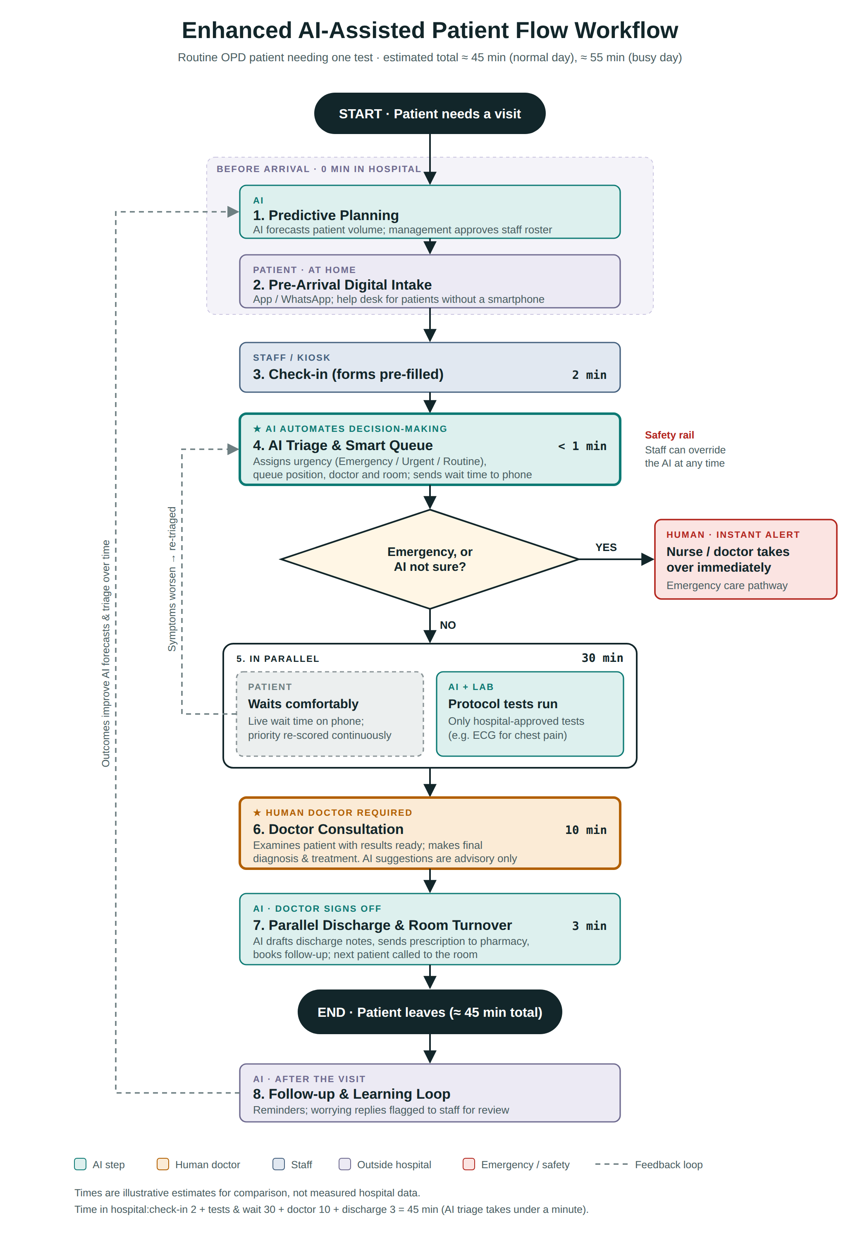
THE COMPLETE PICTURE
The full flowchart
Read it top to bottom:
Teal boxes: AI steps
Orange box: the human doctor step
Red branch: emergencies go straight to a human
Dashed lines: feedback loops: re-triage and learning
In hospital: 2 + 30 + 10 + 3 = about 45 min
SMART PATIENT FLOW · 14
Notes:
Ye poora flowchart hai. Upar se neeche parhein. Teal boxes AI ke steps hain, orange box doctor ka step hai, red branch emergency ka rasta hai jahan insaan foran aata hai, aur dashed lines feedback loops hain. Hospital ke andar kul time: 2 jama 30 jama 10 jama 3, yani taqreeban 45 minute.

Slide 15
RESULTS
From 200 minutes to 45
45min
55min
78%
Why busy days matter most
Traditional hospitals get much slower when crowded (290 min).
Predictive planning puts more staff on duty before the rush.
So the enhanced flow only rises from 45 to 55 min.
on a normal day
on a busy day
less time in hospital
down from 200
down from 290
on a normal day
Where the time is saved
Registration
20 → 2 min
Queues & triage
75 → 30 min
Doctor time
15 → 10 min
Separate test trip
65 → 0 min
Discharge
25 → 3 min
Grey = old time Gold = new time. Illustrative estimates, not measured data.
SMART PATIENT FLOW · 15
Notes:
Nateeja: normal din 200 se 45 minute, rush wale din 290 se 55 minute. Yani taqreeban 78 percent kam time. Sab se zyada bachat alag test ke chakkar mein hoti hai, jo ab bilkul khatam ho gaya kyun ke test intezar ke dauran hi ho jata hai. Ye sab andaze hain, asal hospital data nahi.

Slide 16


HOW IT HELPS
Better for the hospital, better for patients
Efficiency
Patient management
Staff matched to demand
Sickest seen first
No overcrowded or empty shifts.
Urgency, not arrival time, sets the order.
No idle rooms
Live wait time
The next patient is called as soon as a room frees up.
Less crowding and fewer complaints.
Less paperwork
Fewer missed visits
Doctors spend their time on patients.
Automatic reminders and follow-ups.
No second queue
Problems caught early
Tests are done before the doctor visit.
Worrying recovery answers reach staff fast.
SMART PATIENT FLOW · 16
Notes:
Hospital ke liye fayde: staff demand ke hisaab se, koi room khali nahi rehta, doctor paperwork se free, aur test ke liye doosri line nahi. Patient ke liye fayde: sab se beemar patient pehle, phone par live wait time, reminders ki wajah se kam missed appointments, aur recovery mein koi masla ho to jaldi pakra jata hai.

Slide 17




MAKING IT WORK
Guardrails, and how we measure success
Safeguards
Success measures (KPIs)
1
Door-to-doctor time
How long until the patient meets a doctor
Data privacy
Connected systems
2
Total time in hospital
Patient consent and secure records.
Records, lab and pharmacy linked together.
Arrival to leaving
3
No-show rate
Missed appointments
4
Triage accuracy
How often the AI sorts correctly
Manual backup
Training & audits
A paper process if the system goes down.
Staff trained; AI reviewed every month.
5
Patient satisfaction
Feedback score after each visit
SMART PATIENT FLOW · 17
Notes:
Ye system tab hi kaam karega jab kuch guardrails hon: patient data ki privacy, records, lab aur pharmacy ka connected hona, system down ho to manual backup, aur staff training ke saath har mahine audit. Kamyabi napne ke liye paanch KPIs: doctor tak pohanchne ka time, hospital mein kul time, missed appointments, AI triage ki accuracy, aur patient satisfaction.

Slide 18
CONCLUSION
AI takes the queue.
Doctors take the care.
Shorter waits, safer decisions, and more doctor time for every patient.
Thank you · Questions?
Faraz
SMART PATIENT FLOW · 18
Notes:
Aakhir mein ek line: AI queue sambhalta hai, doctor care karta hai. Is se intezar kam hota hai, faisle safe rehte hain, aur har patient ko doctor ka zyada waqt milta hai. Shukriya, ab agar koi sawal ho to poochiye.

