Slide 1

Searches for new physics with machine learning at the LHC
By Khalil Pierre

Slide 2
Motivation
Standard model (SM) is the most precisely tested particle physics theory we have currently
SM is an believed to be an incomplete theory
Deficiencies of the SM include :
The baryon asymmetry of the universe
Currently gravity is not described by the standard model
Standard model has no dark matter candidate
These deficiencies coupled with recent results from the muon g-2 experiment at fermi labs are evidence that physics beyond the standard model (BSM) exists
Measurements of the invisible Higgs decay branching ratio is a active area of research into BSM physics at the LHC

Slide 3
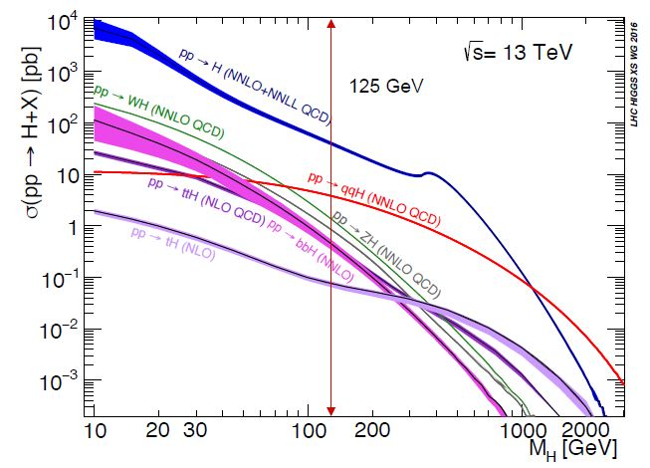
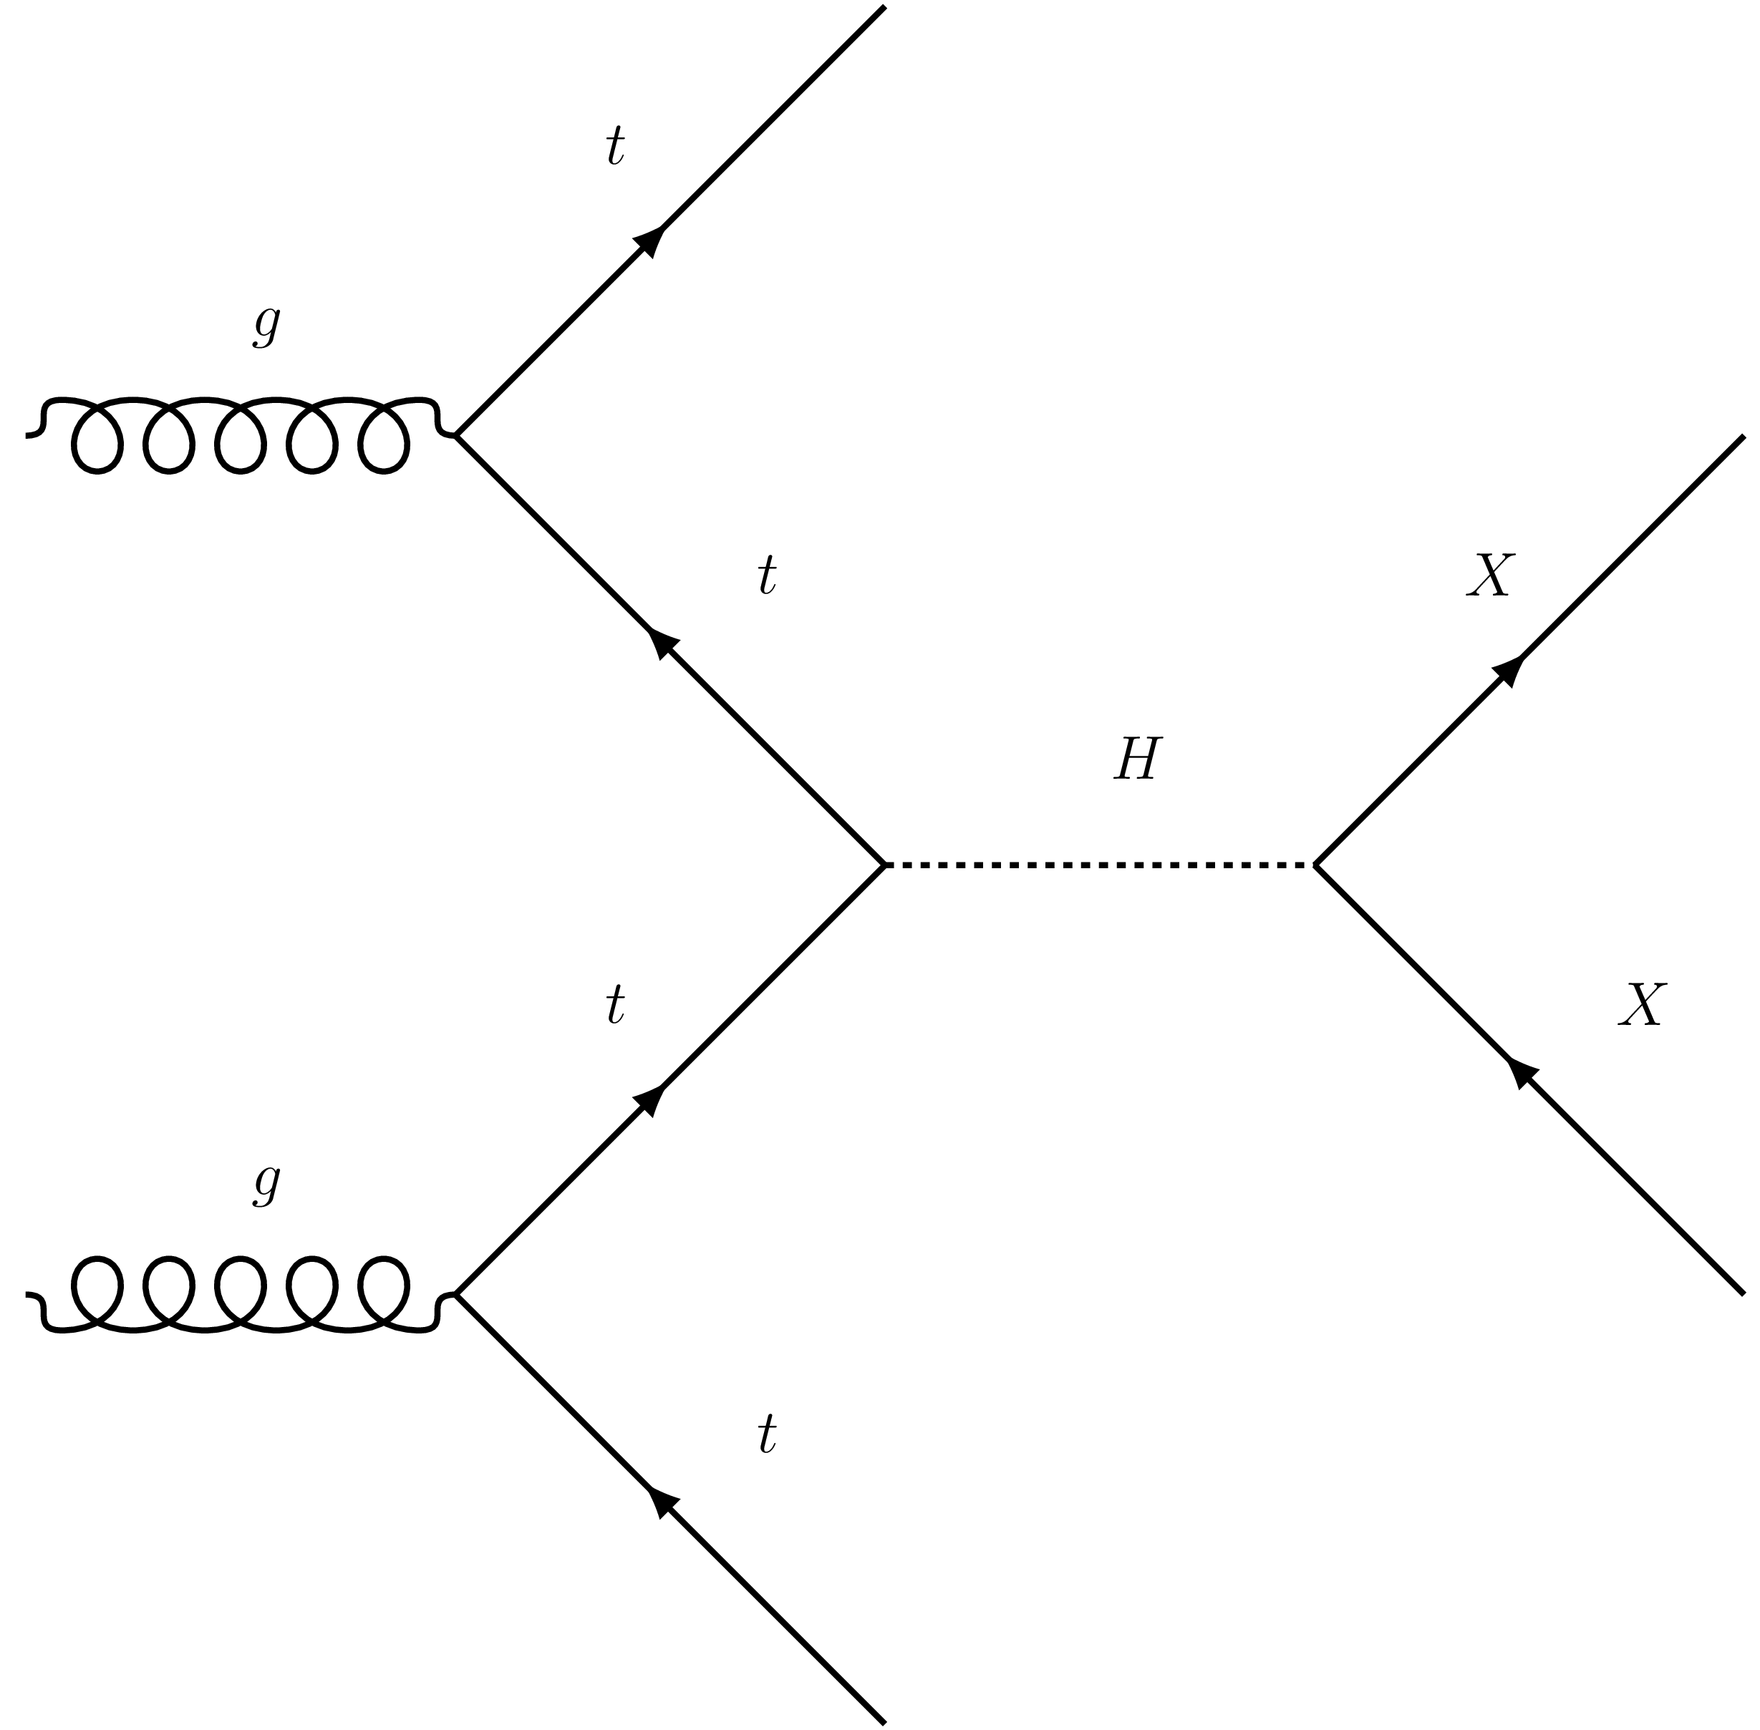

Invisible Higgs decay
When the decay products of the Higgs boson are not detected it is said to have decayed invisibly
The Higgs boson has 4 main production modes at the LHC: gluon-gluon fusion (ggf), vector boson fusion (VBF), Higgs Strahlung (ZH) and top associated production (tth)
In the SM the Higgs can decay invisibly via
$H →Z^{∗}Z→4v$
The SM predicts a Higgs branching ratio (BR($H →inv$)) of 0.1%
Measurements at ATLAS have put an upper bound of 13% on BR($H →inv$)
If a significant excess of invisible Higgs decays exists it could signal new physics
Higgs bosons couples to all massive particles
This makes invisible Higgs decay a possible probe into the Dark sector
Work is being done on refining the measurement of BR($H →inv$)
tth production followed by invisible decay

Slide 4
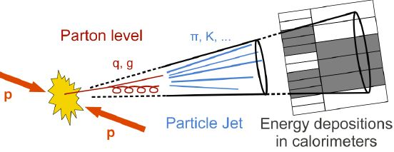
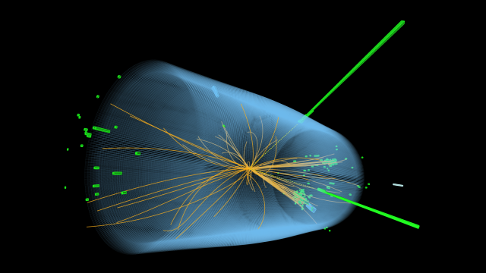

Measuring invisible Higgs branching ratio
Banks of detector arrays at CMS and ATLAS are used to reconstruct collisions at the LHC
The most common object formed in proton colliders are jets, they form due to the hadronization of unbound color charge
Variables like: the number of jets, mass of jets, angle between jets are determined by the production event
The combination of these variables make can be used to identify an event
Background signal will be present from other SM processes which have similar variable topology
The dominant backgrounds for $BR(tth →inv)$are from Z $→$ vv and W $→$ lv (lost lepton)
Cuts are used to suppress background processes; for tth requiring a large missing transverse energy (MET), and angle between jets
Recently neural networks have been used to help with classification
Photograth: CMS Collaboration

Slide 5
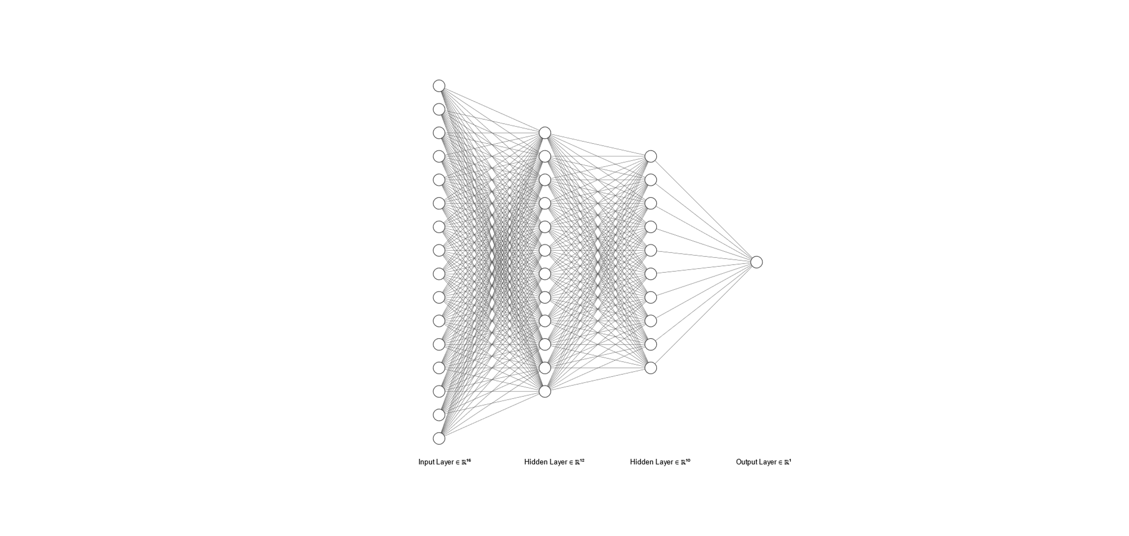
Neural Networks
Neural networks are made up of layers of neurons
The value of a neuron is determined by the weighted and biased sum of all neurons in the previous layer
Networks are trained on simulated data*
The network outputs a prediction for each simulated event
The prediction is evaluated, and the weights are updated
Neural networks can learn nonlinear relationships between variables
*see appendix - Gradient descent

Slide 6
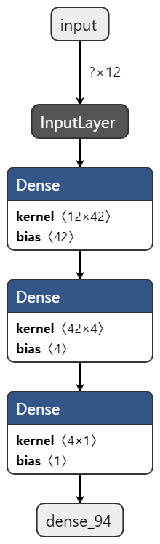
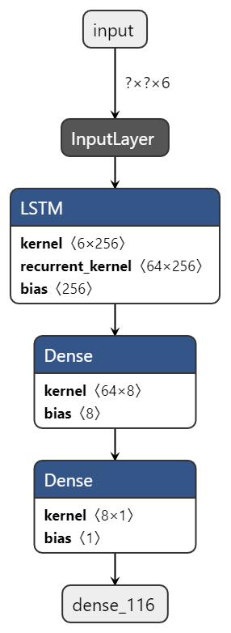
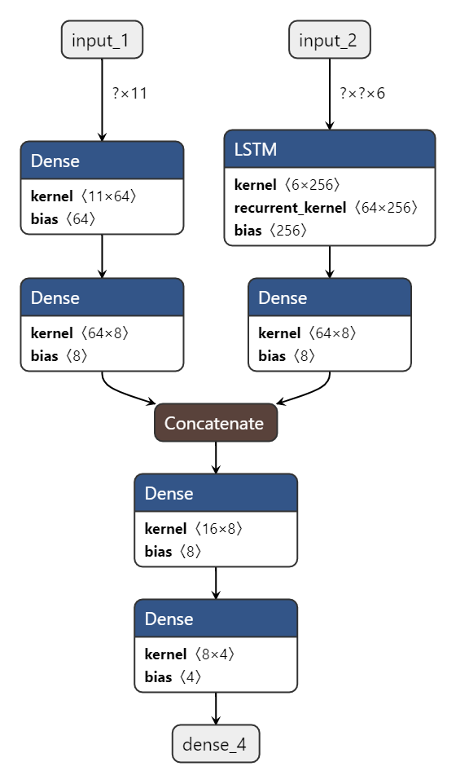
Feed forward network (FFN)
Recurrent network (RNN)
Fully connected network (FCN)
See appendix - RNN

Slide 7

Results

Slide 8
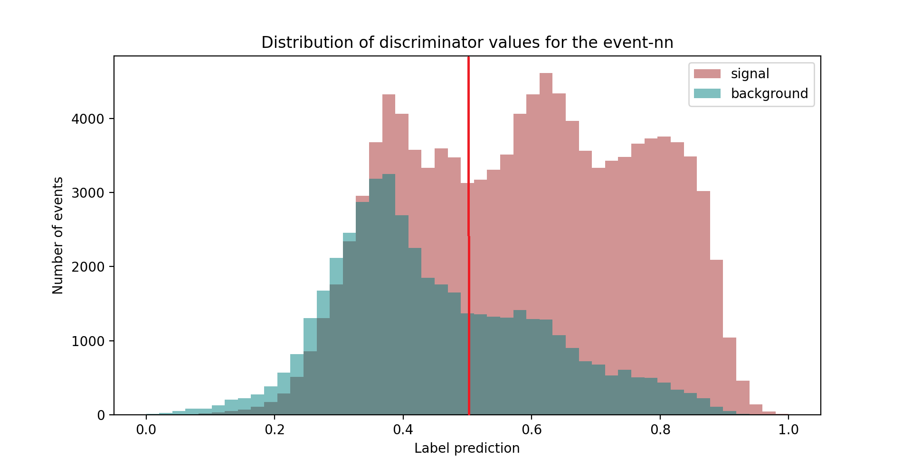
Network output - discriminator

Slide 9
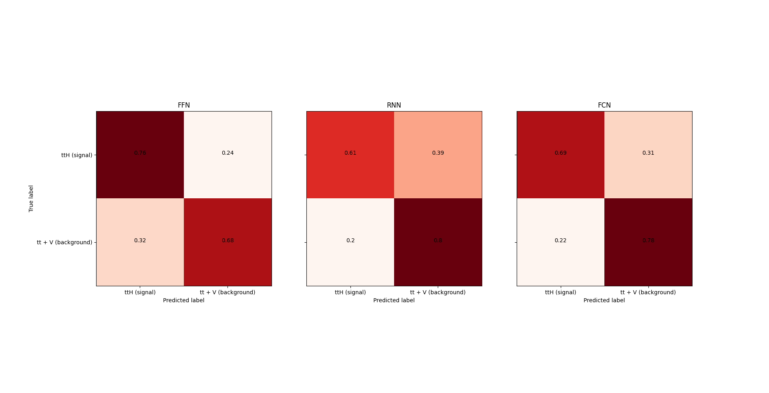
Confusion matrix

Slide 10
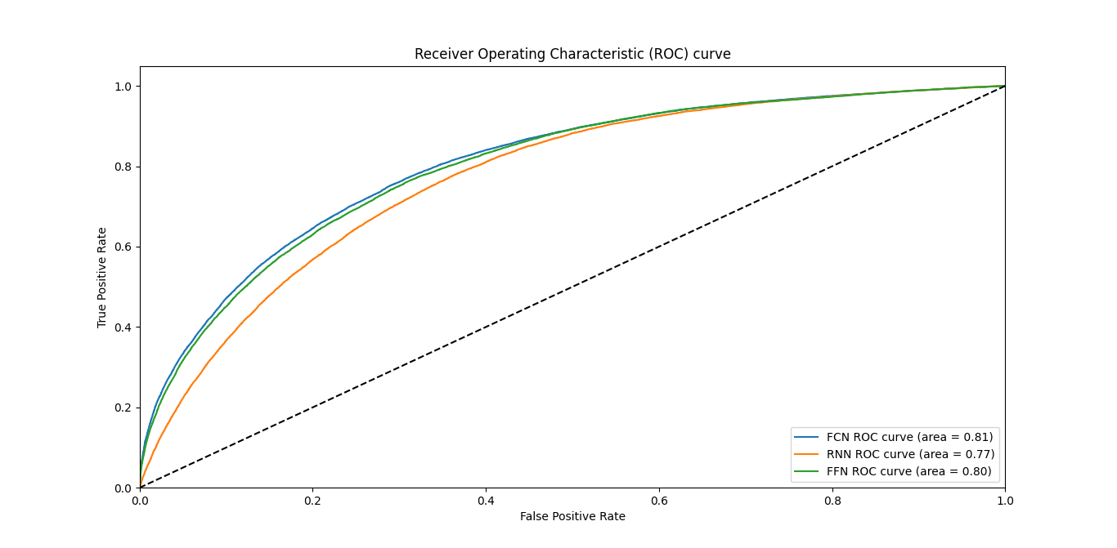
ROC Curve

Slide 11
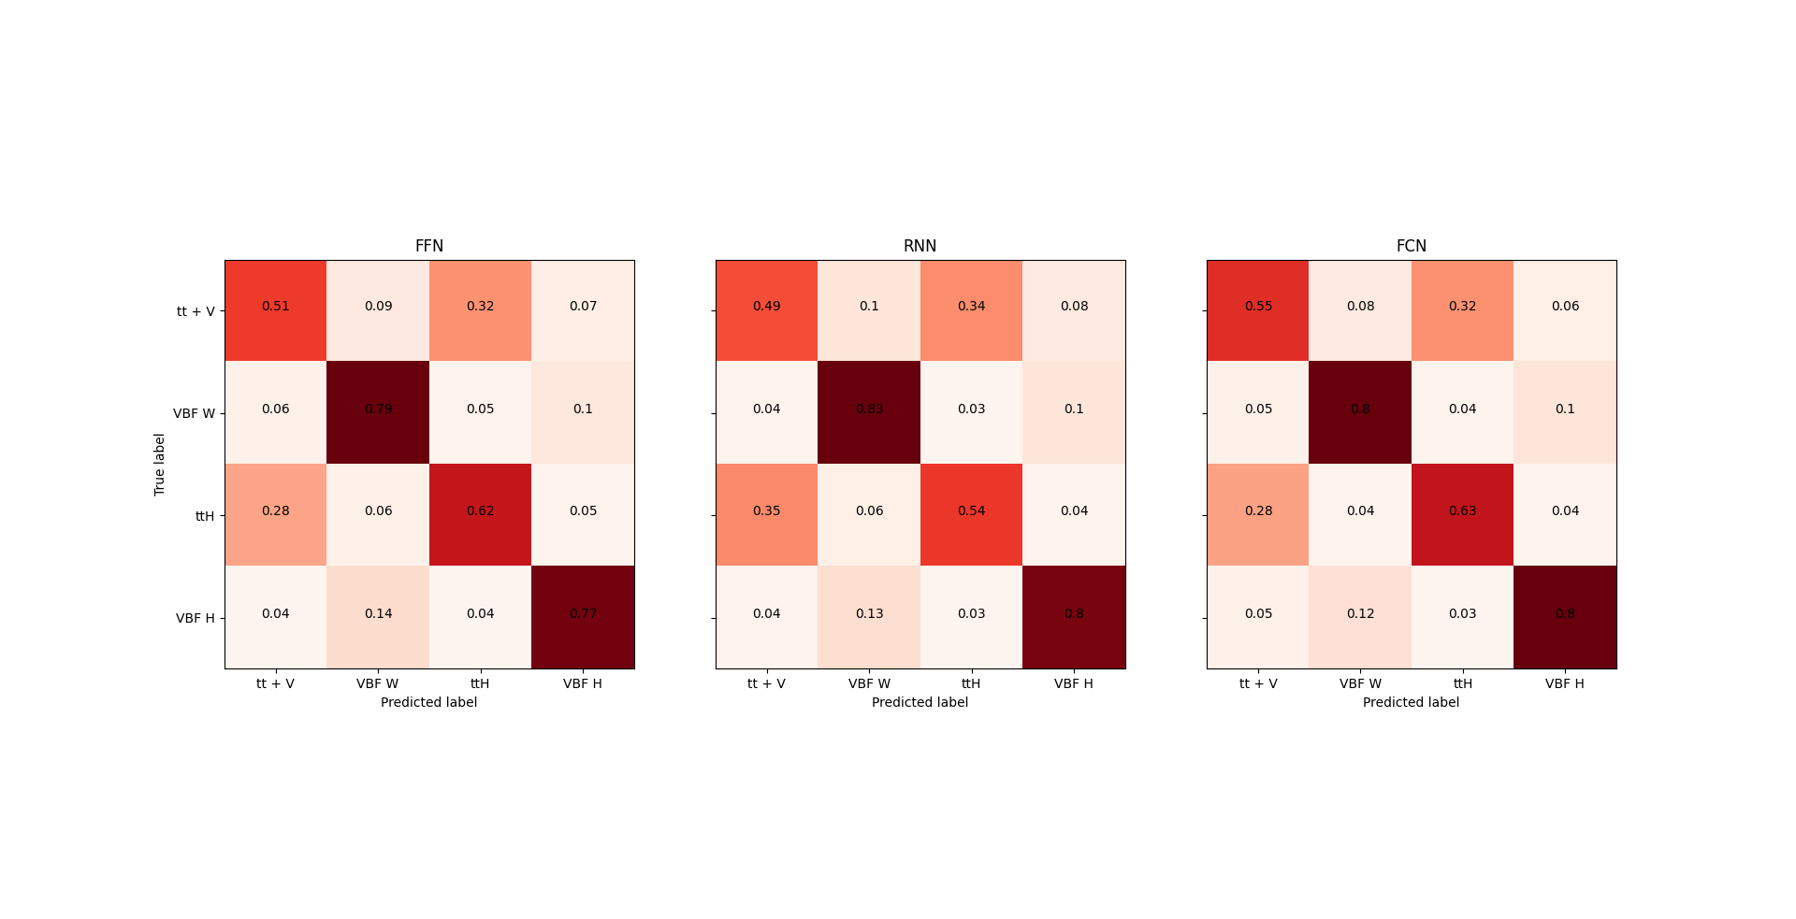

Slide 12
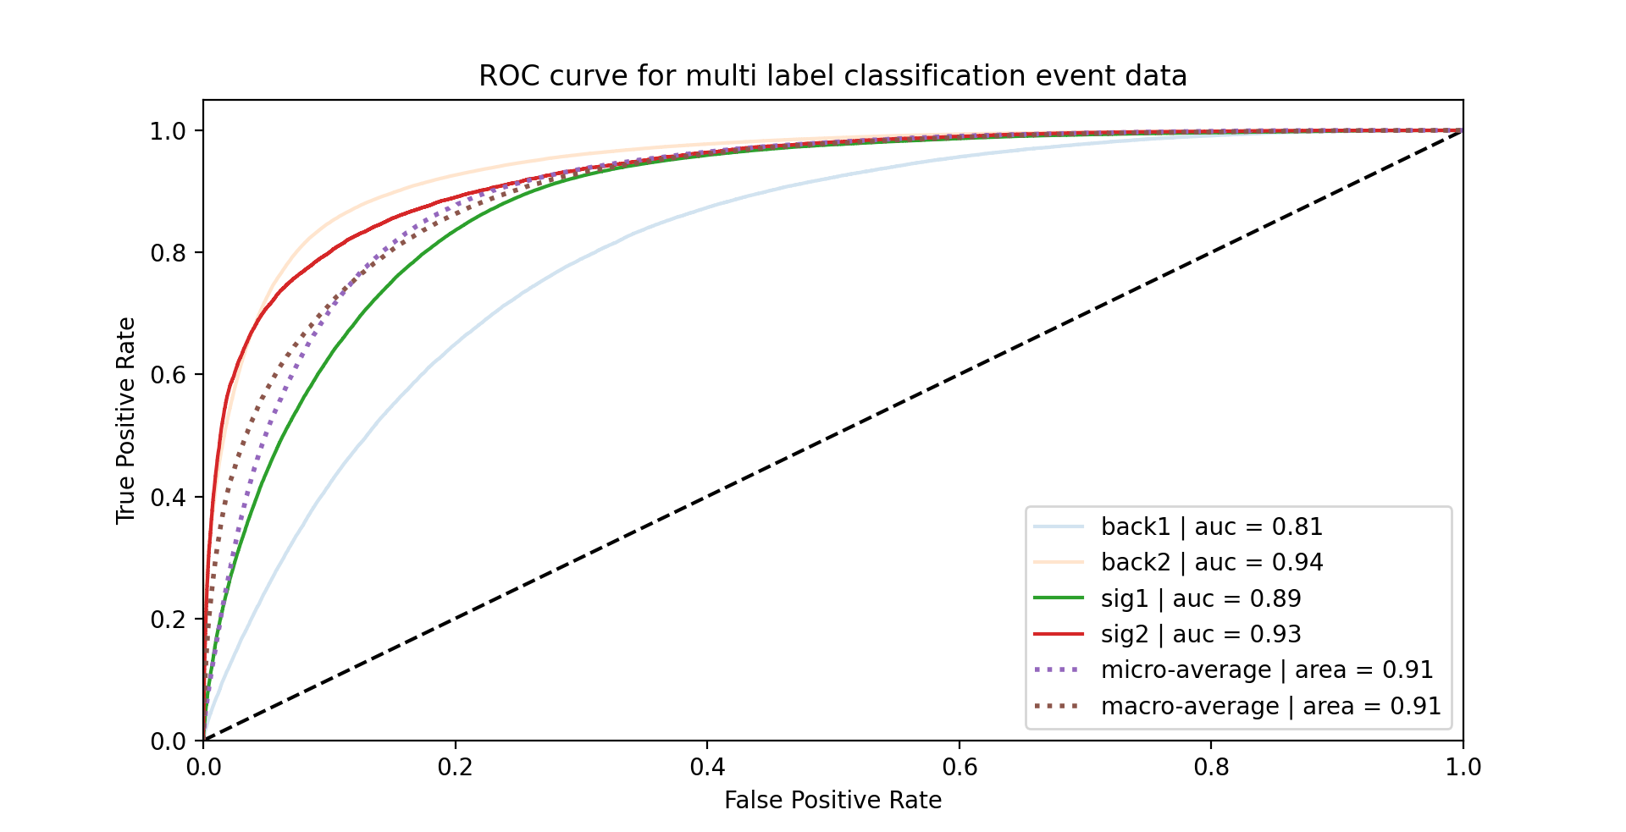
FFN

Slide 13
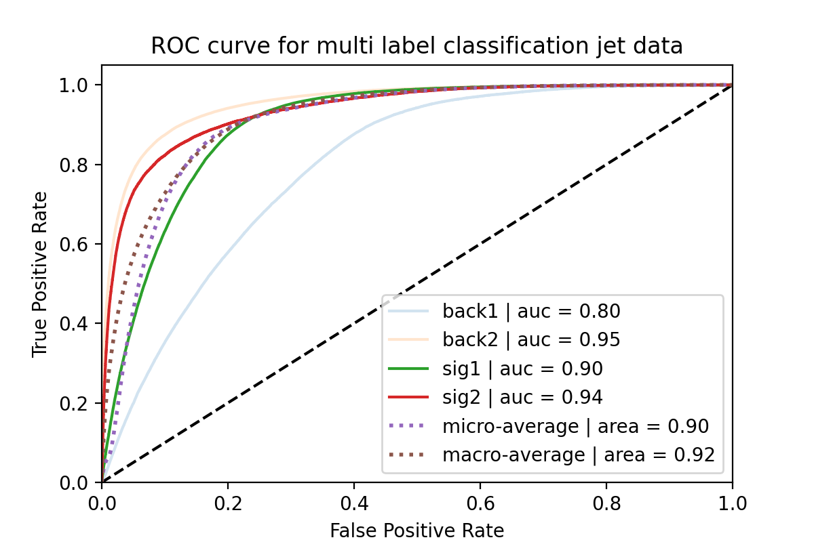
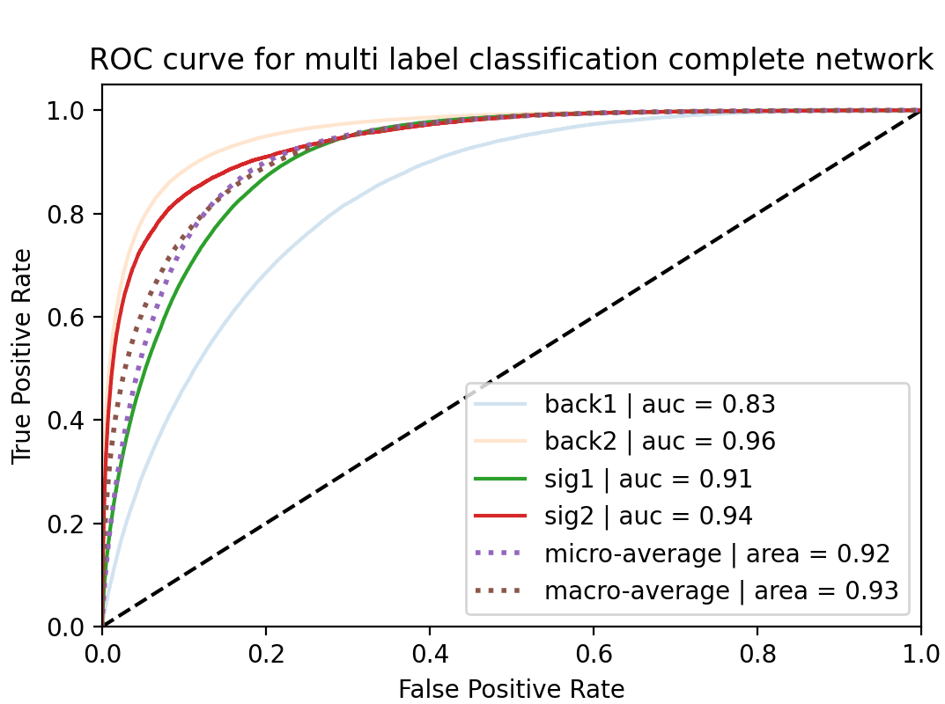
RNN
FCN

Slide 14
References
Vishal S. Ngairangbam, Akanksha Bhardwaj, Partha Konar, and Aruna Kumar Nayak. Invisible Higgs search through Vector Boson Fusion: A deep learning approach. Eur. Phys. J. C, 80(11):1055, 2020.
Search for invisible Higgs boson decays with vector boson fusion signatures with the ATLAS detector using an integrated luminosity of 139 fb⁻¹. 42020.
G. Aad, T. Abajyan, and et al. Observation of a new particle in the search for the standard model higgs boson with the atlas detector at the lhc. Physics Letters B, 716(1):1 - 29, 2012.
Dr. Aaron Bundock. Current topics in particle physics: Beyond the standard model. Bristol University, 2020.
Diptimoy Ghosh, Rohini Godbole, Monoranjan Guchait, Kirtimaan Mohan, and Dipan Sengupta. Looking for an Invisible Higgs Signal at the LHC. Phys. Lett. B, 725:344-351, 2013.

Slide 15
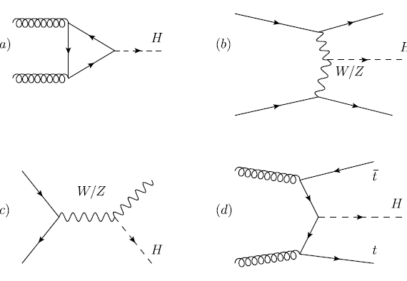
Appendix – Higgs production Feynman diagrams
Gluon-gluon fusion (ggF)
Vector boson fusion (VBF)
Higgs Strahlung (ZH)
top associated production (tth)
D. Ghosh, R. Godbole, M.G., K. Mohan, and D. Sengupta. Looking for an Invisible Higgs Signal at the LHC. Phys. Lett. B, 725:344-351, 2013.

Slide 16
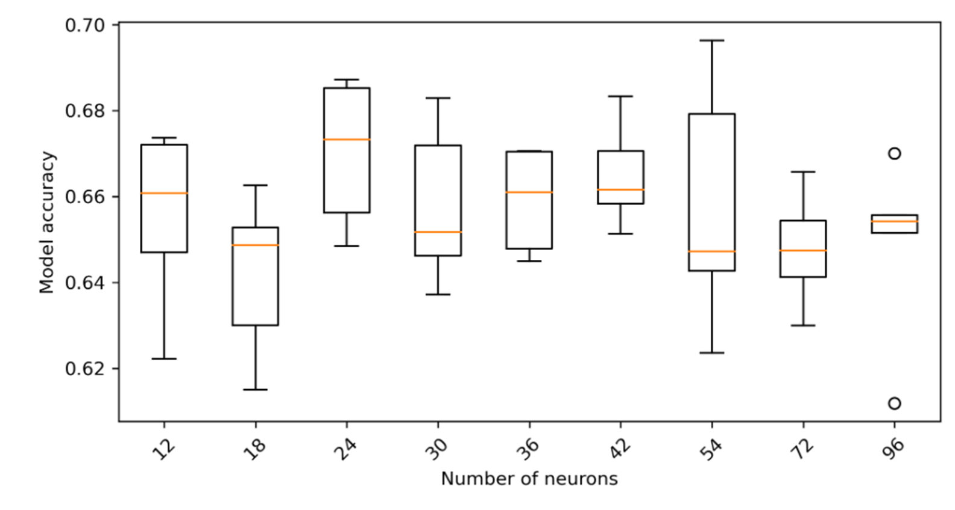
Appendix – Hyperparameter Tunning
Trial and error is required to set the parameters of the network
Different configurations are tried and the best is selected

Slide 17
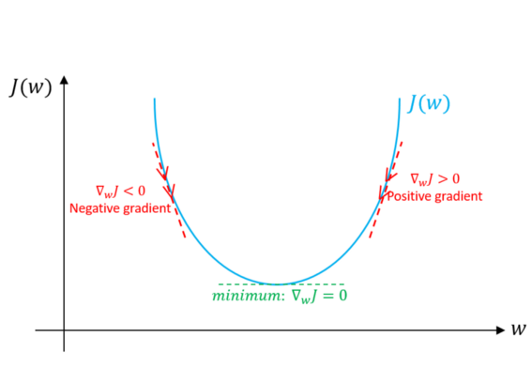
Appendix – Gradient Descent
The loss function calculates the difference between the predicted value and the true value
Gradient descent and other training algorithms seek to minimize the loss function
Gradient descent works out the derivative at each point in parameter space
The algorithm then moves the parameter space towards the local minimum
Imad Dabbura. Gradient Descent Algorithm and Its Variants

Slide 18
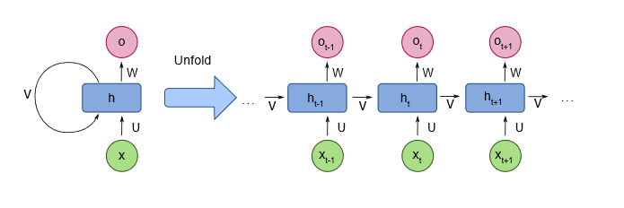
Appendix – RNN
The neurons in a recurrent network are calculated using previous instance of the neurons
This allows for inputs to be ordered (by jet energy for example) and for the order to matter!
It also allows for uneven length inputs (if the number of jets varies)
LSTMs are a type of RNN which specialises in retaining longer
By fdeloche - Own work, CC BY-SA 4.0, https://commons.wikimedia.org/w/index.php?curid=60109157

