Slide 1








$$x_{2}$$
$$x_{1}≤1$$
$$1$$
$$x_{2}≤1$$
$$2x_{1}+2x_{2}≤3$$
$$x_{1}$$
$$0$$
$$1$$

Slide 2


$$c_{1}$$
$$c_{2}$$
Optimal Cone
Feasible Region

Slide 3

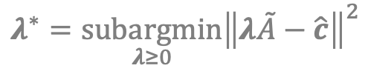






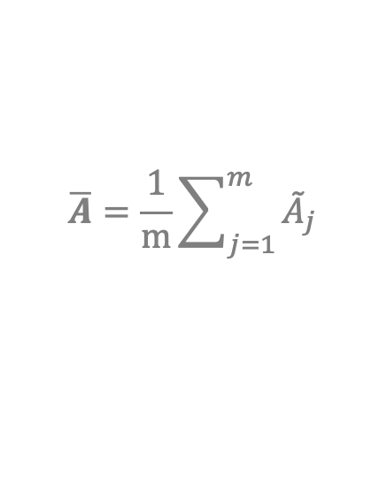
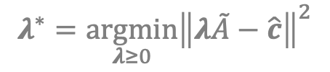






$$p_{\hat{c}}=λ^{∗}\tilde{A}$$
$$p_{\hat{c}}=λ^{∗}\tilde{A}$$
$$p_{\hat{c}}=\left(1−α\right)\hat{c}+α\overline{A}$$
$$λ^{∗}=\underset{λ≥0}{argmin}{{\left\|λ\tilde{A}−\hat{c}\right\|}^{2}}$$
$$λ^{∗}=\underset{λ≥0}{subargmin}{{\left\|λ\tilde{A}−\hat{c}\right\|}^{2}}$$
$$\overline{A}=\frac{1}{m}\sum_{j=1}^{m}{{\tilde{A}}_{j}}$$
$$\hat{c}$$
$$c$$
$$\hat{c}$$
$$c$$
$$\hat{c}$$
$$c$$
$$\overline{A}$$
$$φ$$
$$φ$$
$$φ$$
Optimal Cone
Optimal Cone
Optimal Cone
Feasible Region
Feasible Region
Feasible Region

Slide 4

$$x_{2}$$
$$x_{1}≤1$$
$$Cost Vector$$
$$1$$
$$x_{2}≤1$$
$$2x_{1}+2x_{2}≤3$$
$$x_{1}$$
$$0$$
$$1$$

Slide 5











$$x_{2}$$
$$No Integer Solution$$
$$x_{1}≤1$$
$$\left(0,1\right)$$
$$Solution:\left(0,1\right)$$
$$1$$
$$x_{2}≤1$$
$$\left(−1,0\right)$$
$$No Integer Solution$$
$$2x_{1}+2x_{2}≤3$$
$$\left(−1,0\right)$$
$$\left(1,0\right)$$
$$x_{1}$$
$$0$$
$$1$$
$$Solution:\left(0,0\right)$$
$$Solution:\left(1,0\right)$$
$$\left(0,−1\right)$$
$$\left(0,−1\right)$$

Slide 6


















$$w_{2}$$
$$w_{2}$$
$$w_{1}≤1$$
$$w_{1}≤1$$
$$w^{∗}\left(c\right)$$
$$w_{2}≤1$$
$$w^{∗}\left(c\right)$$
$$w_{2}≤1$$
$$1$$
$$1$$
Feasible Region
（Points）
Feasible Region
$$2w_{1}+2w_{2}≤3$$
$$2w_{1}+2w_{2}≤3$$
$$w_{1}$$
$$w_{1}$$
$$0$$
$$1$$
$$0$$
$$1$$

Slide 7

$$w_{2}$$
$$w_{2}$$
$$w_{1}≤1$$
$$w_{1}≤1$$
$$w^{∗}\left(c\right)$$
$$w_{2}≤1$$
$$w^{∗}\left(c\right)$$
$$w_{2}≤1$$
$$1$$
$$1$$
Feasible Region
（Points）
Feasible Region
$$2w_{1}+2w_{2}≤3$$
$$2w_{1}+2w_{2}≤3$$
$$w_{1}$$
$$w_{1}$$
$$0$$
$$1$$
$$0$$
$$1$$
$$w_{1}+w_{2}≤1$$

Slide 8










$$x_{2}$$
$$x_{1}≤1$$
$$\left(1,1\right)$$
$$Solution:\left(0,1\right)$$
$$x_{2}≤1$$
$$1$$
$$\left(−1,0\right)$$
$$x_{1}+x_{2}≤1$$
$$\left(1,1\right)$$
$$\left(−1,0\right)$$
$$x_{1}$$
$$0$$
$$1$$
$$Solution:\left(0,0\right)$$
$$Solution:\left(1,0\right)$$
$$\left(0,−1\right)$$
$$\left(0,−1\right)$$

Slide 9


$$x_{2}$$
$$x_{1}≤1$$
$$\left(1,1\right)$$
$$Solution:\left(0,1\right)$$
$$x_{2}≤1$$
$$1$$
$$\left(−1,−1\right)$$
$$x_{1}+x_{2}=1$$
$$\left(1,1\right)$$
$$x_{1}$$
$$0$$
$$1$$
$$Solution:\left(1,0\right)$$
$$\left(0,−1\right)$$

Slide 10



































$$x_{2}$$
$$x_{2}$$
$$x_{2}$$
$$x_{1}≤1$$
$$No Integer Solution$$
$$x_{1}≤1$$
$$x_{1}≤1$$
$$\left(0,1\right)$$
$$\left(1,1\right)$$
$$\left(0,1\right)$$
$$\left(0,1\right)$$
$$\left(1,1\right)$$
$$Solution:\left(0,1\right)$$
$$Solution:\left(0,1\right)$$
$$Solution:\left(0,1\right)$$
$$1$$
$$x_{2}≤1$$
$$1$$
$$x_{2}≤1$$
$$1$$
$$x_{2}≤1$$
$$\left(−1,0\right)$$
$$\left(−1,0\right)$$
$$\left(−1,0\right)$$
$$\left(−1,−1\right)$$
$$x_{1}+x_{2}≤1$$
$$No Integer Solution$$
$$x_{1}+x_{2}=1$$
$$2x_{1}+2x_{2}≤3$$
$$\left(1,1\right)$$
$$\left(1,1\right)$$
$$\left(−1,0\right)$$
$$\left(1,0\right)$$
$$x_{1}$$
$$\left(−1,0\right)$$
$$\left(1,0\right)$$
$$x_{1}$$
$$\left(1,0\right)$$
$$x_{1}$$
$$0$$
$$1$$
$$0$$
$$1$$
$$0$$
$$1$$
$$Solution:\left(0,0\right)$$
$$Solution:\left(1,0\right)$$
$$Solution:\left(0,0\right)$$
$$Solution:\left(1,0\right)$$
$$Solution:\left(1,0\right)$$
$$\left(0,−1\right)$$
$$\left(0,−1\right)$$
$$\left(0,−1\right)$$
$$\left(0,−1\right)$$
$$\left(−1,−1\right)$$
$$\left(0,−1\right)$$

