Slide 1

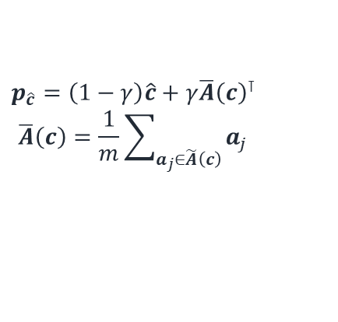


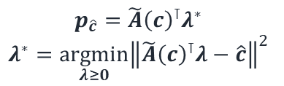


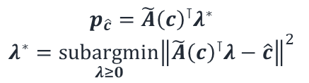
$$p_{\hat{c}}={\tilde{A}\left(c\right)}^{⊺}λ^{∗}$$
$$λ^{∗}=\underset{λ≥0}{argmin}{{\left\|{\tilde{A}\left(c\right)}^{⊺}λ−\hat{c}\right\|}^{2}}$$
$$p_{\hat{c}}={\tilde{A}\left(c\right)}^{⊺}λ^{∗}$$
$$λ^{∗}=\underset{λ≥0}{subargmin}{{\left\|{\tilde{A}\left(c\right)}^{⊺}λ−\hat{c}\right\|}^{2}}$$
$$p_{\hat{c}}=\left(1−γ\right)\hat{c}+γ{\overline{A}\left(c\right)}^{⊺}$$
$$\overline{A}\left(c\right)=\frac{1}{m}\sum_{a_{j}∈\tilde{A}\left(c\right)}{a_{j}}$$
$$\hat{c}$$
$$c$$
$$\hat{c}$$
$$c$$
$$\hat{c}$$
$$c$$
$$φ$$
$$φ$$
$$φ$$
Optimal
Subcone
$$\overline{A}$$
Feasible
Region

