Slide 1

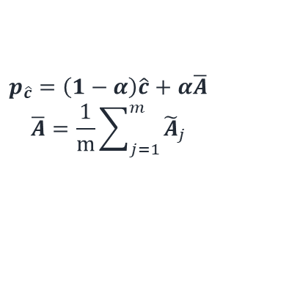


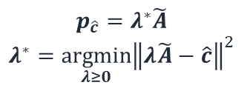


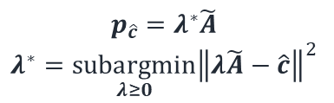
$$p_{\hat{c}}=λ^{∗}\tilde{A}$$
$$λ^{∗}=\underset{λ≥0}{argmin}{{\left\|λ\tilde{A}−\hat{c}\right\|}^{2}}$$
$$p_{\hat{c}}=λ^{∗}\tilde{A}$$
$$λ^{∗}=\underset{λ≥0}{subargmin}{{\left\|λ\tilde{A}−\hat{c}\right\|}^{2}}$$
$$p_{\hat{c}}=\left(1−α\right)\hat{c}+α\overline{A}$$
$$\overline{A}=\frac{1}{m}\sum_{j=1}^{m}{{\tilde{A}}_{j}}$$
$$\hat{c}$$
$$c$$
$$\hat{c}$$
$$c$$
$$\hat{c}$$
$$c$$
$$φ$$
$$φ$$
$$φ$$
Optimal
Subcone
$$\overline{A}$$
Feasible
Region

