Slide 1

Causalitty
Capstone Project Phase A
By:
Majd Zidan & Khaleel Warwar
Advisor:
Dr. Ayala Dente-Byron
Code: 26-2-R-14
khalil212002/CausalDiscovery
1

Slide 2
Road Map

Slide 3
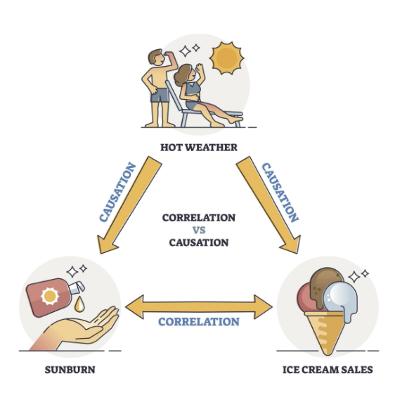
Correlation vs Causation
Rise of AI
Confounders
Medical field
2

Slide 4
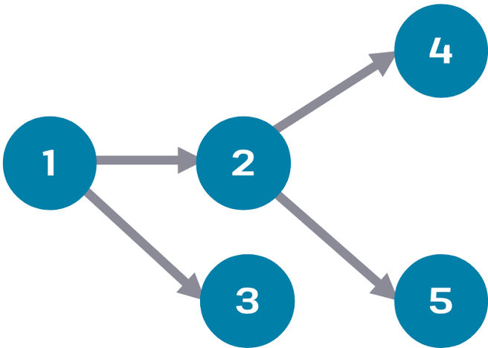
Directed Acyclic Graphs (DAG)
Nodes represent variables
edges represent dependencies
Directed edges represent causal relationships
No cycles (a variable cannot cause itself)
3

Slide 5
Graph Validation
D-seperation
CI Test
5

Slide 6
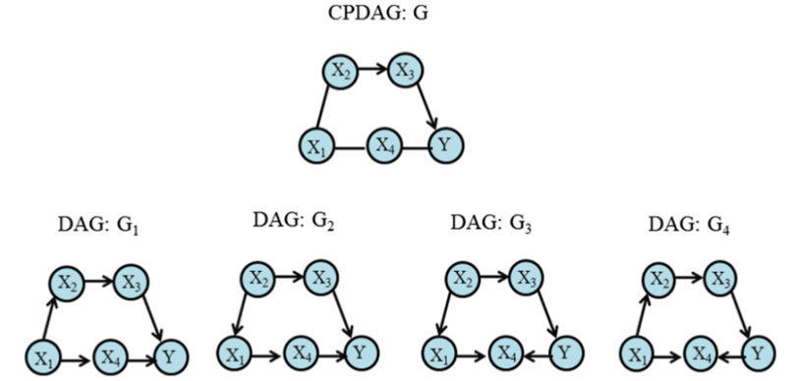
Completed Partially DAG(CPDAG)
Markov Equivalence class
Contains both directed and undirected edges
Undirected edges indicate uncertain causal direction
Represents all equivalent DAGs with the same conditional independencies
6

Slide 7
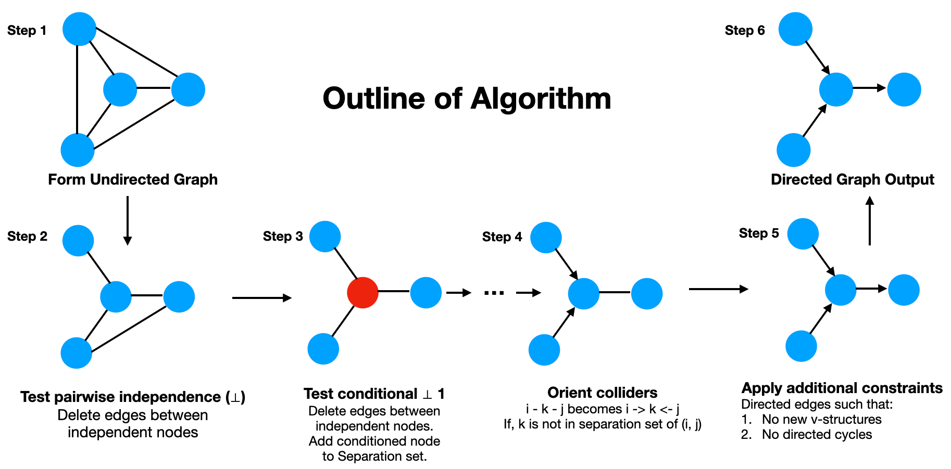
Causal Discovery algorithms Algorithms
Types:
  Constrains-Based
  Score-Based
Cons:
  Hight computational power
  Pure data modeling
  Consequential error
8

Slide 8
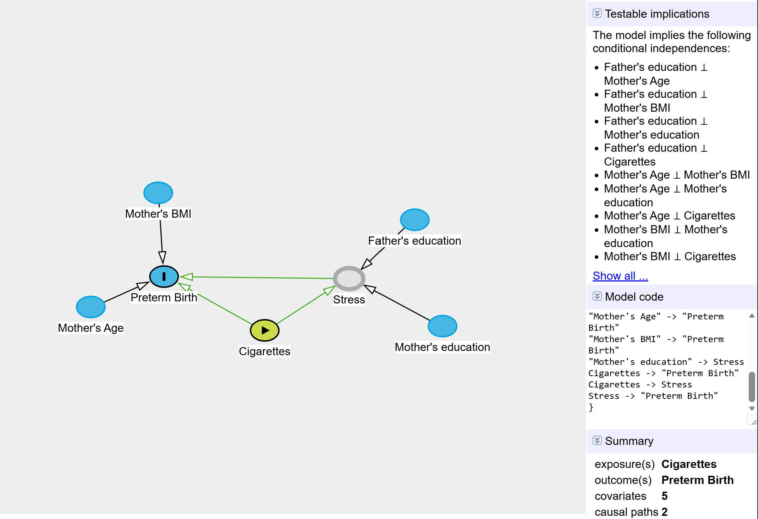
Dagitty
Reason for popularity
Missing features
9

Slide 9
Needed solution
Causal Discovery Algorithms
Dagitty
Fully Manual
Fully autonomous
Causalitty
Level of control of dagitty
With
Ease and autonomy of CDAs
10

Slide 10
Causalitty’s Features
Familiar manual graph building
Domain knowledge utilization
Zero-code CI tests
Graph patching
14

Slide 11
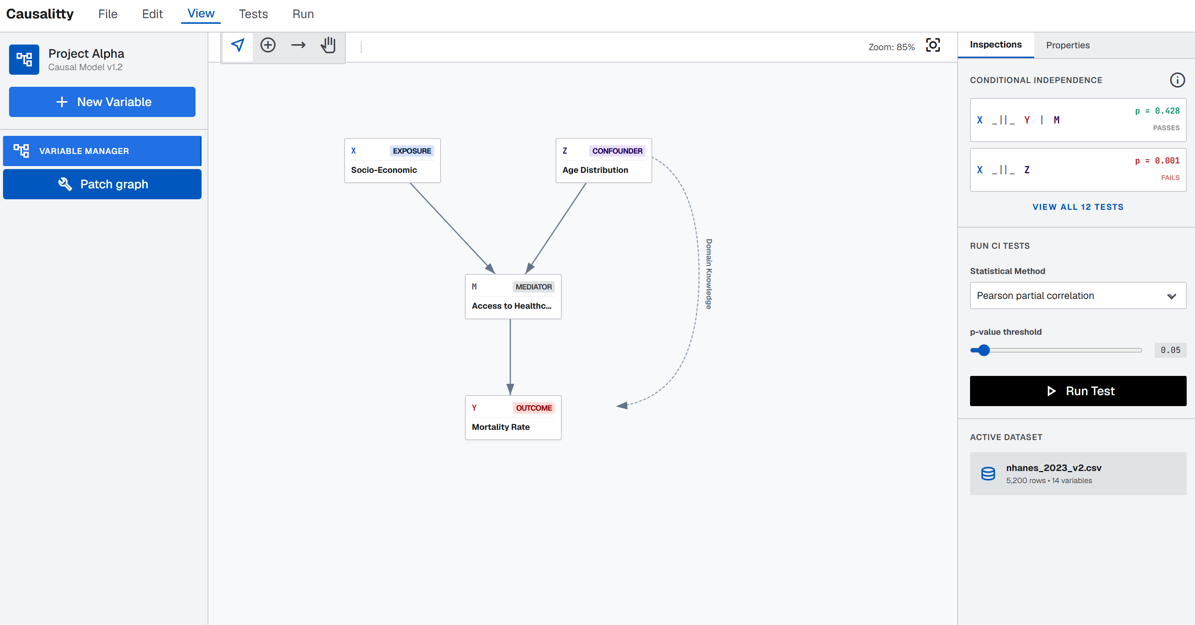
Causalitty

Slide 12
Challenges
Fixing / patching graphs with failed CI tests.
AI hallucination
Figuring out the type of information
The type of graph to use
11

Slide 13
Domain Knowledge Search
Create pair combinations
Fetch meta-analyses
Analyze with LLM
Add edges to the graph
12

Slide 14
Graph Patching (Modified GES)
Empty graph
Score = BIC=
-2ln(L)+kln(N)
Partially correct graph
Score = BIC + αSHD
13

Slide 15
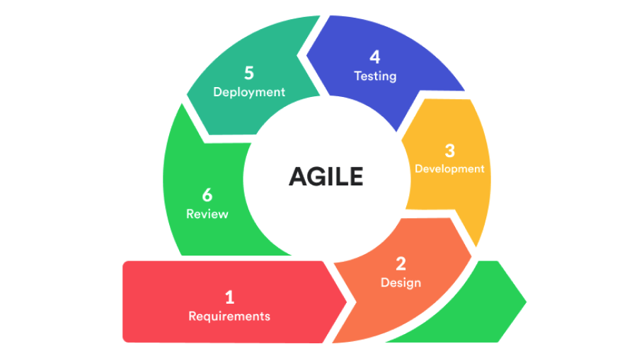
Project Implementation
Agile methodology
Per sprint checkup meeting
15

Slide 16
Development Stages & stack
Implementing the base CPDAG editor (pyside & it’s canvas)
1
Implementing dataset management and manipulation (pandas)
2
Implementing the domain search function (apis and prompt)
3
Implementing the CI tests (pgmpy)
4
Implementing graph patching algorithm(pgmpy)
5
Implementing packaging for zero-config setup (pyInstaller)
6
16

Slide 17
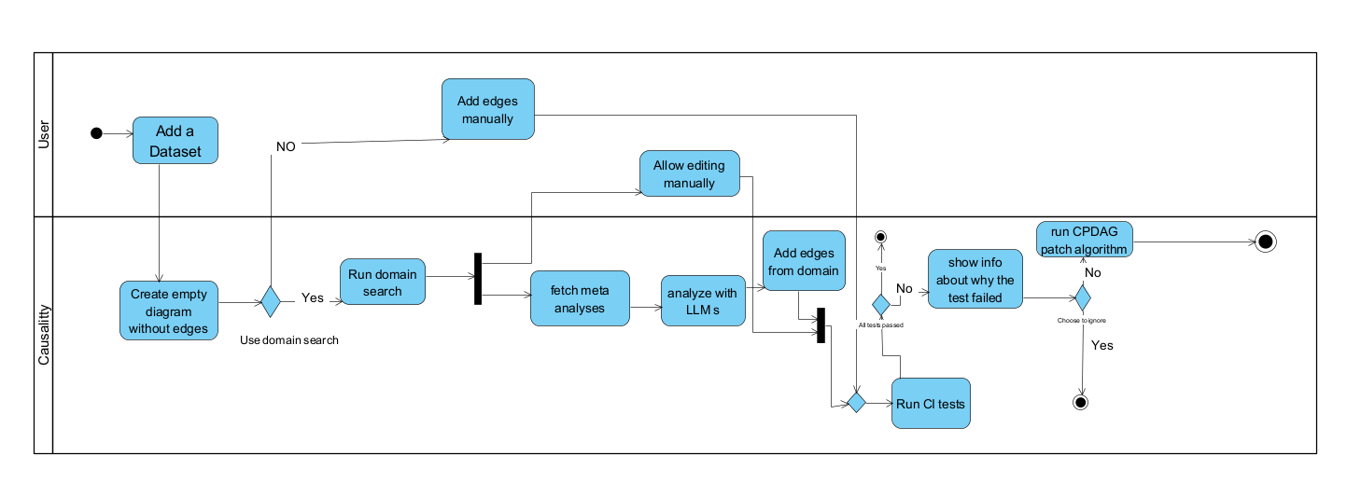
Activity diagram

Slide 18
Testing and evaluation
17

