Slide 1
StorePrint
Brand Store Management Platform
Unify · Audit · Operate · Grow
Executive Presentation | 2026
Brand Hub
GPS Auditing
Attendance
Roster
Store Ops
Analytics

Slide 2
The Challenge Facing Multi-Store Brands
⚡
Scattered Operations
📋
Manual Auditing
No single platform to manage compliance, attendance, assets and communication across all stores.
Paper-based checklists, inconsistent standards, no GPS verification or automated scoring.
👥
Attendance Gaps
💸
High SaaS Costs
No real-time visibility of who is on the floor. Clock-ins unverified and unreliable.
Global platforms charge $15–50/user/month with limited customisation or data control.

Slide 3
StorePrint
One platform. Seven modules. Complete store control.
📱
🖥️
⚙️
Mobile App
Admin Portal
API Backend
iOS, Android & Web
Staff, managers, auditors
Web dashboard
Full brand oversight
Self-hosted
Secure, scalable, yours
React Native · Node.js · PostgreSQL · Docker · Self-Hosted

Slide 4
Technical Architecture
All containerised via Docker · Self-hosted or cloud-deployable
MOBILE APP
API LAYER
INFRASTRUCTURE
iOS App
Express API
PostgreSQL
Android App
Auth / JWT
MinIO Storage
Web Browser
GPS Verify
Redis Cache
Permissions
Meilisearch

Slide 5
Seven Integrated Modules
🗂️
✅
🕐
📅
Brand Hub
Auditing
Attendance
Roster
Digital asset library
GPS-verified compliance
Real-time presence
Shift management
🏪
📊
🔧
Store Ops
Analytics
Admin
6 operational modules
Performance insights
Full brand control
Each module is independently accessible via role-based permissions

Slide 6
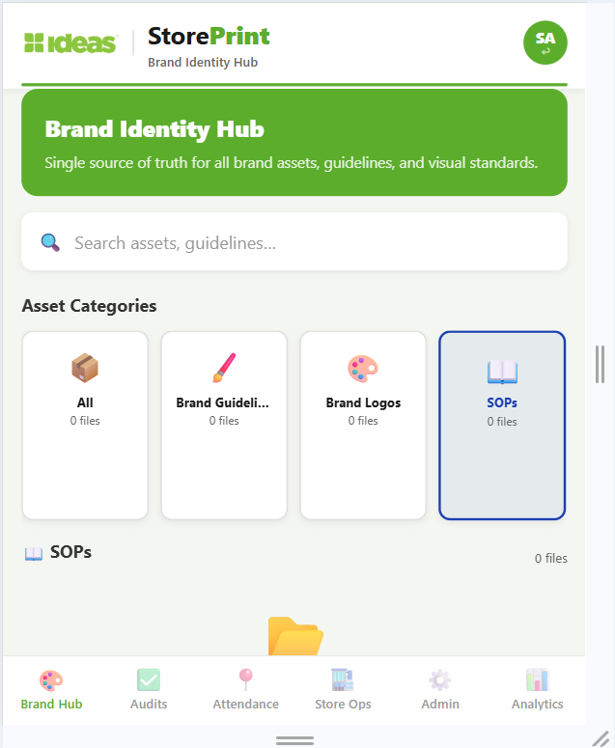
Brand Hub
Centralised Digital Asset Library
Brand guidelines, logos and campaigns in one place
Supports images, PDFs and documents
Brand Hub
Mobile App
Category-based organisation and search
One-tap WhatsApp & email sharing
Role-based access control per module

Slide 7
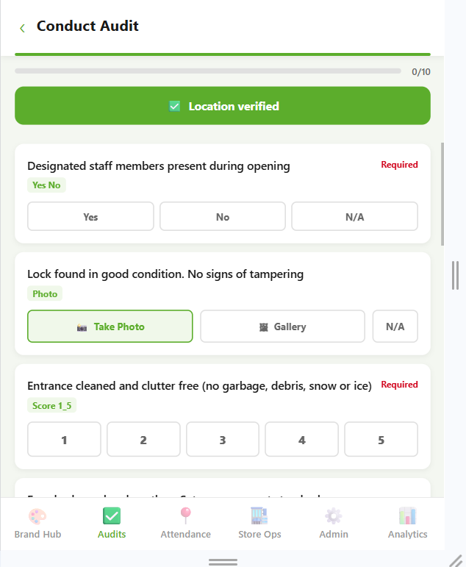
Store Compliance Auditing
GPS-verified, scored, automated
Smart Templates
1
Yes/No, Photo, Score 1–5, Free Text question types
Audit Form
Weighted Scoring
2
Each question carries a weight multiplier (1–5×)
GPS Enforcement
3
Auditor must be physically at store to submit
Auto Corrective Actions
4
Critical failures instantly create assigned action items

Slide 8
Audit Workflow
1
2
3
4
5
Admin Builds
Template
Auditor Selects
Store
Answers All
Questions
GPS Verified
Submission
Score & Report
Generated
⚖️
📍
⚡
Auto-weighted Scoring
GPS Timestamped
Instant Corrective Actions
Eliminates manual calculation
Every submission geo-verified
Critical fails auto-assigned

Slide 9
Field Attendance
Real-time GPS-verified presence management
GPS clock in/out — verified against store geofence
Live Presence
Ahmed R.
Present
Real-time live presence dashboard
Sara K.
Present
Late arrival & early exit detection
Bilal M.
Late
Full attendance log with timestamps
Nadia T.
Present
Usman F.
Absent
Status tracking: Present / Late / Absent
Rizwan S.
Present
4 Present
1 Late
1 Absent

Slide 10
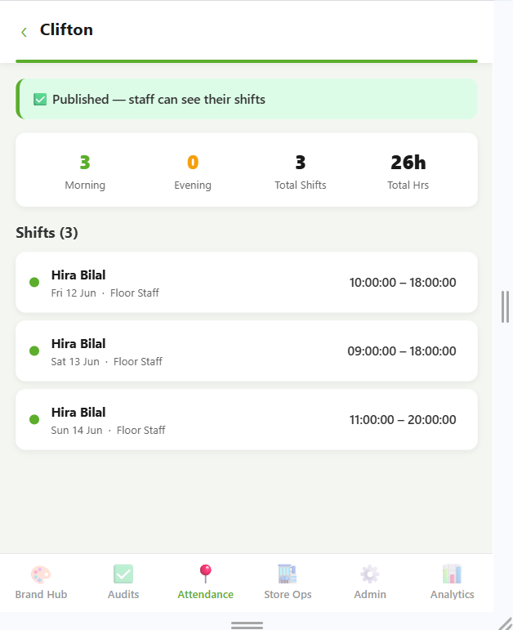
Roster Management
👔 For Managers
Create weekly/monthly rosters
Assign shifts: date, time, role, zone
Roster View
Draft-to-Publish workflow
Ahmed – Morning
Morning / Evening classification
🧑‍💼 For Staff
Bilal – Morning
My Shifts view — upcoming & past
Instant visibility on roster publish
Total hours display

Slide 11
Store Operations
Six operational modules in one tab
🖼️
📣
🪧
Visual Merchandising
Campaigns
Signage
Planogram compliance & VM tasks
Campaign rollout tracking
In-store signage compliance
🎓
🏗️
⭐
Training
Environment
Customer Experience
Staff onboarding & certification
Store condition checks
CX surveys & feedback

Slide 12
Analytics & Insights
📊
🕐
📈
✅
Audit Scores
Attendance
Benchmarks
Compliance
Compliance % by store
Real-time presence data
Compare stores side by side
Brand standard adherence
Store Compliance Scores — Last 30 Days
92%
95%
88%
87%
78%
71%
DHA
Clifton
Gulshan
PECHS
Saddar
Bahadurabad

Slide 13
Admin Web Portal
Complete brand oversight from a browser
👤 User Management
🏪 Store Management
📝 Audit Builder
Create users & assign roles
GPS geofence setup
Build templates with categories
Set granular permissions per module
Store hierarchy & zoning
Set question weights
Active/inactive status control
Staff assignment & status
Publish & manage templates

Slide 14
Granular Role-Based Access Control
Role
Brand Hub
Auditing
Attendance
Roster
Store Ops
Analytics
Admin
Super Admin
Full
Full
Full
Full
Full
Full
Full
Area Manager
Read
Full
Full
Full
Full
Full
—
Store Manager
Read
Full
Full
Full
Full
Read
—
Auditor
—
Full
Read
Read
—
Read
—
Field Staff
—
—
Full
Read
—
—
—
Customer Support
Read
—
—
—
Full
—
—
Full Access
Read Only
No Access

Slide 15
Global Market Comparison
StorePrint vs. established players — including AI-powered platforms
CLOSEST COMPETITOR
AI-POWERED
Wooqer
AI-powered frontline OS — audits, tasks, SensEye planogram AI, Lens SOP assistant, Wally co-pilot. 450+ enterprise clients worldwide.
Custom pricing
Est. $20–40/user/mo
Bindy
GoSpotCheck
Reflexis / Zebra
Retail audit & task mgmt
Field execution (now Movista)
Enterprise workforce mgmt
$25–40/user/mo
$30–50/user/mo
$20–35/user/mo
Tulip Retail
StoreForce
Axonify
Store ops — no GPS auditing
Retail workforce — scheduling only
Retail training — single module only
$40–60/user/mo
$15–25/user/mo
$10–20/user/mo
StorePrint | Self-Hosted | No Per-User Fees | 7 Integrated Modules | GPS-First Architecture

Slide 16
Feature Comparison
Feature
StorePrint
Wooqer
Bindy
GoSpotCheck
Reflexis
Tulip
GPS-Verified Auditing
✓
✓
✓
✓
✗
✗
Photo Evidence in Audits
✓
✓
✓
✓
✗
✗
GPS Clock In/Out
✓
✗
✗
✗
✓
✗
Roster / Shift Management
✓
✗
✗
✗
✓
✗
Digital Asset Library
✓
✗
✗
✗
✗
✓
Self-Hosted Option
✓
✗
✗
✗
✗
✗
Mobile + Web App
✓
✓
✓
✓
✓
✓
Corrective Action Mgmt
✓
✓
✓
✓
✗
✗
Custom Permissions
✓
✓
~
~
✓
~
No Per-User Fees
✓
✗
✗
✗
✗
✗
AI-Powered Features
✗
✓
✗
✗
✗
✗
~ = Limited | Wooqer AI features include SensEye planogram AI, Lens SOP assistant, and Wally co-pilot

Slide 17
Cost Benefit Analysis
50 users · 3-year total cost of ownership
Avg. Competitor
StorePrint
Your Savings
$15,000
$3,600
$34,200
Year 1 cost
Year 1 cost
3-Year savings
Avg $25/user/month
Infrastructure ~$300/mo
Year 1 saved: $11,400
50 users = $1,250/mo
No per-user fees ever
Year 2 saved: $11,400
Year 2: $15,000
Year 2: $3,600
Year 3 saved: $11,400
Year 3: $15,000
Year 3: $3,600
3-Year Total: $45,000
3-Year Total: $10,800
76% Cost Reduction
* Wooqer custom enterprise pricing est. $20–40/user/month — still 3–7× StorePrint infrastructure costs

Slide 18
Return on Investment
💰
⏱️
Direct Cost Savings
Time Savings
No $25–50/user/month licensing. For 50 users over 3 years: save $34,200+
GPS-verified auditing cuts admin time ~60%. Auto-scoring eliminates manual calculation.
📈
⚙️
Compliance Lift
Operational Efficiency
Real-time visibility drives store compliance. Issues corrected same-day, not next week.
Unified platform replaces 6+ separate tools. One login for all store operations.

Slide 19
Deployment & Security
🔒 Self-Hosted Architecture
📦 What's Included
Docker containerised — deploy anywhere
PostgreSQL database
JWT authentication + role permissions
MinIO file storage (S3-compatible)
Meilisearch for fast search
GPS geofencing per store
Ntfy push notifications
Your data stays on your servers
nginx reverse proxy
Redis caching for performance
Full Docker Compose setup

Slide 20
Built for Real Users
📊
🏪
📱
Area Manager
Store Manager
Field Staff / Auditor
Monitors all stores from one screen. Reviews audit scores, tracks attendance across locations, manages rosters.
Creates rosters, conducts audits, views live presence. Manages day-to-day store operations end-to-end.
Clocks in with GPS, fills audits on phone, views their roster. Simple and focused mobile interface.

Slide 21
Mobile-First Design
Works on iOS, Android, and Web Browser
Cross-Platform
Role-Based Tabs
⚡
🔐
Expo/React Native — one codebase, three platforms
Locked modules shown clearly per user role
GPS-Native
Web App
📍
🌐
Camera, location, all device features built-in
Progressive Web App — works in any browser

Slide 22
Implementation & Onboarding
1
2
3
4
Week 1
Setup & Deploy
Week 2
Configure
Week 3
Onboard
Week 4
Go Live
Docker deployment
Add stores & users
Train managers
Full rollout
Database setup
Set permissions
Pilot audit run
All modules active
Initial configuration
Build audit templates
GPS calibration
Monitoring live
📅 Full deployment completed within 4 weeks · Dedicated onboarding support included

Slide 23
Product Roadmap
NOW — Live
NEXT — Q3 2026
FUTURE — Q4 2026+
Brand Hub
Push notifications on publish
AI compliance insights
GPS Auditing
Cloud photo upload
Multi-brand support
Field Attendance
Audit trend charts
WhatsApp bot integration
Roster Management
Shift swap approvals
AI planogram checking
Store Operations
Offline mode (basic)
Predictive analytics
Analytics
Admin Portal

Slide 24
Why Choose StorePrint?
🔗
All-in-One Platform
7 modules replacing 6+ separate tools. One login, complete visibility.
💸
90% Cost Reduction
Self-hosted infrastructure only. No per-user licensing fees ever.
📍
GPS-First Design
Every clock-in, audit start, and submission geo-verified at the store.
🔒
Data Sovereignty
Your data on your servers. No third-party cloud. Full compliance control.
📈
Built to Scale
Docker architecture scales from 10 to 10,000 users with no cost increase.

Slide 25
StorePrint
One Platform. Complete Store Control.
Request a Demo
Review Technical Documentation
Start Pilot Deployment
Built for brands that demand excellence

