Slide 1
Talky Walky
MEJRI Khalil
MARZOUK Mohamed Ali
CHALGHAF Jihed

Slide 2
Summary
Architecture
Scenarios
Tools
Notes
Demo

Slide 3
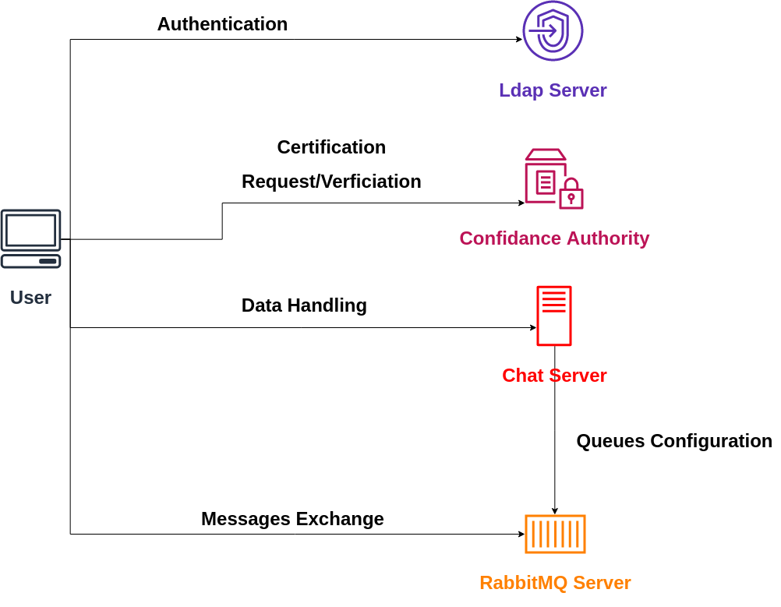
Architecture

Slide 4
Scenarios
Client side :
. Register -> Enter credentials (first time)
. Login / block authentication (redirect)
. View all active users
. Select user-> chat area opened / Select room
. Using RSA technique to encrypt/decrypt all messages sent between clients.
. See message date & time
. Disconnect && quit application

Slide 5
Server side
Register user :
. Add new user to the active directory via LDAP
. Create PKI -> get a x509 certificaton via authority server
. Start communication with the chat/Rabbitmq server
Login user :
. Enter credentials -> verify user in the active directory via LDAP
. Verify the signature via authority server
Chatting :
. Encrypt /decrypt messages while exchanging them between clients

Slide 6
Tools
- RabbitMq : Messaging Broker based on AMQP protocol
- pycryptodome : well-documented python library for encryption/decryption
- OpenSSL : a python package that provides a high-level interface to the functions in the OpenSSL library such as X509 certs generation.
- Tkinter : Standard Python interface to the Tk GUI toolkit.
- cryptography : python library for X509 certs with good API
- OpenLDAP : is an implementation under ubuntu for LDAP protocol
- Pika : Rabbitmq python client

Slide 7
Notes
In this project we learned:
- LDAP server configuration, helping us manage user authentication
- How to set up an authority server that accepts certification requests, creates them, then signs them in order to verify their state
- How to use RabbitMQ for chatting, which is a powerful tool

Slide 8
Demo !

