Slide 1


Quantum Optimization for
Access Point Selection
Under Budget Constraint
Mohamed Khalil Brik¹ · Ahmed Shokry² · Moustafa Youssef¹
¹American University in Cairo · ²Pennsylvania State University
IEEE QCNC 2026 · April 6–8, Kobe, Japan

Slide 2
What is Indoor Localization?
📍 You enter a hospital, airport, or warehouse. GPS doesn't work indoors. How does an app know exactly where you are?
PHASE 1 — OFFLINE (Setup)
PHASE 2 — ONLINE (Live Use)
Build the Radio Map
Locate the User
A technician walks through the building with a device
User's phone passively picks up WiFi signals from nearby APs
→
At each known location, the device records WiFi signal strengths (RSS) from every nearby access point
The live signal pattern is compared to the fingerprint database
These readings are stored as a fingerprint database: location → signal pattern
The best-matching location in the database is returned as the estimated position
Think of it as teaching the system what every spot 'sounds like' in radio waves
No special hardware needed, just existing WiFi infrastructure

Slide 3
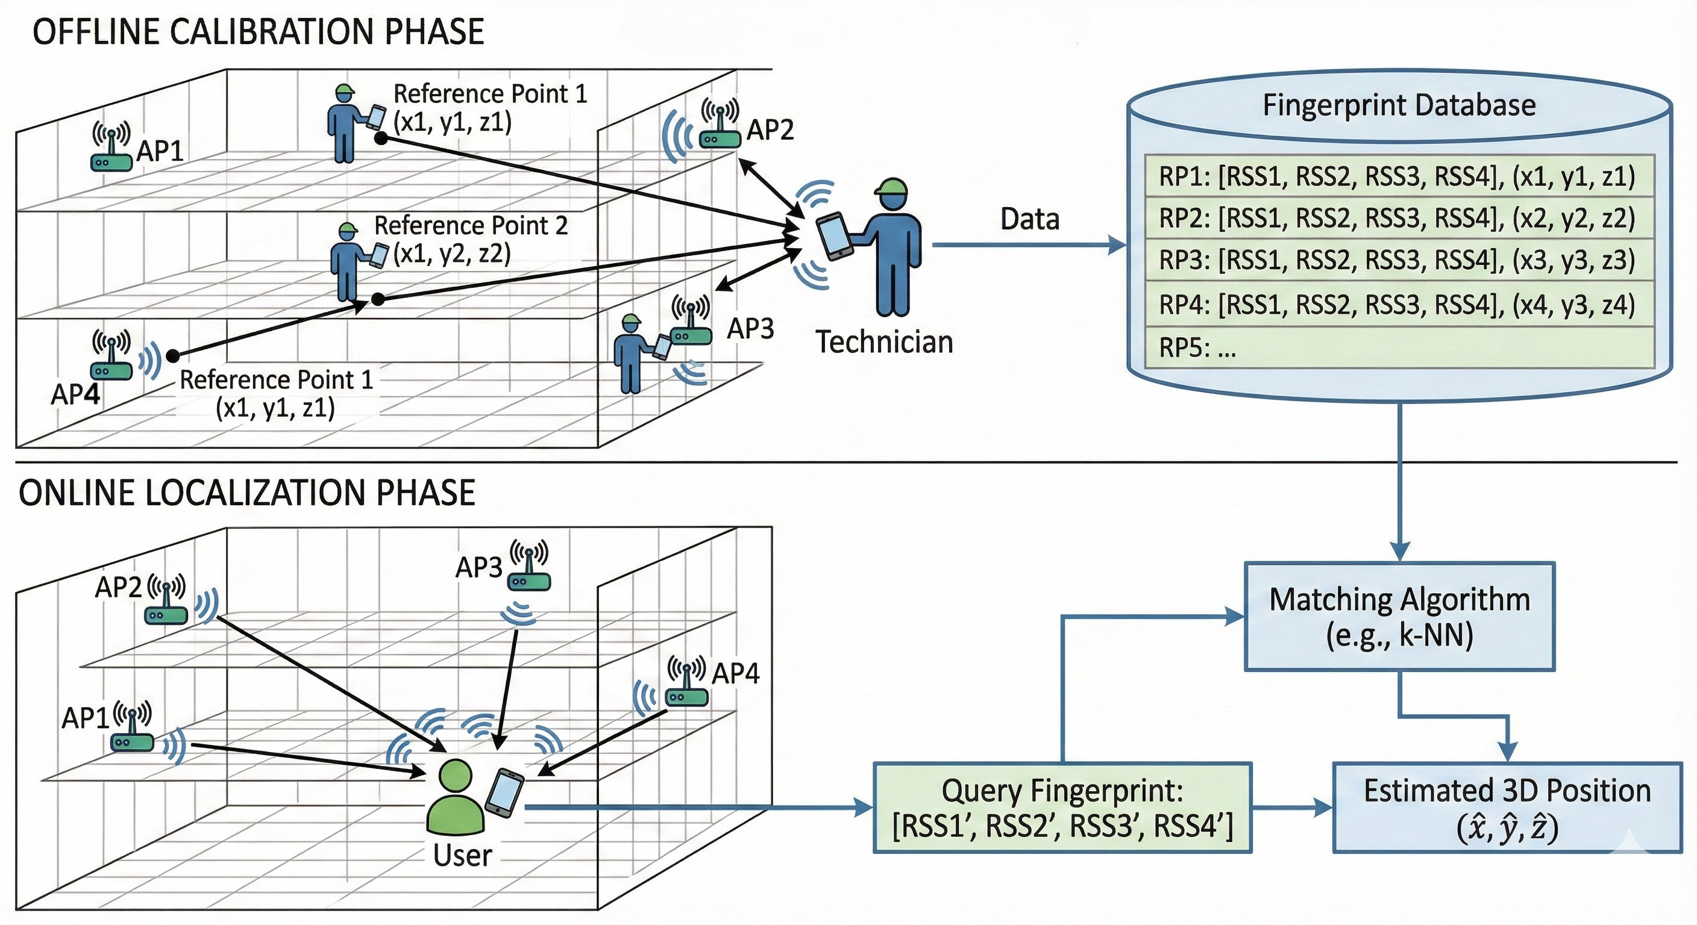

Slide 4
The Access Point Selection Problem
A modern building has hundreds of WiFi access points (APs). Using all of them is expensive and creates noise. Which APs should you keep?
Too Many APs → Problems
Classical Selection is Slow
Our Quantum Solution
Redundant signals inflate database size
Optimal subset = NP-hard combinatorial problem
Formulate as QUBO, solved by quantum annealing
Matching is slower with more APs
Greedy/PCA methods don't scale to 500+ APs
Maximize AP importance (signal discrimination)
Noisy APs hurt localization accuracy
Exhaustive search of all combinations is infeasible
Minimize AP redundancy (correlated signals)
High hardware & maintenance cost
No budget guarantee on number of selected APs
Enforce strict budget: select exactly k APs

Slide 5
Motivation: Why Quantum?
01
Scale Problem
02
3D Is Harder
03
Missing Constraint
IoT and smart buildings can have 500+ APs. Classical algorithms that try every combination of APs grow exponentially. They simply cannot scale to global deployments.
Most prior work handles 2D floor plans. Real applications need 3D: latitude, longitude, and floor. Adding the vertical dimension multiplies the search complexity further.
Existing quantum AP selection methods select APs freely. They may pick 200 when you can only deploy 20. A strict hardware budget constraint is essential for real deployment.

Slide 6
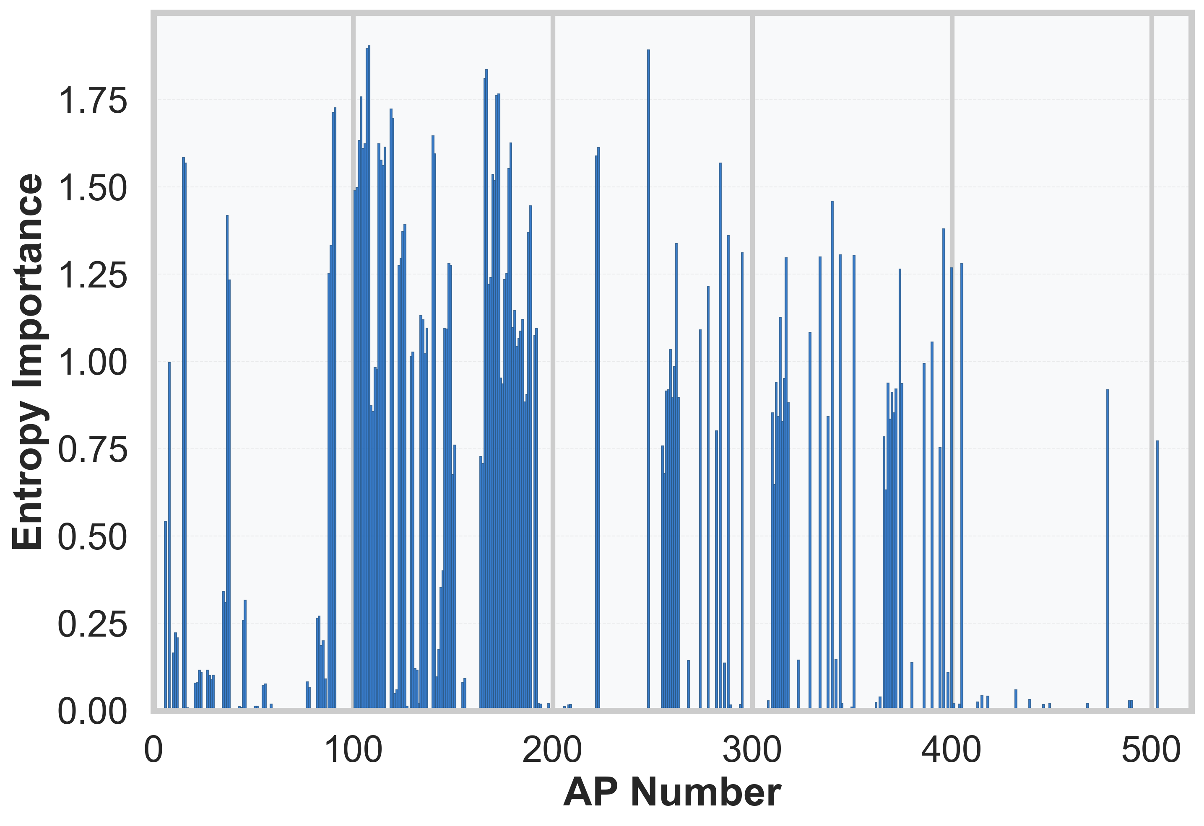
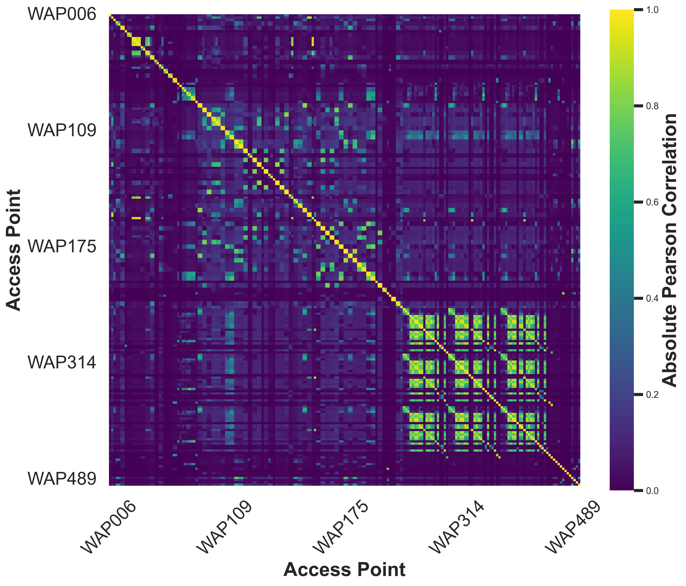
Background: Quantum Annealing & QUBO
Quantum Annealing
Superposition
Explores many candidate solutions simultaneously, not one at a time like classical methods
Importance Metric
Tunneling
Can 'tunnel' through energy barriers, escaping local minima that trap classical optimizers
QUBO
Maps optimization problems onto a mathematical form solvable by quantum hardware
OpenJij / D-Wave
Redundancy Metric
Quantum annealing simulator and hardware used to solve our AP selection problem

Slide 7
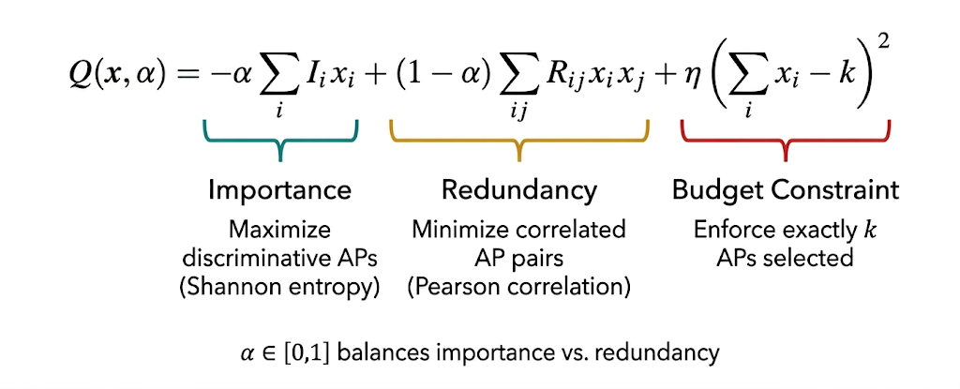
QUBO Formulation

Slide 8
Experimental Setup
Dataset
Access Points
UJIIndoorLoc
520 APs
5-floor building · ~110 m² per floor · publicly available
Building APs + neighboring overheard APs
Fingerprints
Quantum Solver
21,048 samples
OpenJij
3D labels: latitude, longitude, floor (z = 3.0 m per floor)
1,000 reads · 1,000 sweeps · Monte Carlo quantum simulation
Classical Baseline
Localization Model
Simulated Annealing
Random Forest
Intel Core i7-12700H @ 2.30 GHz · 16 GB RAM · Windows 11
Floor classification & 3D position estimation

Slide 9
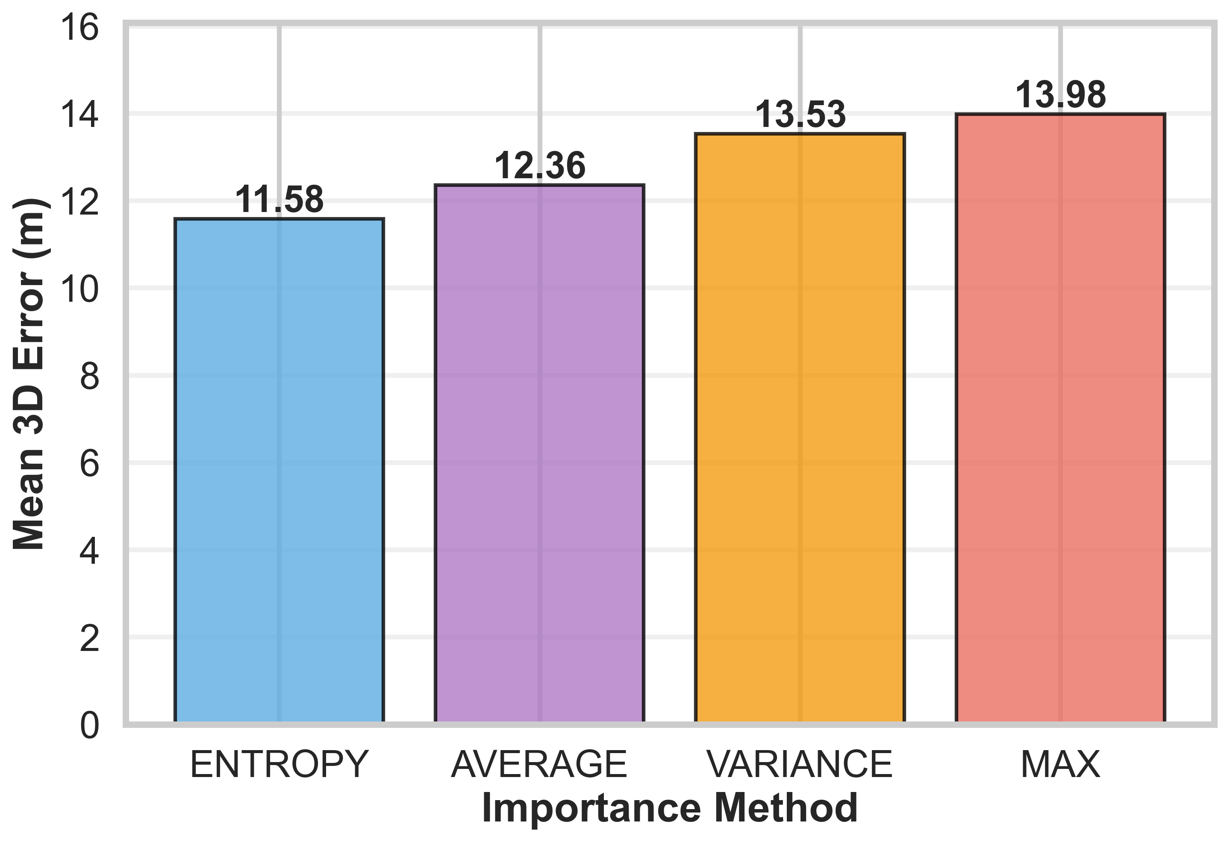
Importance Metric Comparison
Mean 3D Localization Error (m) — Lower is Better
✓ Entropy best captures location-discriminative signal variation. Shannon entropy measures RSS diversity across all fingerprint locations, directly aligned with what fingerprinting needs.

Slide 10
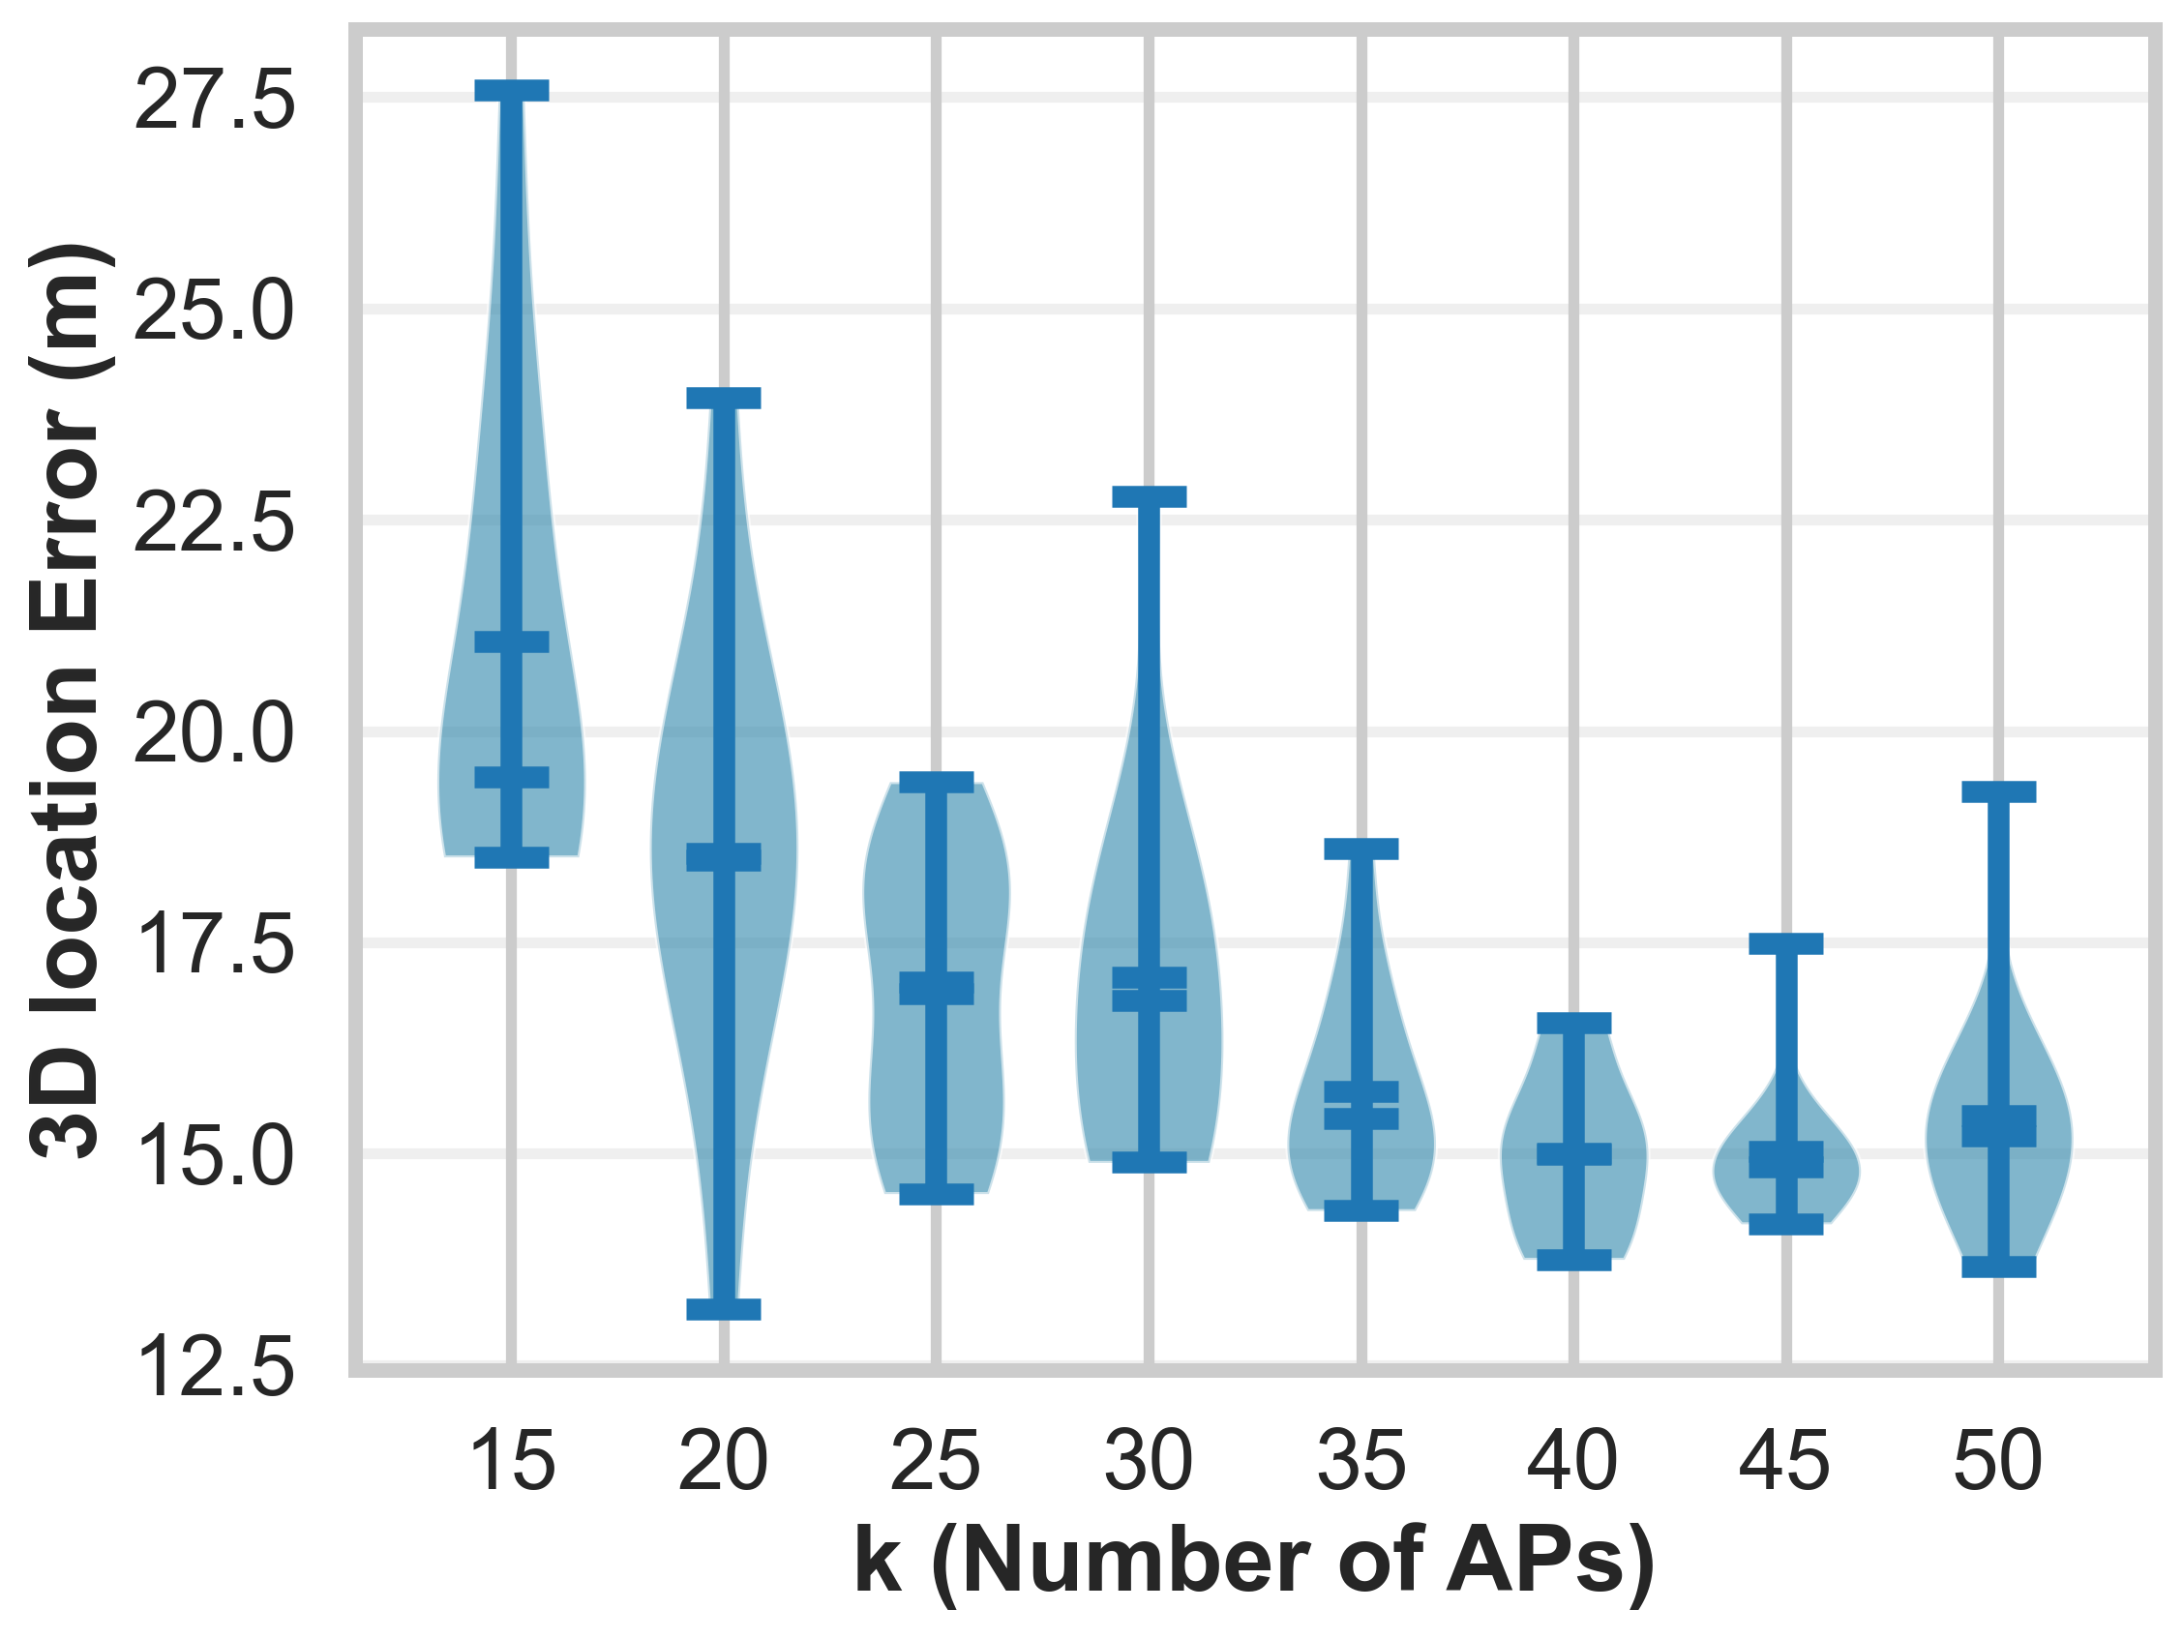
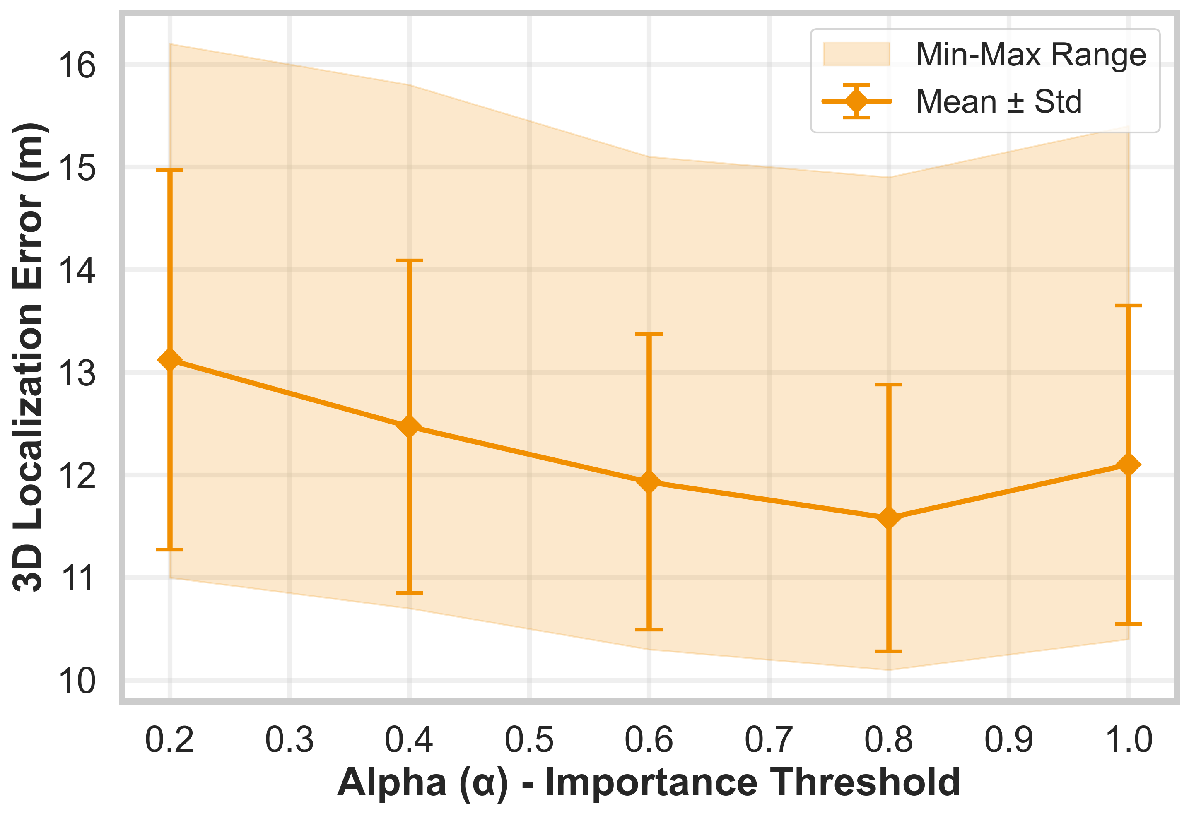
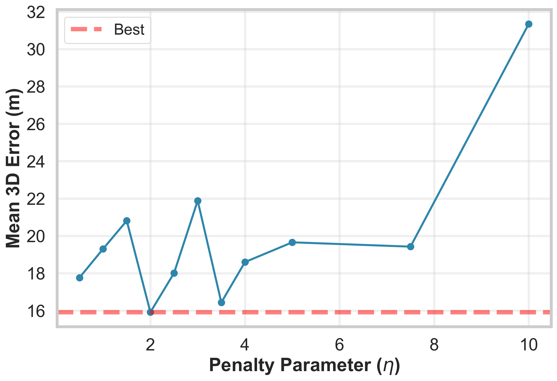
QUBO Hyperparameter Analysis
Balancing Parameter α
Penalty Coefficient η
AP Budget k
Default: α = 0.8
Default: η = 2.0
Default: k = 20
Importance-dominant weighting is more effective than redundancy-dominant in 3D fingerprinting.
Large η traps the annealer in local minima before reaching the target k — accuracy collapses.
96.1% AP reduction (520 → 20) with comparable 3D localization accuracy vs. using all APs.

Slide 11
Results: Quantum vs. Classical
96.1%
61×
18.2%
0.20 s
AP Reduction
(520 → 20 APs)
Speedup over
Simulated Annealing
Mean 3D Error
Reduction vs. SA
Time-to-Solution
(Quantum)
Performance Comparison
Method
APs Used
Mean 3D Error
Floor Accuracy
Time (s)
All APs
520
12.4 m
70.4%
—
Simulated Annealing
520
14.3 m
58.6%
12.28 s
Quantum Annealing ★
20
11.7 m
73.0%
0.20 s
★ Quantum annealing achieves best accuracy AND fastest runtime with fewest APs

Slide 12
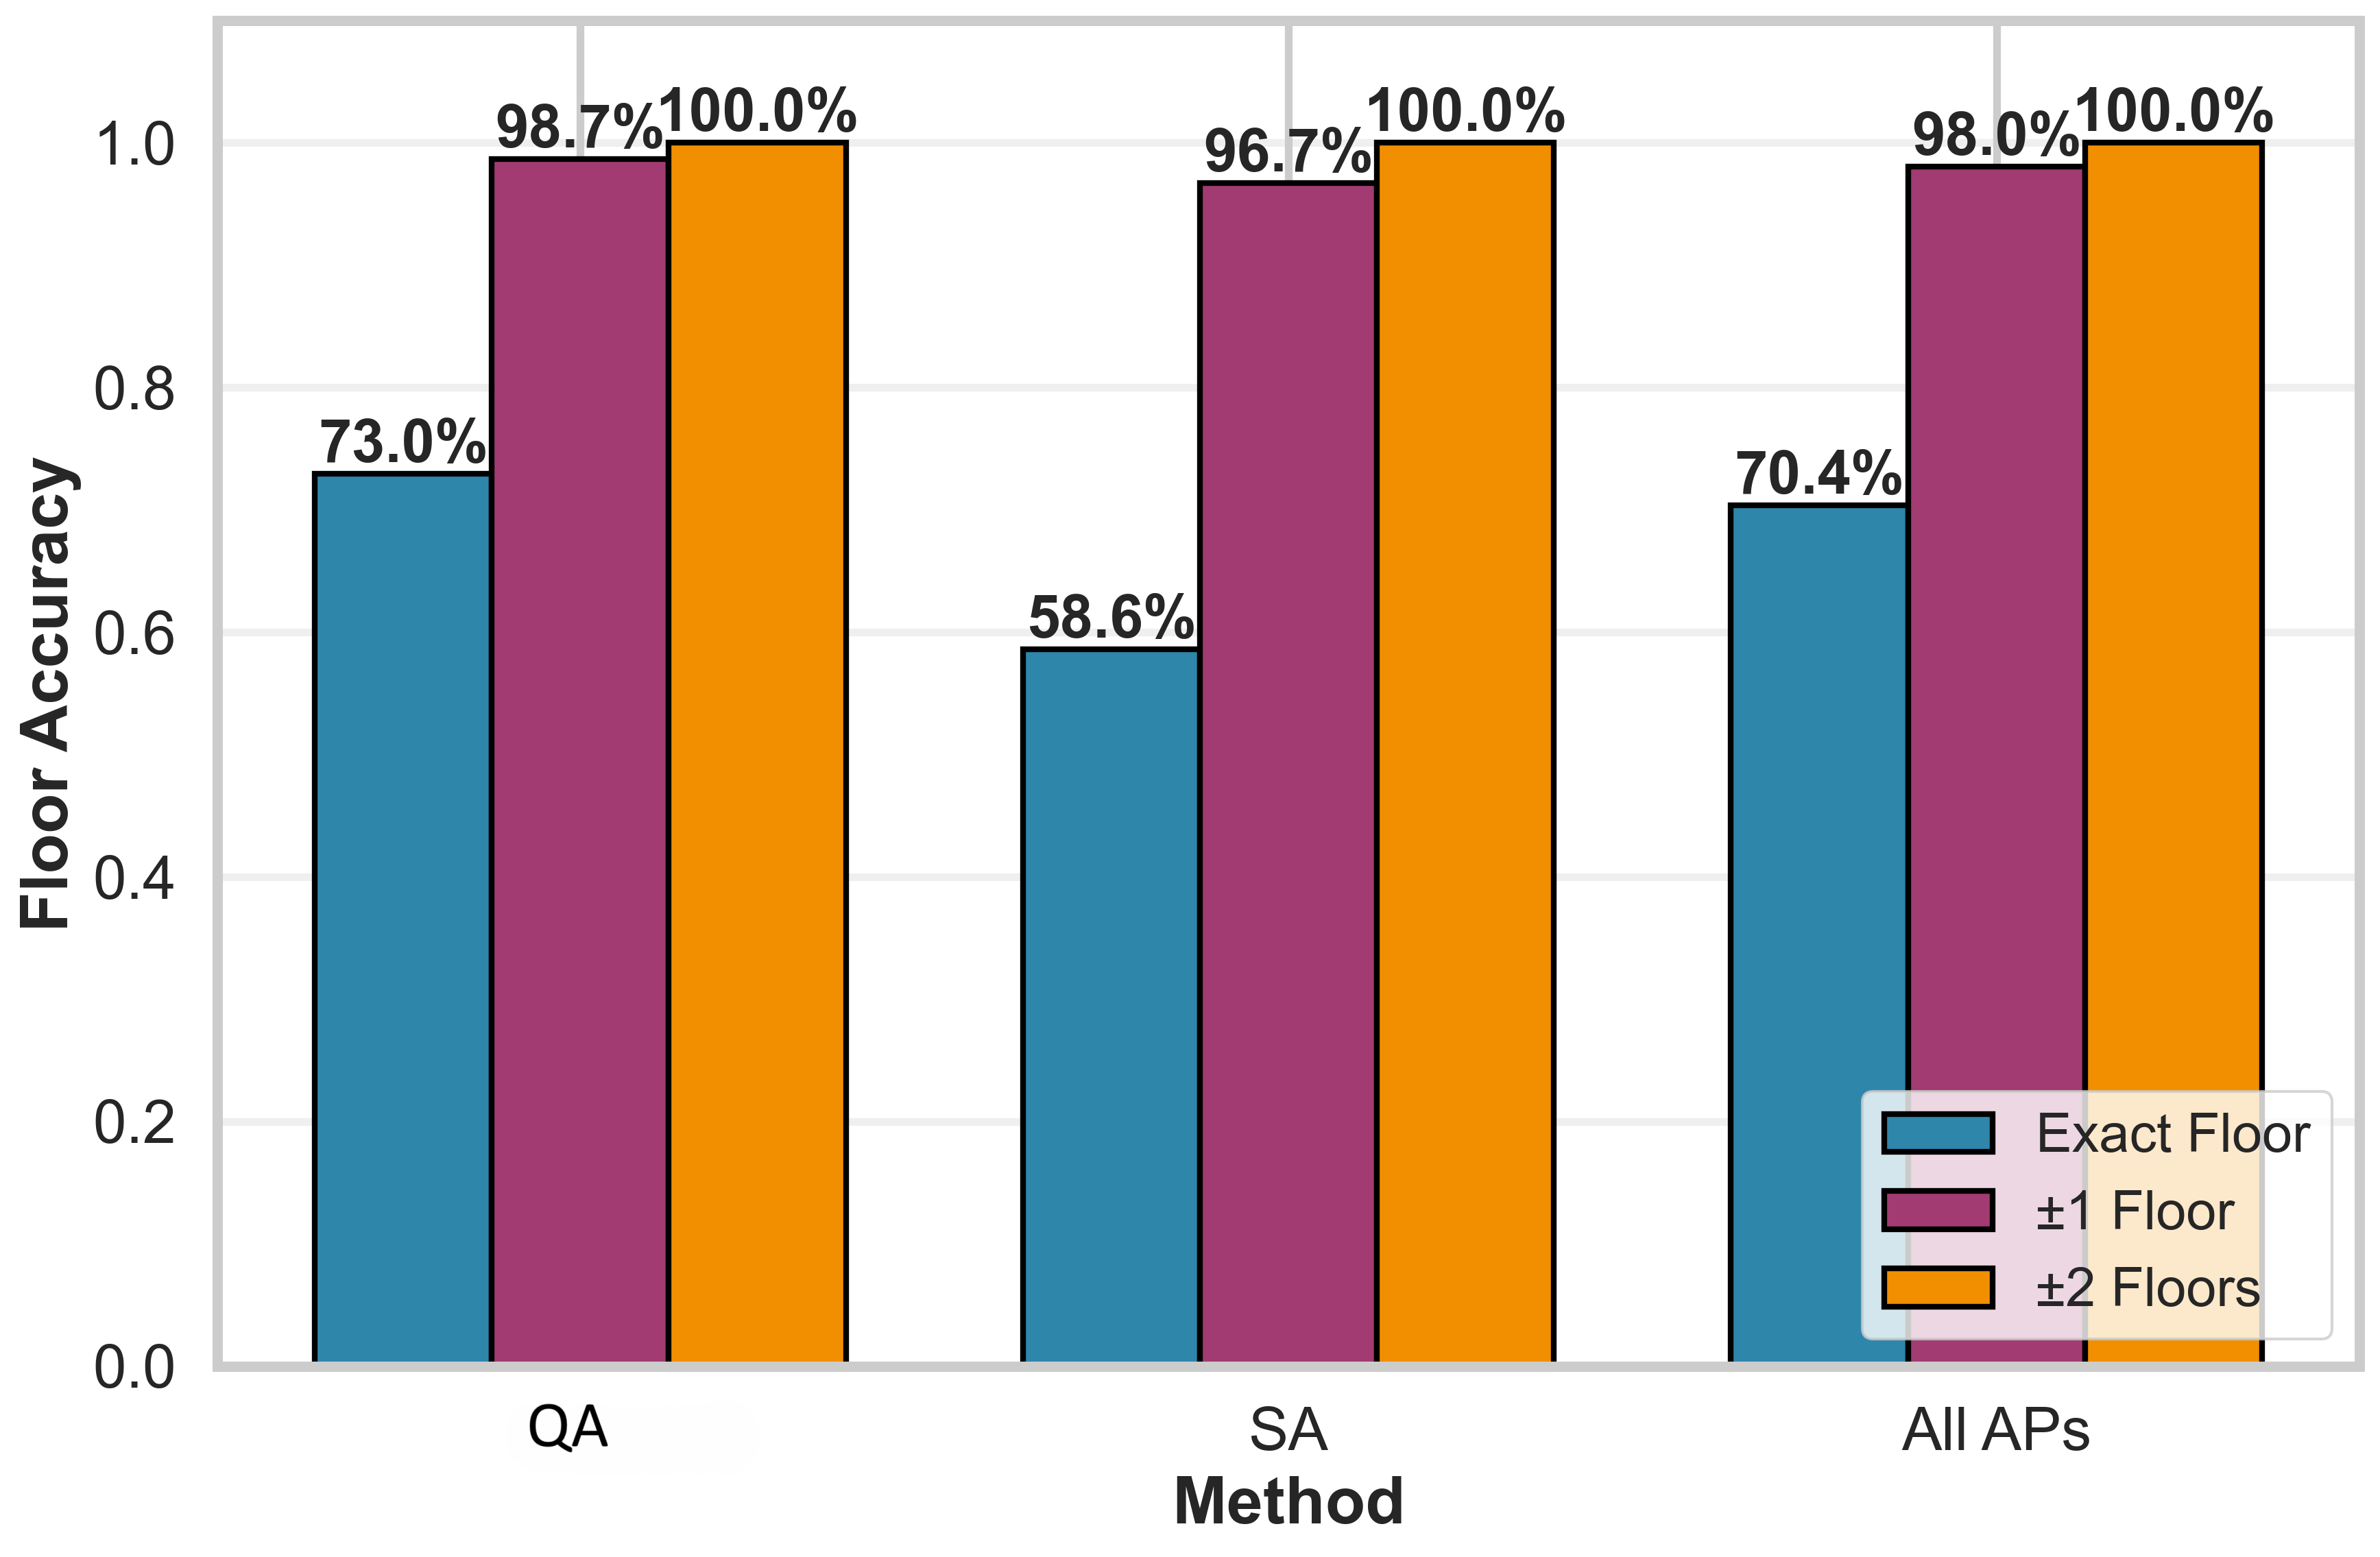
Floor Localization Accuracy
Floor Classification Accuracy (%)
Why QA
beats
All APs?
Removes
noisy APs
Minimizes
redundancy
Entropy-
guided
Quantum
tunneling

Slide 13
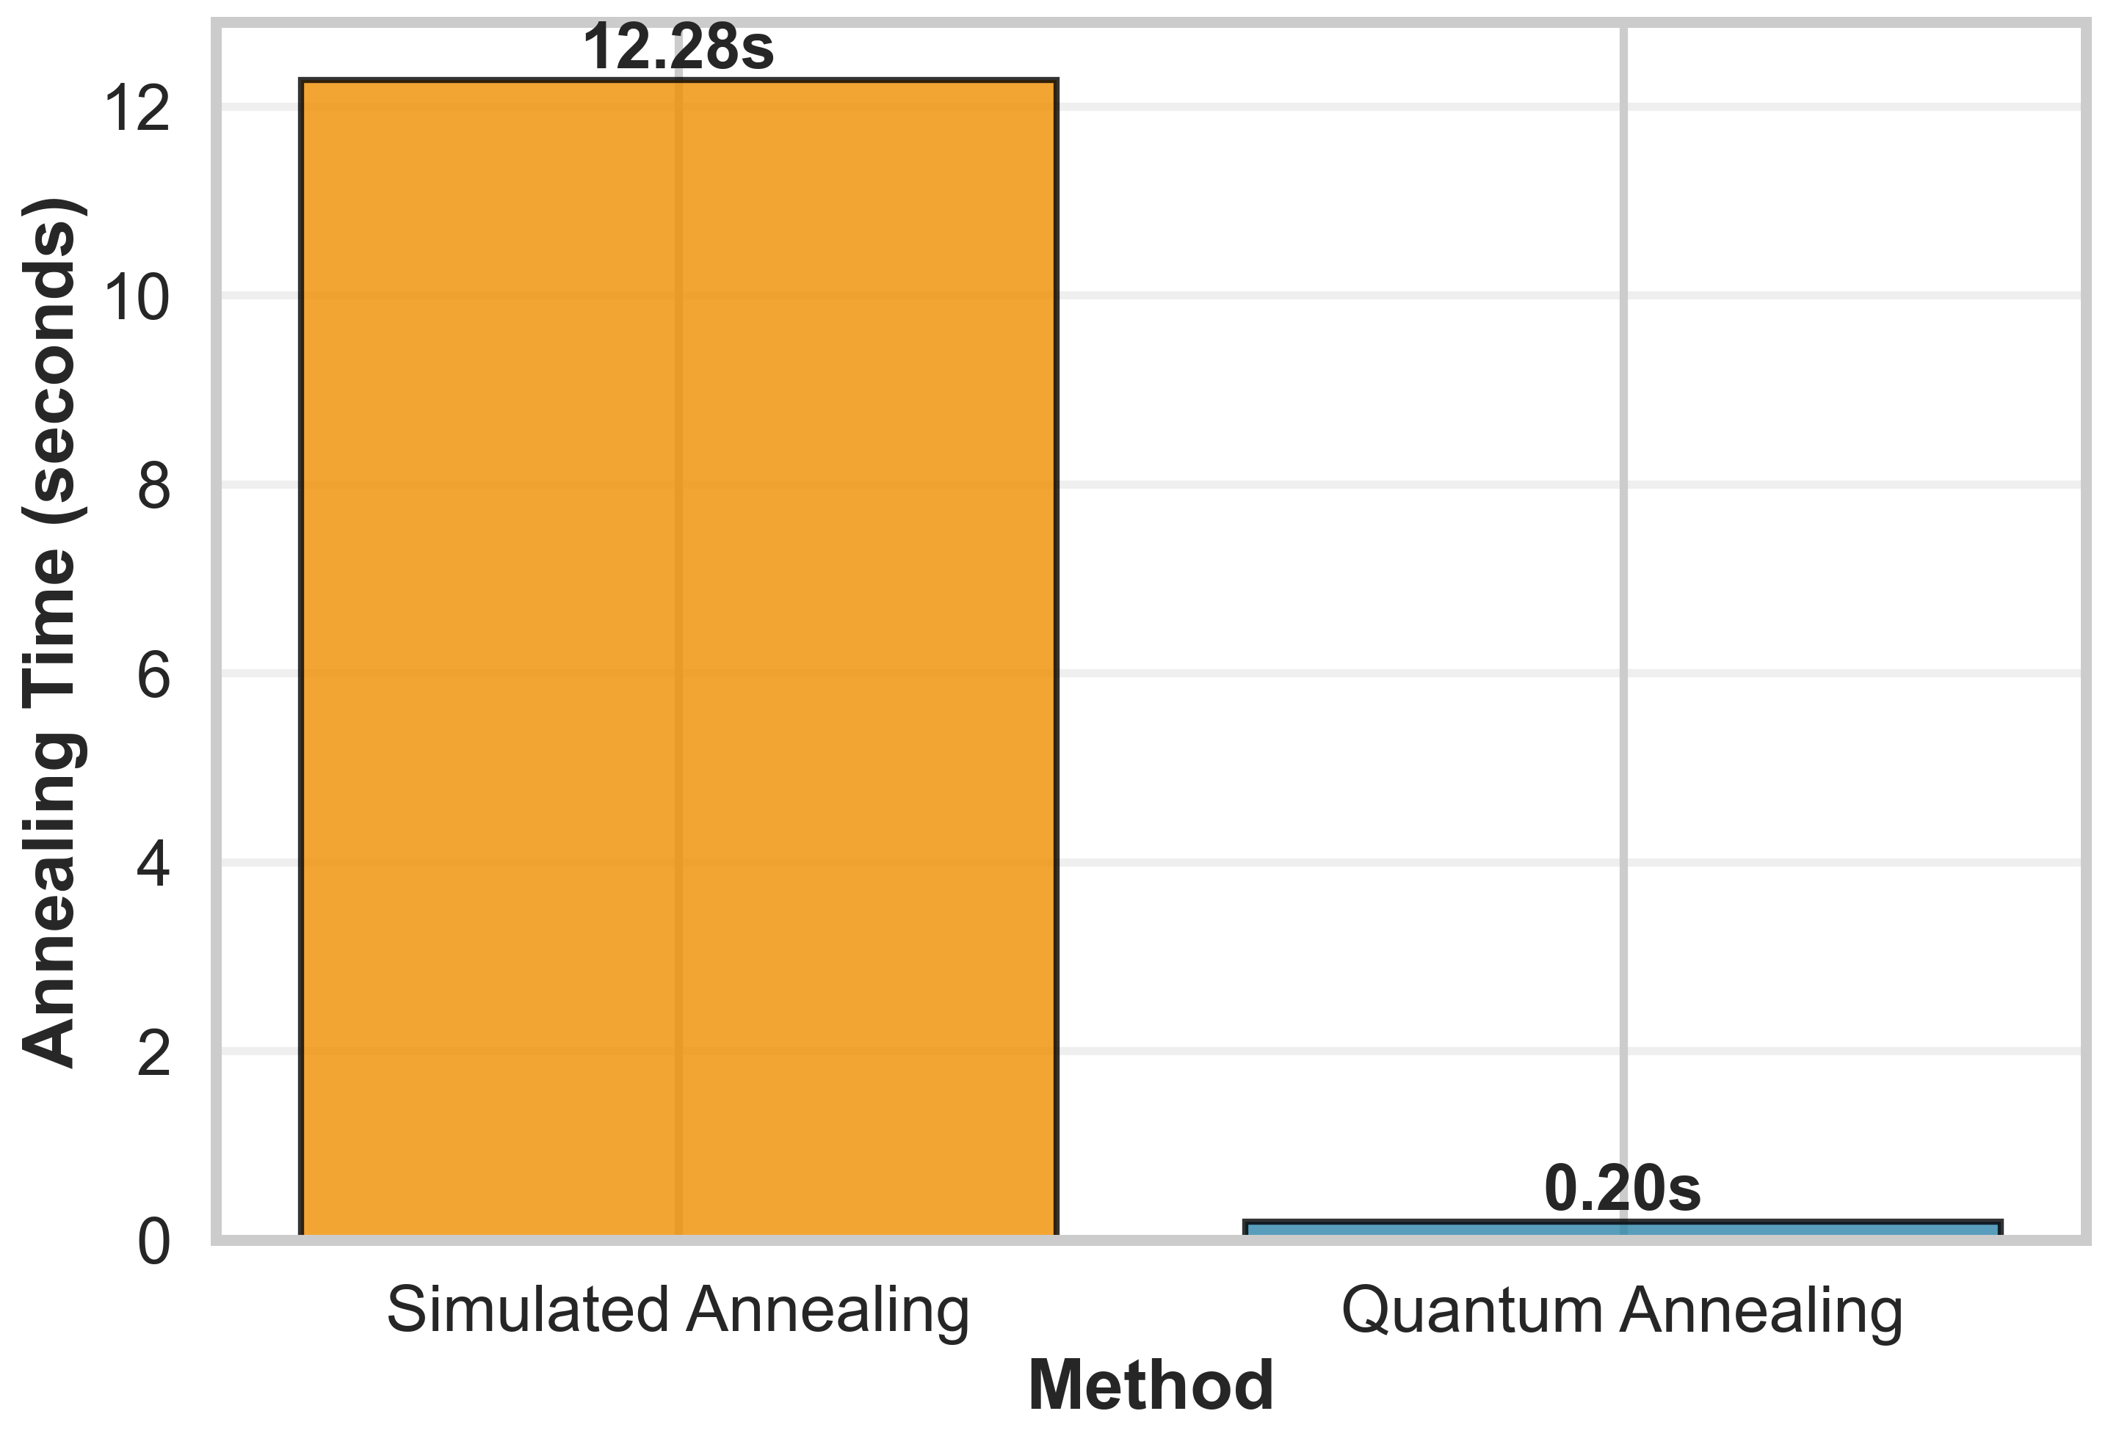
Computational Speedup
Annealing Time Comparison
61×
Quantum Annealing achieves a 61× speedup over classical Simulated Annealing same QUBO problem, same budget constraint

Slide 14
Conclusion
First QUBO formulation with a strict AP budget constraint for 3D indoor localization
96.1% reduction in required APs (520 → 20) with negligible accuracy loss
73% floor accuracy — outperforming classical SA (58.6%) and all-AP baseline (70.4%)
61× speedup: 0.20 s vs 12.28 s for simulated annealing
Entropy-based importance metric identified as optimal for fingerprinting workloads
Future Work: Real D-Wave hardware deployment · Multi-building 3D scaling · Journal fast-track (Digital Communications & Networks)

Slide 15
Thank You
Questions & Discussion
Mohamed Khalil Brik
mohamedkhalil.brik@aucegypt.edu
American University in Cairo · Computer Science & Engineering
Website: khalilbriktn.github.io/personal-website/
IEEE QCNC 2026 · Kobe, Japan · April 6–8, 2026

