Slide 1


Quantum Optimization for
Access Point Selection
Under Budget Constraint
Mohamed Khalil Brik¹ · Ahmed Shokry² · Moustafa Youssef¹
¹American University in Cairo · ²Pennsylvania State University
IEEE QCNC 2026 · April 6–8, Kobe, Japan

Slide 2
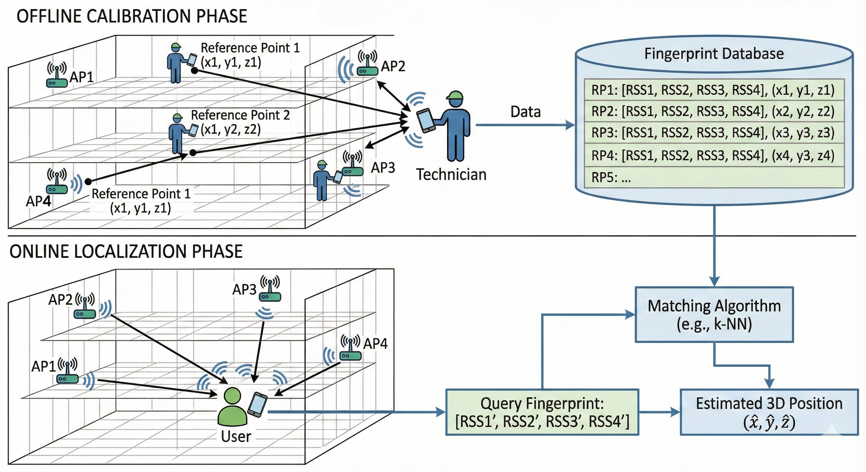
What is Indoor Localization?
📍 You enter a hospital, airport, or warehouse. GPS doesn't work indoors. How does an app know exactly where you are?

Slide 3
The Access Point Selection Problem
A modern building has hundreds of WiFi access points (APs). Using all of them is expensive and creates noise. Which APs should you keep?
Too Many APs → Problems
Classical Selection is Slow
Our Quantum Solution
Redundant signals inflate database size
Optimal subset = NP-hard combinatorial problem
Formulate as QUBO, solved by quantum annealing
Matching is slower with more APs
Greedy/PCA methods don't scale to 500+ APs
Maximize AP importance (signal discrimination)
Noisy APs hurt localization accuracy
Exhaustive search of all combinations is infeasible
Minimize AP redundancy (correlated signals)
High hardware & maintenance cost
No budget guarantee on number of selected APs
Enforce strict budget: select exactly k APs

Slide 4
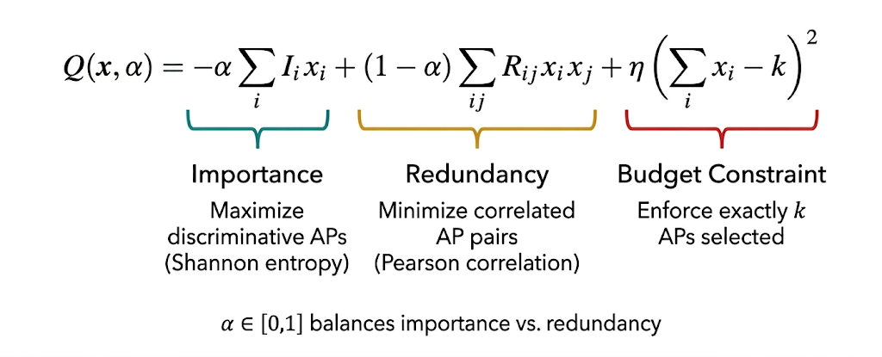
QUBO Formulation

Slide 5
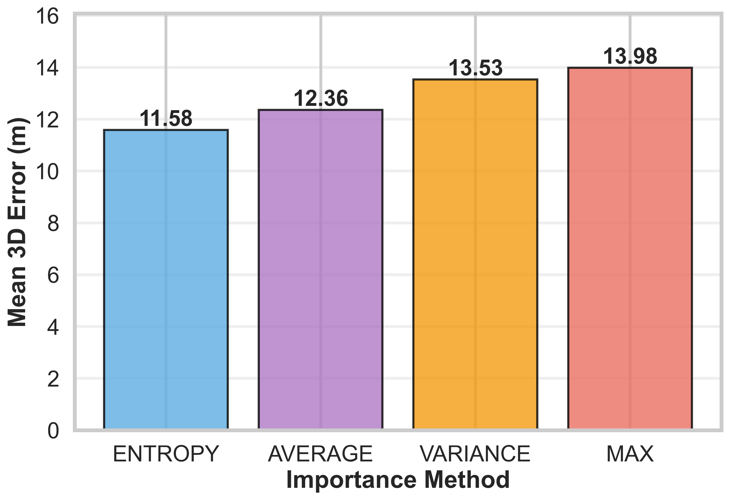
Importance Metric Comparison
Mean 3D Localization Error (m) — Lower is Better
✓ Entropy best captures location-discriminative signal variation. Shannon entropy measures RSS diversity across all fingerprint locations, directly aligned with what fingerprinting needs.

Slide 6
Results: Quantum vs. Classical
96.1%
61×
18.2%
0.20 s
AP Reduction
(520 → 20 APs)
Speedup over
Simulated Annealing
Mean 3D Error
Reduction vs. SA
Time-to-Solution
(Quantum)
Performance Comparison
Method
APs Used
Mean 3D Error
Floor Accuracy
Time (s)
All APs
520
12.4 m
70.4%
—
Simulated Annealing
520
14.3 m
58.6%
12.28 s
Quantum Annealing ★
20
11.7 m
73.0%
0.20 s
★ Quantum annealing achieves best accuracy AND fastest runtime with fewest APs

Slide 7
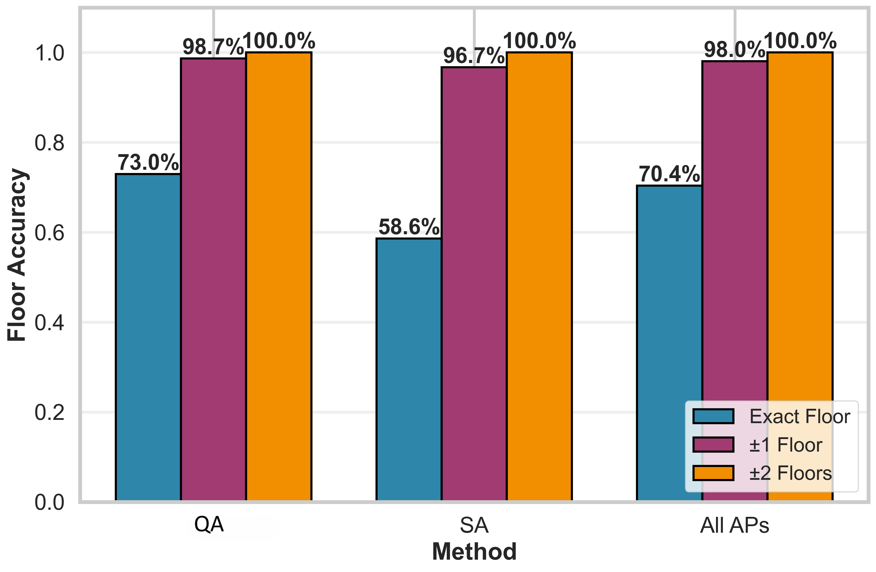
Floor Localization Accuracy
Floor Classification Accuracy (%)
Why QA
beats
All APs?
Removes
noisy APs
Minimizes
redundancy
Entropy-
guided
Quantum
tunneling

Slide 8
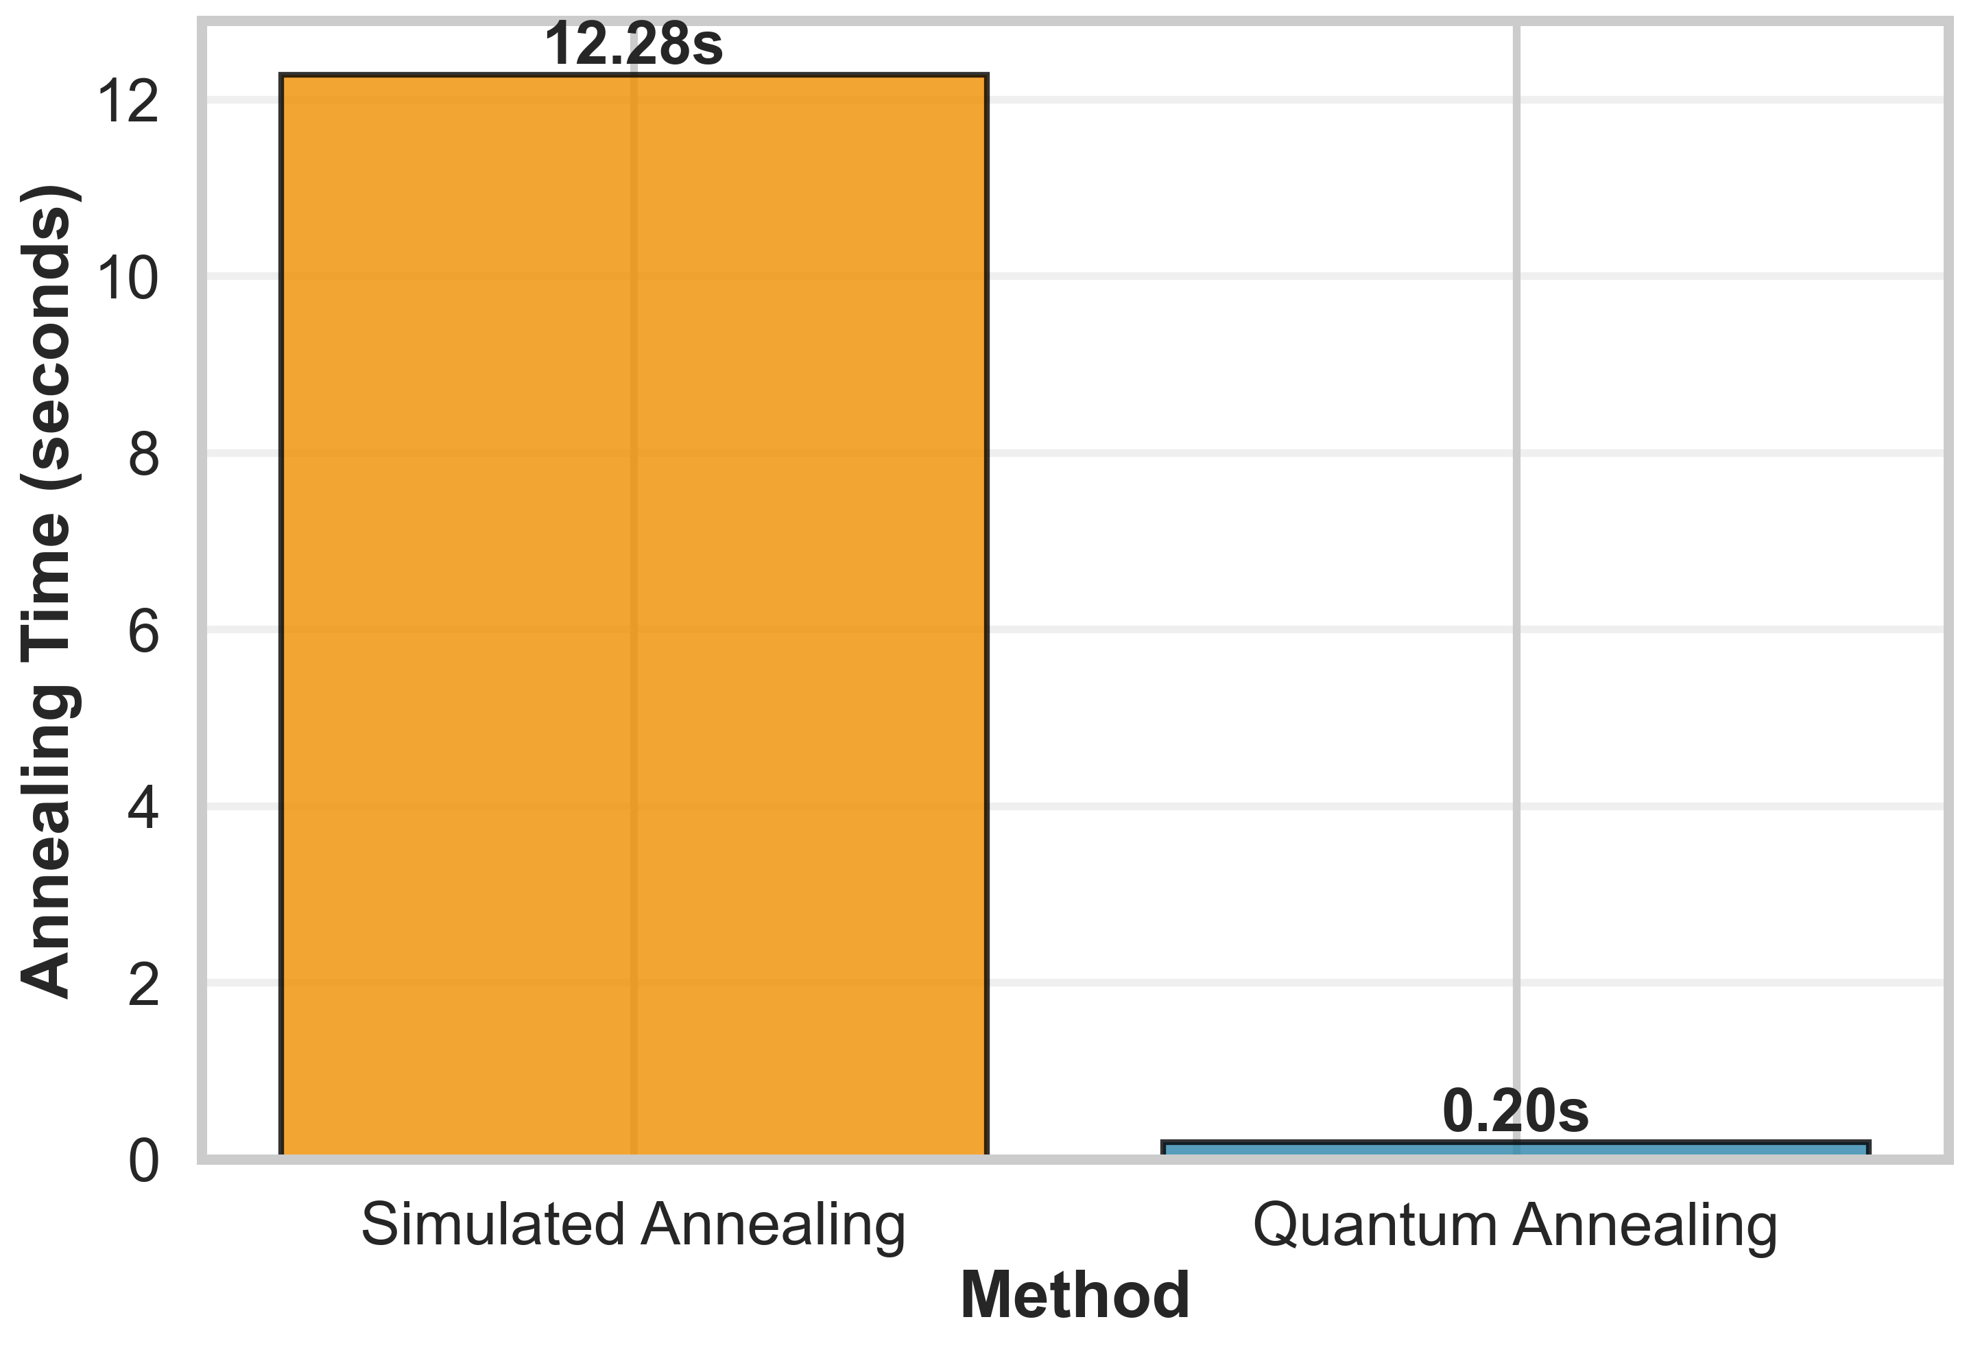
Computational Speedup
Annealing Time Comparison
61×
Quantum Annealing achieves a 61× speedup over classical Simulated Annealing same QUBO problem, same budget constraint

Slide 9
Conclusion
First QUBO formulation with a strict AP budget constraint for 3D indoor localization
96.1% reduction in required APs (520 → 20) with negligible accuracy loss
73% floor accuracy — outperforming classical SA (58.6%) and all-AP baseline (70.4%)
61× speedup: 0.20 s vs 12.28 s for simulated annealing
Entropy-based importance metric identified as optimal for fingerprinting workloads
Future Work: Real D-Wave hardware deployment · Multi-building 3D scaling · Journal fast-track (Digital Communications & Networks)

Slide 10
Thank You
Questions & Discussion
Mohamed Khalil Brik
mohamedkhalil.brik@aucegypt.edu
American University in Cairo · Computer Science & Engineering
Website: khalilbriktn.github.io/personal-website/
IEEE QCNC 2026 · Kobe, Japan · April 6–8, 2026

