Slide 1
FAVORITE MOVIE

Slide 2
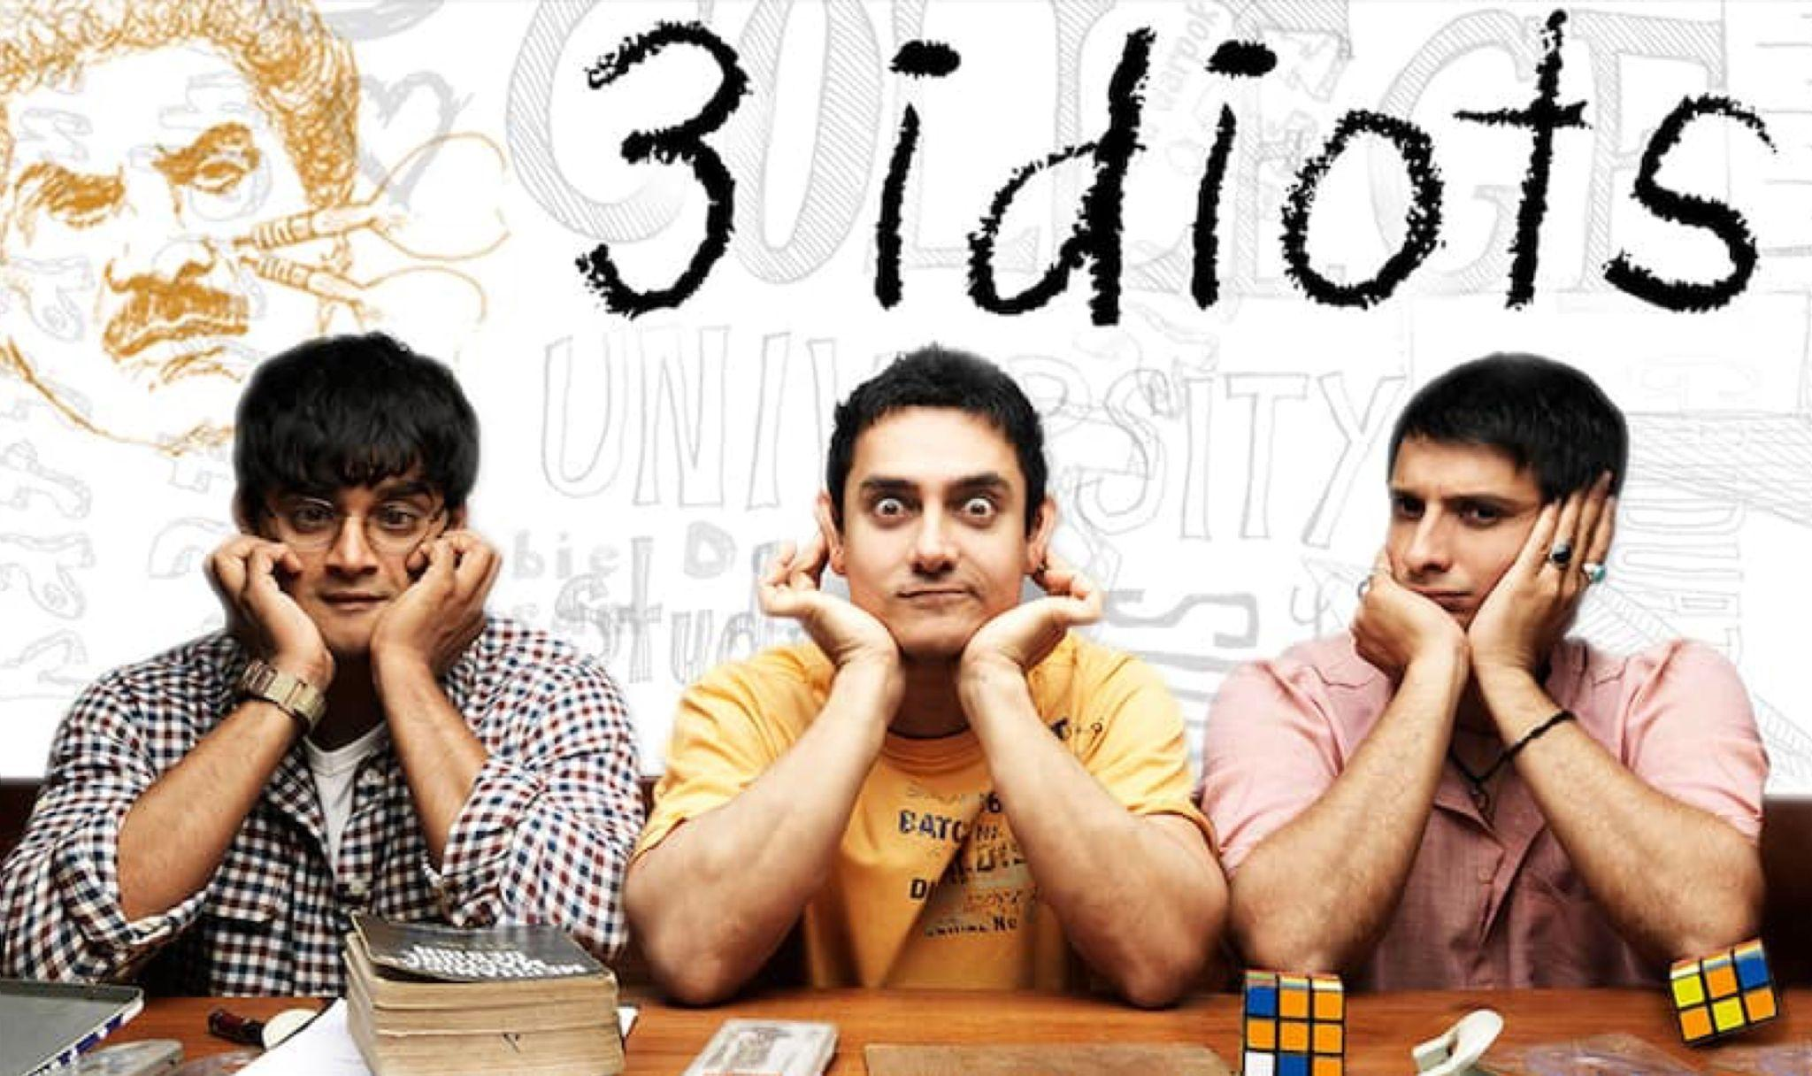

Slide 3
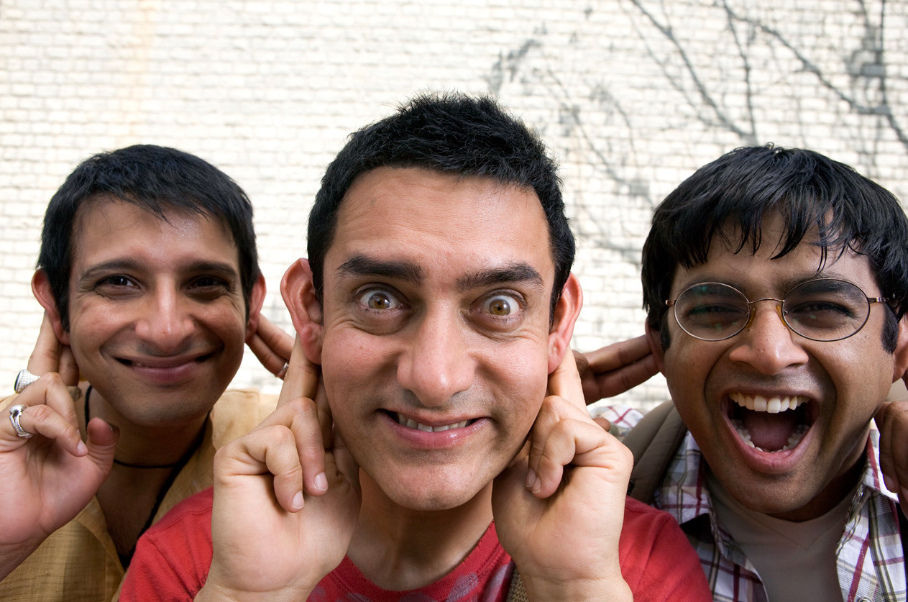
Why We love 3 idiots?
Best Motivation movie ever.
Helps to take decisions.
Helps to be passionate.
Teaches to enjoy life.
Teaches to respect the teachers.

Slide 4
Best Plots Of This Movie
If you love your work you can do it easily.

Slide 5
Best Plots Of This Movie
Expressing what comes to your decision for life

Slide 6
Best Plots Of This Movie
For Education No Need Any Time, Age, Name

