Slide 1
Building Web Components
Polymer

Slide 2
What are Web Components about?
Building wEb components
http://w3c.github.io/webcomponents/explainer/
Templates
Custom Elements
Shadow DOM
HTML Imports
These are individual pieces but together forms the term Web Component
Set of Drafts, some details are still changing, but polyfill is available
Finally we can build components which are
Reusable
Implements real encapsulation (page won’t break our component and vica versa)

Slide 3
Templates
Building wEb components
Part of HTML5
http://www.whatwg.org/specs/web-apps/current-work/multipage/scripting-1.html#the-template-element
The content of the template tag is not rendered by the browser:
It will not initiate requests to fetch images
Will not execute JS code inside it
<template id=’commentTemplate’> <div> <img src=""> <div class="comment-text"></div> </div> </template>
But it’s content still can be accessed and reused:
document.querySelector(’#commentTemplate’).content.cloneNode(true)
http://www.html5rocks.com/en/tutorials/webcomponents/template/

Slide 4
Custom Elements
Building wEb components
http://w3c.github.io/webcomponents/spec/custom/index.html
We have control on API, including elements prototype:
var p = Object.create(HTMLButtonElement.prototype); var FancyButton = document.registerElement('fancy-button', {extends: 'button', prototype: p});
Its name should contain a hyphen
Turn to semantic rules to choose parent our element will be upgraded to
Lifecycle callbacks:
createdCallback,attachedCallback, detachedCallback
attributeChangedCallback
<button is="fancy-button"></button>
<tick-tock-clock></tick-tock-clock>
http://www.html5rocks.com/en/tutorials/webcomponents/customelements/

Slide 5
Shadow DOM
Building wEb components
http://w3c.github.io/webcomponents/spec/shadow/index.html
Hidden, isolated subtree of nodes
element.createShadowRoot()
Its root is the Shadow Host
The subtree is called Shadow Tree
Which is surrounded by the Shadow Boundary
Once an element has Shadow DOM, that will be rendered instead of its children elements.
Unless we are using Insertion Points
Reprojection via content tag, select attribute
http://www.html5rocks.com/en/tutorials/webcomponents/shadowdom/

Slide 6
HTML Imports
Building wEb components
http://w3c.github.io/webcomponents/spec/imports/index.html
CORS compatible way of loading html documents for further use by scripts
<link rel="import" href="goodies.html">
var link = document.querySelector('link[rel=import]'), importedContent = link.import, pulse = importedContent.querySelector('div.pulse');
It blocks parsing the host document unless marked async
To protect against XSS, it’s compatible with Content Security Policy
http://w3c.github.io/webappsec/specs/content-security-policy/csp-specification.dev.html
http://www.html5rocks.com/en/tutorials/security/content-security-policy/
http://www.html5rocks.com/en/tutorials/webcomponents/imports/

Slide 7
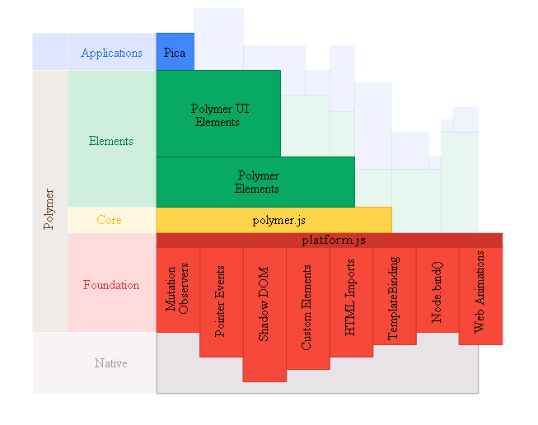
Polymer project
Building wEb components
http://www.polymer-project.org/
http://www.polymer-project.org/images/architecture-diagram.svg

Slide 8
Polymer project
Building wEb components
http://www.html5rocks.com/en/tutorials/webcomponents/yeoman/
Polyfills for web standards inside platform.js
Can be used independently
Some of the parts are not standardised yet
Polymer.js the framework itself
Combines the parts of the platform to make the work convenient and easy
Some elements which are optional to use
A few core elements, from Polymer Lab:Polymer Elements, Polymer UI Elements for widgets
Vulcanize http://www.polymer-project.org/articles/concatenating-web-components.html
Component gallery site just for pick up some widget you need: http://customelements.io/

Slide 9
Polymer project
Building wEb components
How to get it?
Install by yeoman (preferred)
Install by bower
Clone the git repository
http://www.html5rocks.com/en/tutorials/webcomponents/yeoman/
npm install -g yo
npm install generator-polymer –g
yo polymer
yo polymer:element post

Slide 10
Create an element
Building wEb components
<polymer-element name="post-element"> <template> <style> @host { :scope {display: block;} } </style> <span>I'm <b>post-element</b>. This is my Shadow DOM.</span> </template> <script> Polymer('post-element', { ready: function() {} }); </script> </polymer-element>
<link rel="import" href="post.html">
<post-element></post-element>

Slide 11
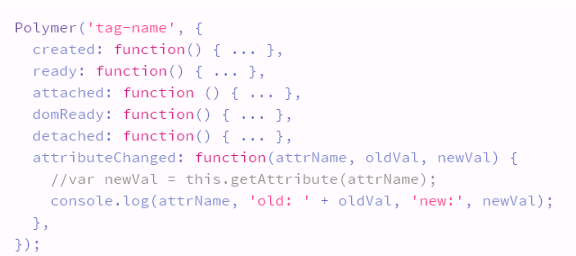
Common methods on elements
Building wEb components
http://www.polymer-project.org/docs/polymer/polymer.html#lifecyclemethods
Event handler methods bound declaratively
http://www.polymer-project.org/docs/polymer/polymer.html#declarative-event-mapping
Changed watchers on published properties:
http://www.polymer-project.org/docs/polymer/polymer.html#change-watchers

Slide 12
Key features
Building wEb components
Published properties
Declarative event mapping
Changed watchers
Custom property observers
Automatic node finding
Custom events
Extending other elements

Slide 13
Styling elements
Building wEb components
http://www.polymer-project.org/articles/styling-elements.html
http://www.polymer-project.org/docs/polymer/styling.html
Prevent FOUC by using [unresolved] (:unresolved is not reliable yet)
Shadow DOM polyfill cannot be perfect, expect issues but we have tools
e.g. Polyfill-* selectorts
:host, ::content, ::shadow and /deep/

Slide 14
Data binding
Building wEb components
Two way binding between models, MDV
Not part of the standard yet but its ideal for templates
It supports declarative definition
It supports iteration and conditional rendering
It can act as communication channel between tags
It has a powerful expression library

Slide 15
Unit testing
Building wEb components
HTML Suites (https://github.com/Polymer/core-tests)
Strong isolation, the best way of testing the web component itself but its costly
Decoupling the widget from the framework
Test it on its own
Assume the framework works well/write just a few sanity checks on them like its done in core-tests
Tests run much faster, but the integration layer can also introduce bugs which are not catched.
Handle it in functional tests
When running functional tests, validate both native and polyfill platforms too

Slide 16
Examples
Building wEb components
Lets see some code

Slide 17
Summary
Building wEb components
The library evolves on top of the standards
Makes us reusable components
Declarative programming
Provides simple solution to bigger problems (e.g. sandboxing)
Its still just javascript, css and html
Less code for more feature

Slide 18
Web Components, Polymer
Building wEb components
Do you have any questions?

