Slide 1
DATA SCIENCE
PROJECT
Topic: Super Market Inventory
Made By : Avneet Kaur
Roll no. : 2017CSC1044

Slide 2
DATA SET

Slide 3
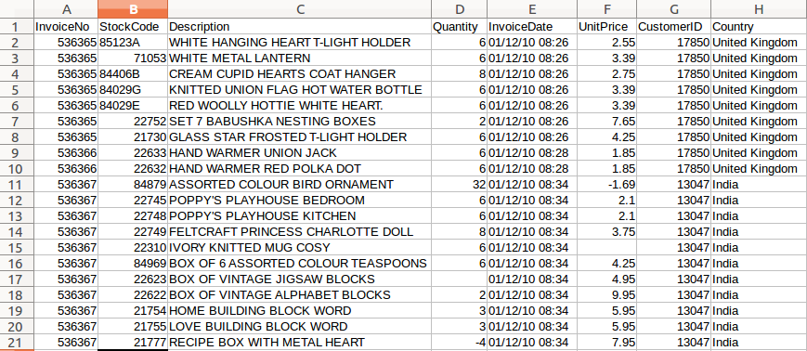
Link of the github repository
https://github.com/khalsaavneet/supermarket
SOURCE: Internet
The Dataset contains a lot of information about the inventory.
The Dataset is read into R using the read.csv() function.
It includes various columns such as Invoice no., Stock Code, Description, Quantity, Invoice Date, Unit Price, Customer ID and Country.
Further we have mutated the two columns two get the other information such as Sales.
Below shows a Sample image of how the data looks like.

Slide 4
Cleansing of Data set
Data cleaning is a data mining technique that involves transforming raw data into an understandable format. Real-world data is often incomplete, inconsistent or lacking in certain behaviors or trends, and is likely to contain many errors. Data preprocessing and cleaning is a proven method of resolving such issues. Data preprocessing prepares raw data for further processing.
During the cleansing process we have filtered the data and removed the values where ever the quantity, stock code, unit price, invoice no have null or negative values using the filter function of the “dplyr” library.

Slide 5
DATA ANALYSIS

Slide 6
1.)Plot of Country vs Sales
Plot of country vs sale (unit price*quantity) gives the total sale in a country accordingly we can set up stores in different countries.
Firstly, we will group the data by country using group by() function so that the total sale of a country is grouped together and gives a customized data for 37 countries.
After seeing the graph we see that the value of sales for United Kingdom is way to large in comparison to other countries, so the graph is very un proportional and hence to show clear figures and a more detailed plot we remove the value of United Kingdom from the data.

Slide 7
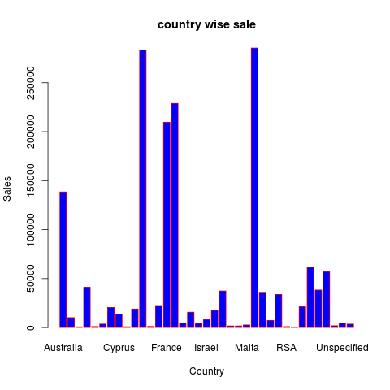
After having a look at the data, we can see that sales for United Kingdom is much more as compared to other countries so excluding it from the graph to get a more detailed plot, we get this graph.

Slide 8
2.)Plot of Stock Code vs Quantity
Plot of stock code vs quantity will give us sale of a product and so we can manage the quantity of products in the inventory.
Firstly, we will group the data by stock code using group by() function so that we get unique stock codes and gives a customized data table for stock code and quantity.
Here the number of stock codes is very large so it is very difficult to infer from the graph, but if we look at a shorter strip of data we get an idea of the graph.

Slide 9
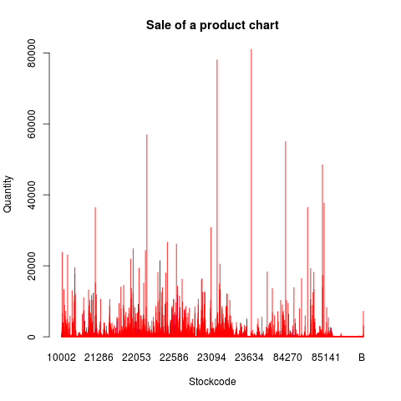
The following graph shows the sale of all the products in the inventory.

Slide 10
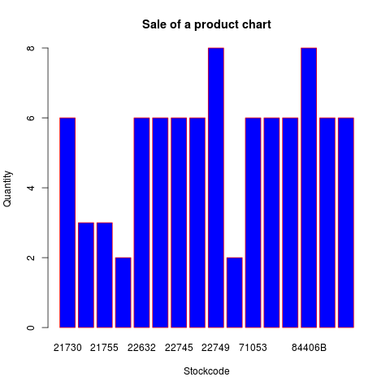
The following graph shows the sale of some selective products in the inventory.

Slide 11
3.)Plot of Customer ID vs Sales
Plot of Customer ID vs Sales gives the total purchase of all customers.
Firstly, we will group the data by Customer ID using group by() function so that we get unique customer ids and gives a customized data table for customer id and sale.
Here the number of Customer ID’s is very large so it is very difficult to infer from the graph, but if we look at a shorter strip of data we get an idea of the graph.

Slide 12
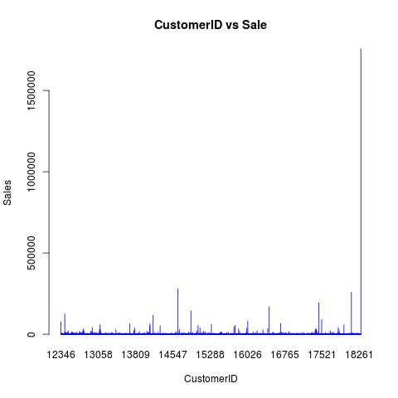
The following graph shows the Customer ID vs Sale for all Customers.

Slide 13
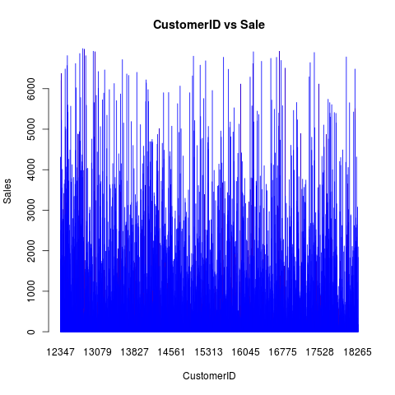
The following graph shows the Customer ID vs Sale for Customers with sales less than 7000 to show a detailed image.

Slide 14
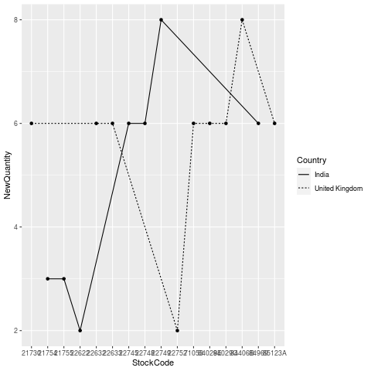
4.)Line chart showing Quantity vs Stock code vs Country
This Line chart shoes Quantity of Stock Codes country wise.
This will give the sale of all products in a country.
Here the number of countries is very large so we have taken in only two of them.

Slide 15
Conclusions &
Future Scope of work
From the graphs and the data we can infer how to improve the future sale.
After obtaining stock data, store data we can combine it with sales data and optimize the storage of stocks in different stores in different countries.
We can also use different machine learning techniques to predict future sales and accordingly lower rates of products in deep recession.

Slide 16
CORRELATION

Slide 17
Correlation is a bivariate analysis that measures the strength of association between two variables and the direction of the relationship.
In terms of the strength of relationship, the value of the correlation coefficient varies between +1 and -1. A value of ± 1 indicates a perfect degree of association between the two variables.
As the correlation coefficient value goes towards 0, the relationship between the two variables will be weaker.
The direction of the relationship is indicated by the sign of the coefficient; a + sign indicates a positive relationship and a — sign indicates a negative relationship.
Usually, we measure three types of correlations:
Pearson correlation,
Kendall rank correlation and
Spearman correlation.

Slide 18
Pearson r correlation
Pearson r correlation is the most widely used correlation statistic to measure the degree of the relationship between linearly related variables.
The following formula is used to calculate the Pearson r correlation:
FORMULA USED:( cor= cor(UnitPrice, Sales, use=“everything”, method=“pearson”))

Slide 19
PREDICTIVE ANALYSIS

Slide 20
Multiple Linear Regression
Multiple linear regression is the most common form of linear regression analysis. As a predictive analysis, the multiple linear regression is used to explain the relationship between one continuous dependent variable and two or more independent variables.
There are 3 major uses for multiple linear regression analysis. 1.) It might be used to identify the strength of the effect that the independent variables have on a dependent variable. 2.) It can be used to forecast effects or impacts of changes. That is, multiple linear regression analysis helps us to understand how much will the dependent variable change when we change the independent variables 3.) Multiple linear regression analysis predicts trends and future values. The multiple linear regression analysis can be used to get point estimates.
FORMULA USED: lm(formula=Sales ~ Quantity+ UnitPrice, data=Salesdata)

Slide 21
THANK YOU

