Slide 1
SOFTWARE VERIFICATION •
Durable Workflow
Engine
How real-world systems keep multi-step processes
moving when services fail
Durable state · Safe retries · Recovery · Compensation
TypeScript · Node.js · SQLite (WAL) · Fastify

Slide 2

SOFTWARE VERIFICATION •
What happens after
you click “Buy Now”?
Designing a durable workflow engine for processes
that must survive failures, retries and restarts.
DURABLE STATE · SAFE RETRIES · RECOVERY · COMPENSATION
A lightweight system inspired by durable workflow platforms

Slide 3
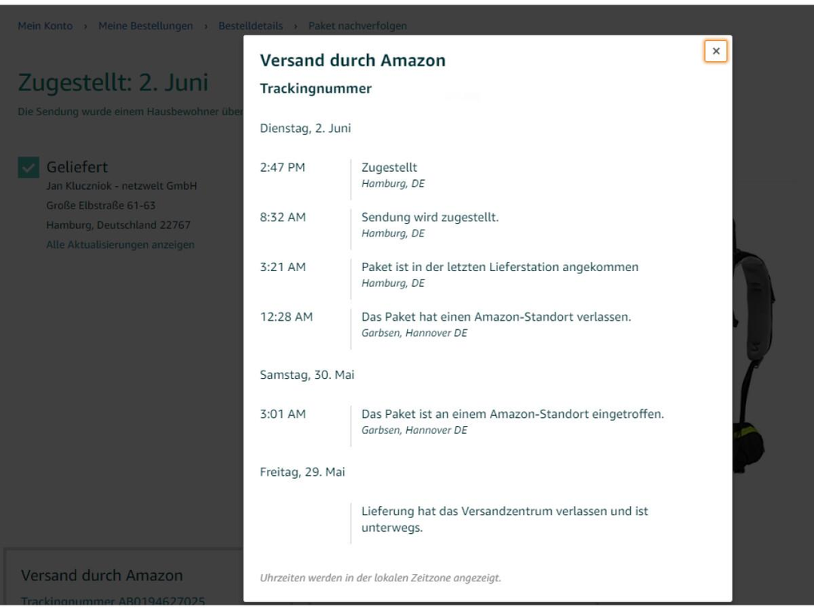
01 · START WITH A FAMILIAR EXPERIENCE
A simple purchase hides a multi-step process
The Amazon screenshots give us the customer-facing view.
The customer sees a product page and tracking updates. The backend must coordinate many operations.
DURABLE WORKFLOW ENGINE • SOFTWARE VERIFICATION
02

Slide 4
02 · BEHIND THE TRACKING PAGE
The visible delivery timeline is a workflow
The screenshot shows shipment events.
Order
created
Payment
authorised
Inventory
reserved
Shipment
prepared
Delivered
Each stage can depend on another service. A failure between stages must not lose the workflow's progress.
DURABLE WORKFLOW ENGINE • SOFTWARE VERIFICATION
03

Slide 5
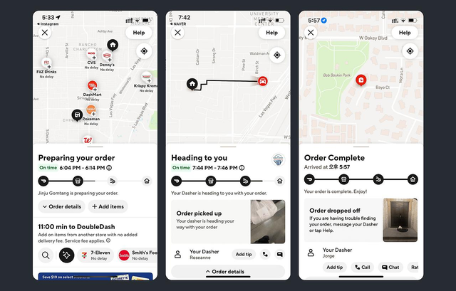
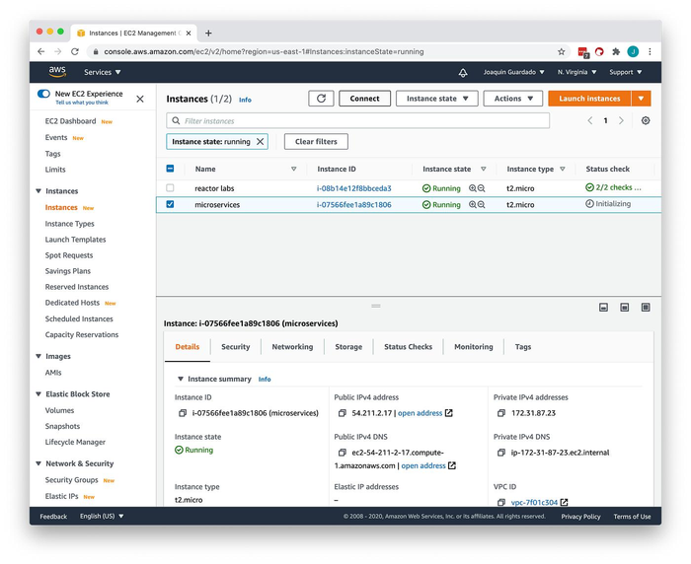
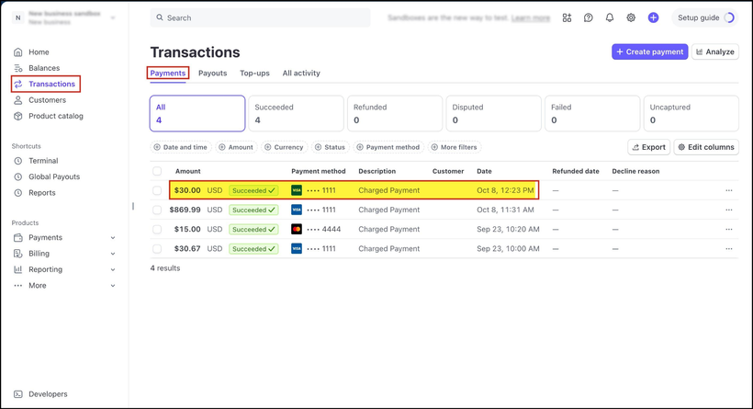
03 · THIS PATTERN IS EVERYWHERE
Different products. The same coordination problem.
These familiar interfaces show how multi-step operations appear in everyday technology.
Payments
Food delivery
Cloud infrastructure
A transaction moves through statuses such as succeeded, refunded or failed.
Restaurant preparation, courier pickup and delivery progress must stay coordinated.
An instance moves through lifecycle states before it is ready to use.
DURABLE WORKFLOW ENGINE • SOFTWARE VERIFICATION
04

Slide 6
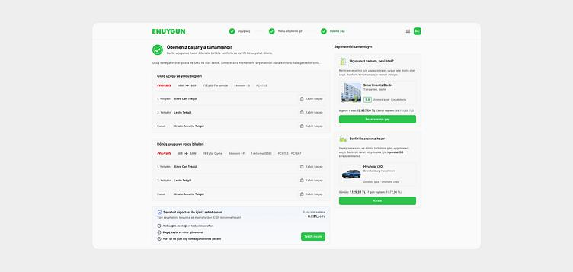
04 · ANOTHER REAL-WORLD SCENARIO
What if a travel booking only partly succeeds?
A travel booking may involve several independent reservations and payments.
1 · Flight booked
2 · Hotel fails
Reservation confirmed.
No room is available.
3 · Compensate
Cancel/refund the flight reservation where supported.
This is the motivation for Saga-style compensation: undo completed steps when a later step cannot proceed.
DURABLE WORKFLOW ENGINE • SOFTWARE VERIFICATION
05

Slide 7
05 · THE FAILURE WINDOW
A crash can happen at exactly the wrong moment
Imagine a payment provider accepts the charge, but the workflow engine crashes before persisting the result.
1
2
!
↻
Send payment
request
Provider charges
customer
Engine crashes
before saving
Workflow retries
after restart
Without protection, the retry may charge the customer twice.
A durable engine must recover progress and make repeated attempts safe.
DURABLE WORKFLOW ENGINE • SOFTWARE VERIFICATION
06

Slide 8
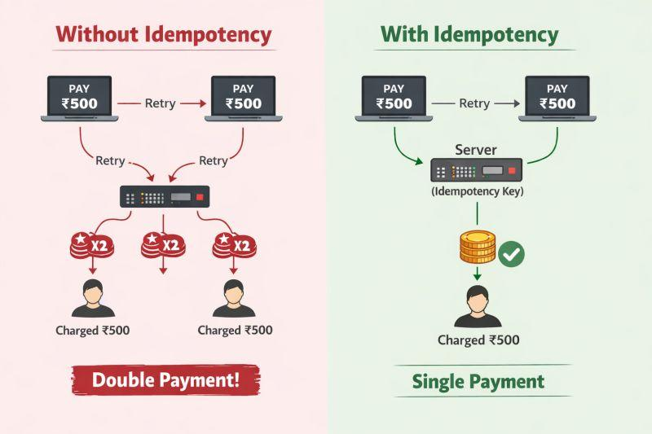
06 · DEMPOTENCY
Same request key. One effective payment.
A stable idempotency key lets a payment service recognise a repeated request.
First attempt
Payment succeeds, but the response is lost.
Retry
The engine sends the same idempotency key.
Safe outcome
Provider returns the original result.
Important: this depends on the downstream provider supporting and correctly enforcing idempotency.
DURABLE WORKFLOW ENGINE • SOFTWARE VERIFICATION
07

Slide 9
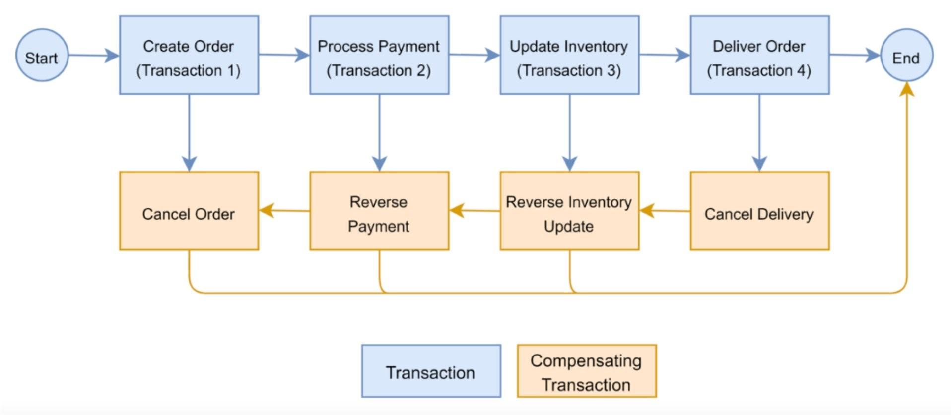
07 · SAGA COMPENSATION
If a later step fails, reverse earlier successful steps
A Saga uses compensating actions rather than assuming one global transaction can undo everything.
Example: cancel delivery → reverse inventory update → reverse payment → cancel order (where each compensation is possible).
DURABLE WORKFLOW ENGINE • SOFTWARE VERIFICATION
08

Slide 10
08 · THE PROPOSED SYSTEM
A lightweight durable workflow execution engine
The project focuses on the core mechanisms needed to execute multi-step workflows reliably.
Workflow definition
Scheduler
Workers
Persistent store
Recovery
Tasks + dependencies
Find eligible work
Execute handlers
Runs + attempts + events
Resume after restart
Persist state before advancing; on restart, reconstruct work from durable records, not worker memory.
DURABLE WORKFLOW ENGINE • SOFTWARE VERIFICATION
09

Slide 11
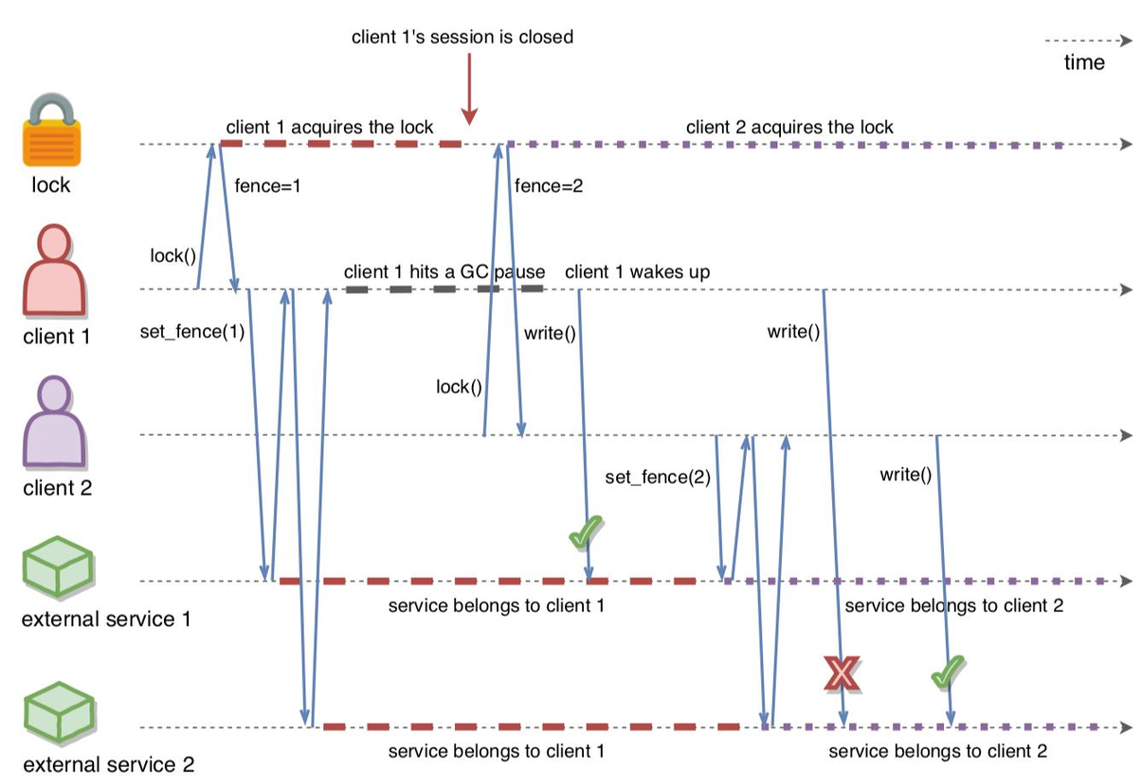
09 · CONCURRENCY CONTROL
What if two workers try to complete the same task?
Leases allow abandoned work to be reclaimed; fencing rejects stale workers.
Worker A
Claims the task; then pauses or crashes.
Worker B
Lease expires; B reclaims and completes it.
Fencing
A returns late; its stale write is rejected.
DURABLE WORKFLOW ENGINE • SOFTWARE VERIFICATION
10

Slide 12
11 · WHERE SOFTWARE VERIFICATION FITS
How do we know the design is correct?
We describe the system as a state machine, state properties, and use a model checker to explore possible behaviours.
1 · Specify
2 · State properties
3 · Model-check
Represent workflow states, task states, workers, leases and transitions in TLA+.
Safety: no invalid transitions, no stale completion.
Liveness: recoverable work can make progress under assumptions.
Use TLC to explore reachable states and inspect counterexample traces.
A checked model is not automatically a proof that the TypeScript implementation conforms to it.
DURABLE WORKFLOW ENGINE • SOFTWARE VERIFICATION
13

Slide 13
13 · WHAT WE AIM TO DELIVER
A working prototype plus verification evidence
Keep the implementation focused; make the correctness claims precise and defensible.
Prototype
Formal verification
Evaluation
Workflow definitions
Task scheduling
Persistent state
Retries and recovery
Saga compensation
Shared state model
Safety + selected liveness properties
TLC checks
Counterexample analysis
Failure-injection demos
Implementation tests
Model/implementation comparison
Limitations and assumptions
Out of scope for the first version: replacing a production platform such as Temporal or guaranteeing exactly-once effects for arbitrary external services.
DURABLE WORKFLOW ENGINE • SOFTWARE VERIFICATION
15

Slide 14
THE PROJECT IN ONE QUESTION
Can we make multi-step software
workflows reliable, even when things fail?
Build a durable engine. Specify its behaviour. Explore failure scenarios. Check the properties that matter.
Questions & feedback
Software Verification • RPTU Kaiserslautern-Landau

