Slide 1
Neural Networks, Artificial Intelligence and Computer Vision
- Ajinkya Khamkar

Slide 2
Projects I’m working on
Image based answering systems
Using Convolutional Neural Networks and Recurrent Neural Networks
Existing techniques use captioned datasets
Major Problem, not a lot of data, easily overfits, fails to generalize

Slide 3
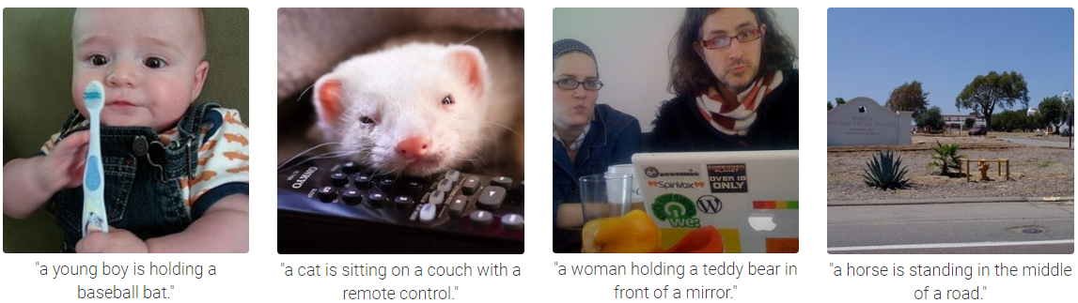
Projects I’m working on
Image based answering systems

Slide 4
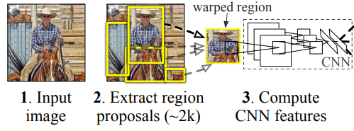
Projects I’m working on
Image based answering systems
Spatial Relationship Black Box
Recurrent Neural Networks Black Box
Man riding a Horse

Slide 5
Projects I’m working on
Image based answering systems
System becomes independent of the image in question, focussed on training a better RNN
Extendible to caption less datasets (HOPEFULLY 😐)

Slide 6
Projects I’m working on
Generative Networks
Computer Vision problem, roots in Artificial Intelligence
Neural networks don’t see what we see.
Neural networks project image spaces to lower dimensions, unrecognizable to human eyes
Find patterns in that space
Classify these patterns

Slide 7
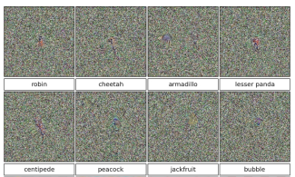
Projects I’m working on
Generative Networks
Neural networks don’t see what we see.

Slide 8
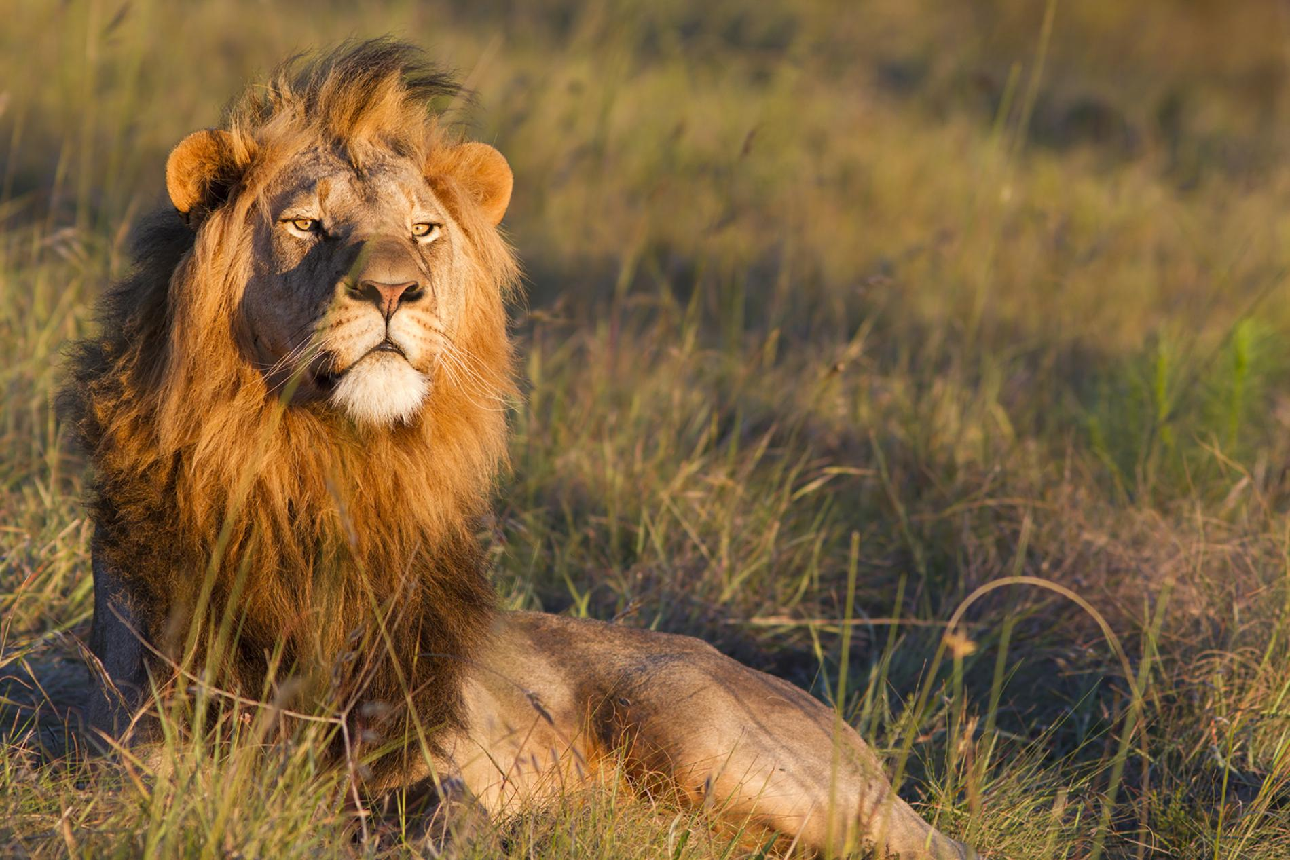
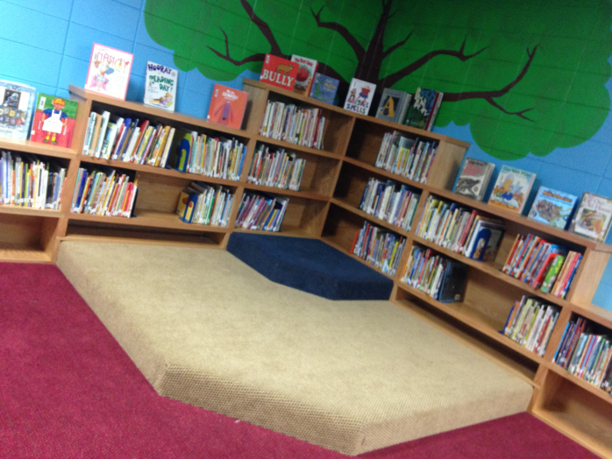
Projects I’m working on
? ? ?
Generative Networks
Neural Networks are fooled easily
All you need is a little noise

Slide 9
Projects I’m working on
Generative Networks
Let’s try making them more robust
Let’s assume a Neural Network town
Neural Network Authority: Runs the town
There’s a problem brewing in the town
There’s a second Neural Network trying to perfect the art of generating fake currency

Slide 10
Projects I’m working on
Generative Networks
The authority is good at detecting fake notes from real notes, but they have a rogue officer
The rogue officer passes information about how the authority detected their notes to be fake from the real

Slide 11
Projects I’m working on
Generative Networks
The generator wants to maximize his chances of getting notes accepted
How would he achieve that, maximize the authority’s error
How can this be achieved, make notes look more legit
How can notes look more legit, the rogue officer tells him exactly that at every iteration

Slide 12
Projects I’m working on
Generative Networks
Minimax Implementation with a catch
Caution: Fancy terms you may not be aware of
The discriminator drives its gradient to minimize its own loss
The generator learns this gradient
Improve parts of its networks and generates a new images.
Discriminator learns new details about true and fake images
Back to Step 1, till global Convergence

Slide 13
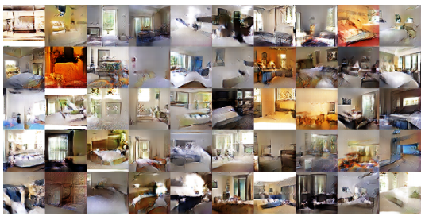
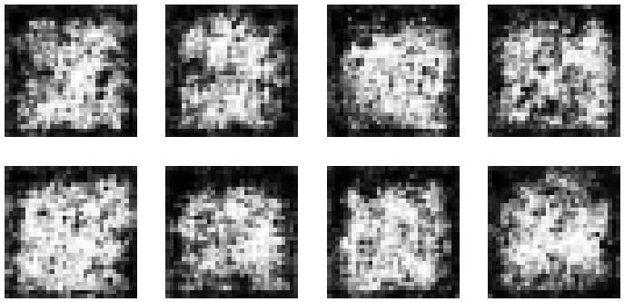
Projects I’m working on
If done correctly
If done incorrectly

Slide 14
Project Ideas
Reinforcement Learning
Risk vs Rewards environment
Pacman agent can make informed decisions about the environment
Knowledge based Artificial Intelligence
Use prior knowledge to drive Artificial Intelligence decisions
Smart Recommendation systems

Slide 15
Project Ideas
Language Modelling
Hidden Markov Models based machine translation
Recurrent Neural Networks are good at remembering sequences
Understanding natural language context
Computer Vision
Siamese Networks tell you how dissimilar two objects are.
Takes about a week to construct a neural network using tools
Object detection using supervised machine learning and unsupervised techniques.

