Slide 1
Beyond Short Snippets: Deep Networks for Video Classiﬁcation
Yue-Hei Ng,
Hausknecht,
Vijayanarasimhan, Vinyals, Monga, Toderici
Presented by: Ajinkya Khamkar
Class: Vision for Intelligent Robots
Professor Michael Ryoo

Slide 2
Neural Networks extensively used for Computer Vision tasks
State of the art architectures achieve human level accuracy in the following tasks.
A. Classification
B. Detection and Localization
C. Segmentation

Slide 3
Can these architectures be extended for Videos ?

Slide 4
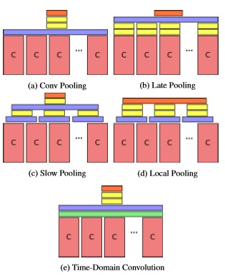
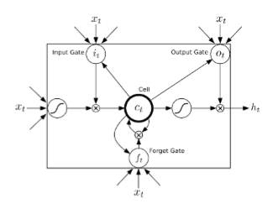
This paper addresses the previous question They present 2 techniques in the paper which extend the existing architectures for Temporal data
Using Temporal Feature Pooling
Using Long-Short-Term-Memory Recurrent Networks
Image Source: Beyond Short Snippets: Deep Networks for Video Classiﬁcation

Slide 5
Previous work
Previously, local feature and motion information was extracted using hand crafted features.
Some of the popular techniques included
a. Histogram of Oriented Gradients (HOG)
b. Histogram of Optical Flow (HOF)
c. Motion Boundary Histogram (MBH)
3. The features obtained were encoded using Bag-Of-Words or Fisher Vector to produce Global Level Descriptors

Slide 6
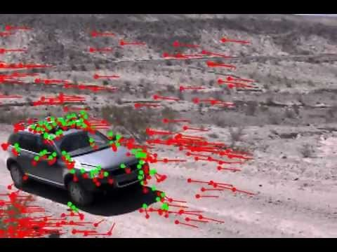
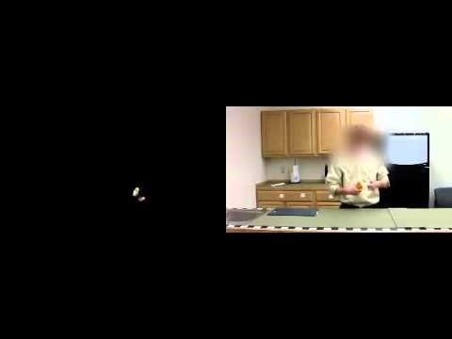
Previous Work
Histogram of Optical Flow
Motion Boundary Histogram
Video 1 source: https://youtu.be/MOaKnCSejXQ Video 2 source: https://youtu.be/hVPvRG9pUc8

Slide 7
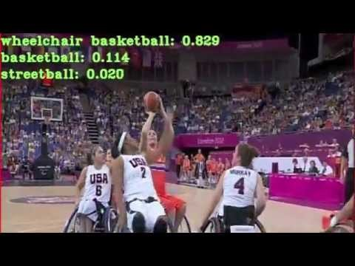
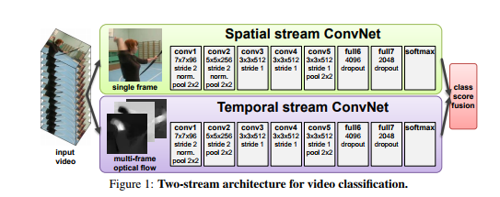
Previous Work
3D-Convolutions over short clips
Use of Optical flow for motion information
2 recognition streams [spatial and temporal]
Spatial stream to recognize actions from still frame.
Temporal stream to recognize actions from motion flow using optical flow
Video source: https://youtu.be/qrzQ_AB1DZk Image source: K. Simonyan and A. Zisserman. Two-stream convolutional networks for action recognition in videos
Notes:
Advantages: spatial convnet can be trained on large scale datasets
a. Learn features from raw frames ~ single images
b. Aggregate predictions

Slide 8
Approach 1 – Feature Pooling Architecture
AlexNet and GoogleNet are used to process Individual video frames.
Use of Max-Pooling instead of Average and Fully-connected Pooling, sparse updates and faster learning
Various Pooling architectures
Conv Pooling
Late Pooling
Slow Pooling
Local Pooling
Time- Domain Convolution

Slide 9
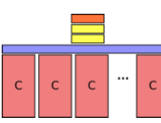
Conv Pooling
Performs Max-pooling over final layer of convolutional network
Spatial information is preserved over time domain
Image Source: Beyond Short Snippets: Deep Networks for Video Classiﬁcation

Slide 10
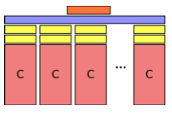
Late Pooling
Passes information through fully-connected layers.
Weights of Conv layers and fully connected layers shared
Combines high level information across frames
Image Source: Beyond Short Snippets: Deep Networks for Video Classiﬁcation

Slide 11
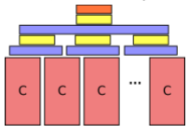
Slow Pooling
Hierarchically combines frame level information
2-layer pooling strategy
Max-pool over 10 frames with stride 5
Pass to fully connected layer and max pool again
Group temporally local features before grouping higher level features
Image Source: Beyond Short Snippets: Deep Networks for Video Classiﬁcation

Slide 12
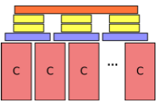
Local Pooling
Hierarchically combines frame level information
Uses single max pooling layer
Two fully connected layers with shared features
Prevents loss of temporal information
Image Source: Beyond Short Snippets: Deep Networks for Video Classiﬁcation

Slide 13
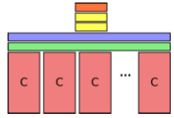
Time Domain Convolution
Extra Convolution layer after spatial layers
Consists of 256 3 x 3 kernels across 10 frames (4D)
Local information between frames in same temporal window
Image Source: Beyond Short Snippets: Deep Networks for Video Classiﬁcation

Slide 14
Approach 2- Long-Short-term-Memory Networks
LSTM are long memory Recurrent Neural Networks
Long-Term memory is achieved using memory cells
Information can get into memory cell if logistic write gate is ON
Information is stored in memory until logistic keep gate is ON
Information can be read from the memory cell if logistic read gate is ON

Slide 15
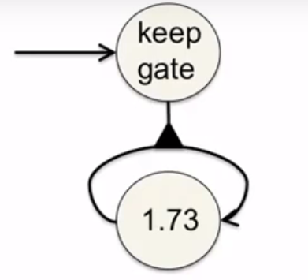
Keep Gate Operation
Till Keep gate is driven to 1, memory cell will hold the current value
The state of the keep gate is driven by the rest of the network

Slide 16
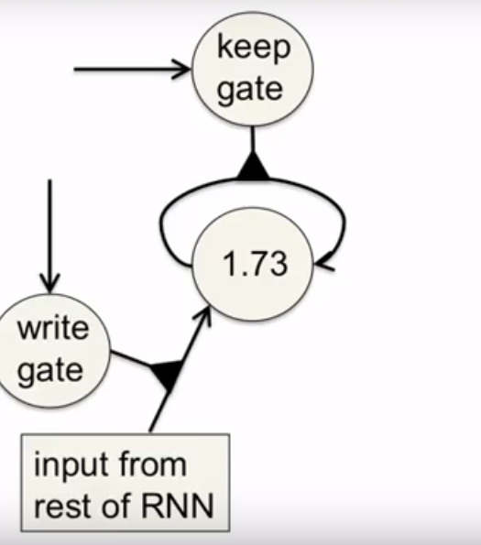
Write Gate Operation
For value to be stored into memory, the write gate needs to be driven to 1
The value will be held in the memory cell till keep get is set to 1 by the rest of the network

Slide 17
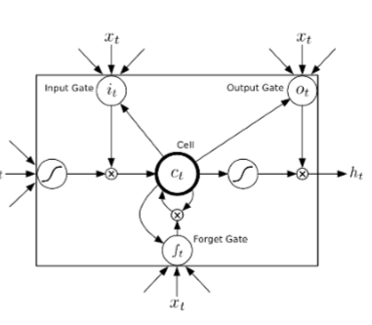
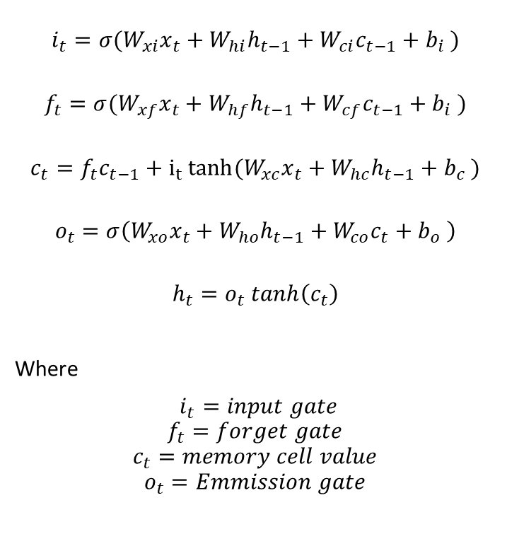
LSTM Cell Operations
$$i_{t}=σ(W_{xi}x_{t}+W_{hi}h_{t−1}+W_{ci}c_{t−1}+b_{i} )$$
$$f_{t}=σ(W_{xf}x_{t}+W_{hf}h_{t−1}+W_{cf}c_{t−1}+b_{i} )$$
$$c_{t}=f_{t}c_{t−1}+i_{t} tanh⁡(W_{xc}x_{t}+W_{hc}h_{t−1}+b_{c} )$$
$$o_{t}=σ\left(W_{xo}x_{t}+W_{ho}h_{t−1}+W_{co}c_{t}+b_{o} \right)$$
$$h_{t}=o_{t} tanh\left(c_{t}\right)$$
Where
$i_{t}=input gate$
$$f_{t}=forget gate$$
$$c_{t}=memory cell value$$
$$o_{t}=Emmission gate$$
Image Source: Beyond Short Snippets: Deep Networks for Video Classiﬁcation

Slide 18
Working of LSTM
Image Source: Colah’s blog http://colah.github.io/posts/2015-08-Understanding-LSTMs/

Slide 19
Setup
Sports- 1M dataset used for experiments
1.1 Million videos, 487 video level class annotations
No information about location of object provided + videos are unconstrained

Slide 20
Setup
5-minutes of video sampled at 1 fps, 300 frames per video
For shorter videos, frames are repeated
First frame randomly chosen and each frame randomly cropped
Each frame resized to 256 x 256, randomly cropped to 220 x 200 and randomly flipped horizontally with 50% probability
For predictions, 240 examples selected using above technique and prediction averaged

Slide 21
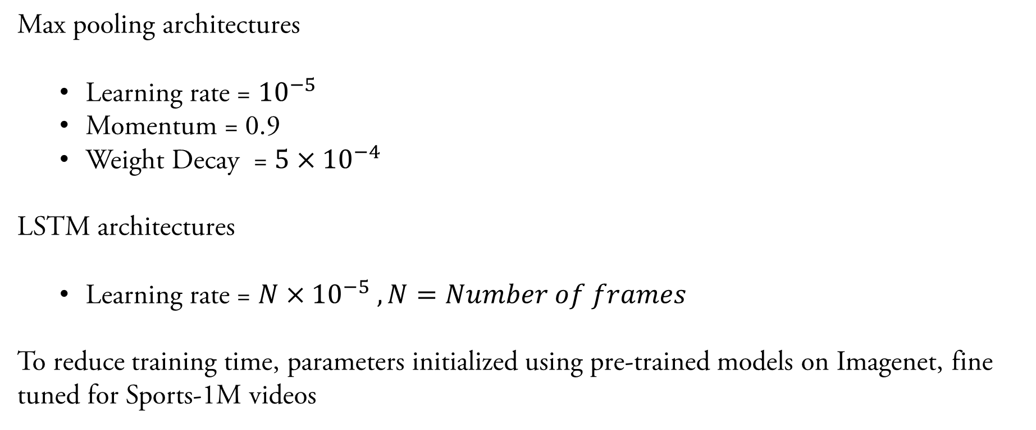
Training
Max pooling architectures
Learning rate = ${10}^{−5}$
Momentum = 0.9
Weight Decay = $5×{10}^{−4}$
LSTM architectures
Learning rate = ${N×10}^{−5} , N=Number of frames$
To reduce training time, parameters initialized using pre-trained models on Imagenet, fine tuned for Sports-1M videos

Slide 22
Training
Multi frame models achieve higher accuracy
Training time is significantly higher from scratch
Since, pooling is performed after Convolution layers, parameters across multi frame and single frame models are similar
Better to initialize multi frame models as single frame models, fine tune to adjust for multiple frames
Significant reduction in the computation time required.

Slide 23
Training
LSTM were trained using 2 methods
1. Labels back propagated per frame, instead of 1 per clip, higher training time
2. A gain ‘g’ used during back propagation per frame, value of g-interpolated during training
Between g = 1 at each frame (all frames) and g = 1 only at the last frame (once per clip) , interpolating g resulted in higher accuracy and reduced training time
To combine frame level predictions into single prediction
1. Return prediction at last step
2. Max-pooling all predictions
3. Summing predictions and returning max
4. Weighing predictions using ‘g’ , summing and returning max
Weighted approach performed better generally

Slide 24
Training
Since architecture uses 1 fps, does not encode motion information
Trained model on raw frames allows faster convergence for optical flow images
Features captured from raw frames (edges etc) help classify optical flow images
Optical flow calculated at 15 fps, thresholding them between -40,40 and rescaling horizontal and vertical flow to [0,255]

Slide 25
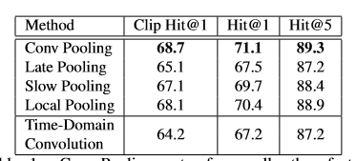
Evaluation
Comparison of feature pooling architecture
Image Source: Beyond Short Snippets: Deep Networks for Video Classiﬁcation

Slide 26
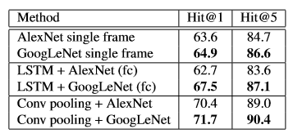
Evaluation
Comparison of CNN architecture
Image Source: Beyond Short Snippets: Deep Networks for Video Classiﬁcation

Slide 27
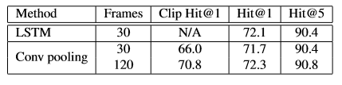
Evaluation
Comparison between number of frames
Image Source: Beyond Short Snippets: Deep Networks for Video Classiﬁcation

Slide 28
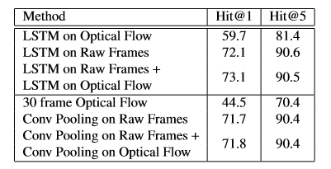
Evaluation
Comparison using optical flow and optical flow + raw frames
Image Source: Beyond Short Snippets: Deep Networks for Video Classiﬁcation

Slide 29
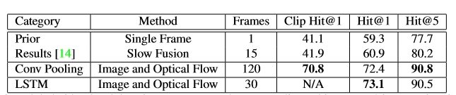
Evaluation
Comparison Between approaches
Image Source: Beyond Short Snippets: Deep Networks for Video Classiﬁcation

Slide 30
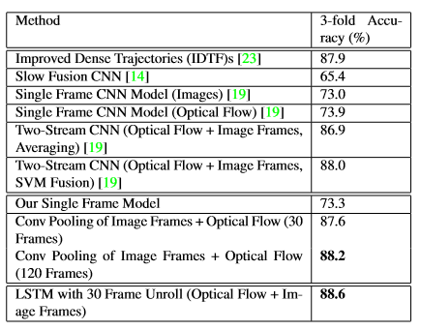
Evaluation
Comparison Between approaches on UCF-101
Image Source: Beyond Short Snippets: Deep Networks for Video Classiﬁcation

Slide 31
Conclusion
Unlike previous work, this approach works well with full length videos
It is better to train single-frame model and then expand them to multi-frame models using fine tuning
Optical flow is not always useful, spatial information gives considerably higher results on 1M dataset
LSTM’s outperform traditional pooling architectures for sequential data

