Slide 1
End-to-End Differentiable Adversarial Imitation Learning
Nir Baram and Oron Anschel and Itai Caspi and Shie Mannor
Presented by- Ajinkya Khamkar

Slide 2
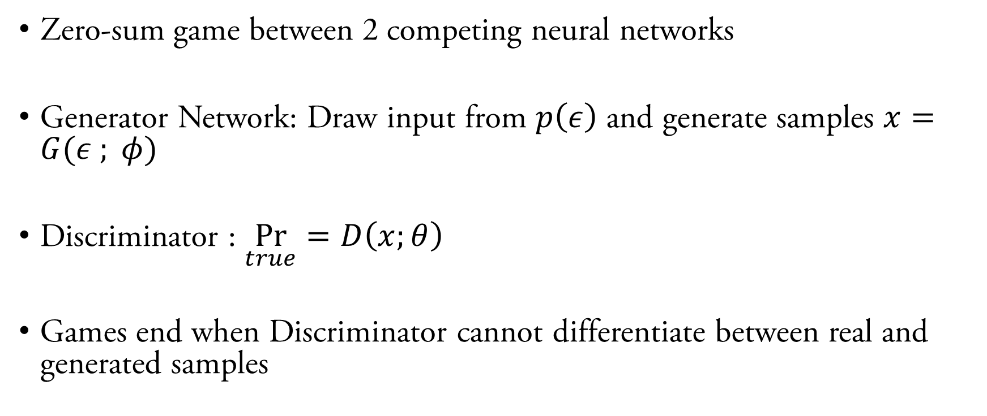
Generative Adversarial Networks
Zero-sum game between 2 competing neural networks
Generator Network: Draw input from $p\left(ε\right)$ and generate samples $x=G(ε ; φ)$
Discriminator : $\underset{true}{Pr}{=D\left(x;θ\right)}$
Games end when Discriminator cannot differentiate between real and generated samples

Slide 3
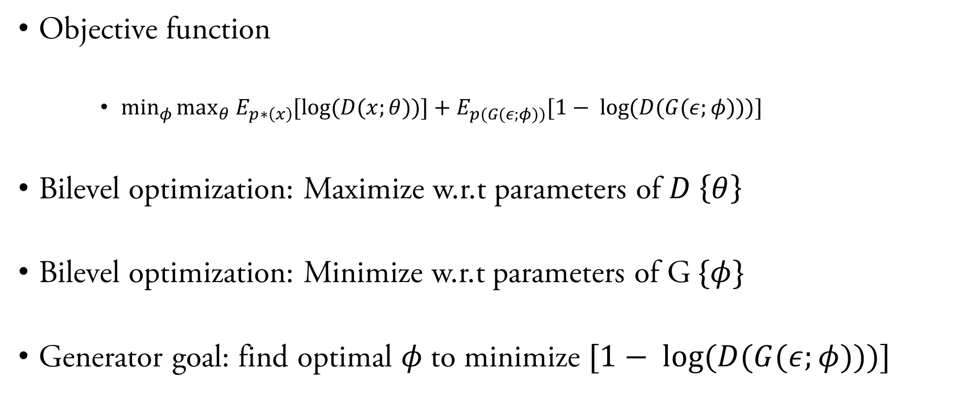
Generative Adversarial Networks
Objective function
$\min_{φ}{\max_{θ} E_{p∗\left(x\right)}{[\log{(D(x;θ))]+E_{p(G(ε;φ))}{[1− \log{(D(G(ε;φ)))] } }} }}$
Bilevel optimization: Maximize w.r.t parameters of $D \left\{θ\right\}$
Bilevel optimization: Minimize w.r.t parameters of G$\{φ\}$
Generator goal: find optimal $φ$to minimize $[1− \log{(D(G(ε;φ)))] }$

Slide 4
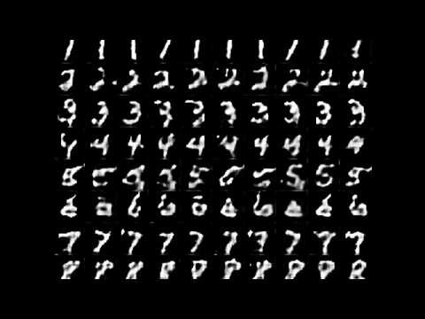
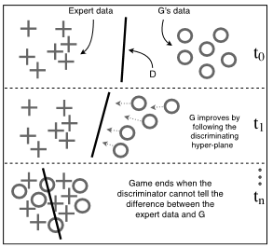
Generative Adversarial Networks
Source: Baram et al., End-to-End Differentiable Adversarial Imitation Learning, 2017.

Slide 5
Imitation Learning
Why ?
Unclear Rewards
Problem being modelled has unclear rewards
Sparser rewards
Credit assignment Problem
Lack of samples
Infeasible reward based training
Autonomous cars can’t be allowed to crash into pedestrians for a reward of -100

Slide 6
Imitation Learning
Previous Approaches
Behavioural Cloning
Supervised approach
Drawbacks
Demonstrations could be sub-optimal / unconstrained
Blind mimicking of demonstrator actions
Demonstrator has higher degrees of freedom

Slide 7
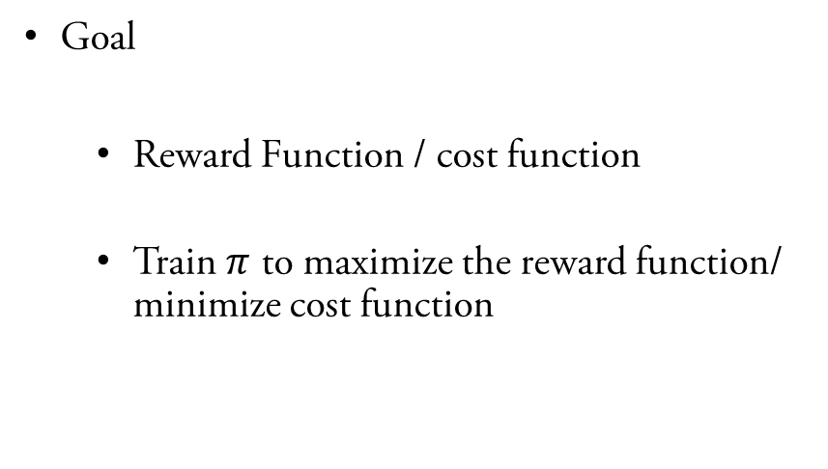
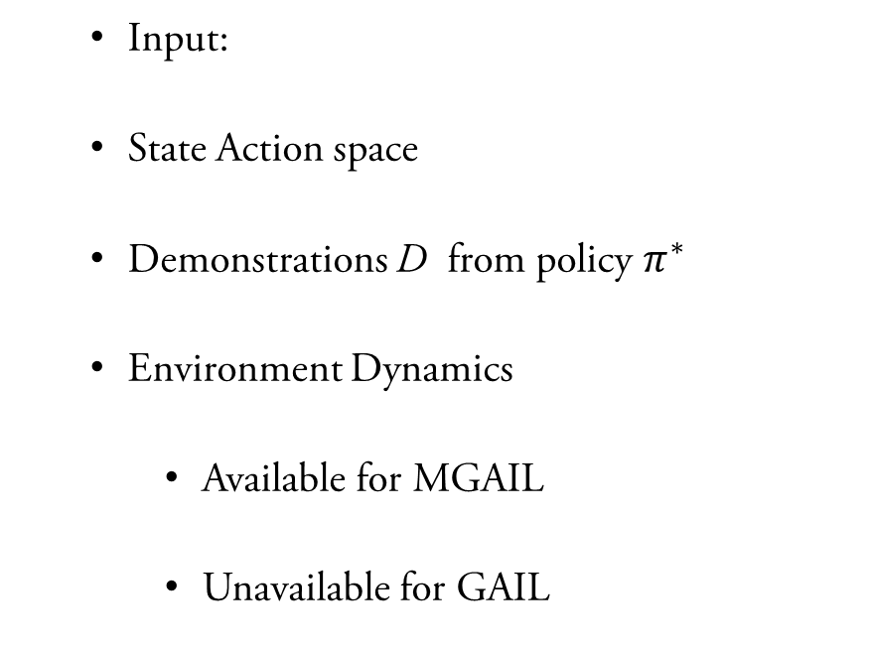
Imitation Learning
Inverse Reinforcement Learning
Goal
Reward Function / cost function
Train $π$ to maximize the reward function/ minimize cost function
Input:
State Action space
Demonstrations D from policy $π^{∗}$
Environment Dynamics
Available for MGAIL
Unavailable for GAIL

Slide 8
Imitation Learning
Inverse Reinforcement Learning
True cost function is unavailable. How do we guarantee our derived cost function is close to the true cost function ?

Slide 9
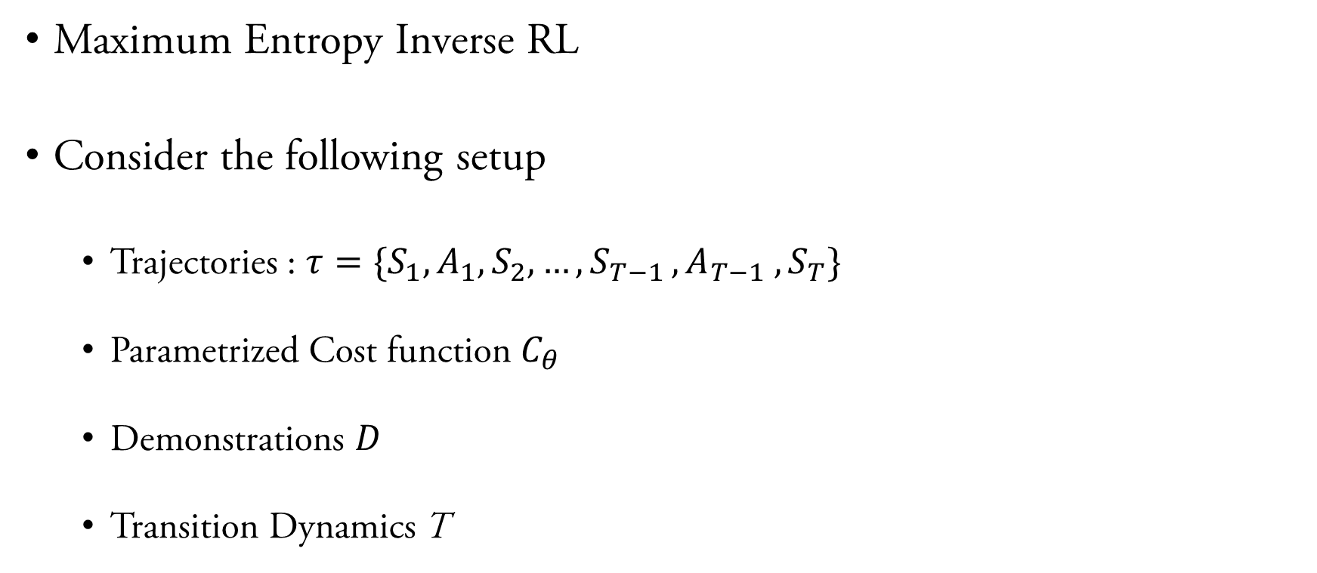
Imitation Learning
Maximum Entropy Inverse RL
Consider the following setup
Trajectories : $τ=\{S_{1},A_{1},S_{2},…,S_{T−1 }, A_{T−1} ,S_{T}\}$
Parametrized Cost function $C_{θ}$
Demonstrations $D$
Transition Dynamics T

Slide 10
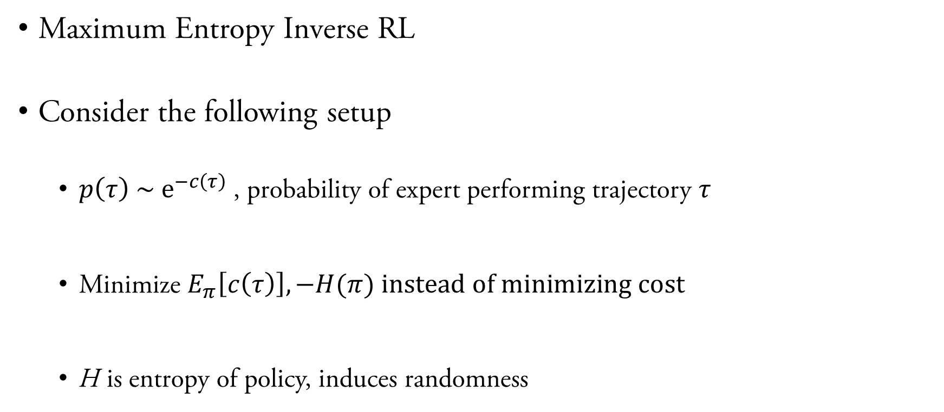
Imitation Learning
Maximum Entropy Inverse RL
Consider the following setup
$p\left(τ\right) \sim e^{−c\left(τ\right)}$, probability of expert performing trajectory $τ$
Minimize $E_{π}\left[c\left(τ\right)\right], −H(π) instead of minimizing cost$
H is entropy of policy, induces randomness

Slide 11
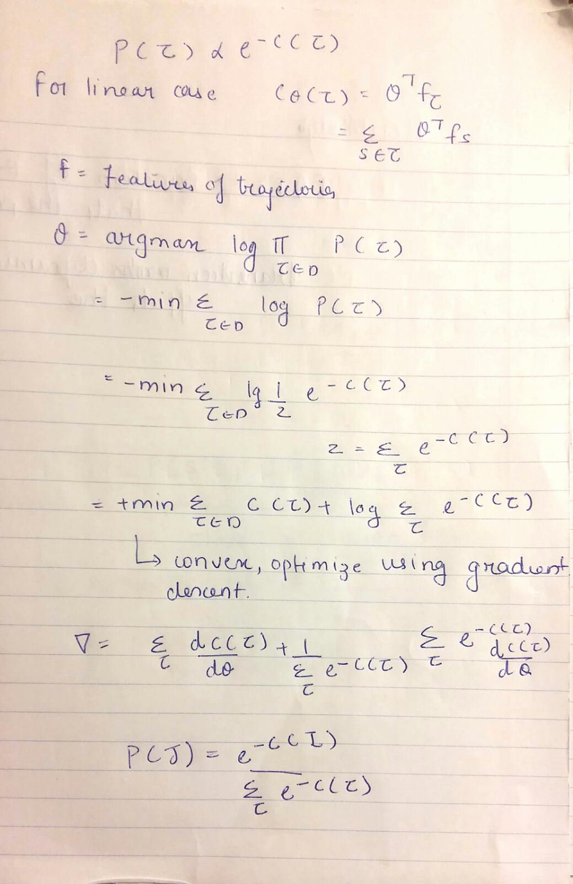
Imitation Learning
Maximum Entropy Inverse RL
Estimating the cost function

Slide 12
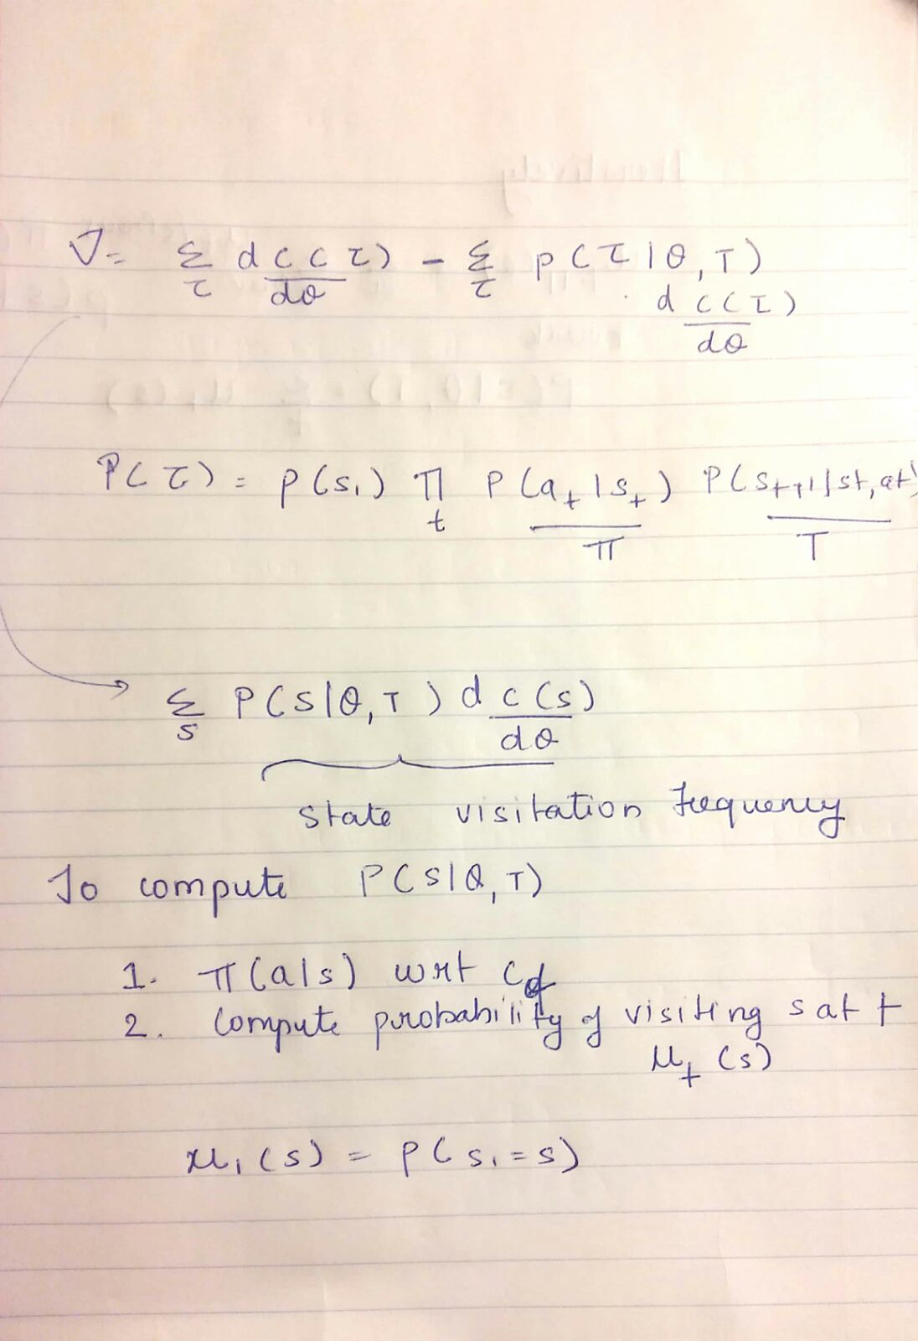
Imitation Learning
Maximum Entropy Inverse RL
Estimating the cost function

Slide 13
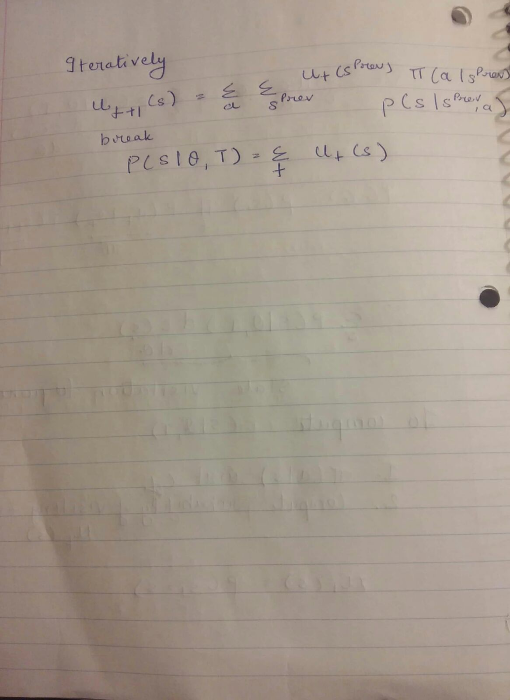
Imitation Learning
Maximum Entropy Inverse RL
Estimating the cost function

Slide 14
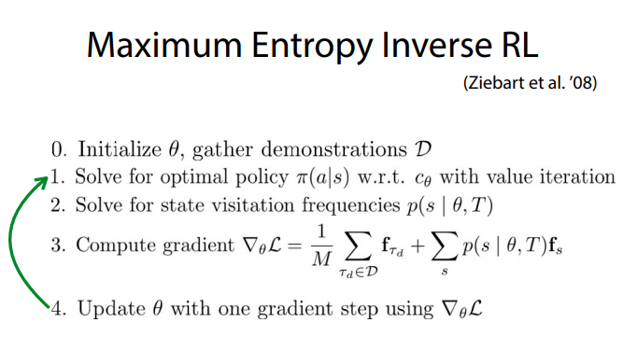
Imitation Learning
Maximum Entropy Inverse RL

Slide 15
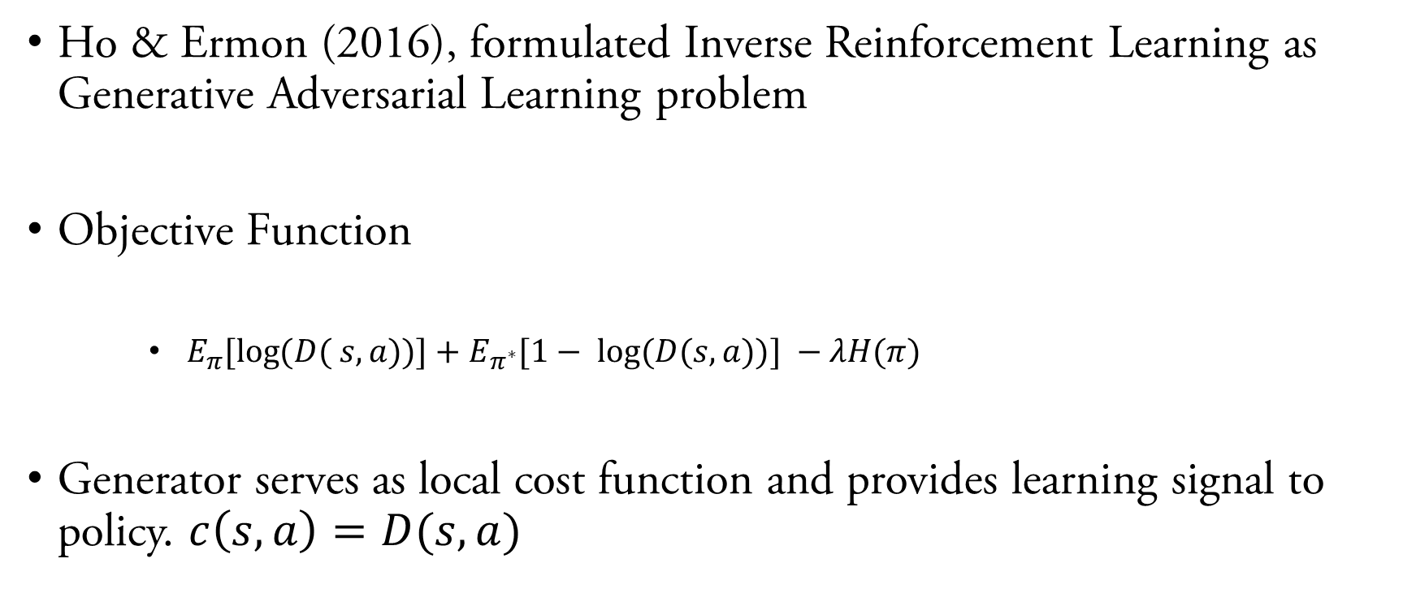
Generative Adversarial Imitation Learning
Ho & Ermon (2016), formulated Inverse Reinforcement Learning as Generative Adversarial Learning problem
Objective Function
$E_{π}{[\log{(D( s,a))]+E_{π^{∗}}{[1− \log{(D(s,a))] −λH(π) } }} }$
Generator serves as local cost function and provides learning signal to policy. $c\left(s,a\right)=D(s,a)$

Slide 16
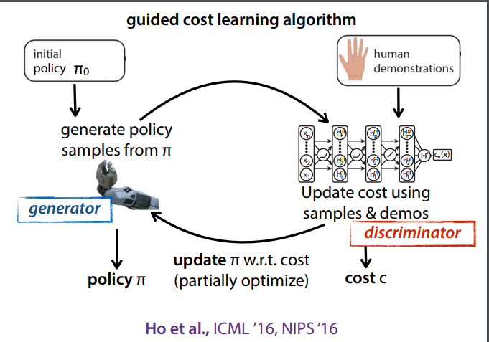
Generative Adversarial Imitation Learning

Slide 17
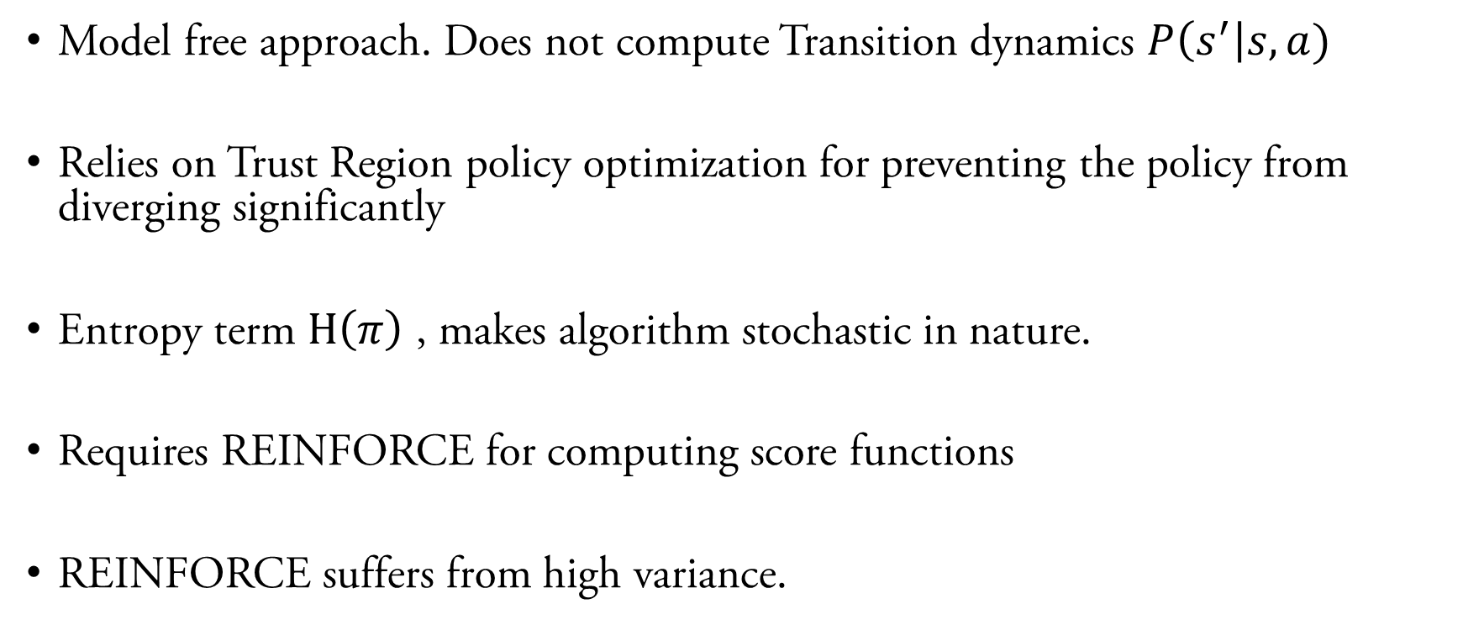
Generative Adversarial Imitation Learning
Model free approach. Does not compute Transition dynamics $P\left(s^{′}\right|s, a)$
Relies on Trust Region policy optimization for preventing the policy from diverging significantly
Entropy term $H\left(π\right)$ , makes algorithm stochastic in nature.
Requires REINFORCE for computing score functions
REINFORCE suffers from high variance.

Slide 18
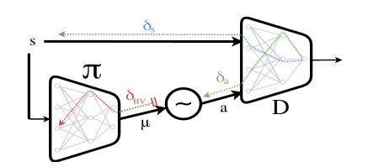
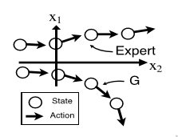

Generative Adversarial Imitation Learning
Model free approach. Does not compute Transition dynamics
The agent is unaware of $P\left(s^{′}\right|s, a)$
$δs$ is flushed, the agent can diverge from expert policy
Source: Baram et al., End-to-End Differentiable Adversarial Imitation Learning, 2017.

Slide 19
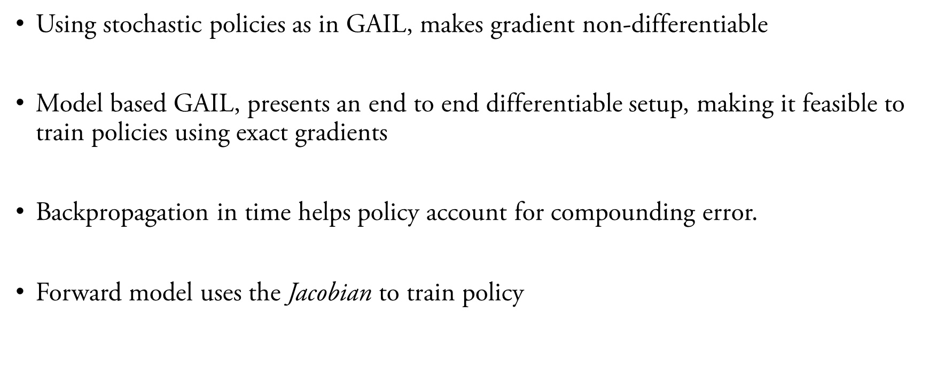
Model-Based Generative Adversarial Imitation Learning
Using stochastic policies as in GAIL, makes gradient non-differentiable
Model based GAIL, presents an end to end differentiable setup, making it feasible to train policies using exact gradients
Backpropagation in time helps policy account for compounding error.
Forward model uses the Jacobian to train policy

Slide 20
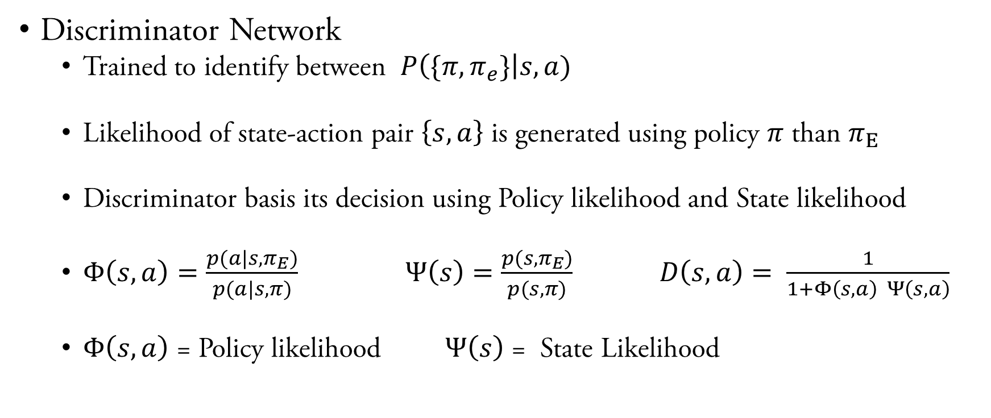
Model-Based Generative Adversarial Imitation Learning
Discriminator Network
Trained to identify between $P\left(\{π,π_{e}\}\right|s, a)$
Likelihood of state-action pair $\left\{s,a\right\}$ is generated using policy $π$ than $π_{E}$
Discriminator basis its decision using Policy likelihood and State likelihood
$Φ\left(s,a\right)=\frac{p(a|s,π_{E})}{p(a|s,π)}$ $Ψ\left(s\right)=\frac{p(s,π_{E})}{p(s,π)} D\left(s,a\right)= \frac{1}{1+Φ\left(s,a\right) Ψ\left(s,a\right)}$
$Φ\left(s,a\right)$ = Policy likelihood $Ψ\left(s\right)$ = State Likelihood

Slide 21
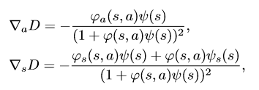
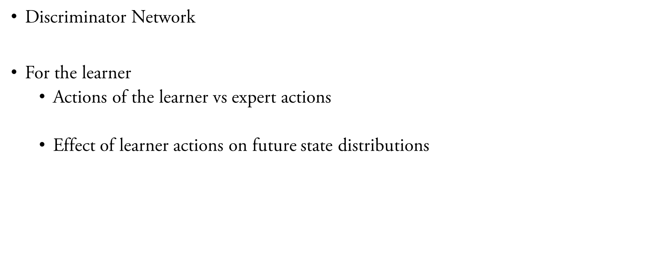
Model-Based Generative Adversarial Imitation Learning
Discriminator Network
For the learner
Actions of the learner vs expert actions
Effect of learner actions on future state distributions
Source: Baram et al., End-to-End Differentiable Adversarial Imitation Learning, 2017.

Slide 22
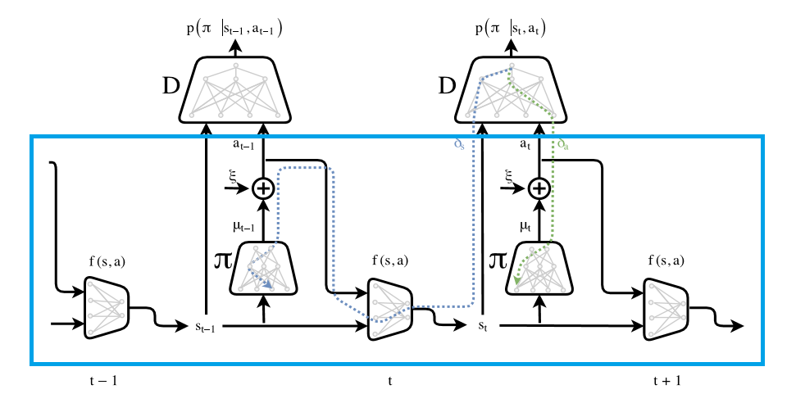
Model-Based Generative Adversarial Imitation Learning
Generator Network
Source: Baram et al., End-to-End Differentiable Adversarial Imitation Learning, 2017.

Slide 23
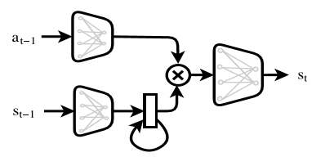
Model-Based Generative Adversarial Imitation Learning
Generator Network
Actions and states sampled from separate distributions
Nth Order Markov Decision Process realized using Gated Recurrent Units
Source: Baram et al., End-to-End Differentiable Adversarial Imitation Learning, 2017.

Slide 24
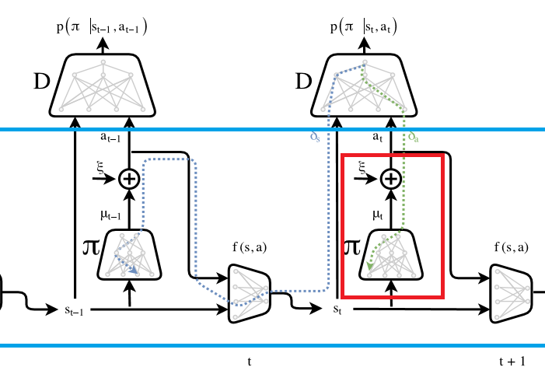
Model-Based Generative Adversarial Imitation Learning
Backpropagation – gradient estimation for stochastic action
Stochastic policy allow exploration
Major problem is backpropagation through stochastic elements
For continuous action space use the reparameterization trick
For discrete action space we, use Gumbel SoftMax trick
Source: Baram et al., End-to-End Differentiable Adversarial Imitation Learning, 2017.

Slide 25

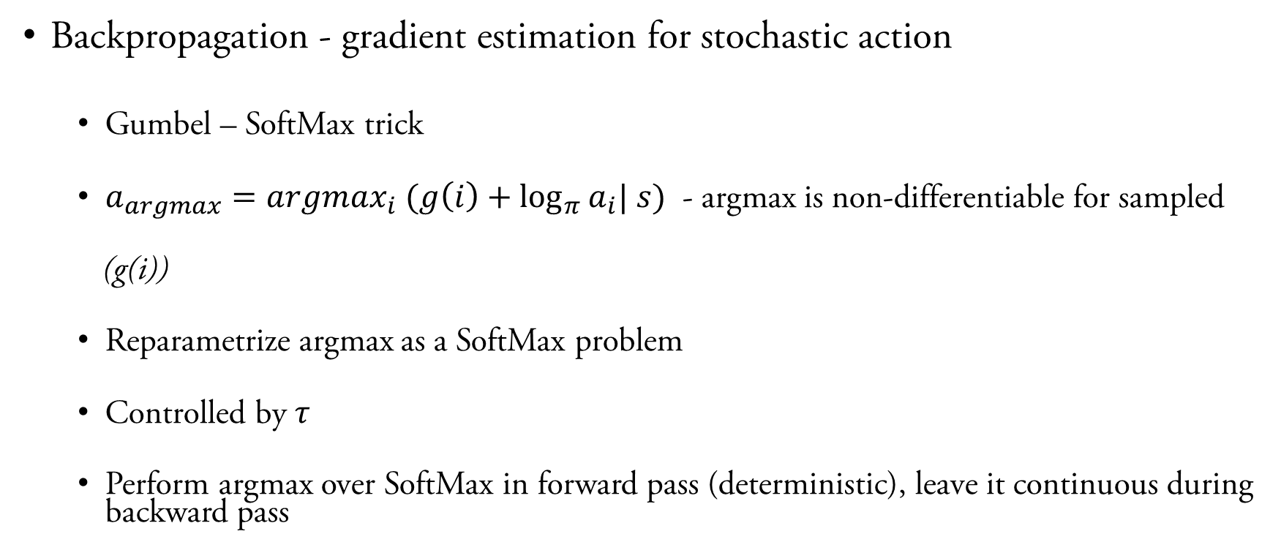
Model-Based Generative Adversarial Imitation Learning
Backpropagation - gradient estimation for stochastic action
Gumbel – SoftMax trick
$a_{argmax}=argmax_{i} (g\left(i\right)+\log_{π}{a_{i}| s})$ - argmax is non-differentiable for sampled
(g(i))
Reparametrize argmax as a SoftMax problem
Controlled by $τ$
Perform argmax over SoftMax in forward pass (deterministic), leave it continuous during backward pass

Slide 26
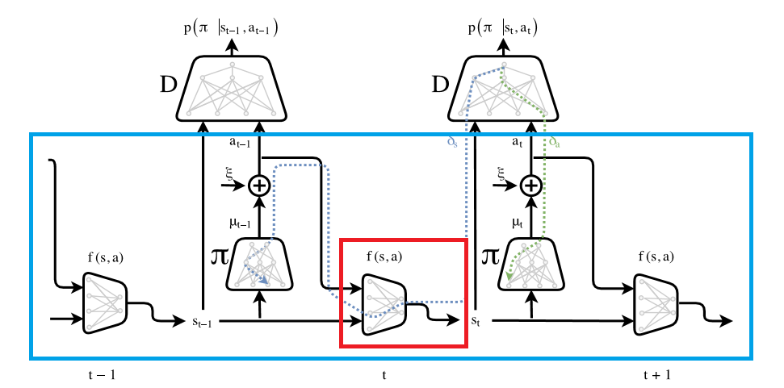
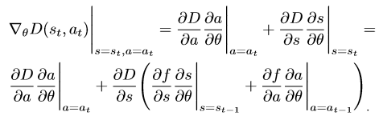

Model-Based Generative Adversarial Imitation Learning
Backpropagation – through forward network
Transition Dynamics $p\left(s_{t+1} | s_{t},a_{t}\right)$
Flow of gradient from time-step t to forward function which generates state at t
Based on outcome of future states, backpropagate in time, influence actions of policy.
Source: Baram et al., End-to-End Differentiable Adversarial Imitation Learning, 2017.

Slide 27
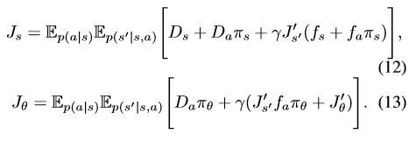
Model-Based Generative Adversarial Imitation Learning
Policy Gradients
Reparameterization of Bellman Equations
Source: Baram et al., End-to-End Differentiable Adversarial Imitation Learning, 2017.

Slide 28
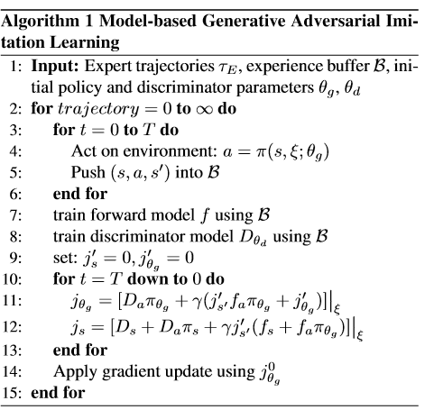
Model-Based Generative Adversarial Imitation Learning
Putting it all together
Source: Baram et al., End-to-End Differentiable Adversarial Imitation Learning, 2017.

Slide 29
Model-Based Generative Adversarial Imitation Learning
Experiments
3 discrete control tasks (Cartpole, Mountain-car, Acrobat)
5 continuous tasks ((Hopper, Walker, Half-Cheetah, Ant, and Humanoid)
Length of trajectory – 1000
Network architecture
2 Hidden layers + ReLU
ADAM Optimizer

Slide 30
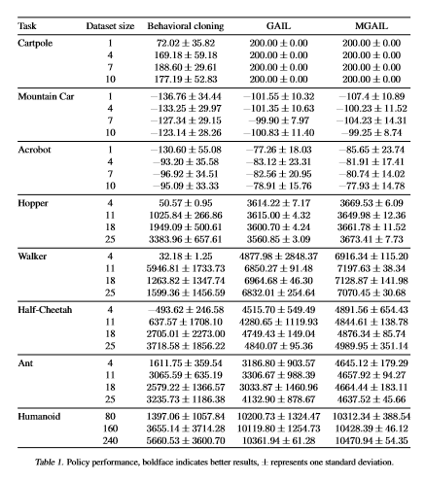
Model-Based Generative Adversarial Imitation Learning
Results
Source: Baram et al., End-to-End Differentiable Adversarial Imitation Learning, 2017.

