Slide 1
End-to-End Differentiable Adversarial Imitation Learning
Nir Baram and Oron Anschel and Itai Caspi and Shie Mannor
Presented by- Ajinkya Khamkar

Slide 2
Imitation Learning
Why ?
Unclear Rewards
Problem being modelled has unclear rewards
Sparser rewards
Credit assignment Problem
Lack of samples
Infeasible reward based training
Autonomous cars can’t be allowed to crash into pedestrians for a reward of -100

Slide 3
Imitation Learning
Previous Approaches
Behavioural Cloning
Supervised approach
State, Action pairs available for agent to train on
Agent unaware of future consequences of action
Infeasible for continuous motion, large state action pairs to train on
Inverse Reinforcement Learning
Given expert policy find reward function
Train agent to learn new policy maximizing the reward function

Slide 4
Generative Adversarial Networks
Zero-sum game between 2 competing neural networks
Generator Network - Generate candidates from noise
Discriminator – Tell apart from real samples and fake samples
Games end when Discriminator cannot differentiate between real and generated samples

Slide 5
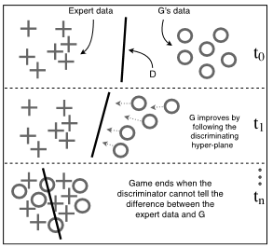

Generative Adversarial Networks
Source: Baram et al., End-to-End Differentiable Adversarial Imitation Learning, 2017.

Slide 6
Generative Adversarial Imitation Learning
Why Generative Networks
Perfect setup for imitation learning
Learner learns from the gradient of the discriminator
No additional loss function / complex model is required

Slide 7

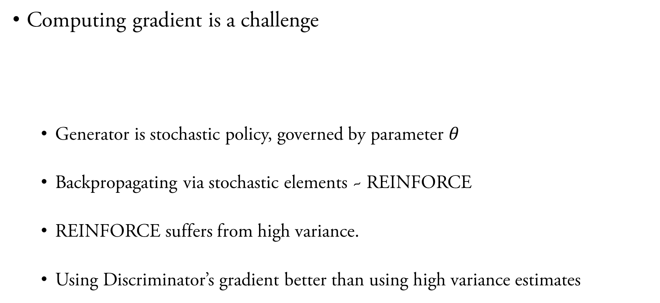
Generative Adversarial Imitation Learning
Computing gradient is a challenge
Generator is stochastic policy, governed by parameter $θ$
Backpropagating via stochastic elements ~ REINFORCE
REINFORCE suffers from high variance.
Using Discriminator’s gradient better than using high variance estimates

Slide 8
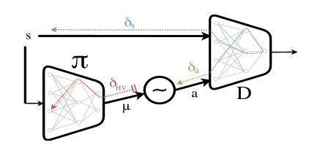
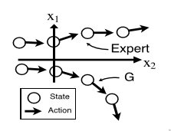

Model-Based Generative Adversarial Imitation Learning
Generative adversarial imitation learning – model free approach (Ho, Sermon, 2016)
The agent is unaware of $P\left(s^{′}\right|s, a)$
$δs$ is flushed, the agent can diverge from expert policy
Source: Baram et al., End-to-End Differentiable Adversarial Imitation Learning, 2017.

Slide 9
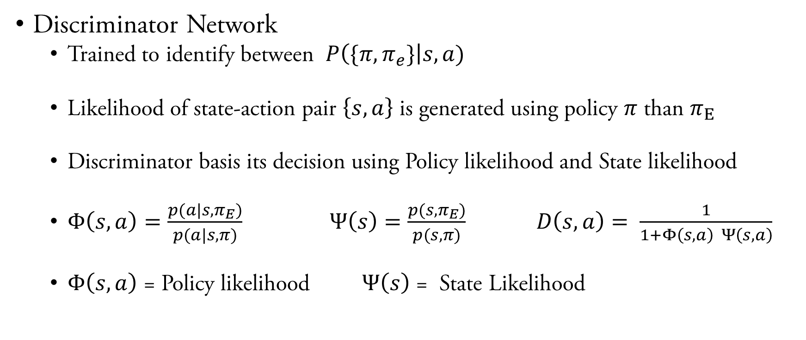
Model-Based Generative Adversarial Imitation Learning
Discriminator Network
Trained to identify between $P\left(\{π,π_{e}\}\right|s, a)$
Likelihood of state-action pair $\left\{s,a\right\}$ is generated using policy $π$ than $π_{E}$
Discriminator basis its decision using Policy likelihood and State likelihood
$Φ\left(s,a\right)=\frac{p(a|s,π_{E})}{p(a|s,π)}$ $Ψ\left(s\right)=\frac{p(s,π_{E})}{p(s,π)} D\left(s,a\right)= \frac{1}{1+Φ\left(s,a\right) Ψ\left(s,a\right)}$
$Φ\left(s,a\right)$ = Policy likelihood $Ψ\left(s\right)$ = State Likelihood

Slide 10
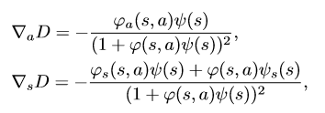
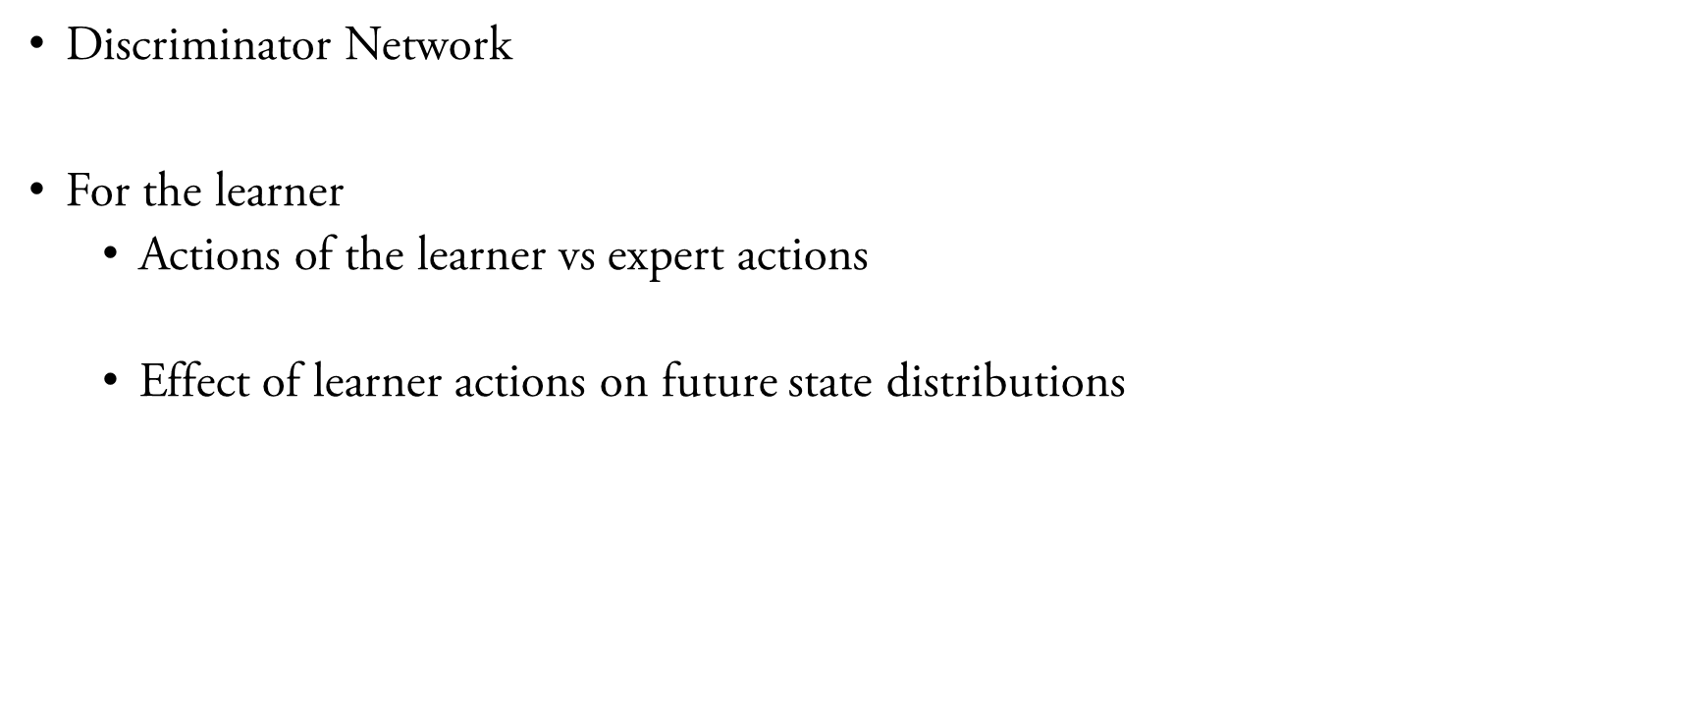
Model-Based Generative Adversarial Imitation Learning
Discriminator Network
For the learner
Actions of the learner vs expert actions
Effect of learner actions on future state distributions
Source: Baram et al., End-to-End Differentiable Adversarial Imitation Learning, 2017.

Slide 11
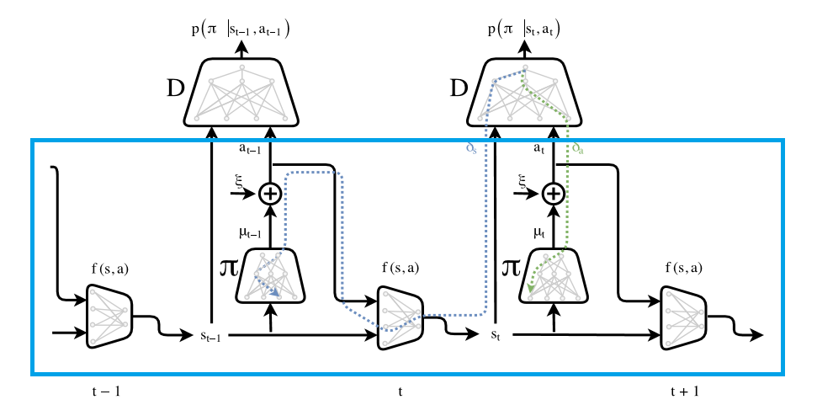
Model-Based Generative Adversarial Imitation Learning
Generator Network
Source: Baram et al., End-to-End Differentiable Adversarial Imitation Learning, 2017.

Slide 12
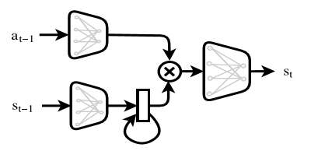
Model-Based Generative Adversarial Imitation Learning
Generator Network
Actions and states sampled from separate distributions
Nth Order Markov Decision Process realized using Gated Recurrent Units
Source: Baram et al., End-to-End Differentiable Adversarial Imitation Learning, 2017.

Slide 13
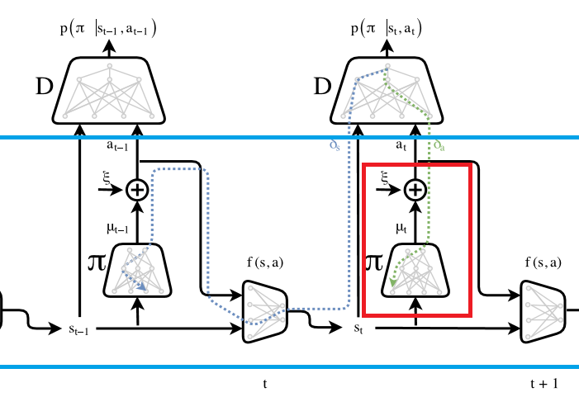
Model-Based Generative Adversarial Imitation Learning
Backpropagation – gradient estimation for stochastic action
Stochastic policy allow exploration
Major problem is backpropagation through stochastic elements
For continuous action space use the reparameterization trick
For discrete action space we, use Gumbel SoftMax trick
Source: Baram et al., End-to-End Differentiable Adversarial Imitation Learning, 2017.

Slide 14

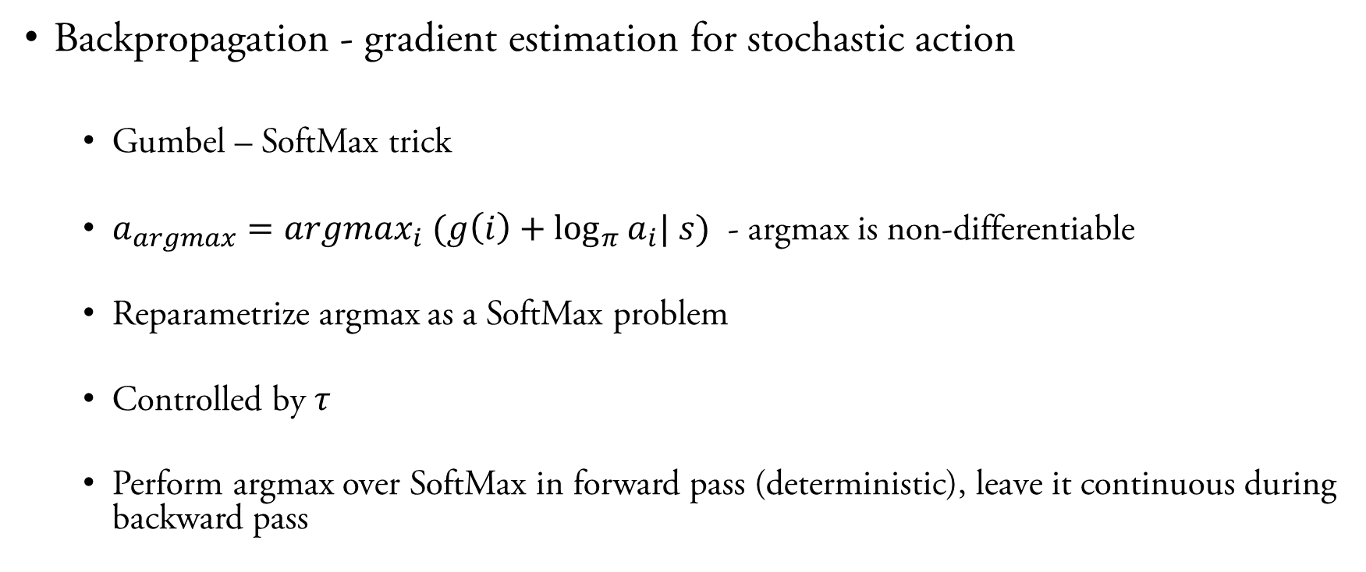
Model-Based Generative Adversarial Imitation Learning
Backpropagation - gradient estimation for stochastic action
Gumbel – SoftMax trick
$a_{argmax}=argmax_{i} (g\left(i\right)+\log_{π}{a_{i}| s})$ - argmax is non-differentiable
Reparametrize argmax as a SoftMax problem
Controlled by $τ$
Perform argmax over SoftMax in forward pass (deterministic), leave it continuous during backward pass

Slide 15
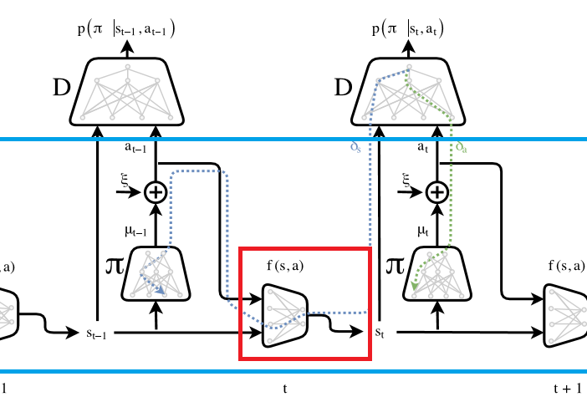
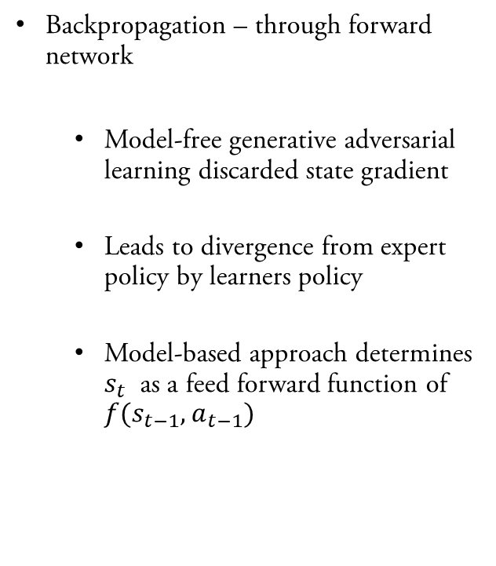
Model-Based Generative Adversarial Imitation Learning
Backpropagation – through forward network
Model-free generative adversarial learning discarded state gradient
Leads to divergence from expert policy by learners policy
Model-based approach determines $s_{t}$ as a feed forward function of $f(s_{t−1}, a_{t−1})$
Source: Baram et al., End-to-End Differentiable Adversarial Imitation Learning, 2017.

Slide 16
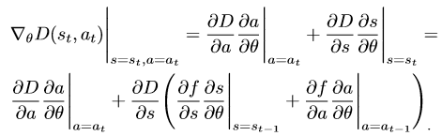
Model-Based Generative Adversarial Imitation Learning
Backpropagation – through forward network
Flow of gradient from time-step t to forward function which generates state at t
Based on outcome of future states, backpropagate in time, influence actions of policy.
Source: Baram et al., End-to-End Differentiable Adversarial Imitation Learning, 2017.

Slide 17
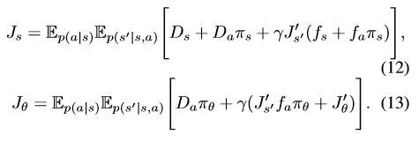
Model-Based Generative Adversarial Imitation Learning
Policy Gradients
Reparameterization of Bellman Equations
Source: Baram et al., End-to-End Differentiable Adversarial Imitation Learning, 2017.

Slide 18
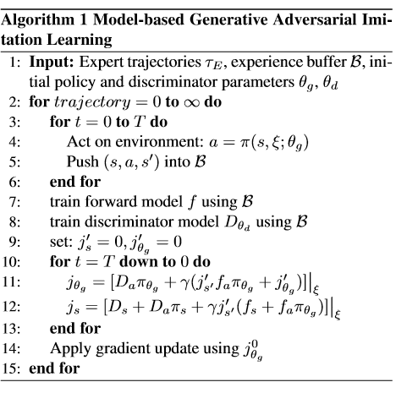
Model-Based Generative Adversarial Imitation Learning
Putting it all together
Source: Baram et al., End-to-End Differentiable Adversarial Imitation Learning, 2017.

Slide 19
Model-Based Generative Adversarial Imitation Learning
Experiments
3 discrete control tasks (Cartpole, Mountain-car, Acrobat)
5 continuous tasks ((Hopper, Walker, Half-Cheetah, Ant, and Humanoid)
Length of trajectory – 1000
Network architecture
2 Hidden layers + ReLU
ADAM Optimizer

Slide 20
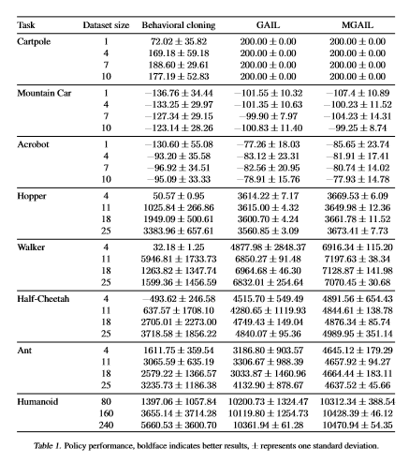
Model-Based Generative Adversarial Imitation Learning
Results
Source: Baram et al., End-to-End Differentiable Adversarial Imitation Learning, 2017.

