Slide 1
CS411 Project 2 - FPGA

Slide 2
Contents
Systolic Array operation
Systolic Array System Module
Bram Example ( + VIVADO Block Diagram )
VIVADO simulation
About Verilog
Project Folder
Submission

Slide 3
Systolic Array Operation

Slide 4
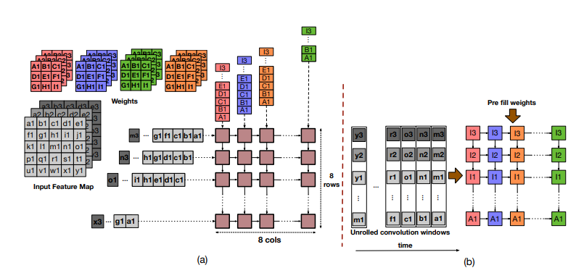
Systolic Array Operation
Operation mode {Weight Stationary, Output Stationary}
Samajdar, Ananda, et al. "Scale-sim: Systolic cnn accelerator simulator." arXiv preprint arXiv:1811.02883 (2018). fig.2

Slide 5
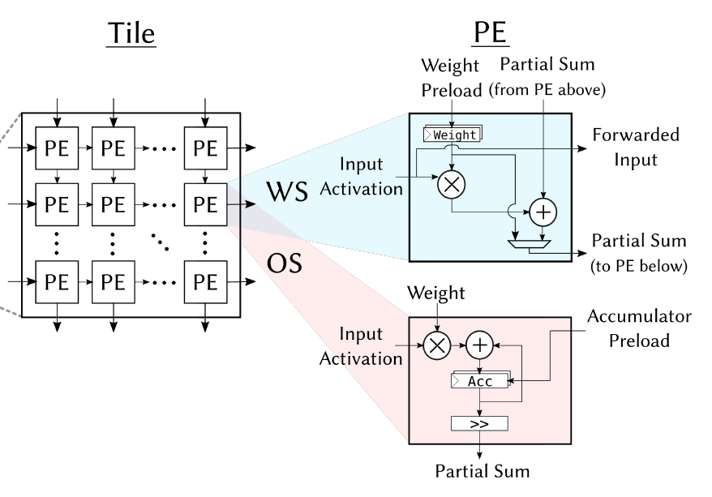
Systolic Array Operation
Operation mode {Weight Stationary, Output Stationary}
PE and Systolic Array can operate in two modes {WS, OS}
The two modes can be switched using a control signal.
H. Genc, A. Haj-Ali, V. Iyer, A. Amid, H. Mao, J. Wright, C. Schmidt, J. Zhao, A. Ou, M. Banister, Y. S. Shao, B. Nikoli´c, I. Stoica, and K. Asanovi´c. Gemmini: An agile systolic array generator enabling systematic evaluations of deep-learning architectures. arXiv:1911.09925 [cs.DC], 2019.

Slide 6
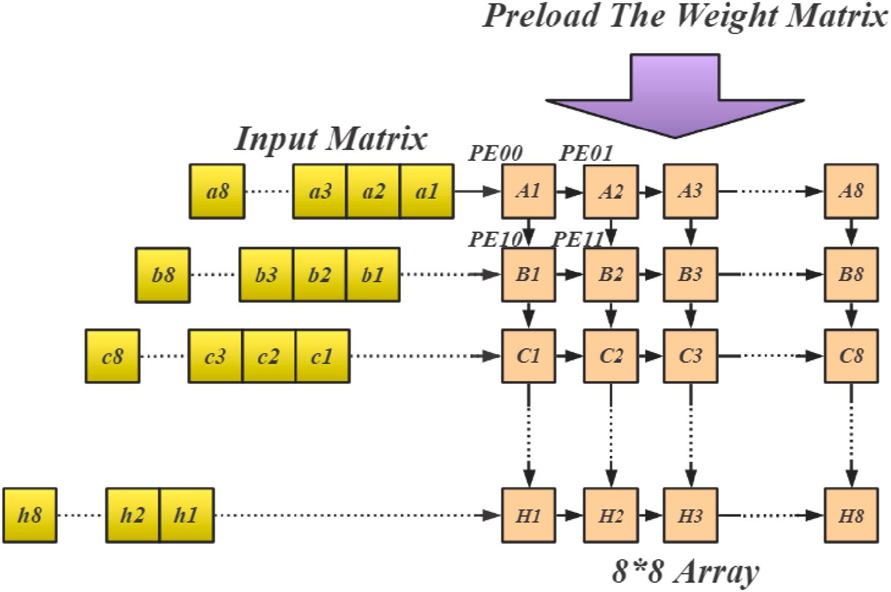
Systolic Array Operation
Operation mode {Weight Stationary}
Pre-load weight matrix into the systolic array.
Flow the activation matrix into the systolic array.
Accumate partial sums in the accumulator.
Store the accumulated result to RAM.
K
N
A
W
M
M
N
Output
K
https://www.sciencedirect.com/science/article/pii/S0167926022000359

Slide 7
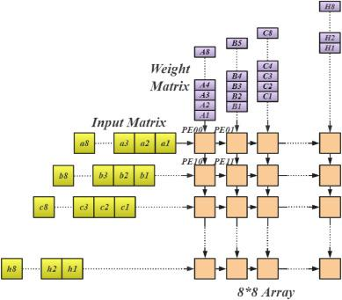
Systolic Array Operation
Operation mode {Output Stationary}
Stream skewed activation and weight data into the systolic array
After all dot-product results are accumulated in the each PE, drain the results into RAM
K
N
A
O
M
M
N
W
K
https://www.sciencedirect.com/science/article/pii/S0167926022000359

Slide 8
Systolic Array Modules
Notes:
\\192.168.2.99\xilinx

Slide 9
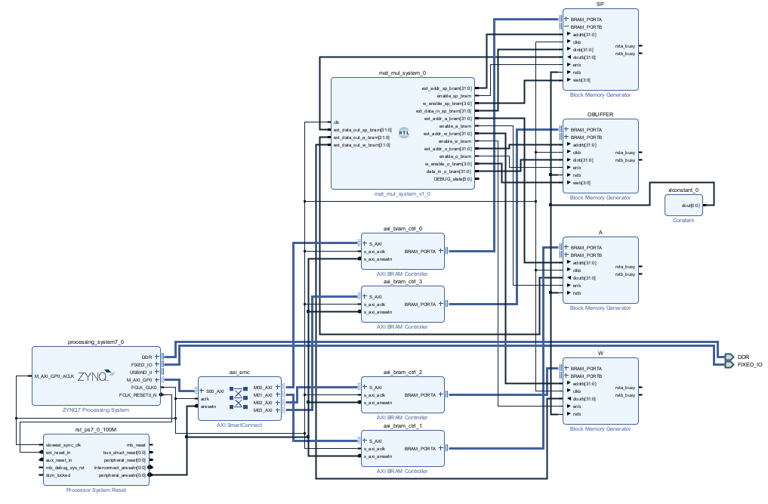
Systolic Array Modules
Entire Diagram
BRAM
A/W_Bram
store activation/weight and feed data to ram
O_Bram
store result (from systolic array)
SP_Bram (you must follow this rule)
addr 0 : start signal (1: start, 0: end)
addr 4 : mode (1: OS, 0: WS)
addr 8 : M
addr 12: K
addr 16: N
addr 100: end signal
[Task 3] Draw this Block Diagram
Verilog Module (Your Task 1,2)
Describe “matmul_system” in the next pages.
In verilog coding, your goal is making matmul.v

Slide 10
Systolic Array Modules
Example Diagram
Ideally, we would create an AXI interface for direct data transfer from DRAM to RAM using DMA.
However, since we haven’t covered that yet, we’re using BRAM to handle data transfer. Additionally, you can simply retrieve data from BRAM.
BRAM_A
matmul_system.v
a_buf
BRAM
FSM
Systolic Array
BRAM_SP
ram
BRAM_O
1
0
BRAM_W
ACC
w_buf
AG
AG : address generator
ACC: accumulator
a_buf: activation buffer
w_buf: weight buffer
AG
signal bus

Slide 11




Systolic Array Modules
③ run automatically
matmul_system
FSM
Output result
A , W Data
BRAM
{A, W}
BRAM_O
⑥ get result
① Set Data and parameter into Bram
② detect start signal
④ set END signal
parameters , start signal
⑤ detect END signal
BRAM_SP
addr 0
addr 100
Notes:
(python) : insert data into A_bram and W_bram. set parameter into SP_bram. + set addr0 of SP_bram to 1 (start signal)
(FPGA) : when start signal set to 1, automatically fsm run and(계산하고) store result to O_bram. + when calculation finish, FPGA sets addr 100 of SP_bram to 1 and addr0 of SP_bram to 0
(python): After observe that addr100 of SP to 1, get result from Bram.

Slide 12
Systolic Array Modules
PE
I/O ports are fixed
act_data_in
INT8 activation data port
wgt_data_in
INT8 weight data port
result_in
INT32
result_out
INT32
operation_signal_in
control signal for PE data flow
{WS : weight preload, activation flow}
{OS : data flow, drain result}
clk
PE
reset
act_data_in [7:0]
result_out [31:0]
wgt_data_in [7:0]
result_in [31:0]
operation_signal_in [2:0]
“ Design your PE !! ”

Slide 13
Systolic Array Modules
SYSTOLIC ARRAY (8x8 example)
Operation
mode : {OS, WS}
input data stream every one cycle.
wgt_data_in
0
0
0
wgt_data_in [7:0]
act_data_in
(0,0)
(0,1)
(0,7)
(1,0)
(1,7)
operation_signal_in [2:0]
PE
result_out [31:0]
operation_signal_in [2:0]
act_data_in [7:0]
(7,0)
(7,1)
(7,7)
result_data_out

Slide 14
Systolic Array Modules
Index/Address Generator (optional)
This module serves the function of determining where to store incoming data in RAM and the accumulator, as well as indicating which data stream out to system.
The input is provided by the enable signal sent from the FSM. When the enable signal is activated, it automatically generates the addresses required for the operation of the systolic array. The output consists of address and the enable signal for RAM and the accumulator.

Slide 15
Bram Example + Block Diagram

Slide 16
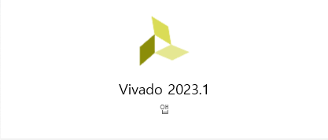
Bram Example
Create the VIVADO project.
This link explain how to create VIVADO project with PYNQ-Z2 Board
https://discuss.pynq.io/t/tutorial-creating-a-hardware-design-for-pynq/145
This example was executed on the following version of VIVADO.
Notes:
This example was executed on the following version of VIVADO.

Slide 17
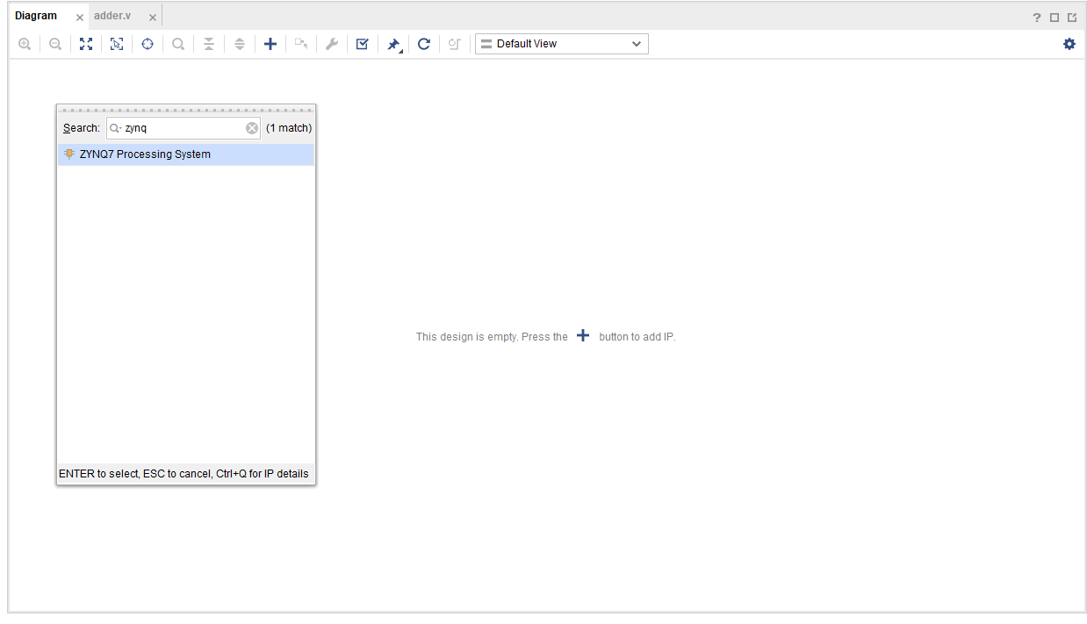
Bram Example
1. Click the “+” button
After you make new project, build the Block Diagram
Add Zynq7 PS that is one part of PYNQ-Z2 board.
2. select “Zynq7 PS”

Slide 18
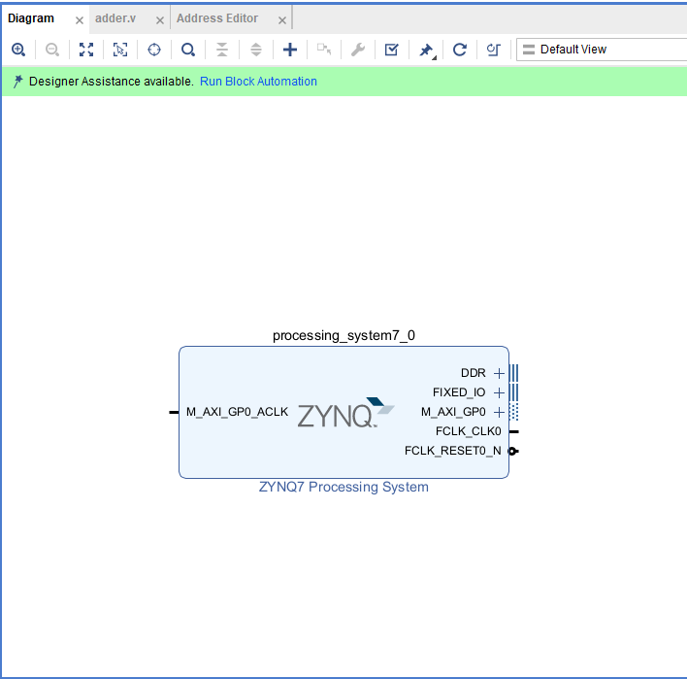
Bram Example
1. Click this : and click OK
Run Block Automation
Make DDR, FIXED_IO external port
There is no need to know detail about this.

Slide 19
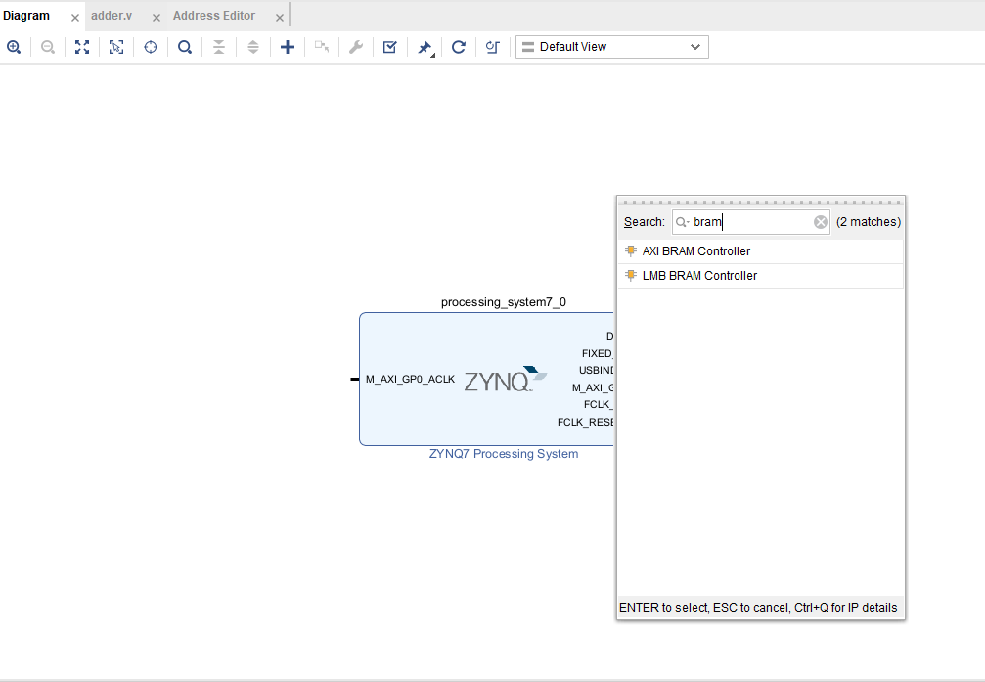
Bram Example
Search “AXI BRAM Controller” and click
Add AXI BRAM Controller.
This IP manages data transfer to/from the PS and stores/retrieves it from BRAM

Slide 20
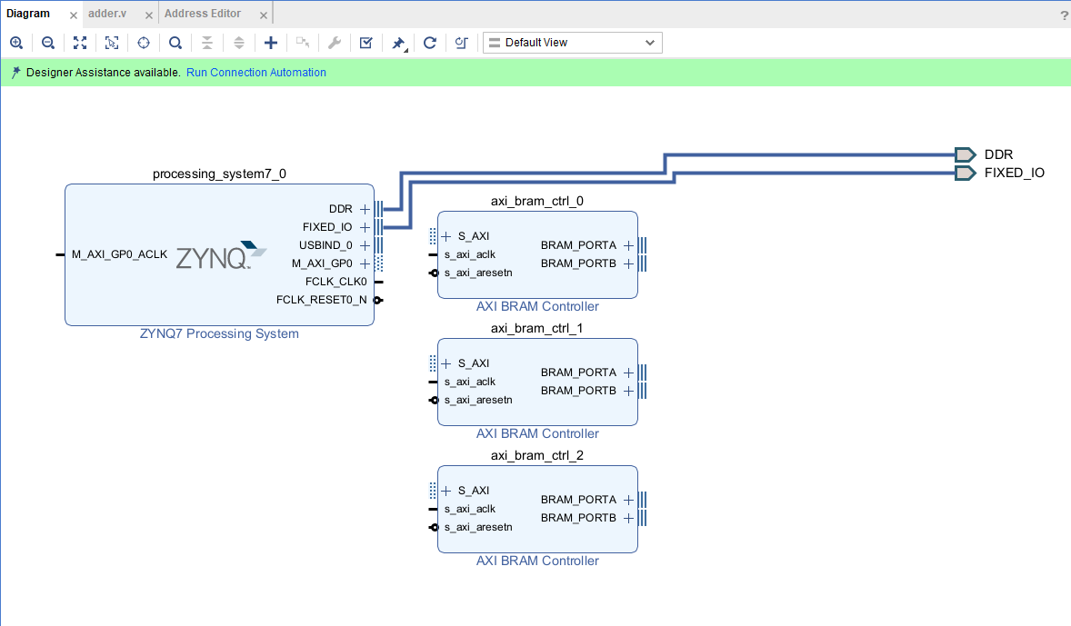
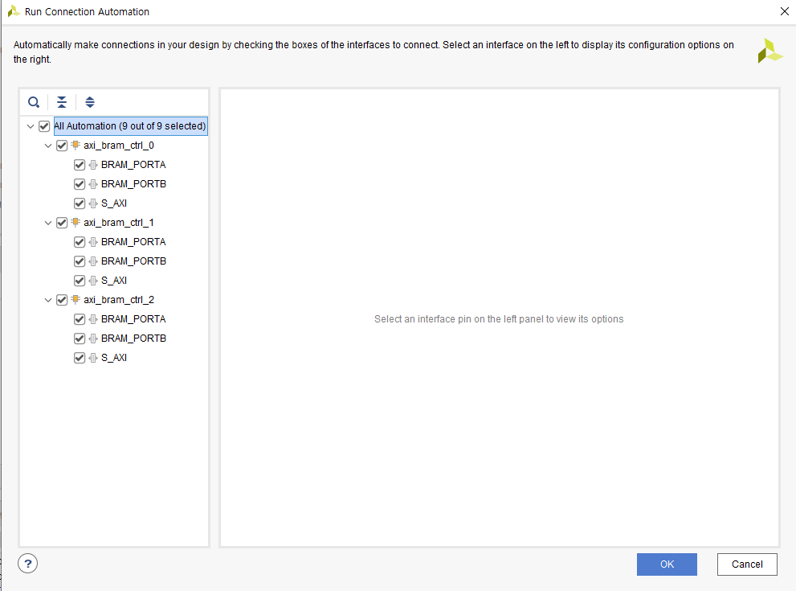
Bram Example
2. After that click this
3. Check all box and Click OK
In our case, you need 3 Bram controller.

Slide 21
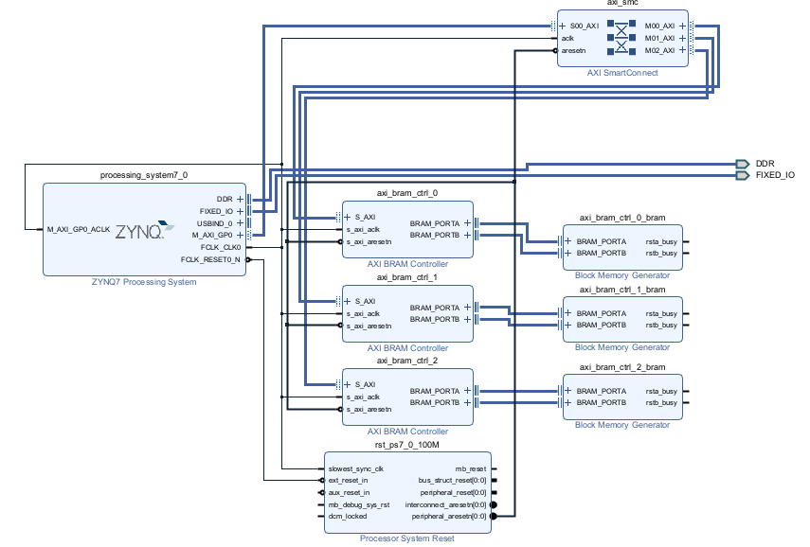
Bram Example
Then, you can see this scheme.

Slide 22
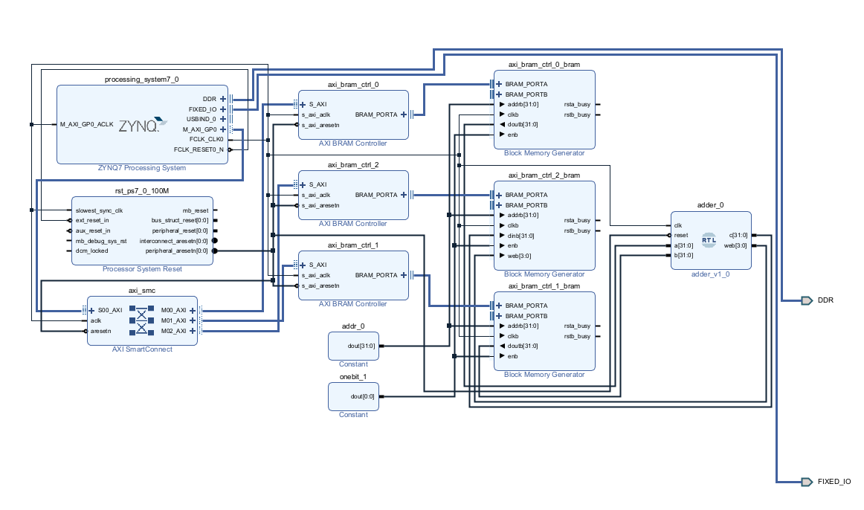
Bram Example
Entire Scheme
Change to 1 port (double click the IP image)
Establish a connection between the ‘adder module, as provided in the project file, and the BRAM port
Add IP “Constant”. If you double click the IP, you can modify constant value and its width.

Slide 23
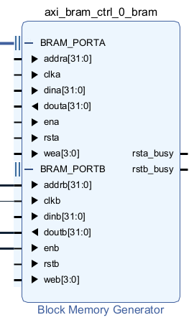
Bram Example
Bram Port
addr : address of Bram
clk : clock signal
din : data_in
dout : data_out
rst : reset
wea[3:0] : write enable (1 bit → 1 byte)
(read)
addr = [address]
dout = (you can get data from here)
(write)
addr = [address]
wea = 4’b1111
din = [4 bytes DATA]

Slide 24
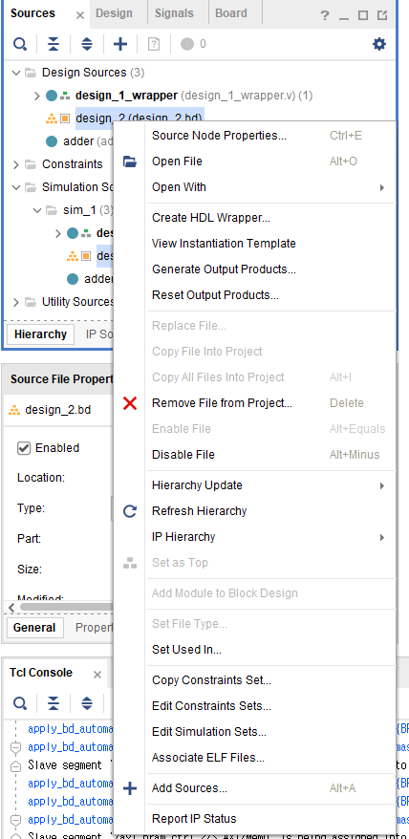
Bram Example
Make wrapper verilog file from your Block Diagram
2. you can make this verilog file : verilog file of Block Diagram
1. click

Slide 25
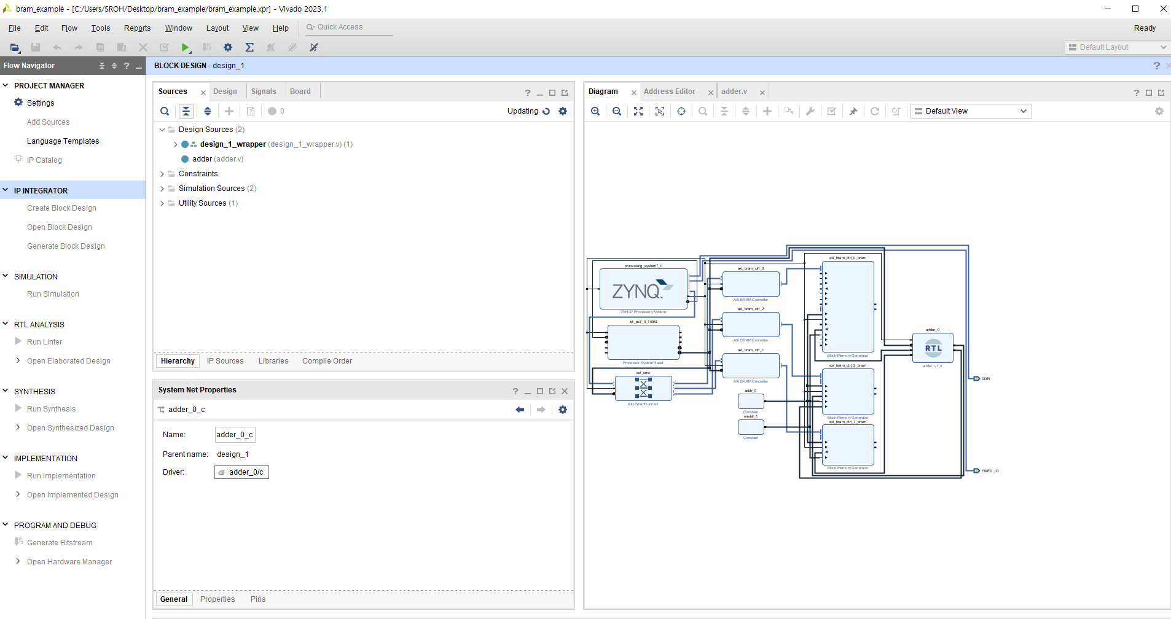
Bram Example
click “generate bitstream”

Slide 26
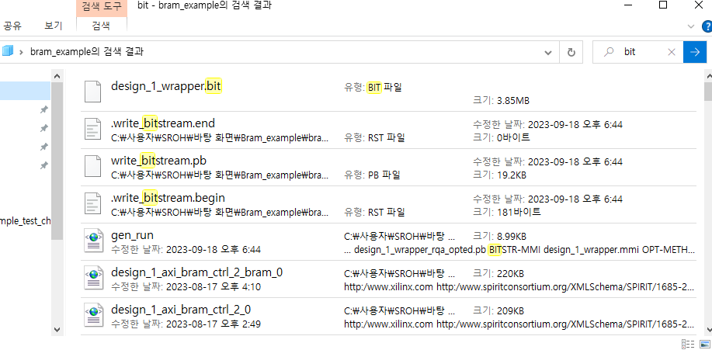
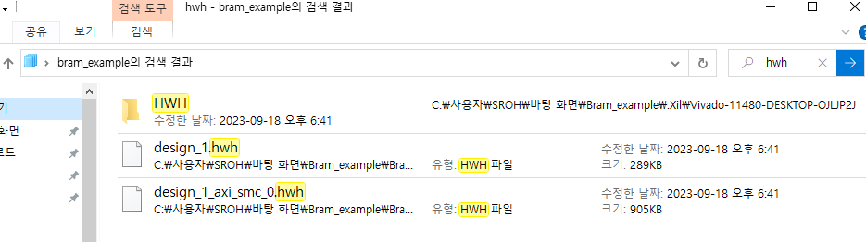
Bram Example
In VIVADO project folder, please search for the ‘bit stream file’ and ‘hwh file’ using the keywords ‘bit’ and ‘hwh.’
Once located, select these two files.
Next, open the Jupyter notebook and move these selected files into the Jupyter notebook folder.
Notes:
"In the VIVADO project folder, please search for the 'bitstream file' and 'hwh file' using the keywords 'bit' and 'hwh.' Once located, select these two files. Next, open the Jupyter notebook and move these selected files into the Jupyter notebook folder."

Slide 27
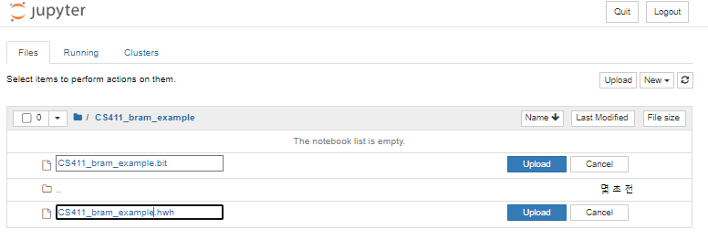
Bram Example
Next, click the Upload button
Upload two file, and change file_name as you want.
In this case, name is “CS411_bram_example”

Slide 28
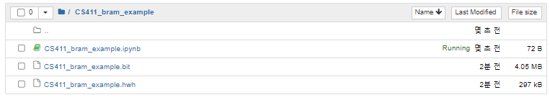
Bram Example
Plus, make new Notebook

Slide 29
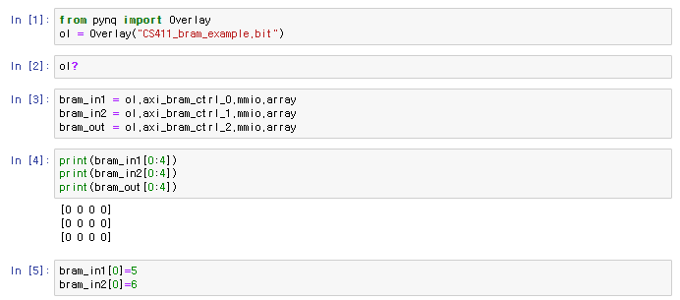
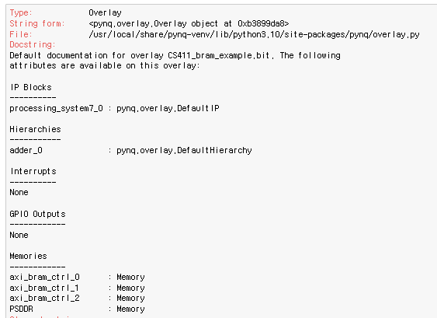
Bram Example
your bitstream file name
ol? generate this
axi_bram_ctrl_x come from here
You can read value from BRAM
You can write value into BRAM

Slide 30
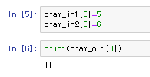
Bram Example
Our adder module read data from addr0 of bram_in1 and bram_in2, and store the result into addr0 of bram_out
https://www.youtube.com/watch?v=zbumITJQ2Z8
[Using PYNQ MMIO (Memory Mapped IO)]
“Now you can communicate with Bram.”

Slide 31
Vivado Simulation

Slide 32
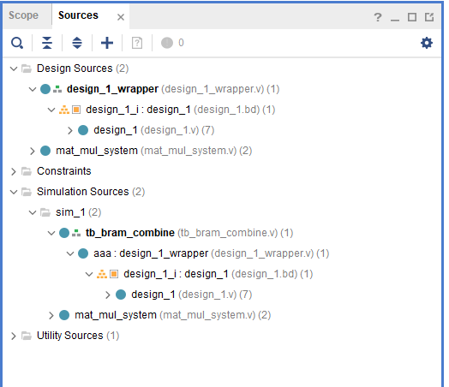
Vivado Simulation
Set Design source file and Simulation source file
This button is for adding new source file (modules or testbenches.)
To set the proper file as the Design Source, right-click on it and select ‘Move to Design Source.’ This file will be used during the synthesis, implementation, and bitstream writing processes.
To set the proper file as the Simulation Source, right-click on it and select ‘Move to Simulation Source’

Slide 33
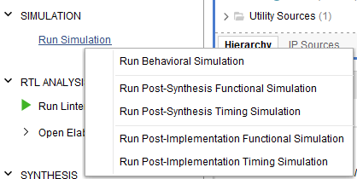
Vivado Simulation
Simulation
prepare test bench file (.v)
(necessary)
You can run the simulation using your ‘module.v’ and ‘testbench.v’ files. The simulation is based on the RTL files.
(necessary)
You can run the simulation after synthesis. First, synthesize the module and prepare ‘testbench.v.’
The simulation will be based on the netlist, which may produce different results from the behavior simulation.
(not necessary)
You can run the simulation after implementation. Please note that if your module has more than 125 I/O ports. you may not be able to proceed with the implementation step.

Slide 34
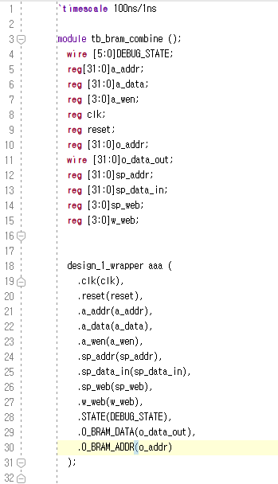
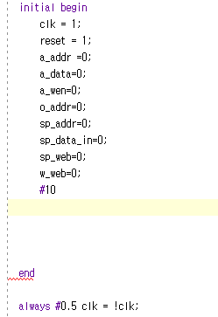
Vivado Simulation
Behavior Simulation
prepare test bench file (.v)
assign value to input port
100ns/1ns is recommended
timescale: #1 = 100ns
simulate every 1ns
Wait 100x10 ns (10 cycle)
…
declare ports :
input → reg
output → wire
Make the instance of your module that you want to simulate.
Clock signal value change every 0.5x100ns
T = 100ns = #1

Slide 35
Vivado Simulation
Post-synthesis Simulation
You have to synthesize your module
This simulation is bases on the synthesis result
If you make changes to your Verilog code or block diagram, you’ll need to synthesize it again.
Ensure you have the testbench file, which should be the same as the one used for behavioral simulation.
(Confirmed) The post-synthesis simulation result corresponds to the same operation as the behavior simulation.

Slide 36
About Verilog

Slide 37
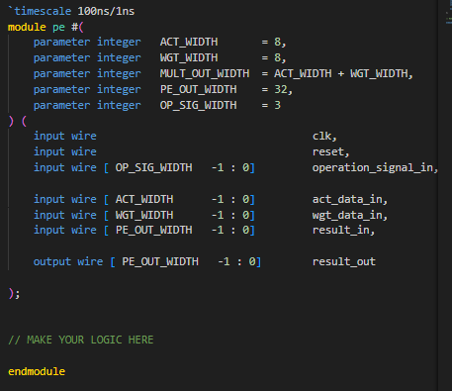
Module
module name
parameters: you can declare them here and use them when you build logic
Here, You can declare I/O ports.
In this part, you can build your logic.
You can declare wires and regs, and build combinational or sequential logics.
(we recommend drawing diagram before writing code)

Slide 38
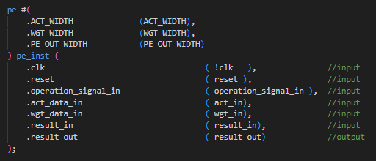
How to make instance of module
The name of module
Name of parameter (same as names in module declaration)
The name of instance
Name of I/O (same as names in module declaration)
In items enclosed within parentheses represent parameters, as well as wires or registers that have been declared at the location where this instance is utilized.

Slide 39
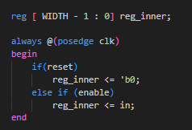
always @
This example is simple register has reset and enable option.
Meaning of code: Every rising edge of clock, if reset is 1, then write 0 into reg_inner, and if reset is 0 and enable is 1, then write ‘in’ into reg_inner

Slide 40
FSM
FSM(Finite State Machine)
Input + Current_state ⇒ Next_state
You can represent STATE in various ways !
STATE | binary encoding | Gray encoding | Johnson encoding | One-hot encoding
0 | 00 | 00 | 000 | 0001
1 | 01 | 01 | 001 | 0010
2 | 10 | 11 | 011 | 0100
3 | 11 | 10 | 111 | 1000

Slide 41
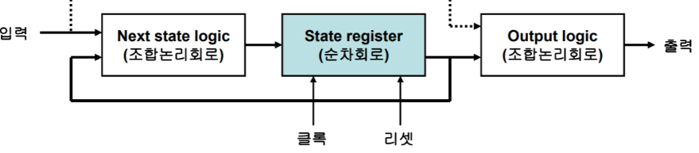
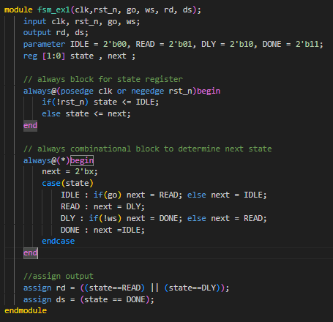
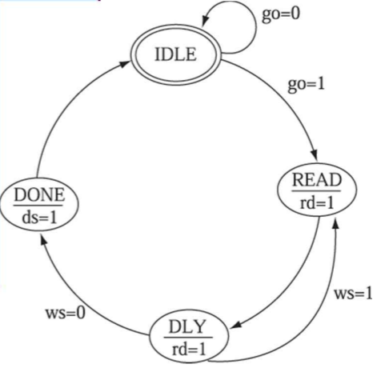
FSM (example)
Input
Output
Clk .
Reset
example code ⇒
https://returnclass.tistory.com/197

Slide 42
FSM
If you are not familiar with FSM.
The following slides will be helpful.
https://inst.eecs.berkeley.edu/~eecs151/sp22/files/verilog/verilog_fsm.pdf
or Try searching on Google

Slide 43
Project Folder

Slide 44
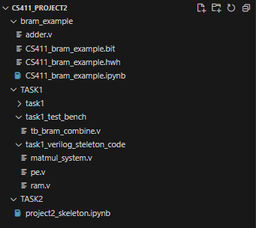
BRAM_example
That is for BRAM_Example and includes the following components:
“adder.v” : This module is utilized in the bram_example.
“.hwh” “.bit” files : In your example, you need to generate a bitstream file that matches functionality if this file.
“.ipynb” file : You should use this file to verify functionality.
4

Slide 45
TASK 1
This is for TASK 1 ~ TASK 2
This folder contains a VIVADO project file (.xpr) specifically designed for running the “bram_combine”test. You can open the VIVADO project by using this file.
There is a test bench file available. You can use this file to perform simulation.
You can find skeleton codes.
You need to write additional module.v files to develop your matmul_system more easily.
4

Slide 46
TASK 4
This is the Jupyter notebook for TASK 4. Please ensure to relocate it to your Jupyter notebook folder. Within this notebook, you are tasked with creating the ‘matmul_WS’ and ‘matmul_OS’ functions. You may refer the example provided in the bram_example case
4

Slide 47
Submission

Slide 48
Score
TASK 0: Design Document (30%)
TASK 1,2: Verilog test bench (tb_bram_combine.v)
{Behavior, Post-synthesis func + timing} (25%, 15%)
TASK 3,4: Test functionality in jupyter notebook (30%)
(Extensible: recommendation)
While it’s not part of the scoring criteria, for Project 3, you do have the flexibility to adjust the size of the systolic array from 8x8 to 16x16 or 32x32 as needed. Modulating the systolic array size using parameters can indeed help reduce the workload and make the code more adaptable to different requirements.

Slide 49
Reference
PYNQ HW Setting
https://blog.umer-farooq.com/a-pynq-z2-guide-for-absolute-dummies-part-i-fun-with-leds-and-switches-47dd76abf9a9
https://pynq.readthedocs.io/en/latest/getting_started/pynq_z2_setup.html

Slide 50
Submission
Due date : 2023.11.09
Team_{Team_number}_project2 (.zip file)
ㄴ Document
ㄴ your all verilog file (.v)
ㄴ VIVADO project folder
ㄴ PYNQ jupyter notebook folder (.jpynb + .bit + .hwh)

