Slide 1
SIMPLE Project – VR Scientific Guidelines
Scientific Advisor: Sébastien Marcombe
sebastienmarcombe@gmail.com
Context: Laos / Southeast Asia

Slide 2
Objective
Ensure VR content is:
- Scientifically accurate
- Locally relevant
- Visually realistic

Slide 3
Target Species
Aedes aegypti
Aedes albopictus
Day-biting, urban mosquitoes

Slide 4
Aedes Life Cycle
Egg → Larva → Pupa → Adult (7–10 days)
Critical visual elements for VR
Eggs laid just above water line (not floating randomly)
Larvae:
Move with wiggling motion
Hang at an angle from surface
Pupae:
Comma-shaped
Active, mobile (not static)
Adults emerging from water surface

Slide 5
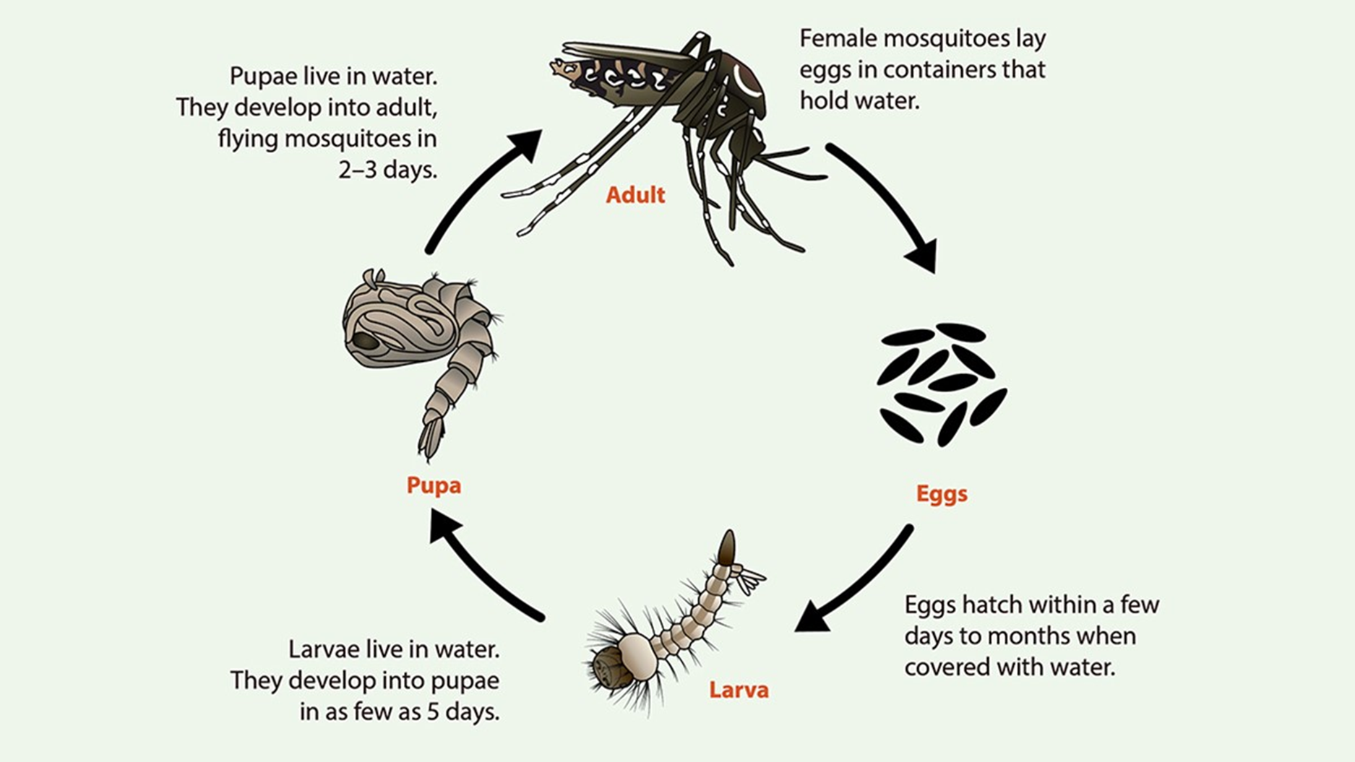
Life cycle

Slide 6
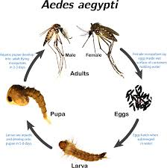
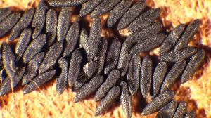
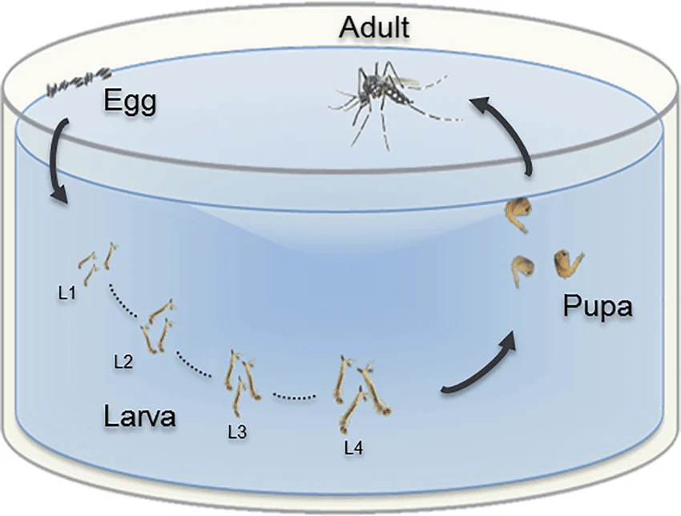

Slide 7
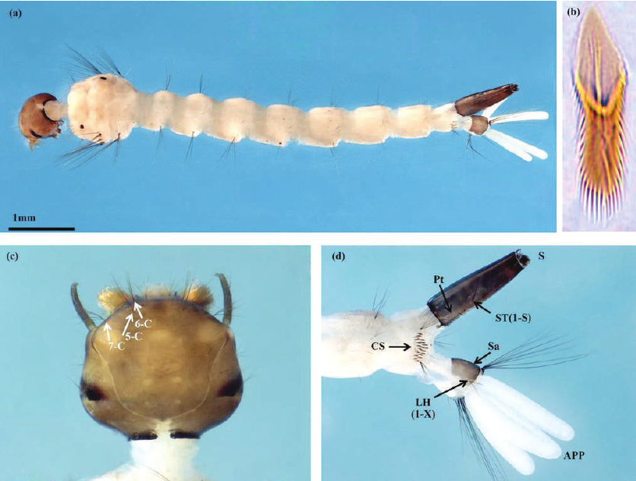
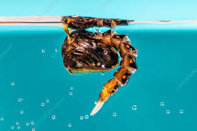
Larvae & pupae

Slide 8
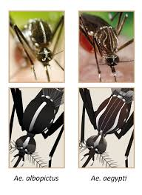

Slide 9
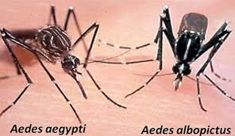
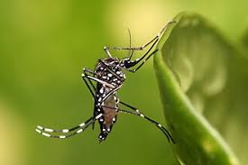

Slide 10
Aedes Life Cycle
Messages to communicate
“Small water = enough for mosquitoes”
“Life cycle is fast → frequent breeding” <10 days
⚠ Common mistakes to avoid
❌ Showing larvae at bottom only
❌ Clean/clear water only (they prefer organic-rich water) Show small containers, not ponds or rivers
❌ Long life cycle (>2 weeks unrealistic in tropics)

Slide 11
Adult Behavior
Key scientific facts
Day-biting mosquito (peak: early morning & late afternoon)
Prefer humans (anthropophilic)
Flight range: short (~50–100 m)
Eggs resist desiccation (important concept!)
Critical visual elements
Biting:
Often lower legs/ankles
Indoor AND outdoor
Resting:
Dark places (under furniture, clothes, walls)
Distinctive black + white stripes

Slide 12
Adult Behavior
Messages to communicate
“You can be bitten during the day”
“Mosquitoes live close to you”
⚠ Mistakes to avoid
❌ Night biting (confusion with malaria vectors)
❌ Long-distance flight scenes
❌ Rural-only setting (Aedes is urban/peri-urban)

Slide 13
Aedes Breeding Sites (Laos)
Domestic
Water storage jars (big ceramic jars)
Buckets, tanks
Flower pots
Peri-domestic
Used tires
Plastic containers
Construction sites
Natural (secondary)
Tree holes
Bamboo

Slide 14
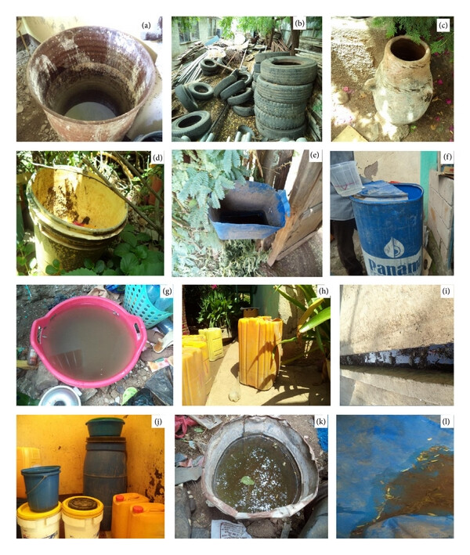

Slide 15
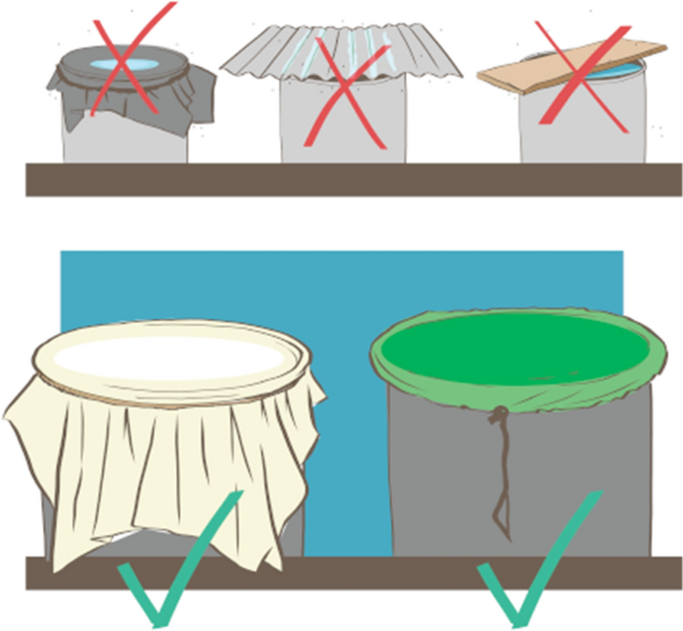

Slide 16
Breeding sites
Critical visual elements
Small water volumes (not big ponds)
Often clean-looking water
Containers close to houses
Messages to communicate
“Your house = main risk area”
“Even clean water can produce mosquitoes”
⚠ Mistakes to avoid
❌ Rice fields / large ponds (not Aedes)
❌ Dirty sewage focus only
❌ Unrealistic Western environments

Slide 17
Human–Mosquito Interaction & Transmission
Human → Mosquito → Human
Only females bite
Virus develops ~7–10 days

Slide 18
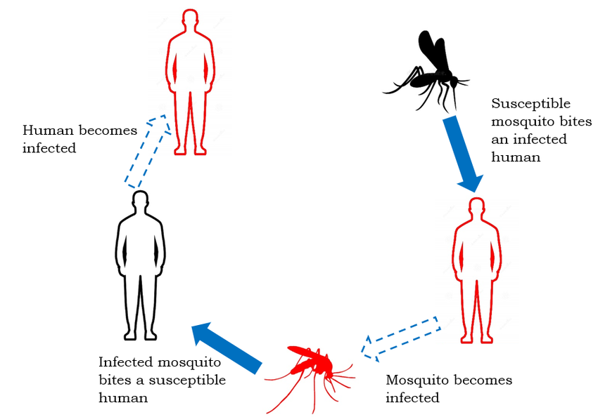
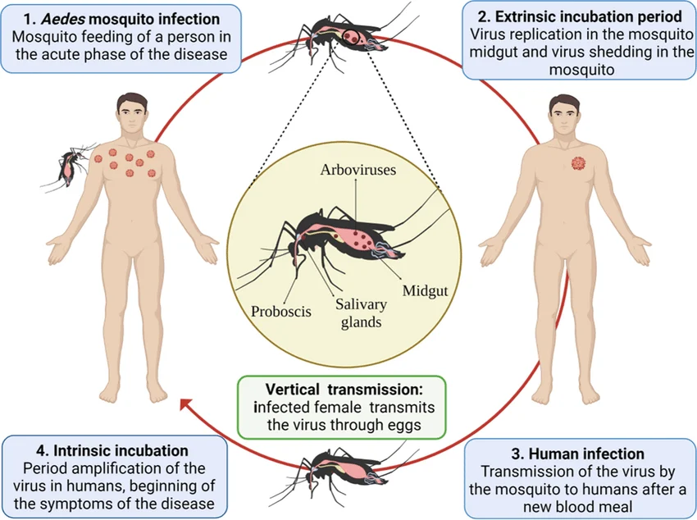

Slide 19
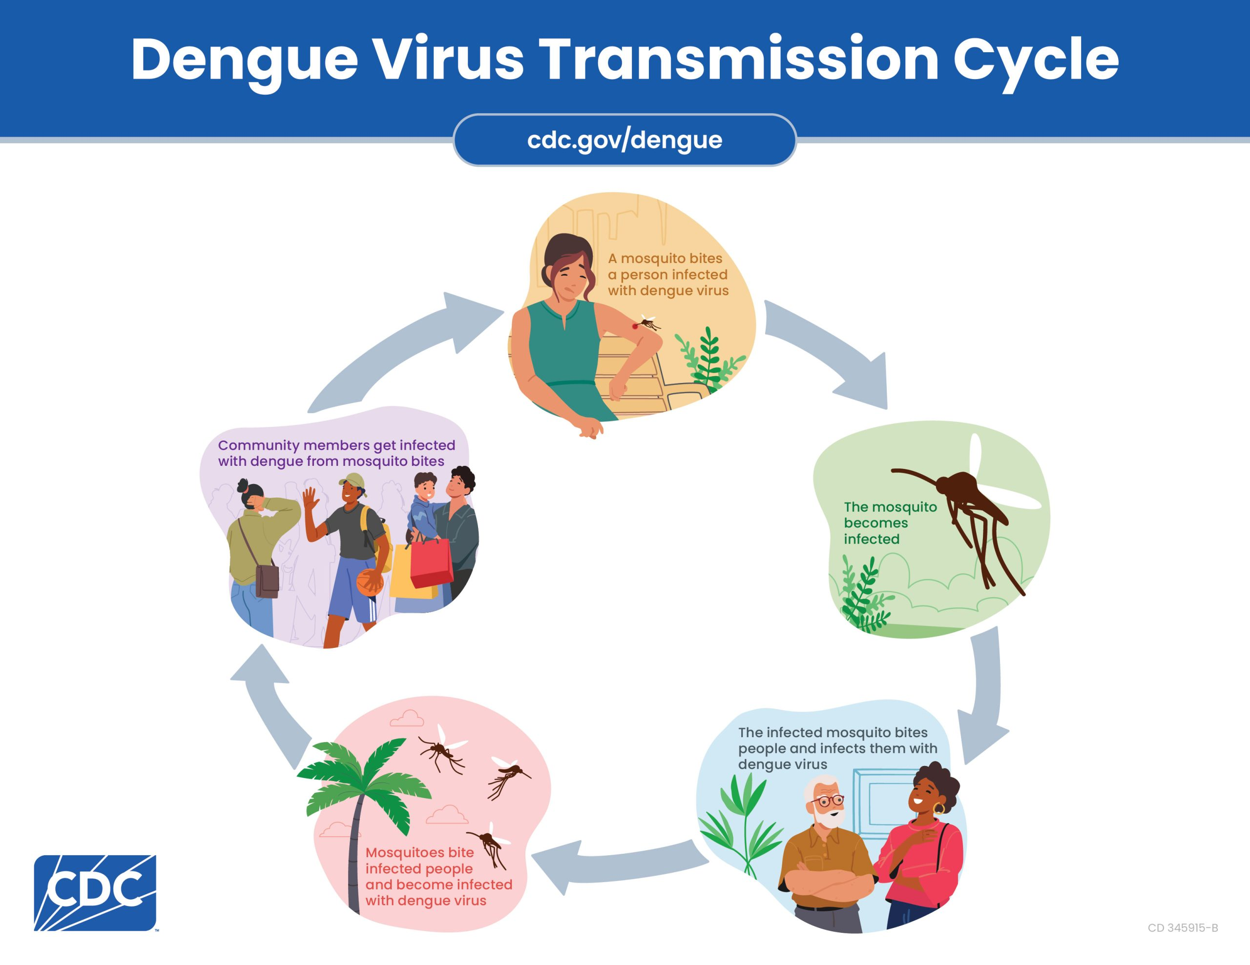
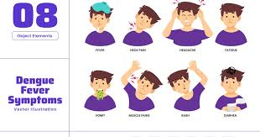

Slide 20
Human–Mosquito Interaction & Transmission
Key scientific facts
Transmission cycle:
Mosquito bites infected human
Virus develops in mosquito (~7–10 days)
Mosquito infects another human
Only female mosquitoes bite

Slide 21
Human–Mosquito Interaction & Transmission
Critical visual elements
Bite → virus uptake → virus in mosquito → next bite
Close-up of proboscis feeding (important for realism)
Messages to communicate
“Humans are part of the cycle”
“Protect yourself = protect community”
⚠ Mistakes to avoid
❌ Mosquito born infected (usually false)
❌ Immediate transmission after first bite
❌ Exaggerated symptoms during bite

Slide 22
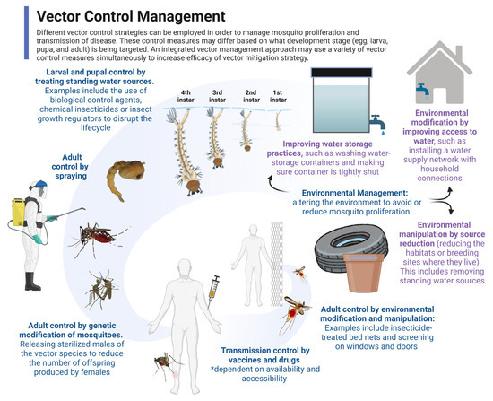
Mosquito control

Slide 23
Mosquito control
🔬 Key interventions
Source reduction (MOST IMPORTANT)
Empty containers
Cover water storage
Clean weekly
Larval control
Bti (biological larvicide)/Insecticide
Fish (guppie- xxx)
Adult control
Space spraying (fogging) → limited effect
Wolbachia program

Slide 24
Mosquito control
Critical accuracy points
DO NOT overemphasize fogging
Focus on community responsibility

Slide 25
Core Messages
Remove standing water
Protect during daytime
Mosquitoes live near you

Slide 26
Validation Checklist
Correct species
Day-biting behavior
Local context
Realistic life cycle
Clear messages

Slide 27
https://www.google.com/search?sca_esv=f7e6af31ea0d095e&hl=en&dcr=0&sxsrf=ANbL-n5uW-Z3CWw62jrXaUkVJLyeOiN-vg:1774852000997&udm=7&fbs=ADc_l-aN0CWEZBOHjofHoaMMDiKpaEWjvZ2Py1XXV8d8KvlI3sbM0Xv-BZKE_VrZb6-djVhOtEikQxVPaqfTMUjZRiWtKCoslmAGmF-50j-Z_XShN7YBAJYdGrM2bb5tisj5TcrLe-qCaC_NeJxSss5zCPpjS20Jvdool_HfeJcqz65IOIEXEq5QWXUgyAFZV8X6VvgcF03shdKku5NvkAPTXoqUU8hnrA&q=aedes+aegypti+/+aedes+albopictus&sa=X&ved=2ahUKEwipjbH4_saTAxWv3zQHHVnIIykQtKgLegQIDhAB&biw=1667&bih=884&dpr=1.09#fpstate=ive&ip=1&vld=cid:9ea75e10,vid:qMT7nkXpgno,st:0

Slide 28
https://youtu.be/-w6FnteWtHU

