Slide 1
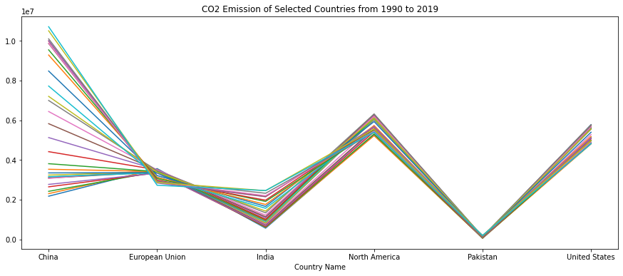
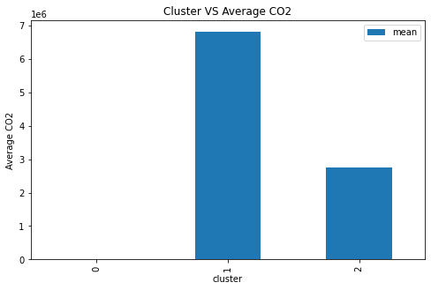
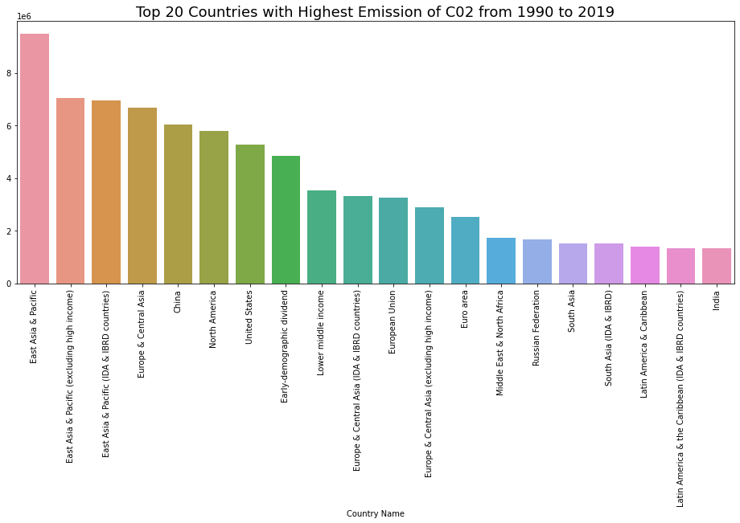
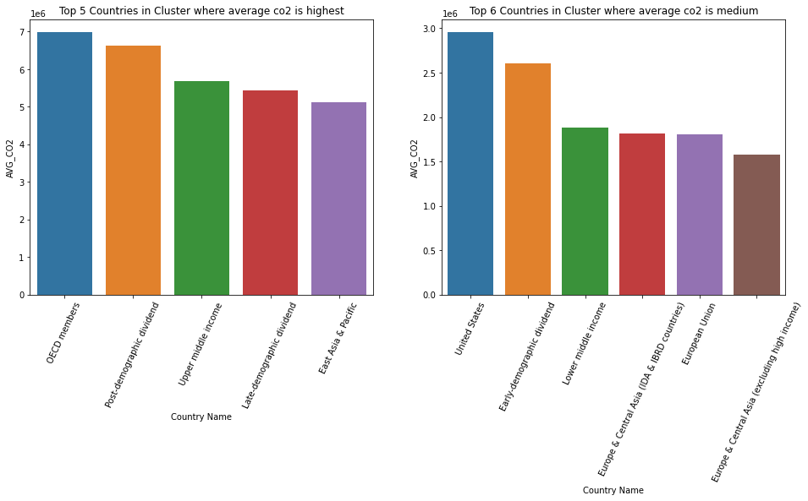
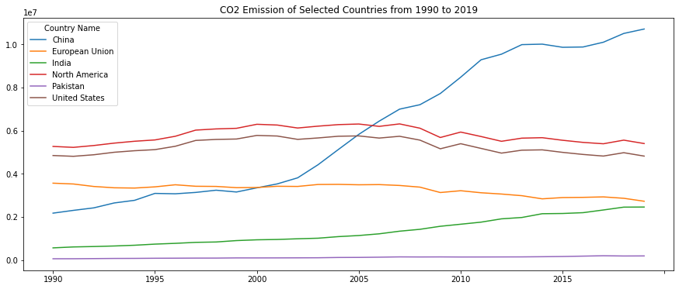
Climate Change
Introduction
Climate change is the long-term changes in temperature, precipitation, wind patterns, and other measures of climate caused primarily by human activities such as the burning of fossil fuels, deforestation, and land-use changes that are releasing CO2 into the atmosphere and warming the planet, causing changes in precipitation patterns, rising sea levels, and extreme weather events with negative effects on human health, agriculture, and natural ecosystems.
Last year 2022, Pakistan faced a heavy flood due to heavy rains that were caused by climate change. So, in this study I’ll be working on world bank dataset to see if it is really true that Pakistan released a lot of CO2 that caused Pakistan to face this tragedy.
Visualization
From world bank dataset I extracted data of total population and CO2 emission for all country and tried to see how much was emitted by Pakistan compared to other countries. Top 20 countries with highest CO2 emission from 1990 to 2019 are…
Let’s compare the CO2 emission of Pakistan with top countries of world with respect to economy and industry.
From the above two plots we can see that Pakistan is even close to these countries for CO2 but still it has to face effects of climate change.
The change in the CO2 emission of these top countries is given in the following table.
CO2 emission from China and India is increasing yearly but European Union is trying to control it that’s why the graph is a little reversed.
Clustering
I applied Kmeans clustering on the countries for their CO2 emission to get the same countries into one group. I made three clusters depending upon CO2 emission.
Low CO2 Emission
Medium CO2 Emission
High CO2 Emission
Pakistan was in Low Emission cluster and Pakistan only emitted 0.005 percent of whole world CO2 from 1990 and it was at the end even in its own cluster. Clusters with average CO2 emission are present below.
Top countries of other clusters with average CO2 emission are…
So, from all above analysis we can see that Pakistan did nothing to harm the climate and nature with respect to other countries but still it has to face natural disasters. So, Climate change is not the issue of only Pakistan. It is an international issue and the whole world has to take steps to overcome this problem.
https://github.com/khan-asim-88/7PAM2000-0901-2022-Applied-Data-Science-1-Assignment-3-Clustering-and-fitting-poster-40

