Slide 1
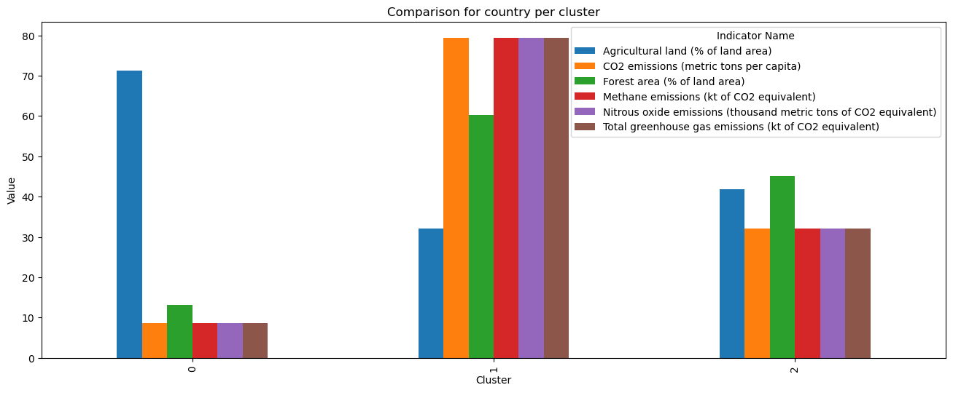
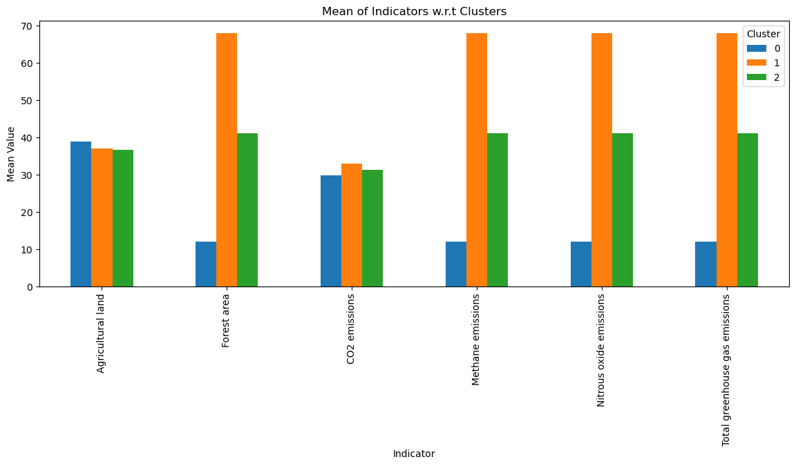
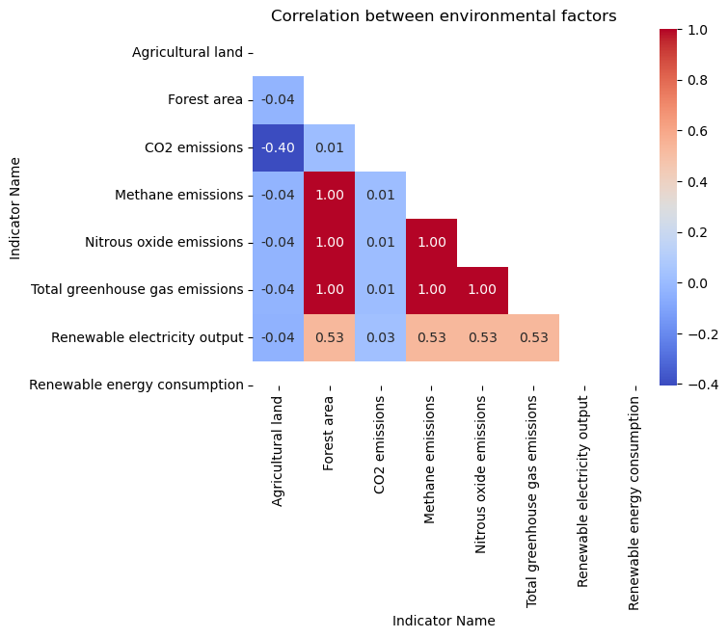
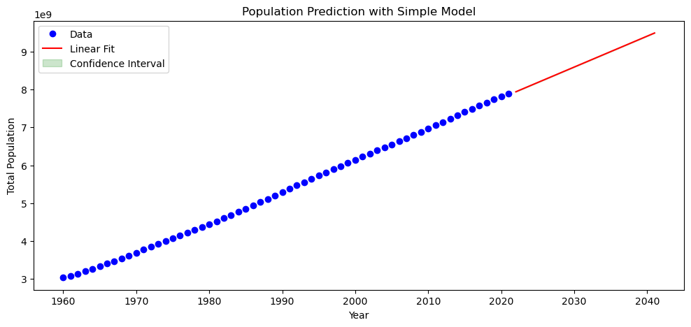
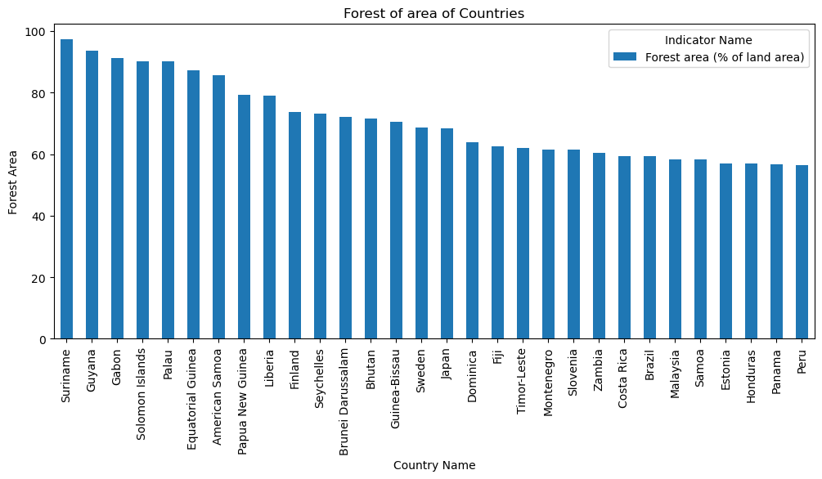
Analyzing the Climate Change Indicators and Population Growth Asim Muhammad Salim
Introduction
Climate change is a growing concern that affects the planet's health and the well-being of people and animals. Human activities, such as deforestation, agriculture, and the use of fossil fuels, contribute to climate change. In this study, we analyze climate change indicators and identify the top forest area countries using data from the World Bank.
Background
We used the following climate change indicators from the World Bank…
Then I performed in-depth analysis on selected data.
Analysis
Cluster 0
Cluster 1
Cluster 2
38.83% Agricultural land
12.12 metric tons of CO229.77% forest area
36.94% Agricultural land
67.84 metric tons of CO232.93% forest area
36.62% Agricultural land
41.05 metric tons of CO231.27% forest area
Agricultural land
Forest area
CO2 emissions
Methane emissions
Nitrous oxide emissions
Total greenhouse gas emissions
Renewable electricity output
Cluster 0 had lowest CO2 and methane emissions, cluster 1 had intermediate, and cluster 2 had the highest.
Pearson correlation analysis showed that forest area had a negative correlation with agricultural land, and other indicators.
We forecasted the world's population until 2040 using a curve_fit model trained on data from 1960 to 2021. The predicted values showed an increase from 7.942 billion in 2021 to 9.495 billion in 2040.
Conclusion
In conclusion, our analysis highlights the urgent need to reduce greenhouse gas emissions, particularly CO2 and methane, to mitigate climate change. The clustering analysis identified countries that require immediate attention to reduce their carbon footprint. The high forest area countries identified can serve as an example for sustainable land use and conservation efforts. Furthermore, our forecast of world population growth emphasizes the need to address climate change now to secure a sustainable future for generations to come. It is essential to take immediate action at both individual and national levels to reduce greenhouse gas emissions and promote sustainable practices to mitigate the adverse impacts of climate change.
The top 20 countries with the highest forest area are…
Our KMeans clustering analysis selected one country from each cluster, with the following average indicator values…
GitHub Repository Link: https://github.com/khan-asim-88/7PAM2000-0901-2022-Applied-Data-Science-1-Ref-Def-rework-assignment-3-40

