Slide 1
AI Intro

Slide 2











AI CAPABILITY
Fairness
Reliability & Safety
Privacy & Security
Inclusiveness
Transparency
Accountability
Visual Perception
Decision Making
Text analysis & Conversation
Speech
Computer vision capabilities
Speech and NLP analysis
Past learning
NLP
Machine Learning
Data Science
Infra hosted On-premise/Cloud/hybrid

Slide 3
Azure AI Services
Speech
Speech Recog.
Language
Text Analysis
Translation
Vision
Image and Video analysis
OCR
Generative
Speech Synthesis
Speech Translation
Speaker Recog.
Language Understanding
Question Answering
Image Classification
Object Detection
Generate text completion
Image Generation

Slide 4















Build/Code
Copilot Studio
Visual Studio Code, Visual Studio etc..
AAI Service
GPT LLMs
DALL-E
Etc..
AAI
Azure Machine Learning Studio
MLOps
Notebooks
Pipelines
Model as a Service
Vendor Provided
Opensource
Machine Learning
Auto ML
Prompt Flow
Etc..
Microsoft Services
Other Apps
Data Platform
Cloud Service Provider
Data lakes, storage account, Database
OneLake
Governance, Risk & Compliance
On-premise
Infra
Datacenter
Compute (CPU, GPU & AI), Continer, Network, IO & Security

Slide 5
Azure AI Services Security, Monitoring & Hosting

Slide 6




AAI Service Security
Accessing endpoint using vault
App uses key to access AAI Services resource
2
3
1
Code Base
Key & Endpoints
Key Vaults
Azure AI Services
Keys & Endpoints
Create Service Principle to access AAI services via Key Vault
4

Slide 7

AAI Service Monitoring
Azure Monitor
Alerts, Diagnostic Loging and Metrics
Accessing endpoint using vault
App uses key to access AAI Services resource
2
3
1
Code Base
Key & Endpoints
Key Vaults
Azure AI Services
Keys & Endpoints
Create Service Principle to access AAI services via Key Vault
4

Slide 8






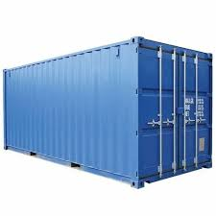







Transport Ind.
IT Ind.

Slide 9
AAI Service Container
Container images available for commonly used AAI services
App uses key to access AAI Services resource
2
3
1
Code Base
Container Host
Container Instance
Azure Kubernetes Service
Azure Container Apps
Use it for AAI Service billing and monitoring purpose
Create Service Principle to access AAI services via Key Vault
4

Slide 10
Azure AI Vision

Slide 11


Azure AI Vision
Images
Video
Detect, analyze and face recog.
Text Reading from Images and Documents
Analyze Image
Image Classification
Analyze Video

Slide 12
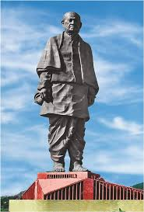
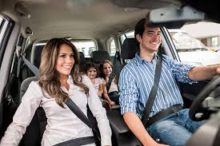
Analyze Image
Object Detection
People Detection
Image metadata
Description and tags
Category identification
Background removal
OCR
Moderation rating
Smart thumbnail generation
VisualFeatures class:
Tags
Objects
Caption
DenseCaptions
People
SmartCrops
Read
Object detection:
Apple, Orange Etc..
Smart Crop:
Extract the object from photos
Tag, Object, People:

Slide 13

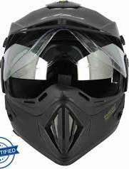

Image Classification
Image Classification
Object Detection
Seat belt
helmet
COCO file: JSON
{
“images”:
{
id:
file_name:
etc…
}
}

Slide 14

Detect, analyze and face recog.
=
Facial Landmark
Facial attributes:
Head pose, Glasses, Blur, Etc..
Facial Comparison
Location
Attributes
Seating Position
Seat Belt
Etc..
Person location
Image Analysis
Face

Slide 15

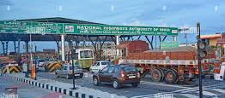
Read Text from image & Documents
Image Analysis
Document Intelligence

Slide 16
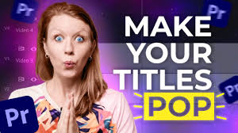
Analyze Video
Azure Video Indexer: Facial recog., OCR, Speech transcription, Topics, Sentiment, Labels, scene segmentation, content moderation

Slide 17
Developing for NLP

Slide 18
NLP
Analyze text with AAI Language
Creating Q & A Solutions
Developing Conversation Lang. model
Custom text classification, custom named entity
Text translation
Speech based: Text to speech, speech to text & translate speech with AAI Speech service

Slide 19

Text Analyze
Language detection
Sentiment analysis
Key phrase extraction
Named entity recog.
Entity linking
Key phrase= “City name”, “the news”
Sentiment=positive
Language=hindi
Entities=https://www.somelink

Slide 20


Creating Q & A solution
Q & A
?
A
Q & A Solution
Conversational Lang. understanding
Users to submit question and expecting some response
User submit an utterance and expect some appropriate response or action
Usage
Response with static answer to the known question
Response indicates the most likely intent and referenced identity
Response
Match and understand question to an answer in the knowledge base
Interpret the utterance, match it to an intent and identify the entities
Query Processing
Client application typically present the answer to the user
Perform appropriate action based on the intent
Client Logic

Slide 21
Conversational Language Understanding
Audio
Text

Slide 22





Custom text classification
Azure AI Language
Single label classification
Multi label classification
Life Insurance
Sports
Life – Term Insurance
Sports & Adv.
General Insurance
Adventure
General Insurance
Adventure
Term Insurance
Strategy
Term Insurance
Strategy
Define Labels
Tag Data
Train Model
View Model
Improve Model
Deploy Model
Classify Text

Slide 23
Custom text classification
Azure AI Language
Single label classification
Multi label classification
Life Insurance
Sports
Life – Term Insurance
Sports & Adv.
General Insurance
Adventure
General Insurance
Adventure
Term Insurance
Strategy
Term Insurance
Strategy
Define Labels
Tag Data
Train Model
View Model
Improve Model
Deploy Model
Classify Text

Slide 24




Speech to Text
Key
SpeakTextAsync()
Audio Data
Properties
Resultid
SpeechSynthesizer
AudioConfig
Translate Speech to Text
Key
RecognizeOnceAsync()
Duration
Properties
Text
Translations
Etc..
TranslationRecognizer
AudioConfig

Slide 25
Azure AI Search

Slide 26

Source Content
Azure AI Search
Application
Query Request
Indexing
Indexes and other structure
Refresh Indexing
Indexing Engine
Query Engine
On-premise with Firewall
AI Enrichment
Query Response
Cloud
Indexing & Querying

Slide 27
Azure AI Document Intelligence

Slide 28
Prebuilt Models
Invoices
Receipts
Identity
Business Cards
Contracts
Tax Forms
Document Analysis Models
Custom Models
Read
Layout
General Document
Template
Neural
Composed

Slide 29
Azure OpenAI

Slide 30
Generative AI?
AI - 1950's
ML - 1990's
DL - 2010's
GAI - 2020's
Generate content based on the prompt – Written, Visual & Auditory
Neural Network layer
Subset of AI – decision or predictions
Exceed human intelligence

Slide 31
Generative AI Model
DALL-E
GPT – 3, 4
Embeddings

Slide 32
Generative AI Prompts and response
Feature | Prompt | Response
Chat | Setup and configure GPT model – Prompt the message | A sequence of relevant responses
Q & A | Question – What is capital of xyz? | Response
Classifying content | Tweet – Awesome product | Positive
Generating new content | Write content for Website | Descriptive information
Transformation/Translation | En -> Fr | Translated response
Continuation | Grow chilies | Start with seeds…
Summarization | Microservice is [description of microservice] | Descriptive information

Slide 33
Development
Open AI – GPT 3.5, 4 AI model
Java
Java
Self-managed
Service provider-managed
Spring Cloud
Open AI – GPT 3.5, 4 AI model
Azure AI Service MS model, custom – Cloud Native services
Azure Open AI – GPT 3.5, 4 AI model

Slide 34































Case Study Solution
Migration/Data Movements
Data Storage & Application
Data Analysis
Artificial Intel.
BI & Reporting
Hot Path
/
Device
IoT Sensor
Bicycle
Event Hubs
Stream Analytics
Data Explorer
Q&A Maker
Social Media
Compute Vision
ADF
ADLS Gen2
Azure Synapse Analytics
Azure Data Migration Assistant
AI Search
Cold Path
Customer Facing web App (B2B, B2C) with DB
Azure Data Bricks
Azure Machine Learning
Boat Service
AKS
App Services
SQL Managed Instance
Cosmos DB
Azure Open AI
Azure Back Up
Front Door
Key Vault
Sentinel
IAM
ADO
Azure Monitor
Notes:
https://learn.microsoft.com/en-us/azure/architecture/solution-ideas/articles/ai-search-skillsets
https://learn.microsoft.com/en-us/azure/architecture/solution-ideas/articles/next-order-forecasting
https://azurecharts.com/learning
https://www.youtube.com/@MicrosoftReactor/videos
https://www.youtube.com/@AzureDeveloperCommunity/videos

