Slide 1

Secrets Management in Azure
OCC – Engineering Team
November 23, 2022

Slide 2
Session objectives
Agenda
1
Secret’s Management Lifecycle
Secrets Management in Azure
2
Service Principal Secret - Create
3
Service Principal Secret - Update
4
Service Principal Secret - Decommission
5
Q & A
6
Appendix

Slide 3
Secret’s Management Lifecycle
Create
Create Service Principal & Secret
Save the secret in Azure Key Vault
Trigger an Email to the Team Mailbox
Complete
Update
Generate a New Secret
Update Azure Vault with New Secret
Trigger an Email to the Team Mailbox
Complete
Decommission
Soft delete the secret in Azure Key Vault
Revoke Permissions and/or consent
Trigger Email to the Team Mailbox
After cooling period, delete the SPN
Trigger an Email to the Team Mailbox
Soft delete the Service Principal
Complete

Slide 4









Service Principal - Create
This is a user-initiated workflow
PowerShell runbook is used to create the Service Principal and Secret
Trigger
Automation Account Runbook
Logic App
Team Mailbox

Slide 5
Service Principal - Update
This is an auto triggered workflow
When ‘Microsoft.KeyVault.SecretNearExpiry’ event is triggered, a new Secret is created and saved in the Key Vault
When ‘Microsoft.KeyVault.SecretExpired’ event is triggered, the expired secret is deleted from both Azure AD and Azure Key Vault
Automation Account Runbook
Polling
Logic App
EventGrid System Topic
Team Mailbox

Slide 6
Service Principal - Decommission
This is a user-initiated workflow
Soft deleted Service Principal can be recovered from Azure AD within 30 days of deletion
Soft deleted Secrets in Azure Key Vault can be recovered within 90 days of deletion
Permanent deletion of Service Principal is automatically handled by Azure
Purging of deleted Secrets in Azure Key Vault is handled automatically by Azure
Trigger
Automation Account Runbook
Logic App
Team Mailbox

Slide 7
Demo

Slide 8
Q&A

Slide 9
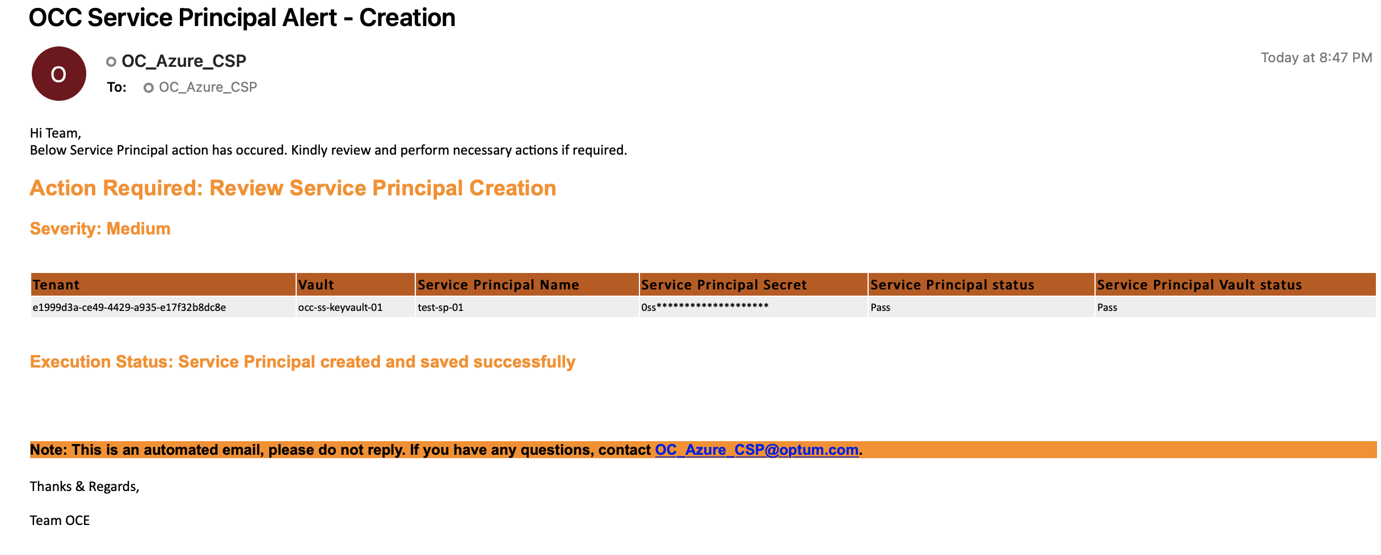
Appendix

Slide 10
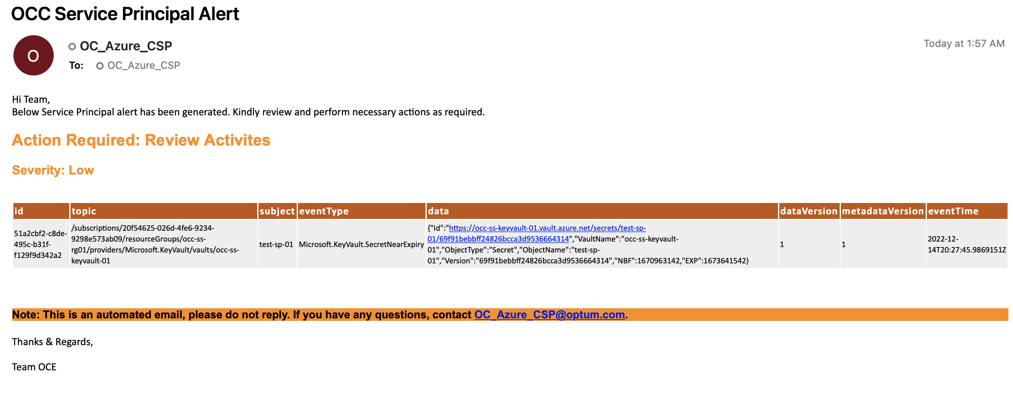
Appendix

Slide 11
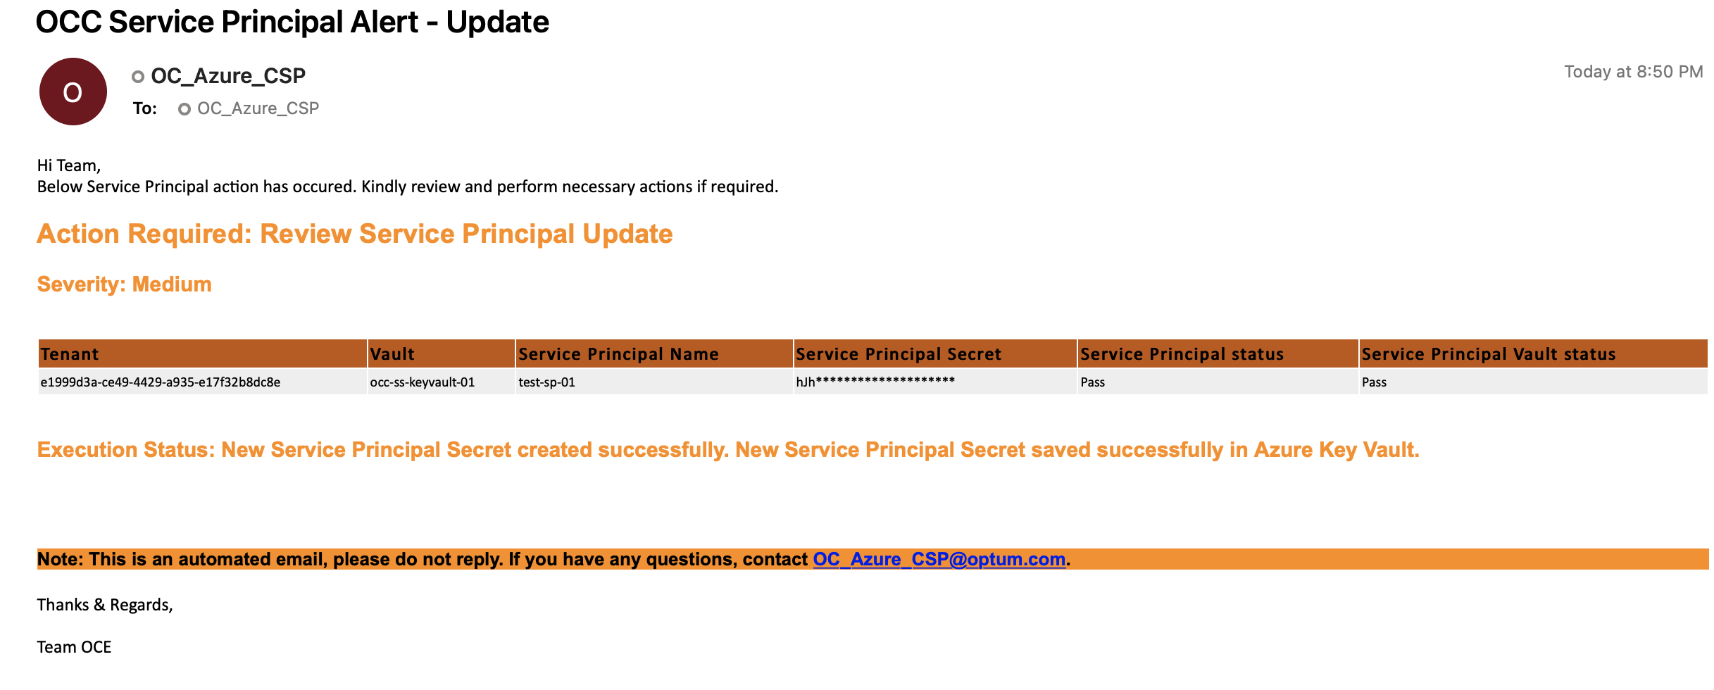
Appendix

Slide 12
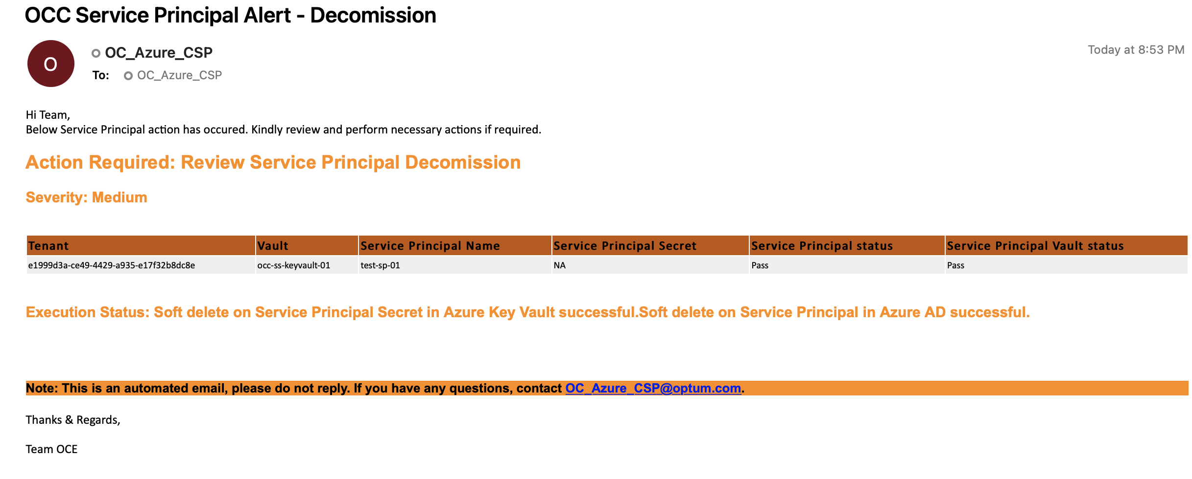
Appendix

