Slide 1
Application Secrets Management in Azure
April 10, 2023

Slide 2
Session objectives
Agenda
1
Secret’s Management Lifecycle
Application Secrets Management in Azure
2
Secret Creation
3
Application Authentication using Secret
4
Auto-Rotation of Secret
5
Decommission of Secret
6
Demo
6
Appendix

Slide 3
Secret’s Management Lifecycle
Create
Generate Application Secret
Save the secret in Azure Key Vault
Trigger an Email to the Team Mailbox
Complete
Update
Generate a New Secret
Update Azure Vault with New Secret
Trigger an Email to the Team Mailbox
Complete
Decommission
Soft delete the secret in Azure Key Vault
Trigger Email to the Team Mailbox
After cooling period, delete the Secret
Trigger an Email to the Team Mailbox
Complete

Slide 4


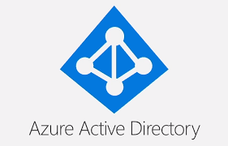




Secret Creation
This will be a user-initiated workflow
Automation Scripts will create new secrets and save them in Azure Key Vault
Azure Active directory and Azure Firewall can be used for Authentication and Authorization
Trigger
Automation
Shared Mailbox

Slide 5

Application Authentication using secret
Azure Active Directory and Azure Firewall is used for Authentication and Authorization
This workflow can be implemented for both Cloud and On-Prem Applications
Azure Key Vault is used to secure and manage the Application Secrets
On Prem Application
1. User Authenticates to Azure
6a. User authenticates to Application using secret
2. Access Token returned
User
Azure Active Directory
6b. User authenticates to Application using secret
3. Request Secret through Azure Firewall using Access Token
5. Secret Returned
4. Vault validates the Access Token
Cloud Application
Azure KeyVault

Slide 6
Auto-Rotation of Secret
This is an auto triggered workflow
When ‘Microsoft.KeyVault.SecretNearExpiry’ event is triggered, a new Secret is created and saved in the Key Vault
When ‘Microsoft.KeyVault.SecretExpired’ event is triggered, the expired secret can be deleted from Azure Key Vault
Start
Secret Expiring event?
Yes
End
Azure KV raises expiring/expired event
Event Listner Service
Automation Script creates new Secret
New Secret saved as new version in Azure KV
Mail alert to Shared Mailbox
No
Secret Expired Event?
Yes
Automation script Soft deletes the secret
No

Slide 7
Azure Key Vault Cost
The cost of Azure Key Vault implementation is $0.030 per 10,000 transactions
Assuming the number of transactions per application per day as 200
Total Applications
Yearly Cost in $

Slide 8
Decommission of Secret
This will be a user-initiated workflow
Soft deleted Secrets in Azure Key Vault can be recovered within 90 days of deletion
Purging of deleted Secrets in Azure Key Vault is handled automatically by Azure
Trigger
Automation
Shared Mailbox

Slide 9
Demo

Slide 10
Q&A

Slide 11
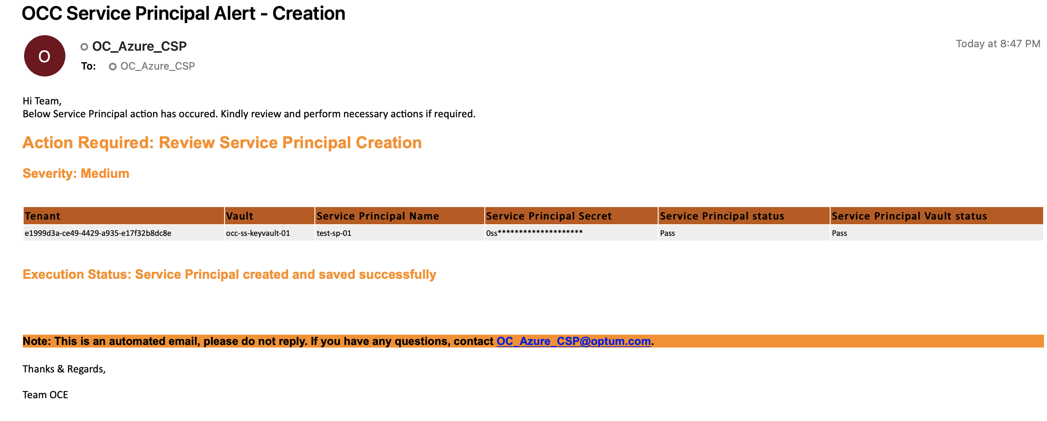
Appendix

Slide 12
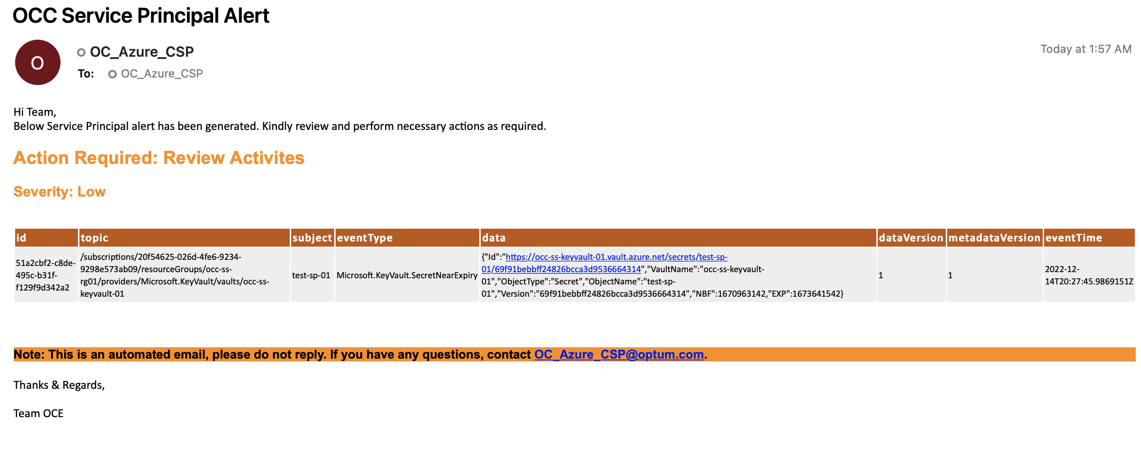
Appendix

Slide 13
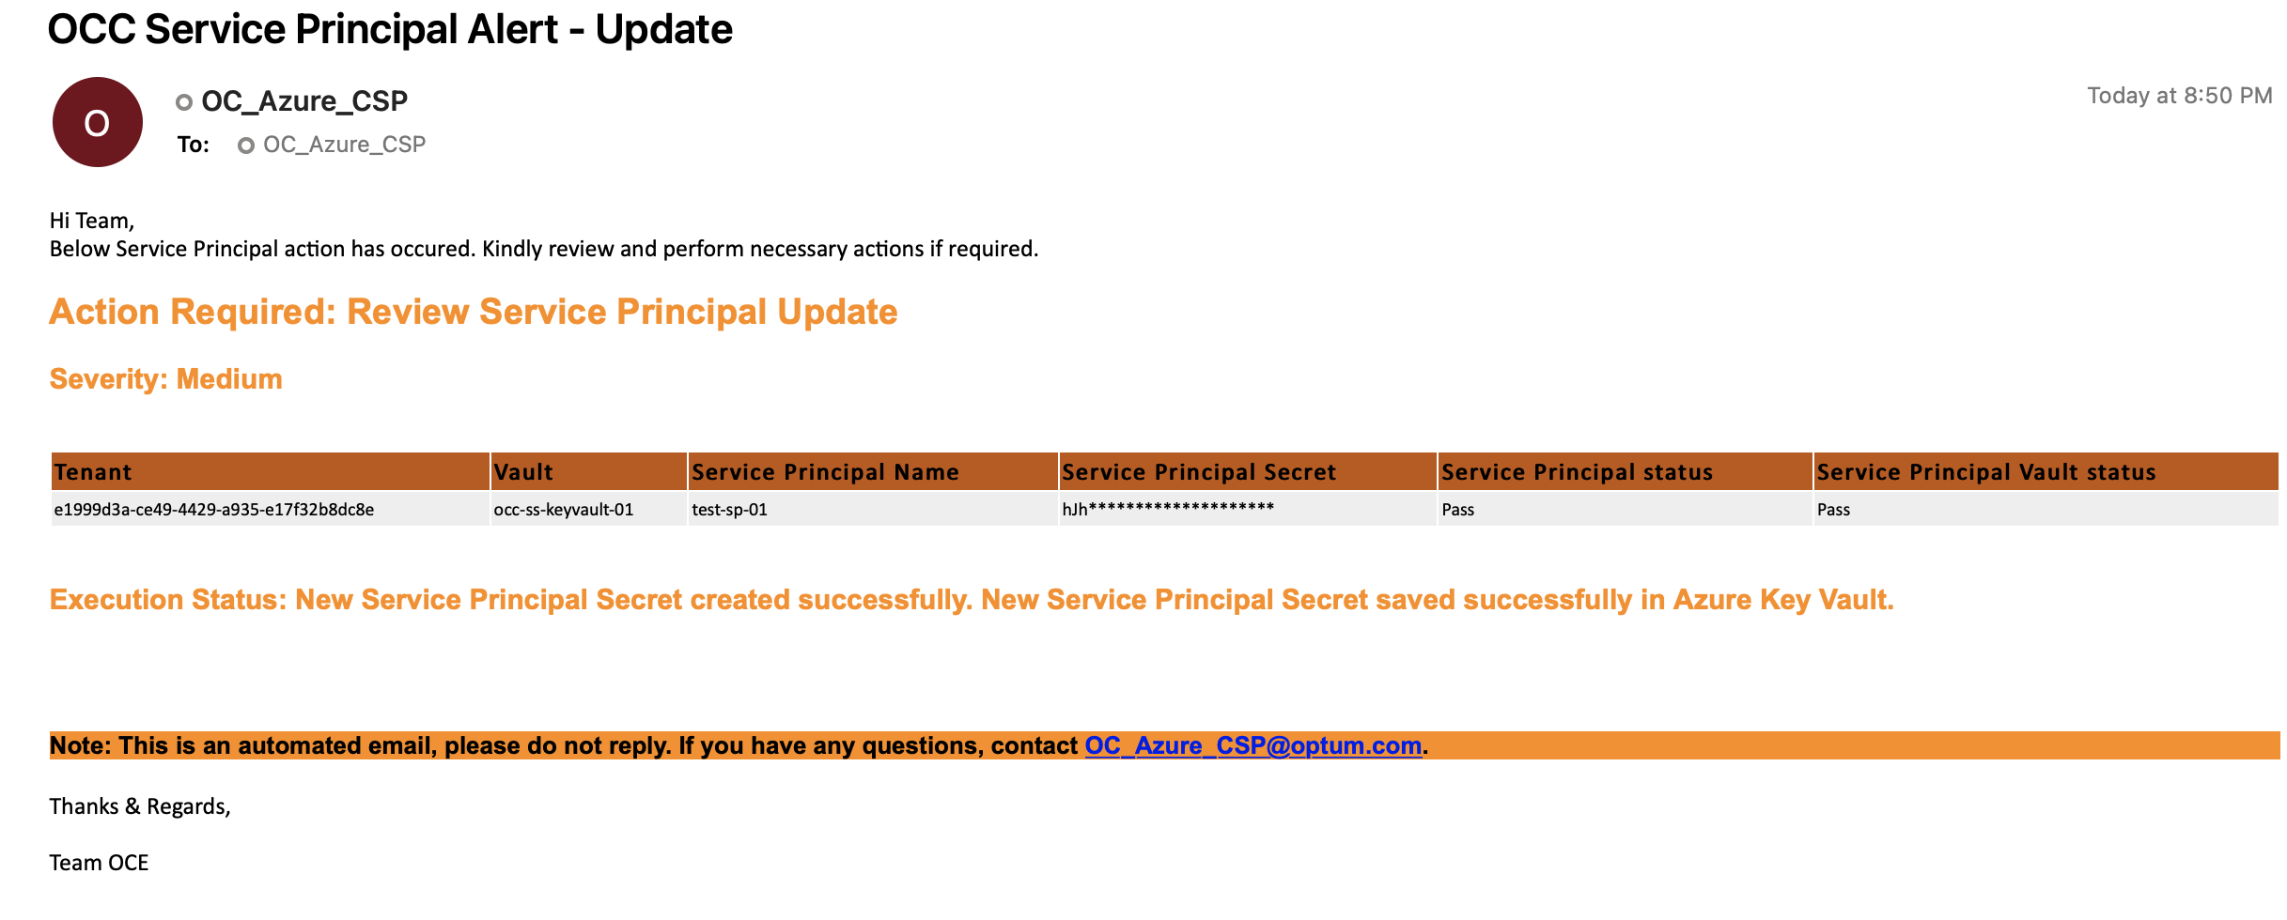
Appendix

Slide 14
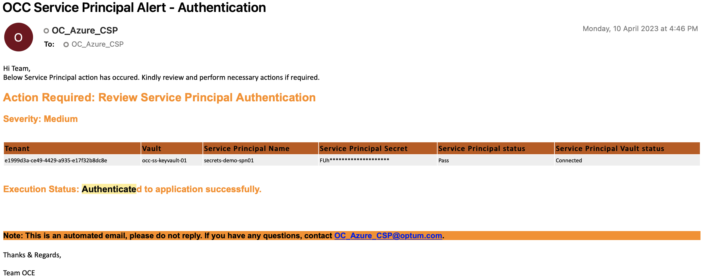
Appendix

