Slide 1
Application Secrets Management in Azure

Slide 2
Session objectives
Agenda
Application Secrets Management in Azure
PGP Keys Management in Azure
1
Secret’s Management Lifecycle
6
Lifecycle of PGP keys
2
Secret Creation
7
Decommission of Secret
3
Application Authentication using Secret
8
Azure Key Vault cost Analysis
4
Auto-Rotation of Secret
9
Demo
5
Managing Secrets stored inside Application
10
Q & A

Slide 3
Secret’s Management Lifecycle
Create
Generate Application Secret
Save the secret in Azure Key Vault
Trigger an Email to the Team Mailbox
Complete
Update
Generate a New Secret
Update Azure Vault with New Secret
Trigger an Email to the Team Mailbox
Complete
Decommission
Soft delete the secret in Azure Key Vault
Trigger Email to the Team Mailbox
After cooling period, delete the Secret
Trigger an Email to the Team Mailbox
Complete

Slide 4







Secret Creation
This will be a user-initiated workflow
Automation Scripts will create new secrets and save them in Azure Key Vault
Azure Active directory and Azure Firewall can be used for Authentication and Authorization
Trigger
Automation
Shared Mailbox

Slide 5

Application Authentication using secret
Azure Active Directory and Azure Firewall is used for Authentication and Authorization
This workflow can be implemented for both Cloud and On-Prem Applications
Azure Key Vault is used to secure and manage the Application Secrets
On Prem Application
1. User Authenticates to Azure
6a. User authenticates to Application using secret
2. Access Token returned
User
Azure Active Directory
6b. User authenticates to Application using secret
3. Request Secret through Azure Firewall using Access Token
5. Secret Returned
4. Vault validates the Access Token
Cloud Application
Azure KeyVault

Slide 6
Auto-Rotation of Secret
This is an auto triggered workflow
When ‘Microsoft.KeyVault.SecretNearExpiry’ event is triggered, a new Secret is created and saved in the Key Vault
When ‘Microsoft.KeyVault.SecretExpired’ event is triggered, the expired secret can be deleted from Azure Key Vault
Start
Secret Expiring event?
Yes
End
Azure KV raises expiring/expired event
Event Listener Service
Automation Script creates new Secret
New Secret saved as new version in Azure KV
Mail alert to Shared Mailbox
No
Secret Expired Event?
Yes
Automation script Soft deletes the secret
No

Slide 7
Managing Secrets stored inside Application
Monitoring mechanism will be setup for these kind of Applications
In this scenario the Secret from Application is also saved in the Azure key Vault and the expiration date is configured as well
When ‘Microsoft.KeyVault.SecretNearExpiry’ event is triggered, a mail notification is sent to the Team Mailbox and the Application Owner
The Application Owner updates the Secret inside the Application and Azure Key Vault
Secret Expiring/Expired event?
Start
Azure KV raises Expiring/Expired event
Event Listener Service
Yes
Mail notification sent to Team Mailbox and Application Owner
Application Owner updates the Secret in Application and Azure KV
End

Slide 8

Lifecycle of PGP keys
User exports the PGP key in .asc format
Save the contents of .asc file to Azure Key Vault
Save the Passphrase(if available) as another secret in Azure Key Vault
Trigger an Email to the Team Mailbox
Storage
Retrieve contents of .asc file using URI
Retrieve Passphrase if applicable using URI
Retrieval
Soft delete the PGP and Passphrase secret in Azure Key Vault
Trigger Email to the Team Mailbox
After cooling period, delete the Secrets
Trigger an Email to the Team Mailbox
Decommission
Currently Azure Key Vault does not support creation of PGP keys. Hence, generation and auto-rotation of PGP keys is out of scope
Currently Azure Key Vault also doesn’t support saving the PGP keys directly in Azure Key Vault. As an alternative PGP keys need to be exported to .asc formatted file and the contents of these file are saved in the secret. Additionally, if Passphrase is also created, that is also saved as another secret in the Azure Key Vault
Current maximum size of secrets that is supported in Azure Key Vault is 25k bytes which is well above the PGP key size i.e. ~=4k bytes in .asc format

Slide 9
Decommission of Secret
This will be a user-initiated workflow
Soft deleted Secrets in Azure Key Vault can be recovered within 90 days of deletion
Purging of deleted Secrets in Azure Key Vault is handled automatically by Azure
Trigger
Automation
Shared Mailbox

Slide 10

Azure Key Vault cost Analysis
Applications
Assumptions
Derived Cost
100
2
Secrets per Application
200
Transactions per day
365 days
Duration
~ $44
Cost/10k Transactions
Transactions include create/update, get, list operations
$0.030

Slide 11
Demo

Slide 12
Q&A

Slide 13
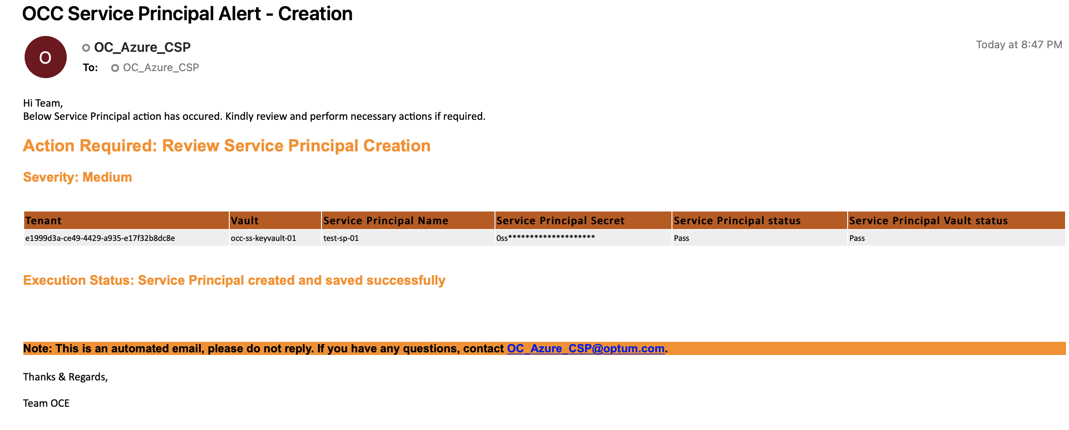
Appendix

Slide 14
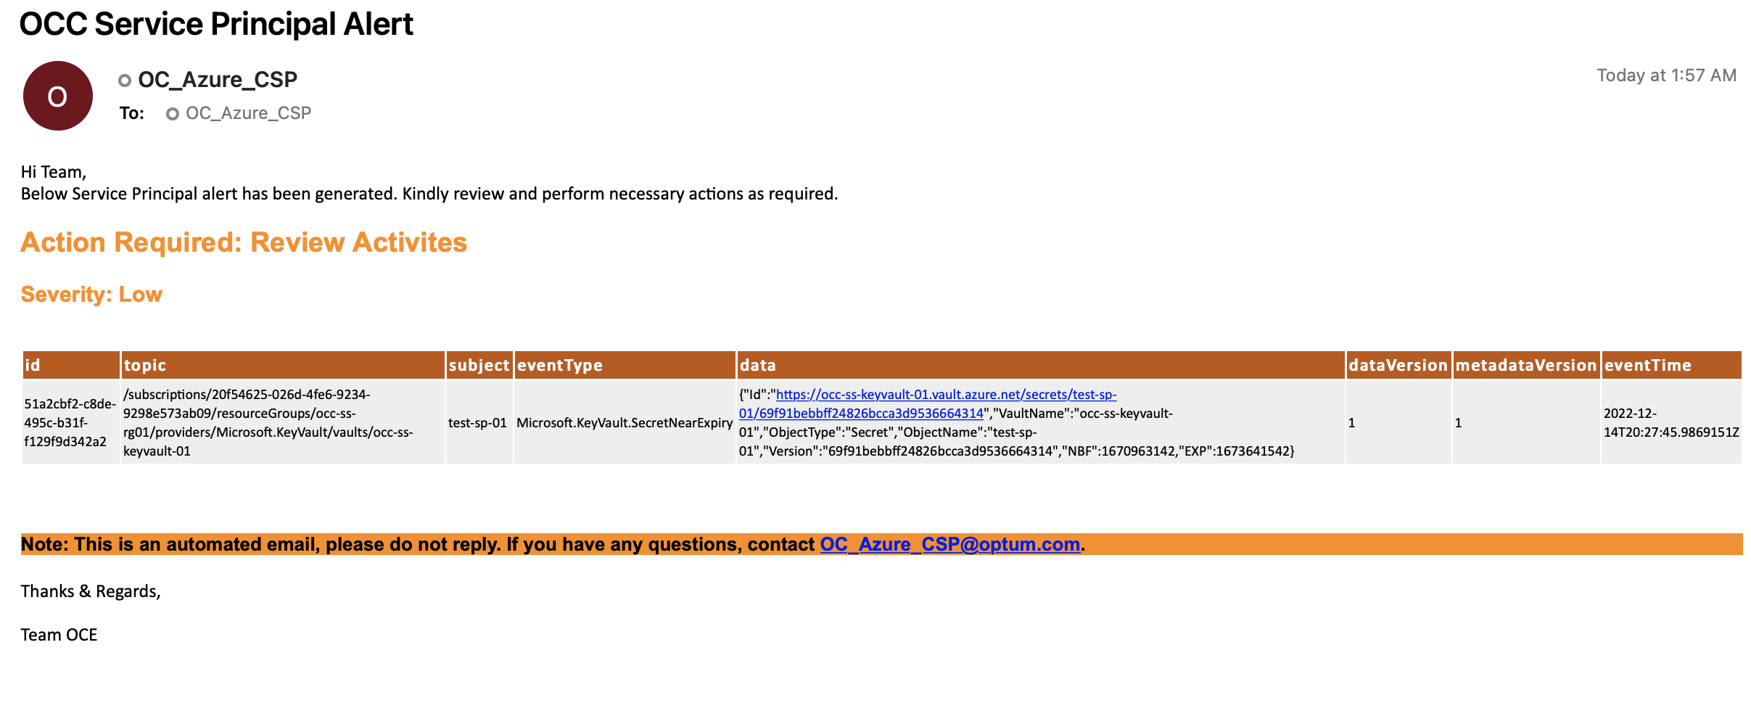
Appendix

Slide 15
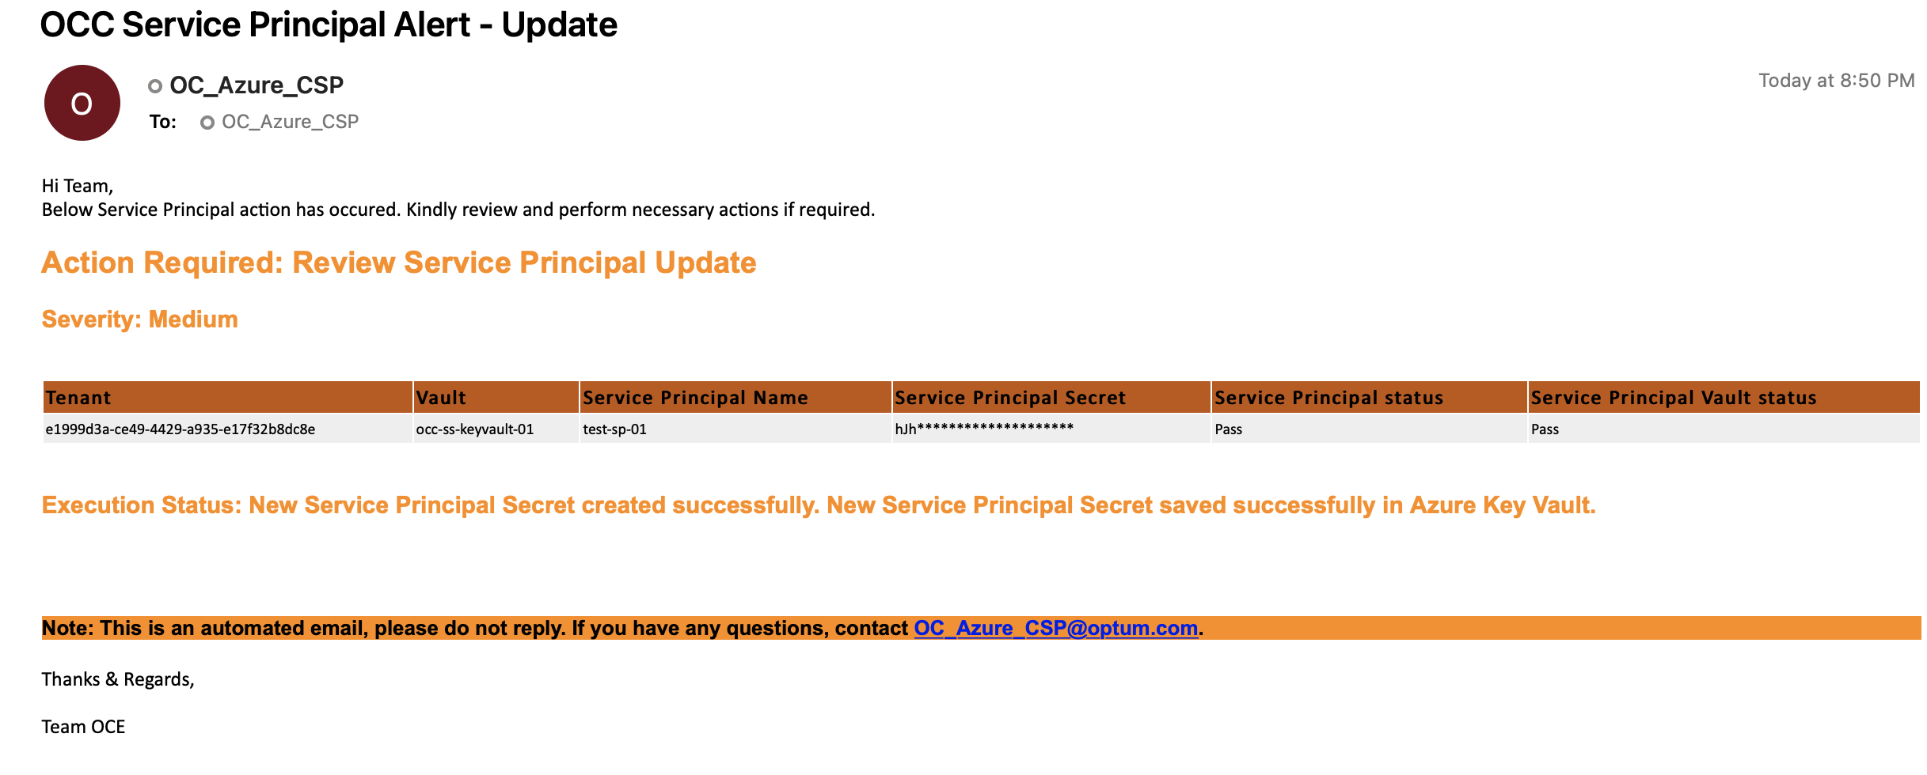
Appendix

Slide 16
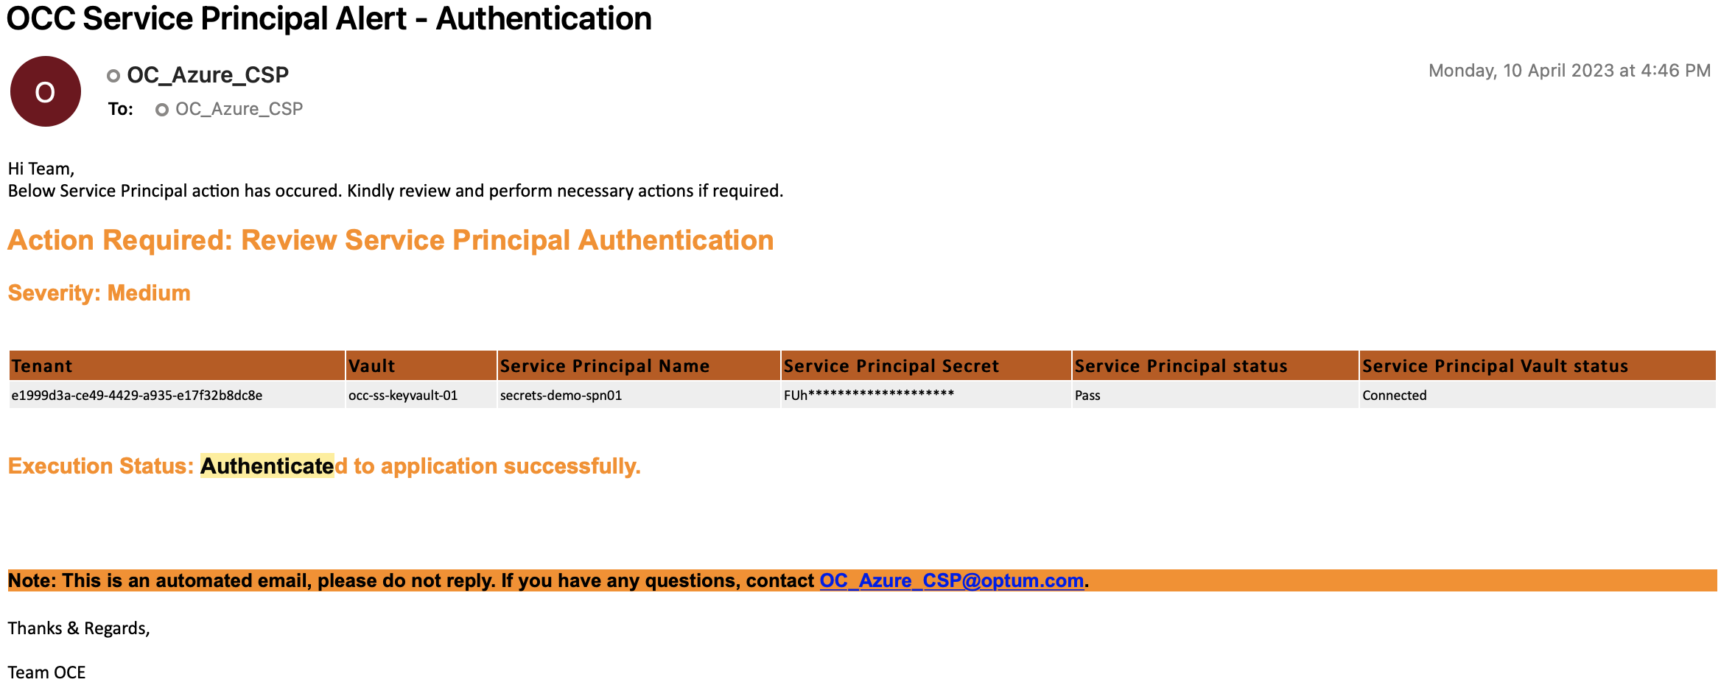
Appendix

