Slide 1
Purpose of the Security Model
Control access to records
Defines actions that users can take on records, based on who the user is, and who owns the record.
Control access to UI elements
Forms, Dashboards, Business Process Flows
Control access to features
Mobile, Export to Excel, Print, etc.
Simplify the user experience
User interface will hide entities, records and features a user does not have the privileges to use.

Slide 2
Role-based security
Within each role, security permissions are defined at the following levels:
Entity and record level. Every role includes the complete list of actions that can be performed on each entity.
Task level. Each role also includes yes/no access levels for certain user and administrative tasks.
Tasks include Print, Merge, Go Offline, and so on.

Slide 3
Privileges
Common privileges found in each role include:
Privilege | Description
Create | Can create records of the entity
Read | Can read records of the entity
Write | Can update data for records of the entity
Delete | Can delete records of the entity
Append | Can attach this entity to other records
Append To | Can attach other records to this entity
Assign | Can assign record ownership to other users or teams
Share | Can share record with other users or teams

Slide 4
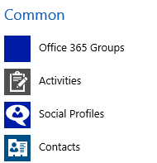
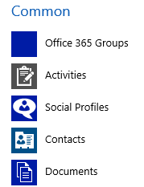
Append vs Append to
Append: Indicates it can be attached to other records
Example: Associate activities to other CRM records
Append to: Indicates it can have other records attached to it
Example: Account record can have cases, contacts, opportunities, etc.
Application behavior is a combination of both
Append to Account
No append Documents
Append to Account
Append Documents
No Append to on Account
Nothing would display in CRM since not records can be attached to it

Slide 5
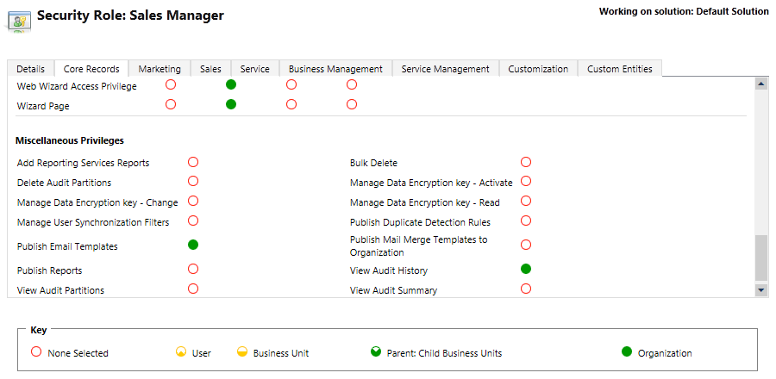
Security Roles: Miscellaneous Privileges

Slide 6
Access Levels
Access levels work in conjunction with Privileges.
Privileges indicate what actions a user can perform on each entity
Access levels define which records for that entity the user can perform actions upon
Access levels are based on a combination of:
record ownership
business unit to which the user belongs

Slide 7

Access Levels
Organization
Root Business Unit
Sales
Marketing
Service
Parent: Child BU
Support
Access level for a specific privilege and record type determines which records you can perform that action on based on the location of each records owner
Business Unit
Projects
User
None

Slide 8
None
X
Organization
Root Business Unit
Sales
Marketing
Service
Parent: Child BU
Support
Business Unit
Projects
User
None

Slide 9
User
Organization
Root Business Unit
Sales
Marketing
Service
Parent: Child BU
Support
Provides access for an entity & privilege:
Records owned by that user/team
Records shared with the user/team
Business Unit
Projects
User
None

Slide 10
Business Unit
Organization
Root Business Unit
Sales
Marketing
Service
Parent: Child BU
Support
Provides access for an entity & privilege:
User Access
Records owned / shared with users in the same business unit
Business Unit
Projects
User
None

Slide 11
Parent: Child BU
Organization
Root Business Unit
Sales
Marketing
Service
Parent: Child BU
Support
Provides access for an entity & privilege:
Business Unit
Records owned / shared with users in any BU subordinate to your BU
Business Unit
Projects
User
None

Slide 12
Organization
Organization
Root Business Unit
Sales
Marketing
Service
Parent: Child BU
Support
Provides access for an entity & privilege:
Entire organization
No access restrictions
Business Unit
Projects
User
None

Slide 13
Security Roles
Roles and business units
Each role must be assigned to a specific business unit.
Roles created in a business unit are automatically inherited by each of its “child” business units.
New roles can be added to any business unit.
Business units may each contain roles with the same name, but permissions and access levels may be completely different.
A user/team can only be assigned roles that belong to the same business unit to which the user/team is assigned.
Moving a User to a new business Unit will remove all the Security Roles associated with their account
They will need new Security Roles from their new BU before they can access Dynamics 365 again.
Root Business Unit
Social Mgr Role
Sales
Social Mgr Role
Support
Social Mgr Role
Projects
Social Mgr Role

Slide 14
Business Unit Hierarchy
Adventure Works Cycles
Root Business Unit
Can be renamed
Cannot be disabled or deleted
Cannot be moved to have a parent business unit
Sales
Marketing
Service
Channel Sales
Support
Child Business Units
Can be renamed
Can be disabled then deleted
Can be moved under a new parent Business Unit
Consumer Sales
Projects

Slide 15
Multiple Security Roles
Users/Teams can be assigned more than one role.
Users/Teams assigned to more than one role use a combination of privileges and access levels for both roles.
They are granted the least restrictive access level for that record type and privilege.

Slide 16
Security Roles: Multiple Roles
Read
Write
Assign
Security Role: Baseline for all users
Account
Opportunity
Case
Security Role: Sales Person
Account
Opportunity
Case

Slide 17
Security Roles: Effect of Multiple Roles
User gets all the privileges of all their roles
Read
Write
Assign
Security Role: Baseline for all users
Account
Opportunity
Case
Effective Permissions: Sales Person
Account
Opportunity
Case

