Slide 1
Boston Red Sox Home Games & Demand for Rental Bicycles
Section 6, Group 4: William Bonner, Ke-Chu Chen, Truong Dinh, Erica Elias, Saif Ali Khan, Katie Schlafhauser

Slide 2
Problem Statement & Hypotheses
Question: How is demand for bicycles correlated with scheduled sporting events?
Hypotheses:
Bicycle demand will be higher on days with a Red Sox home game than days without a home game
Bicycle demand will be stronger in areas immediately around the stadium on game days versus non-game days
A higher number of males will rent on game days versus females
Younger individuals will rent at higher rates on game days than older people
Data Sources - linked together by Date:
Sports Radar API
Blue Bikes Boston Data
How do Red Sox home games in Boston impact the demand for bicycle rentals in the Boston area, relative to non-game days?
Notes:
Maybe we add the time component here?
Presenter: Erica?

Slide 3
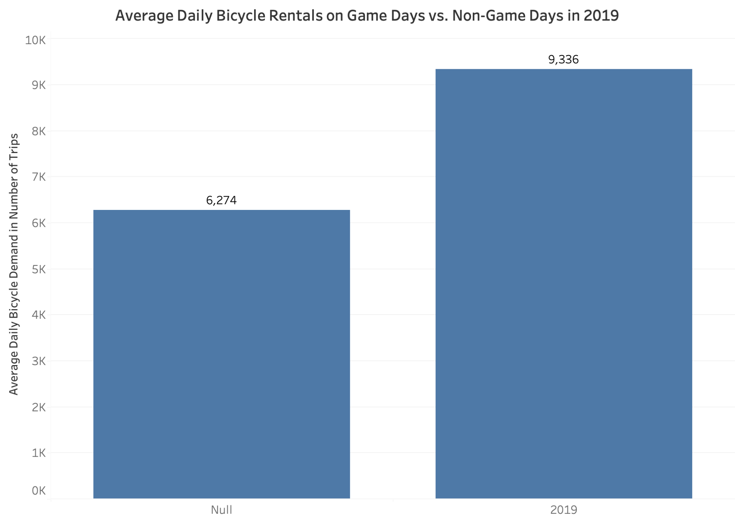
Hypothesis 1 - Bicycle demand will be higher on days with a Red Sox home game than days without a home game
The average daily bicycle rentals are much higher on game days than non-game days (49% higher) likely due to the increased number of visitors that want to explore more of the city while downtown for the game
Non-Game Days
Game Days
Notes:
Presenter: Katie
A potential limitation of this conclusion is that non-game days include bike rental year-round data; there may be higher demand on game days because they typically happen during the summer

Slide 4
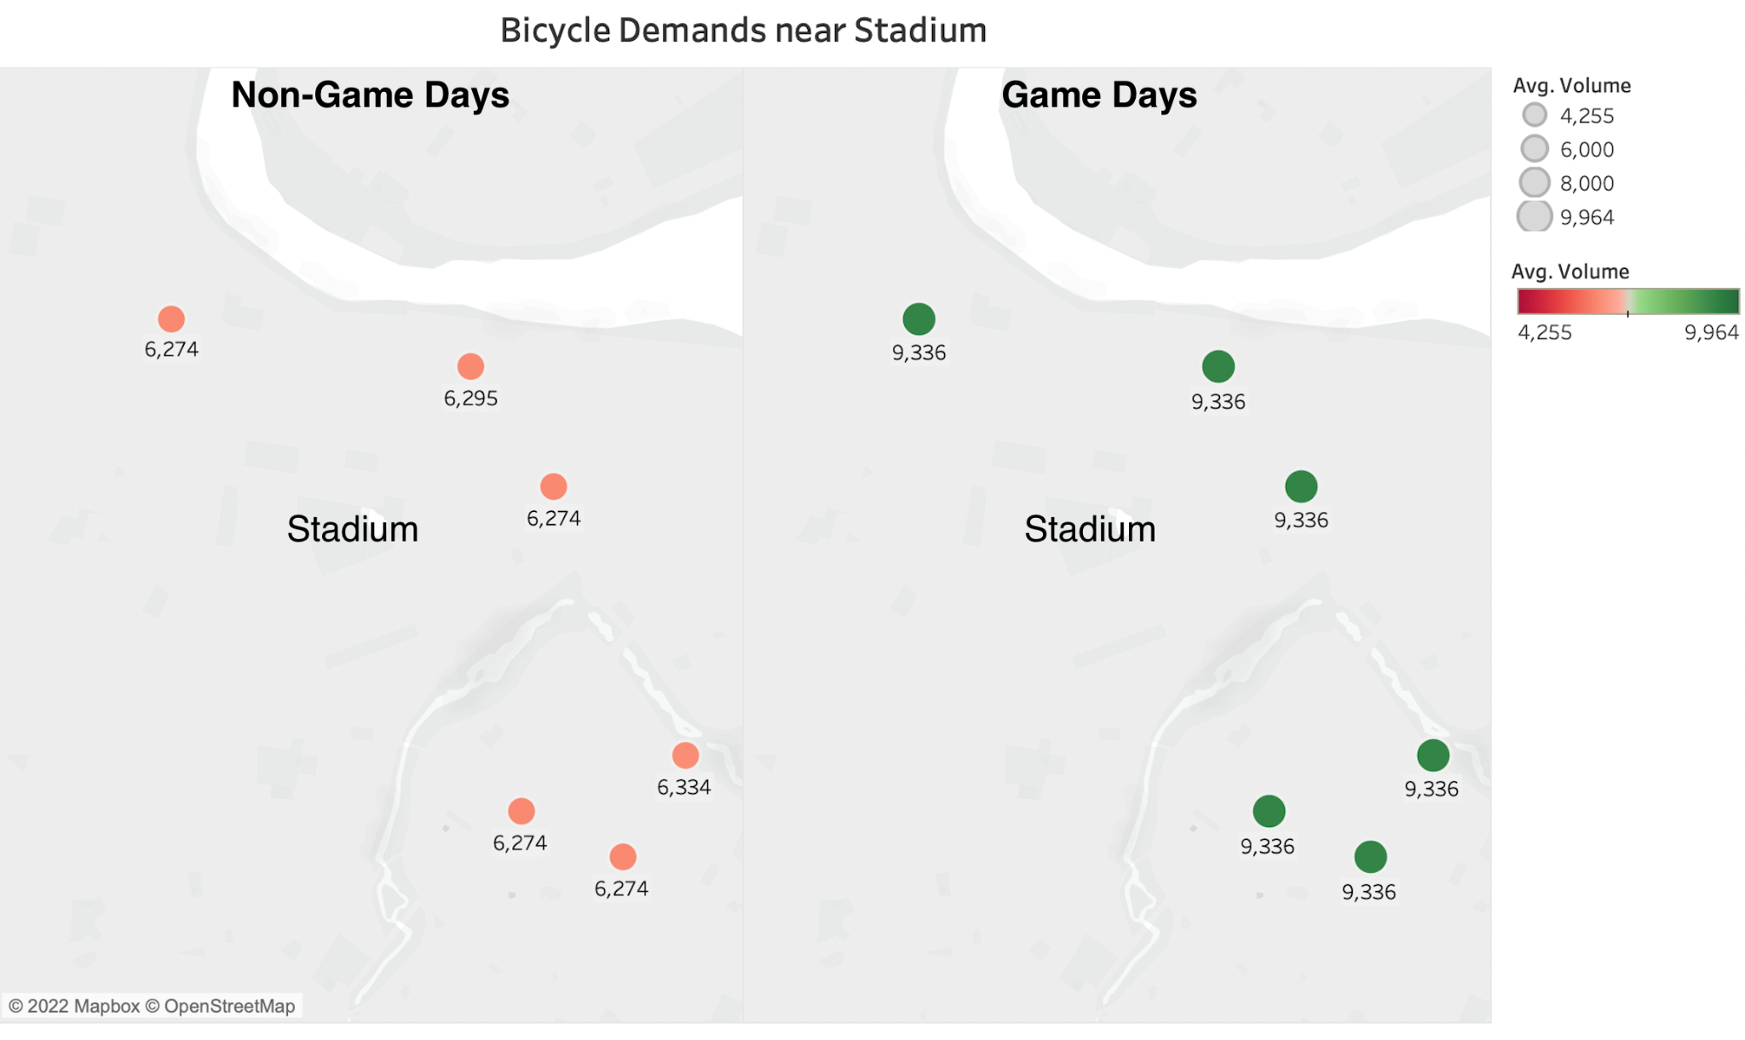
Hypothesis 2 - Bicycle demand will be stronger in areas immediately around the stadium on game days vs. non-game days
After layering in geographic data, the average number of bicycle rentals is much higher in stations around the stadium on game days vs. non-game days; this may be because people are dropping off bike rentals on their way to a baseball game
Notes:
Presenter: Ke-Chu

Slide 5
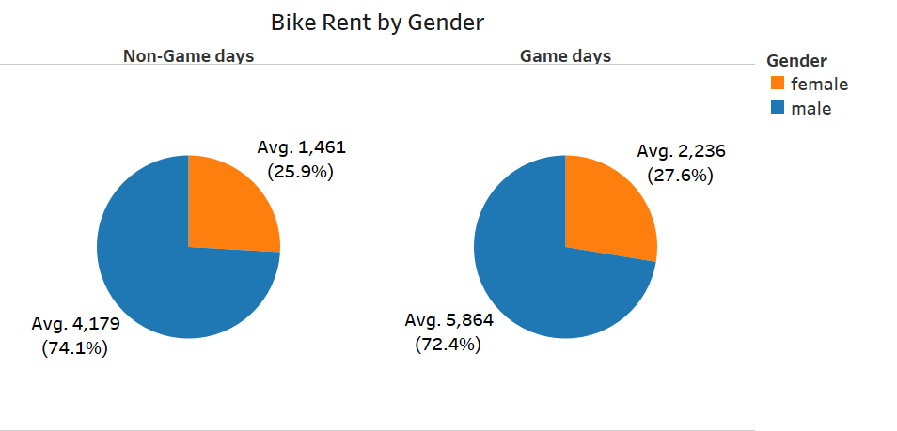
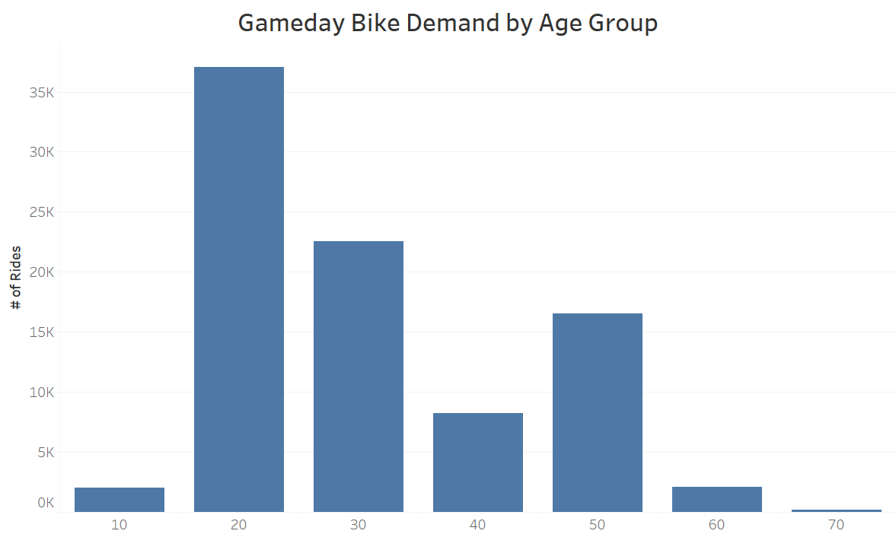
Hypothesis 3 & 4 - A higher proportion of males will rent on game days than females; younger individuals will rent at higher rates on game days than older people
Male account for the majority of bike rental, and on game day the percentage of female renters increase by nearly 2% (about 775 rentals)
Majority of gameday bike demand is from customers 20-29 years old. It’s interesting to see customers in their 50s have higher gameday bike demand compared to customers in their 40s.
Notes:
Presenter: Truong - Hyp 3, Bill - Hyp 4

Slide 6
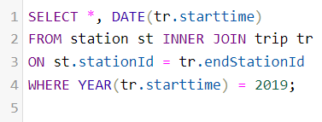
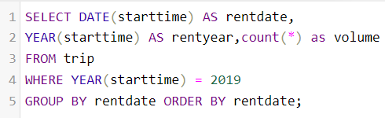
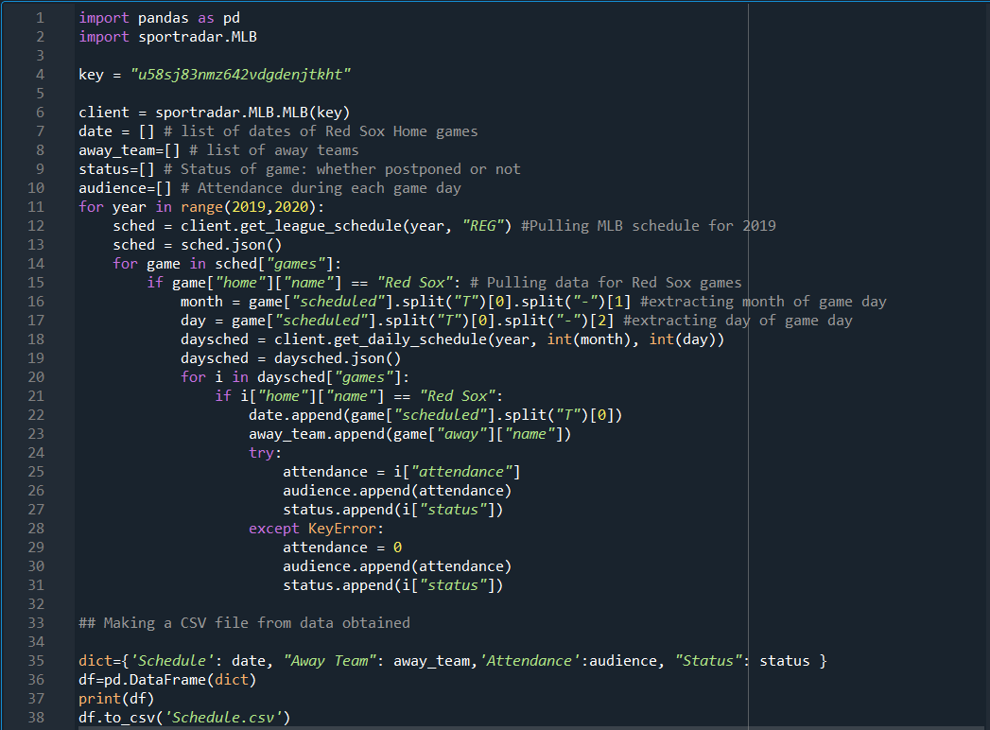
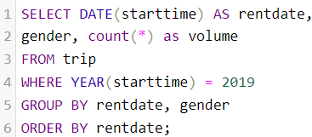
Appendix with Python and SQL Codes
Join tables based on end station ID for 2019
Group trip data by date
Group trip data by gender
Python code for pulling down sportradar API data

