Slide 1

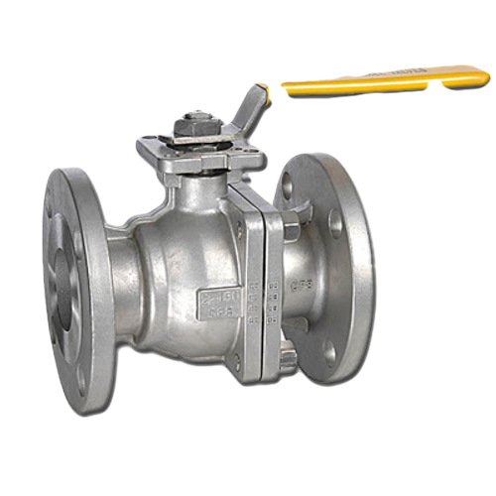
Banner Image Template
Don’t change the size of the below rectangle.
Place your Value image as shown below.
Remove the sample image and place your image at the same location.
Select Panel and Value image together by mouse , right click on it and click save image.
Open your web page ( admin panel )and upload your new banner image.

