Slide 1
BorrowNest
AbdulMuiz Khan

Slide 2
Objective and Key features
Allow lenders to lend small scale household items reliably on an established platform, enabling a much wider reach than otherwise possible
Key features:
Flexible renting terms
Multiple delivery options
Lender / Renter protection
Ability to build credibility as a lender

Slide 3
Requirement Definition: example
Req: Item Listing
Desc: he most essential feature of all, and is the basis of how the user will interact with the app. Listing creations are initiated in the frontend client and persisted in the database.

Slide 4
ID: | #1
Title: | Item Listing
Description: | Listing creations are initiated in the frontend client and persisted in the database.
Preconditions: | User is logged in, has bank info setup
Postconditions: | Listing is created and saved in the system
Success scenario: | Lender fills out create form Uploads images of the product Uploads insurance proof if certain category selected Submits form for saving
Alternate scenarios: | Errors in form submission: problematic fields are highlighted in red to fix Moderator finds issues not caught w/ computer algorithm and sets status of listing to ‘pending’ which alerts the user to fix submission
Frequency: | Very often, whenever there is a new product to list
Priority: | High

Slide 5
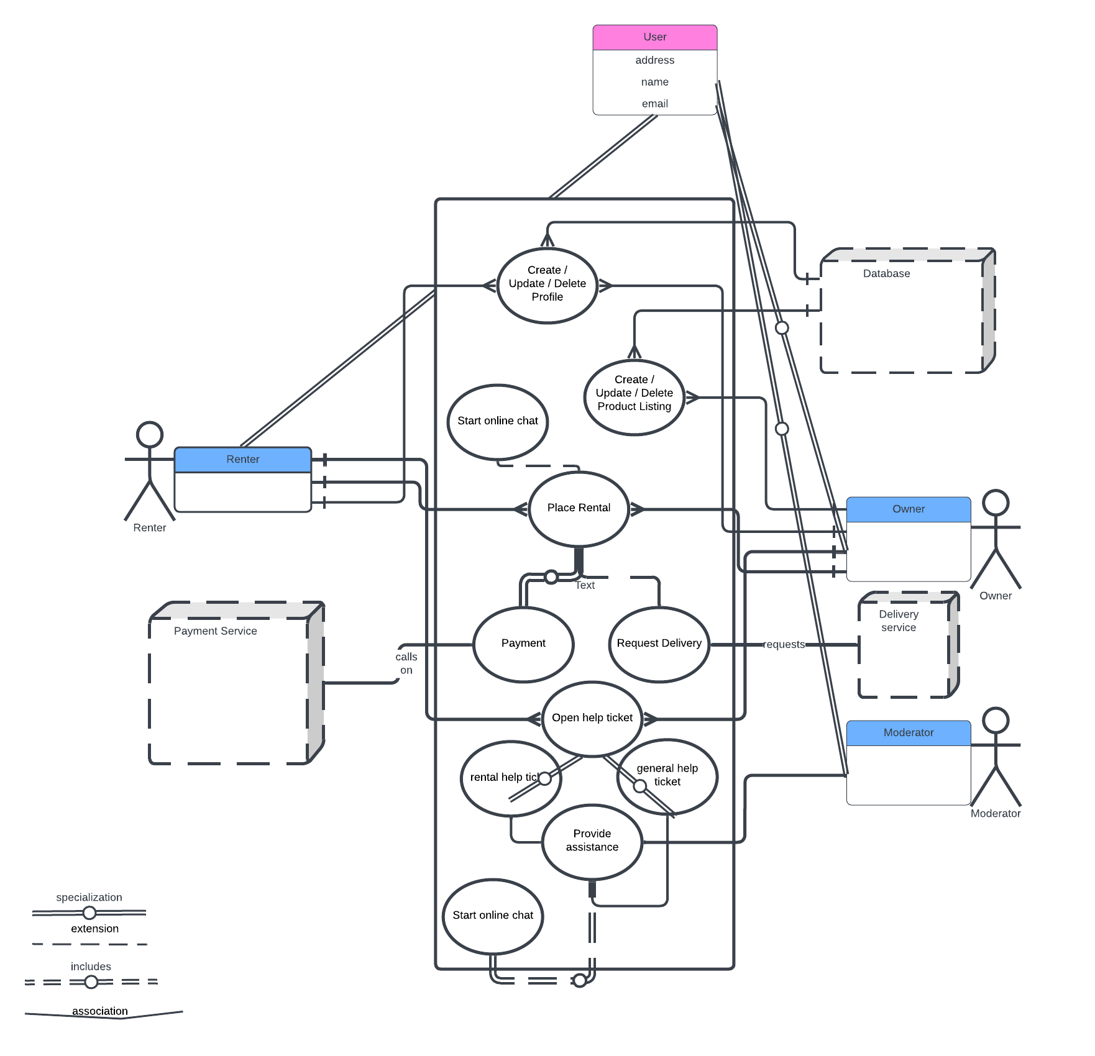

Slide 6
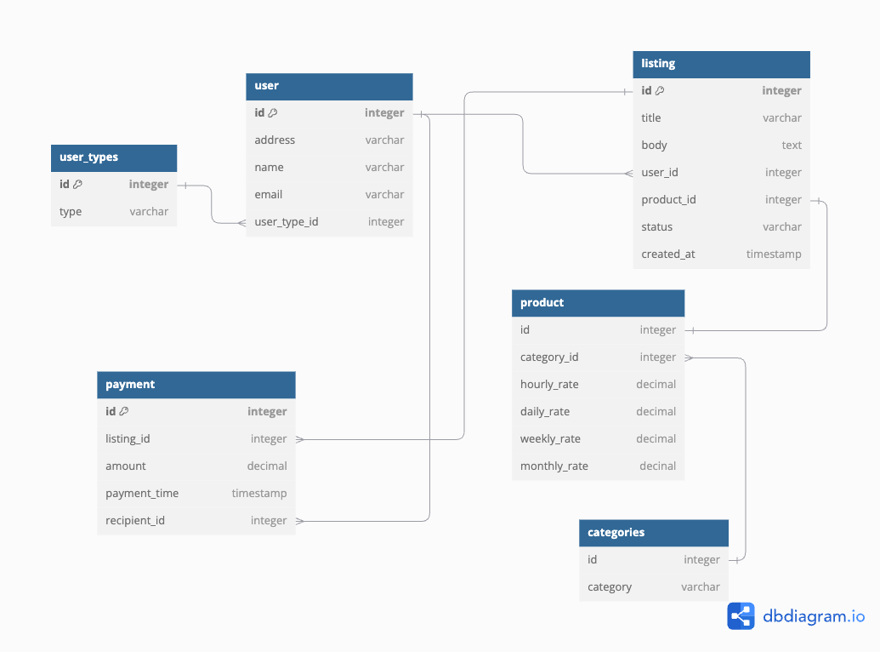
Class Diagram
User can be of type ‘user’, or ‘admin’. The ‘user’ type will be able to act both as a lender and renter.
Users are in charge of creating listing entities, which has foreign keys to both the creator and product.
Products fall under a certain category.
Payment entity keeps track of all the transactions. Its amount field is calculated at the time of the rental as duration * time unit of rental. Lender will have prices

