Slide 1
Sudoku Problem (Algorithmic Problems)

Slide 2
Sudoku Problem
it is a combinatorial number-placement puzzle
the objective is to fill a 9×9 grid with digits so that each column, each row and each of the nine 3×3 subgrids (boxes) that compose the grid contain all of the digits from 1 to 9
initially we have a partially completed grid which for a well-posed puzzle has a unique solution
the same integer may not appear twice in the same row, same column or in any of the nine 3×3 boxes of the 9x9 grid

Slide 3
Sudoku Problem
It is again an NP-complete problem
brute-force approach has exponential running time compleity

Slide 4
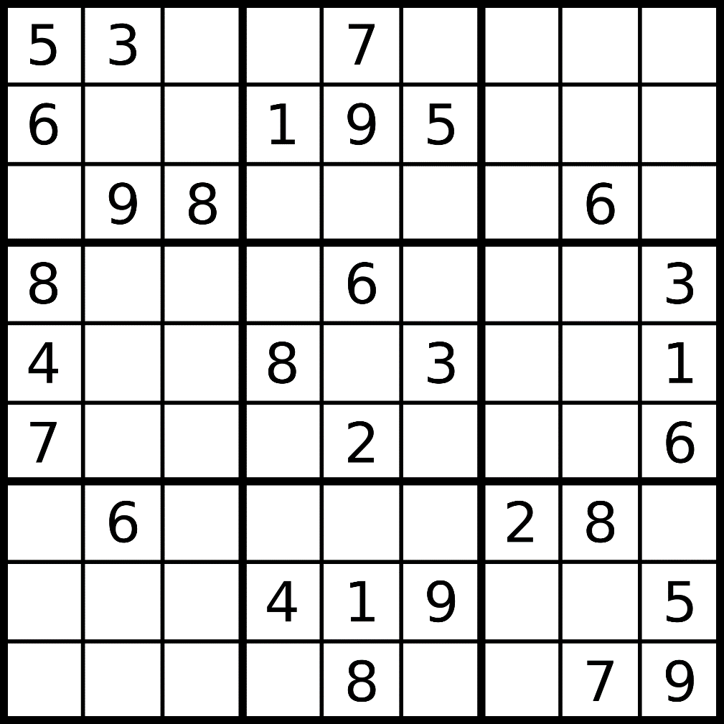
Sudoku Problem

Slide 5
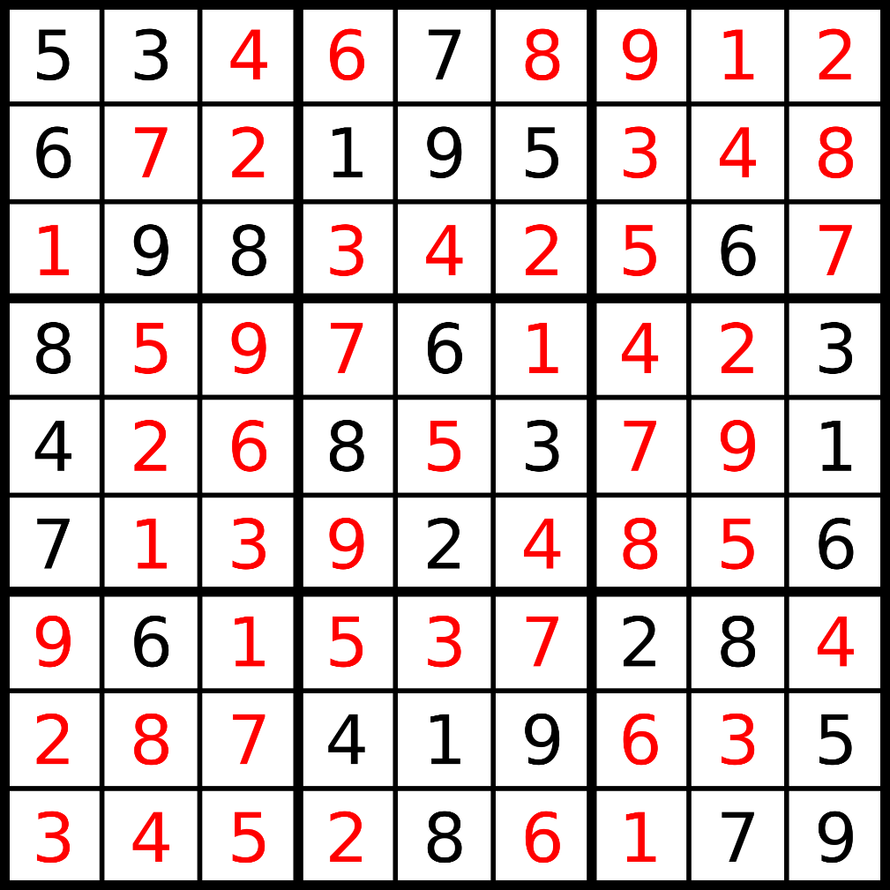
Sudoku Problem

Slide 6
Sudoku Problem
5
3
6
9
8
5
3
5
3
5
3
5
3
5
3
5
3
5
3
5
3
5
3
6
6
6
6
6
6
6
6
6
1
9
8
2
9
8
3
9
8
4
9
8
5
9
8
6
9
8
7
9
8
8
9
8
9
9
8

Slide 7
Sudoku Problem
5
3
6
9
8
5
3
5
3
5
3
5
3
5
3
5
3
5
3
5
3
5
3
6
6
6
6
6
6
6
6
6
1
9
8
2
9
8
3
9
8
4
9
8
5
9
8
6
9
8
7
9
8
8
9
8
9
9
8
5
3
5
3
5
3
6
1
6
5
6
9
5
9
8
5
9
8
5
9
8

Slide 8
Sudoku Problem
5
3
6
9
8
5
3
5
3
5
3
5
3
5
3
5
3
5
3
5
3
5
3
6
6
6
6
6
6
6
6
6
1
9
8
2
9
8
3
9
8
4
9
8
5
9
8
6
9
8
7
9
8
8
9
8
9
9
8
5
3
5
3
5
3
6
1
6
5
6
9
5
9
8
5
9
8
5
9
8

Slide 9
Sudoku Problem
5
3
6
9
8
5
3
5
3
5
3
5
3
5
3
5
3
5
3
5
3
5
3
6
6
6
6
6
6
6
6
6
1
9
8
2
9
8
3
9
8
4
9
8
5
9
8
6
9
8
7
9
8
8
9
8
9
9
8
5
3
5
3
6
1
6
5
5
9
8
5
we can prune these branches
and beause of that we can discard
mutiple bad states (subtrees) in the same iteration
PRUNING BOOSTS THE RUNNING TIME OF BACKTRACKING
9
8

