Slide 1
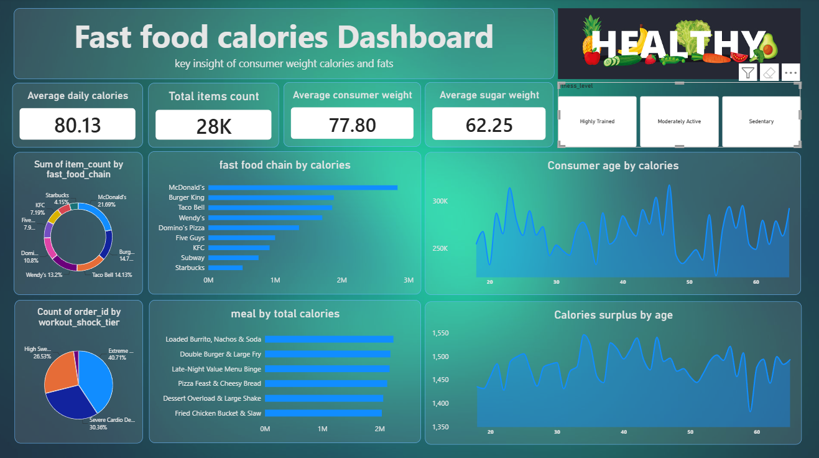
FAST FOOD CALORIES
Dashboard Presentation • Descriptive Analysis
Based on the supplied Power BI dashboard image
01

Slide 2
Dashboard at a Glance
The original dashboard combines summary cards, brand comparisons and age-based trends.
What the dashboard contains
Four KPI cards across the top
Brand-level item-count and calorie comparisons
Meal-category total calorie comparison
Age-based calorie and surplus trends
Consumer segment distributions
Use the visuals together to move from summary measures to comparisons and trends.
02

Slide 3
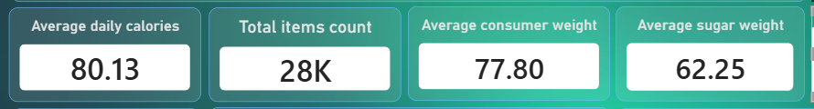
Headline Metrics (KPIs)
The figures below are read directly from the supplied dashboard screenshot.
Why these matter
Quickly summarise the selected dataset
Give viewers a starting point before chart analysis
Help compare the dashboard’s measures at a glance
Average daily calories: 80.13 • Total item count: 28K
Average consumer weight: 77.80 • Average sugar weight: 62.25
Confirm units and field definitions in the dataset before interpreting these numbers.
03

Slide 4
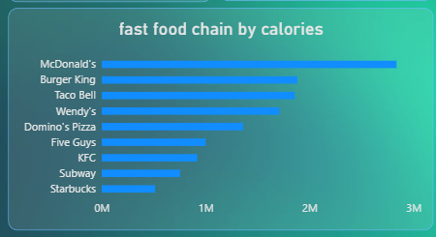
Fast-Food Chain by Calories
Reference visual: horizontal bar chart in the middle of the dashboard.
What stands out
McDonald’s has the longest bar in this comparison.
Burger King and Taco Bell are among the next highest.
Starbucks appears toward the lower end.
The chart is useful for ranking brands by the displayed measure.
Interpretation depends on the aggregation and units used in the source data.
04

Slide 5
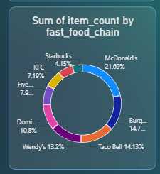
Item Count by Fast-Food Chain
The pie chart shows the distribution of item count across the listed chains.
How to read this visual
Each slice represents a fast-food chain’s share of the displayed item count.
McDonald’s is labelled as the largest share in the visible chart.
The chart offers a quick overview of how the count is distributed.
Small slices and truncated labels may be easier to inspect in Power BI.
The percentages shown are those visible in the dashboard image.
05

Slide 6
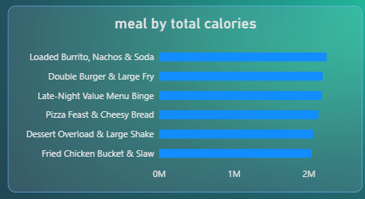
Meal Categories by Total Calories
Reference visual: lower-middle horizontal bar chart.
Key observations
Loaded Burrito, Nachos & Soda is among the highest displayed categories.
Double Burger & Large Fry and Late-Night Value Menu Binge are also near the top.
The bars are fairly close in length, so the differences appear limited.
Use consistent category definitions when comparing meals.
Meal names are taken from the supplied dashboard screenshot.
06

Slide 7
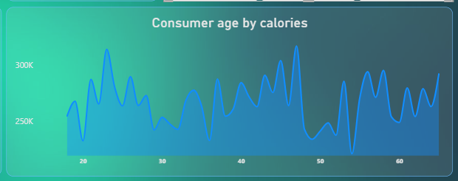
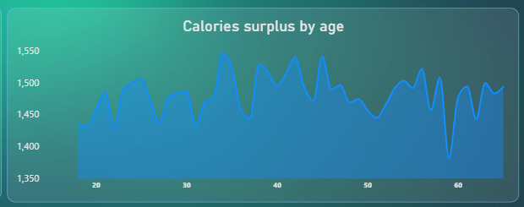
Consumer Age & Calories Surplus
Two line charts show how the selected measures change across consumer ages.
Age vs calories
Calories surplus by age
Both lines fluctuate; they do not show a simple steady increase or decrease.
07

Slide 8
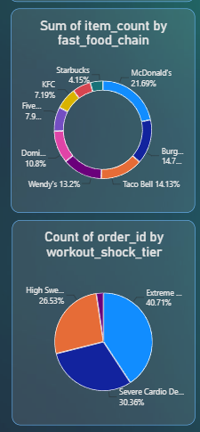
Consumer Segments & Conclusion
The dashboard supports descriptive comparisons; additional validation is needed for deeper conclusions.
Summary and recommended next steps
Use the chain and meal charts to compare the displayed calorie measures.
Use age and segment filters to explore differences between groups.
Confirm metric units, field definitions and aggregation methods.
Improve truncated labels and include clear axis titles where possible.
Treat these patterns as descriptive, not proof of cause and effect.
Thank you
08

