Slide 1
Introduction to Algorithms
Presented By
Piyush kumar Srivastava

Slide 2
Algorithm: Definition
An algorithm is any well defined computational procedure, that takes some values , or set of values , as input and produces some value or set of values as output.
It is an informal description, a blueprint of solution of a computational problem.
It is a sequence of computational steps that transforms the input into output.
It is specific computational procedure for achieving that input , output relationship.

Slide 3
Algorithm: Characteristics
Input:- An algorithm must contain 1 or more inputs.
Output:- An algorithm must return at least one or more values as output.
Finiteness:- Any algorithm must stop and complete its execution after a finite number of steps.
Definiteness:- The steps of any algorithm must be defined precisely with clarity. i.e. No ambiguity.
Effectiveness:- The steps of any algorithm must be effective enough to solve a computational problem .

Slide 4
Algorithm vs Program
Algorithm
Program
Simple English like language , with no predefined syntax.
Person writing algorithm must have domain knowledge.
Critical usage in Design Phase of SDLC.
H/W and OS independent.
Analysis is done to ensure its efficiency.
Predefined syntax and grammar, compatible to a programming language.
Developed and made by programmer
Used in Coding phase of SDLC.
H/W and OS dependent.
Testing is done to check its correctness

Slide 5
Analysis of Algorithms
A problem P may have multiple solutions, A1, A2, A3…An.
We need to figure out best possible solution among them through comparing them.
Analysis of the algorithm is the process of analysing the problem solving capability of algorithm in terms of time and space required.
Efficiency of an algorithm is determined by finding its Complexity.
Criteria for Efficiency: TIME TAKEN and SPACE CONSUMED.

Slide 6
Complexity of an Algorithm
The complexity of an algorithm is the metric to measure the efficiency of an algorithm.
It computes the amount of time and space required by an algorithm for an input size n.
It is the measure which evaluates the count of operations, as a function of size of input data.
Complexity of an algorithm can be classified in to two types
Time Complexity
Space Complexity

Slide 7
Space Complexity
Space complexity of an algorithm is total space taken by algorithm with respect to the input size and auxiliary space.
Auxiliary space is the temporary space used by the algorithms.
Space Complexity= Auxiliary Space + Input Space

Slide 8
Time Complexity
Time complexity corresponds to the amount of time a computational device takes to run an algorithm.
To analyse the real time complexity of a program, we need to determine two parameters for every instruction of algorithm:
Amount of Time a single statement will take.
No of times, the instruction will get executed.
Product of these two, will be the total time taken by the statement.

Slide 9
Time Complexity (contd)
First no. depends upon the machine and compiler used , hence the real time complexity is machine dependent.
A generic RAM (Random Access Machine) executes set of operations sequentially.
Set of primitive operations: Arithmetic. Logical, Comparisons, Function calls
Exact amount of execution time of single instruction will be machine dependent.
Hence to simplify matter, all operations cost is assumed to be 1.

Slide 10
Frequency Count Method
To make analysis machine independent, it is assumed that every instruction takes SAME CONSTANT AMOUNT OF TIME for its execution.
Hence the determination of time complexity of a program is matter of summing the frequency counts of all instructions.
Total Time = ∑(N)*C (for all instructions)
Where N is no of times an instruction is executed.
C is constant amount of time, every instruction is assumed to be taking for execution.

Slide 11
Asymptotic Analysis of Algorithms
Asymptotic is a line is that approaches a curve, but never touches it.
A curve and a line that get closer but never intersect are Asymptotic to each other.
In Asymptotic analysis, performance of an algorithm is evaluated in terms of input size. i.e. how does time (or space) taken by an algorithm increases when input size is increased EXPONENTIALLY.

Slide 12
Analysis of Algorithms: Growth Rate
Average time complexity is the function defined by numbers of steps between max & min no of steps taken on input size n.
The constant time is faster than any function which is dependent on n.
Growth Rate: It is the rate at which running time of an algorithm grows when input size grows. The LEADING TERM (DEGREE) defines the order of growth. e.g T(n)= 5n2+3n+5, The order of growth is n2.

Slide 13
Analysis of Algorithms: Growth Rate
T(n)= O(1) CONSTANT TIME
T(n)= O(log n) Logarithmic Function
T(n) = Axn+Bxn-1+Cxn-2+…….K Polynomial Function

Slide 14
Analysis of Algorithms: Asymptotic Notations
Efficiency of algorithms are analysed using asymptotic notations in three says:
Big oh Notation O(f(n)), which corresponds to worst case of an algorithm.
Big Omega Notation Ω(f(n)), which corresponds to best case of an algorithm.
Theta Notation Ɵ(f(n)), which corresponds to average case of an algorithm.

Slide 15
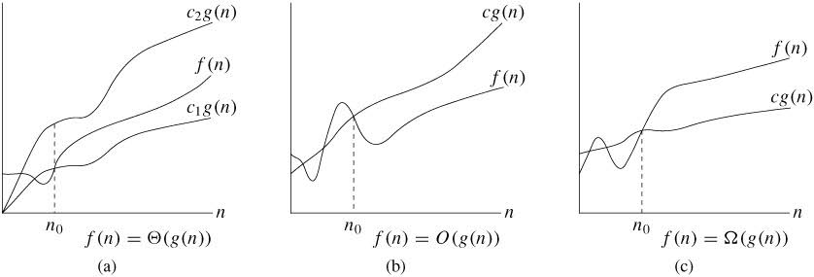
Analysis of Algorithms: Asymptotic Notations

Slide 16
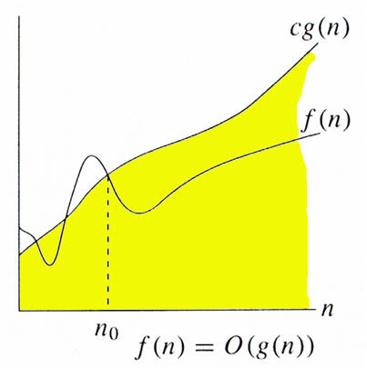
Asymptotic Notations: Big O Notations

Slide 17
Asymptotic Notations: Big O Notation
It defines the upper bound of an algorithm.
O(g(n)) ={f(n): there exists positive constant c and no such that
f(n)<= c(g(n)) where c>0, no >=1}
Then f(n) =O(g(n)) {f is upper bounded by g}

Slide 18
Asymptotic Notations: Big O Notation
Big Oh denotes worst case for a function f(n).
O(g(n) bounds a function in such way, that after n=n0 , the worst case value never crosses g(n). i.e the value of c(g(n)) is always greater than f(n).
e.g. f(n)= 3n+2, g(n)=n; then we can say,
f(n)= O(g(n))-> f(n)<=cg(n)
3n+2<=cn -> This condition holds true for c=4 and n>=2

Slide 19
Asymptotic Notations: Big Ω Notation
It defines the lower bound of an algorithm.
Ω(g(n)) ={f(n): there exists positive constant c and no such that
f(n)>= c(g(n)) where c>0, no >=1}
Then f(n) = Ω(g(n)) {f is lower bounded by g}

Slide 20
Asymptotic Notations: Big Ω Notation
Big Omega denotes best case for a function f(n).
Ω(g(n) bounds a function in such way, that after n=n0 , the best case value never crosses g(n). i.e the value of c(g(n)) is always lesser than f(n).
e.g. f(n)= 3n+2, g(n)=n; then we can say,
f(n)= Ω(g(n)) -> f(n)>=cg(n)
3n+2>=cn -> This condition holds true for c=1 and n>=1

Slide 21
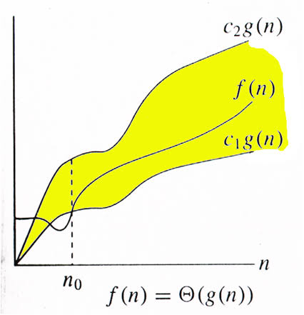
Asymptotic Notations: Big Ɵ Notation

Slide 22
Asymptotic Notations: Big (Theta) Ɵ Notation
Big Theta bounds a function from above and below, i.e between upper and lower bound
Ɵ(g(n)) ={f(n): there exists positive constant c1, c2 and no such that
c1g(n)<=f(n)<= c2(g(n))
where c1, c2>0, no and no >=1}
Then f(n) = Ɵ(g(n)) {f is lower and upper bounded by g}

Slide 23
Asymptotic Notations: Big (Theta) Ɵ Notation
Big Theta denotes AVERAGE case for a function f(n).
Ɵ(g(n) bounds a function in such way, that after n=n0 , the average case value always lies in between c1g(n) and c2g(n).
e.g. f(n)= 3n+2, g(n)=n; then we can say,
f(n)= Ɵ(g(n)) -> c1g(n)<=f(n)<=c2g(n)
c1n<=3n+2<=cn -> This condition holds true for c1=1 , c2=1and n0=2

Slide 24
Examples : Constant & Linear loop
i=1
Loop(I <= 1000)
1 application code
2 I = I + 1
The body of the loop is repeated 1000 times.
I = 1
Loop (I <= n)
Application code
I = I + 2
For this the code time is proportional to n

Slide 25
Examples : Square loop
MatrixAdd(A,B,n)
{ for(i=0;i<n;i++) \\ n+1
for(j=0; j<n;j++) \\n*(n+1)
C[i,j]=A[i,j]+B[i,j]; \\n*n
}
F(n)= n2+n*(n+1)+n+1=2n2+2n+1=O(n2)

Slide 26
What is the Time Complexity of ?
Multiply Loop
for(i=1;i<n; i=i*2)
print(“BCA”)
Divide Loop
for(i=n; i>1; i=i/2)
print(“BCA”)

Slide 27
Nested loop- linear logarithmic
i = 1
loop(I <= n)
1 j = 1
2 loop( j < = n)
1 application code 2 j = j *2
3 I = I + 1

Slide 28
Dependent Quadratic
for (i=0; i<n ; i++)
for (j=0; j<i ; j++)
{ Statements }
1+2+3+4+….+n= n(n+1)/2= O(n2)

Slide 29
Recurrence Relations
A function calling itself, is called recursive function.
A recurrence is an equation or inequality that describes a function in terms of its value or small inputs.
T(n) = O(1) ; if n<=c
else : aT(n/b)+D(n)+c(n)

Slide 30
Recurrence Relations
A recurrence relation is a mathematical expression that defines a sequence in terms of its previous terms. In the context of algorithmic analysis, it is often used to model the time complexity of recursive algorithms.
Some of the common uses of Recurrence Relations are:

Slide 31
Time Complexity Analysis
Generalizing Divide and Conquer Algorithms
Analyzing Recursive Algorithms
Defining State and Transitions for Dynamic Programming.

Slide 32
Recurrence Relations Solution
Three Types:
Substitution Method
Iteration Method
Recursion Tree Method
Masters Theorem

Slide 33
Substitution Method
In Substitution Method, we guess a bound and then use mathematical induction method to prove our guess correct.
The substitution method entails two steps:
Guess the form of the solution.
Use mathematical induction to find the constants and show the solution works.

Slide 34
Forward Iterative Method
Ex: solve the following recurrence relation by forward substitution method.
T(n)=T(n-1)+1 if n>1
T(1)=1 if n=1
Solution:
We have given recurrence relation
T(n)=T(n-1)+1 -------------- (1)
first we put n=2 in equation 1,
We get

Slide 35
Continue…
T(2)=T(2-1)+1
T(2)=T(1)+1
T(2)=1+1
T(2)=2 ---------(2)
Now we put n=3 in equation (1)
T(3)=T(3-1)+1
T(3)=T(2)+1
T(3)=2+1=3--------(3)

Slide 36
Continue…..
Now we put n=4 in equation (1), we will get
T(4)=T(4-1)+1
T(4)=T(3)+1
T(4)=3+1
T(4)=4------------(4)
From equation (1),(2),(3) and (4) we can observe that
T(n)=n
So therefore the time complexity will be
T(n)=O(n)

Slide 37
Iterative Method
The iterative method, also known as backward substitution method, is a technique, which is used to solve a recurrence relation to find its time complexity.
The basic idea is to expand the recurrence and express it as a summation of terms dependent only on ’n’ and the initial conditions.

Slide 38
Design Strategy
Divide & Conquer approach
Greedy Approach
Dynamic Programming Approach
Backtracking Approach
Branch and Bound Approach

Slide 39
Algorithm Techniques: Divide & Conquer
In divide and conquer approach, the problem is divided into several small sub problems.
Then the sub problems are solved recursively & combined to get the solution of original problem.
It involves following steps at each level:
Divide: The original sub problem is divided into sub problems.
Conquer: The sub problems are solved recursively.
Combine: Solutions of sub problems are combined together to get solution of original problem.

Slide 40
Binary Search
Binary search, also known as half-interval or logarithmic search, is a search algorithm that finds the position of target value within a sorted array.
Binary search is a fast search algorithm with run time complexity, of O(log n) .
This algorithm works on principle of divide and conquer.

Slide 41
Binary Search
Binary search compares the target value to the middle element of the array.
If they are not equal, the half, in which target cannot lie is eliminated & search continues on the remaining half, again by taking the middle element to compare the target value.
This continues until the target value is found. If the search ends with remaining half being empty, the target is not present in the array.

Slide 42
Algorithm of Binary Search
int b_search(a[],low,high,key)
{
if(a[l)==key)
{
return l;
}
else
{
return 0;
}
}

Slide 43
else
{
mid==(low+high)/2;
if(key==a[mid])
return mid;
if(key<a[mid])
return b_search(low,mid-1,key);
else
return b_search(low+1,mid,key);
}

Slide 44
STRASSEN’S MATRIX MULTIPLICATION
The matrix multiplication of algorithm due to Strassens is the most dramatic example of divide and conquer technique (1969).
The usual way to multiply two n x n matrices A and B, yielding result matrix ‘C’ as follows :
for i := 1 to n do
for j :=1 to n do
c[i, j] := 0;
for k: = 1 to n do
c[i, j] := c[i, j] + a[i, k] * b[k, j];

Slide 45
This algorithm requires n³ scalar multiplication’s (i.e. multiplication of single numbers) and n³ scalar additions.
So we naturally cannot improve upon.

Slide 46
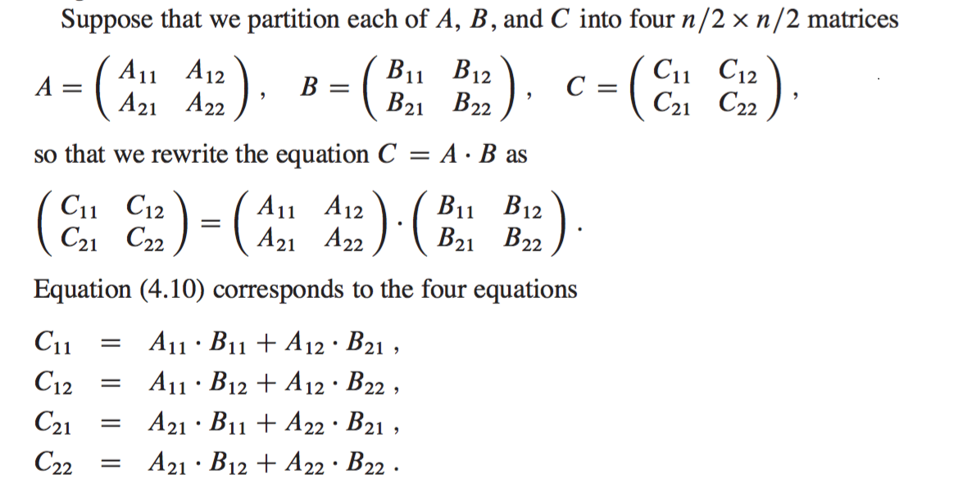
BLOCK PARTITIONING

Slide 47
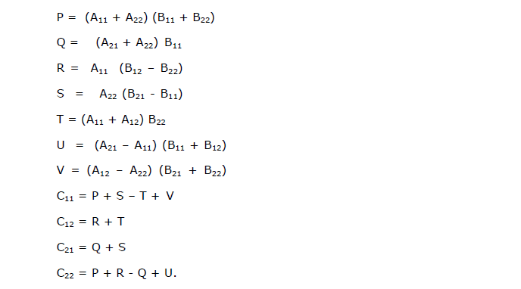
BLOCK PARTITIONING

Slide 48
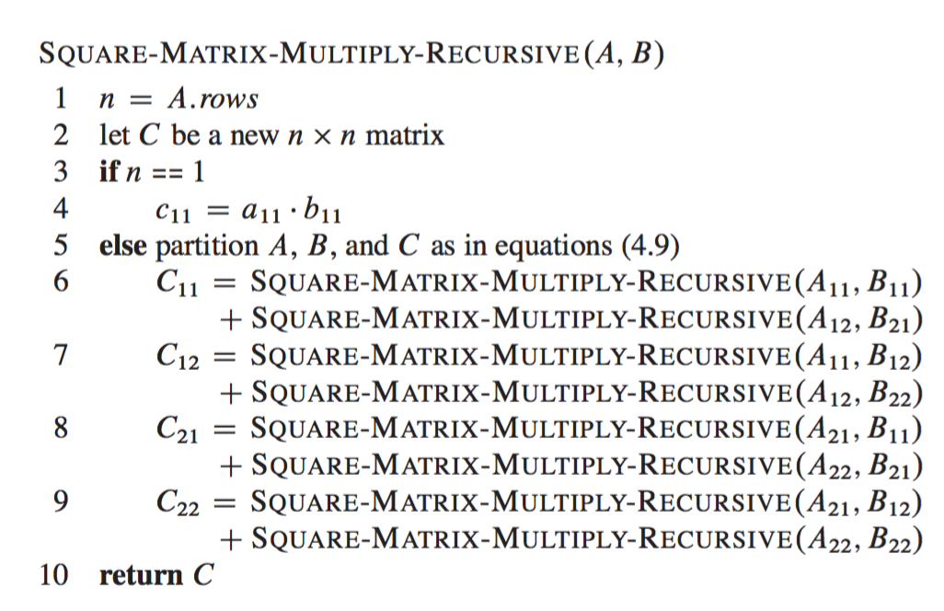

Slide 49
ALGORITHM
Divide the input matrices A and B into n/2 x n/2 sub-matrices, which takes Θ(1) time by performing index calculations.
Create 10 matrices S1, S2, S3, … S10 each of which is the sum or difference of two matrices created in step 1.
Using the sub-matrices created from both of the steps above, recursively compute seven matrix products P1, P2, … P7.
Each matrix Pi is of size n/2 x n/2.
Get the desired sub-matrices C11, C12, C21, and C22 of the result matrix C by adding and subtracting various combinations of the Pi sub-matrices.

Slide 50
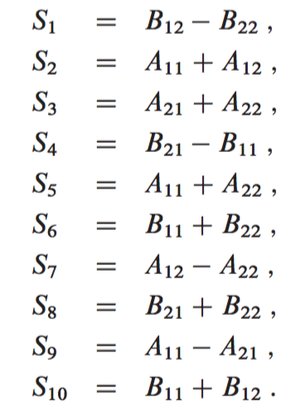
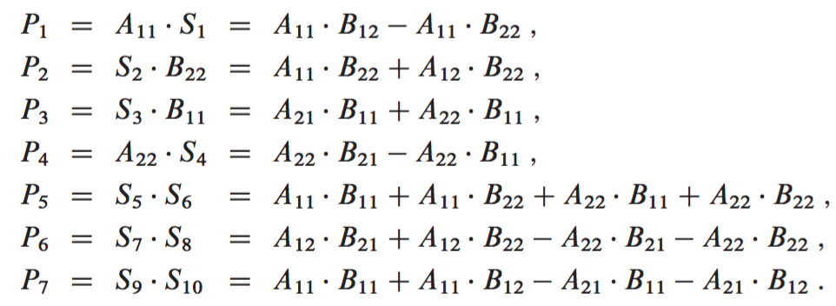

Slide 51
