Slide 1
The Quantum Hall Effects
Xinyuan Lai

Slide 2
Outline
About the Quantum Hall Effects (QHEs):
Integral, Fractional, Anomalous, Quantum Spin
Hall Effect, etc.
Unconventional QHE in Graphene
Methods to Characterize the Effects
Transport, Direct Probing (Quantum
Capacitance), STM Spectroscopy…

Slide 3
Hall Effect (1879)
B
+++++++++++++++++++
E_{x}, j_{x}
V_{H}
E_{y}
- - - - - - - - - - - - - - - - - -

Slide 4
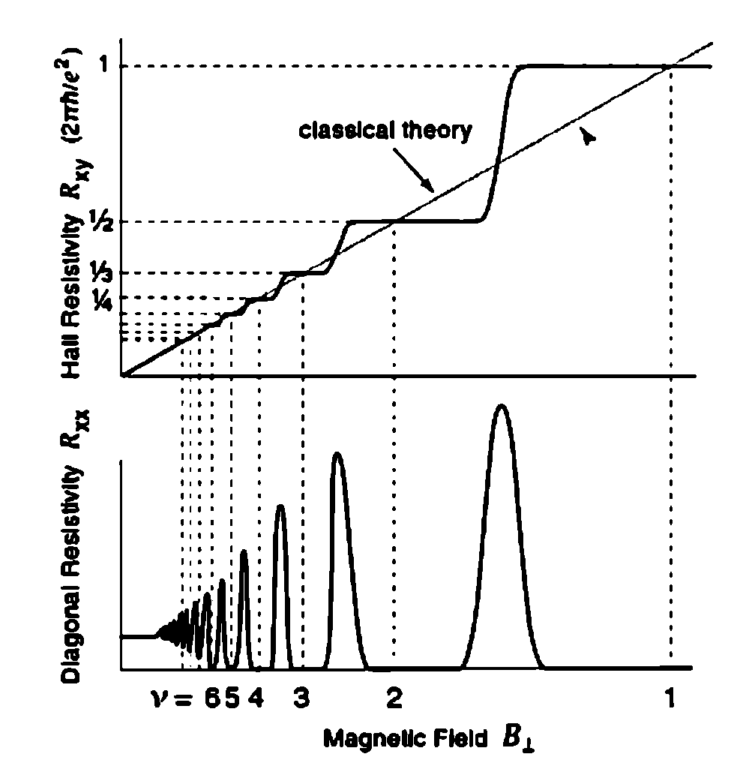
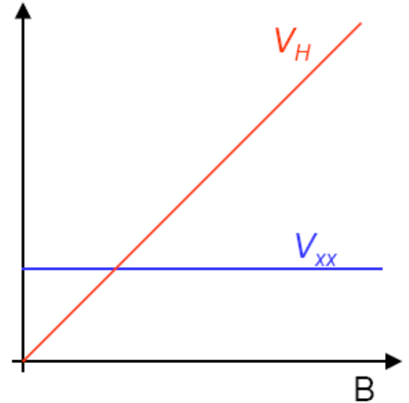
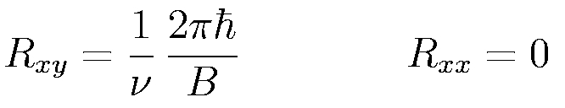


Integral QHE vs. HE
Zyun Francis Ezawa, Quantum Hall Effects: Field Theoretical Approach and Related Topics
$$R\sim v\frac{e^{2}}{ℏ}$$
$$R\sim B_{⊥}$$
Shubnikov-de Hass Oscillation

Slide 5
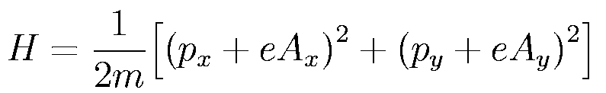
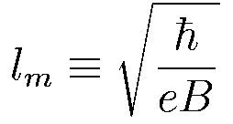
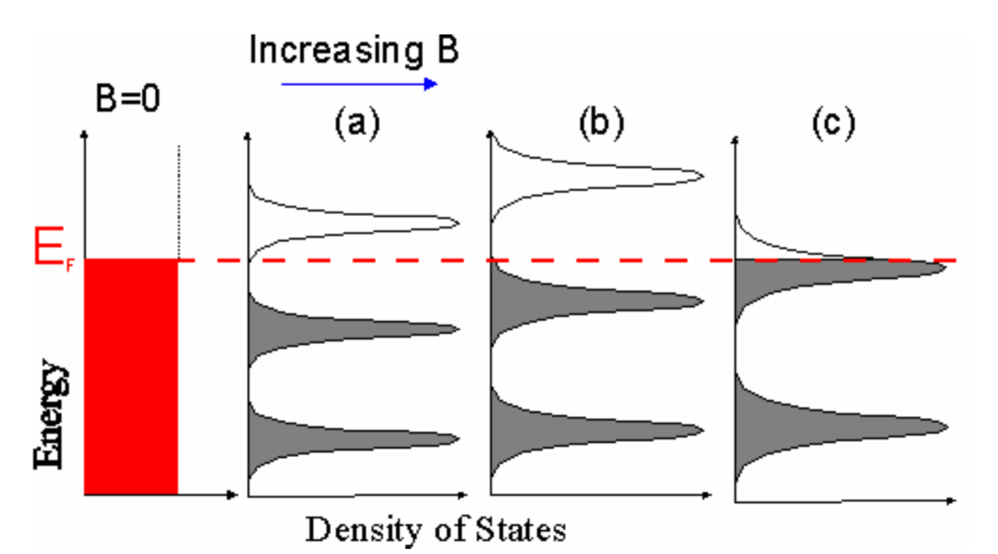
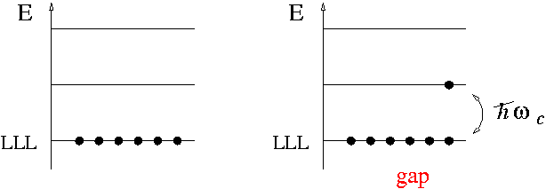
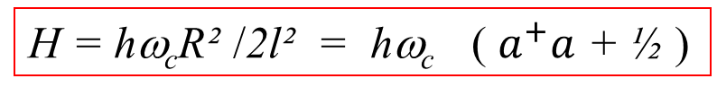
Landau Quantization
Zyun Francis Ezawa, Quantum Hall Effects: Field Theoretical Approach and Related Topics
electron
center of
cyclotron motion
radial vector of
cyclotron motion
R
Generalizing to Harmonic Oscillators gives:
X
H = hω_{c}R² /2l² = hω_{c} ( $a^{+}a$ + ½ )
Link of video
Notes:
the area of the QH system can change only in units of 2pilm^2 associated with one Dirac ﬂux quantum. lt is accompanied with a creation of a
quasiparticle, as costs a nonzero creation energy.

Slide 6
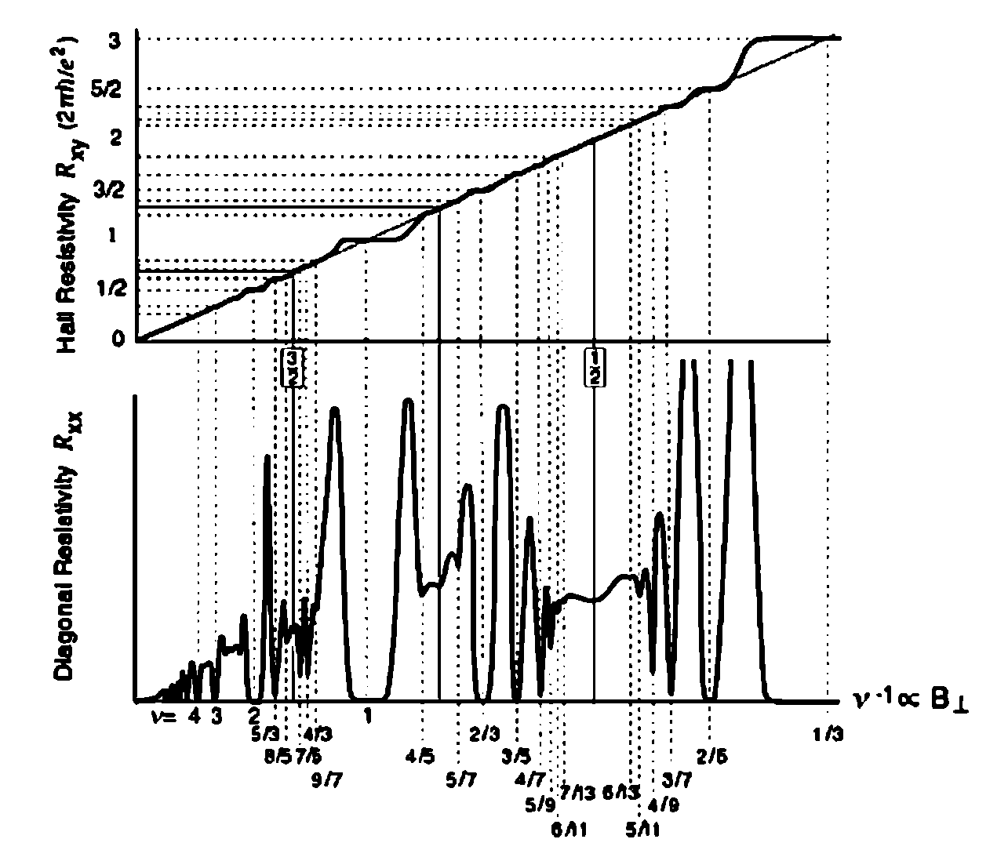
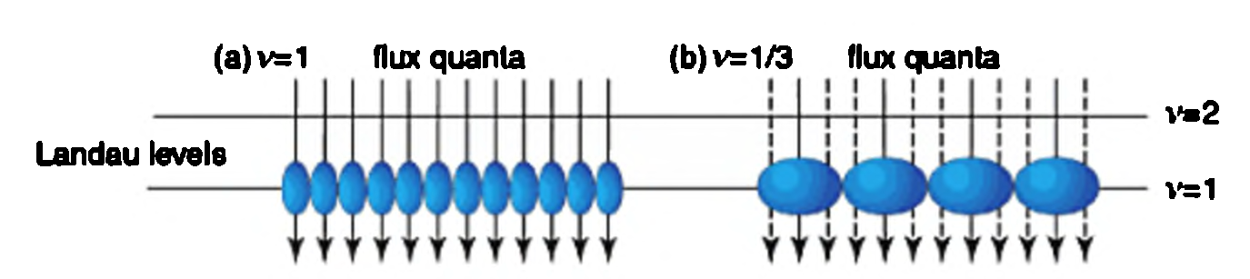

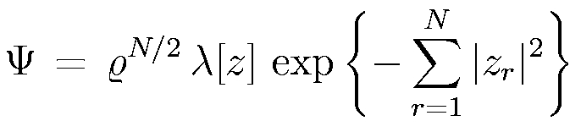
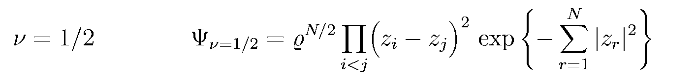
Fractional QHE
Zyun Francis Ezawa, Quantum Hall Effects: Field Theoretical Approach and Related Topics
DC Tsui, PRL, 1982
Filling Factor equals to some fractional values:
Composite Particle Picture:
Described by Laughlin Wave Function:
m
m
Integral Quantization of Quasi-particles !

Slide 7
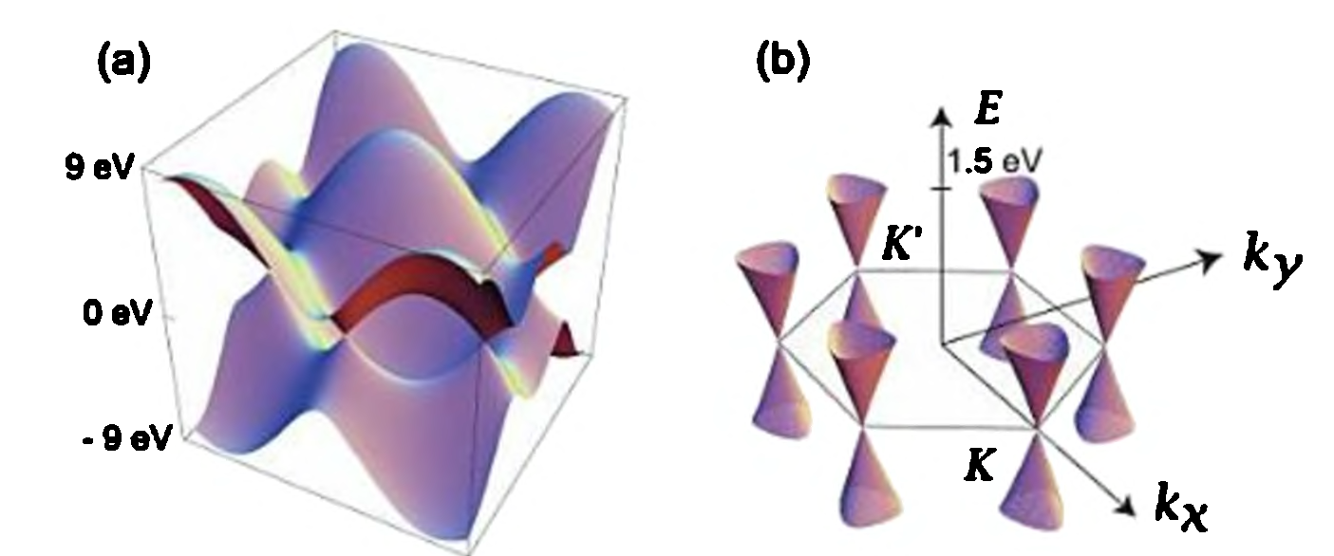
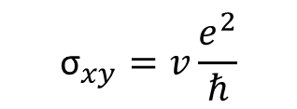
Unconventional QHE in Graphene
Eva Y Andrei et al, Rep. Prog. Phys. 2012
2x Degeneracy in Graphene System
Not equally spacing LLs:
$$v=0, ±1, ±2,±3 …$$
Normal:
$$v= ±2, ±6,±10 …$$
Graphene:
$${\text{σ}}_{xy}=v\frac{e^{2}}{ℏ}$$

Slide 8
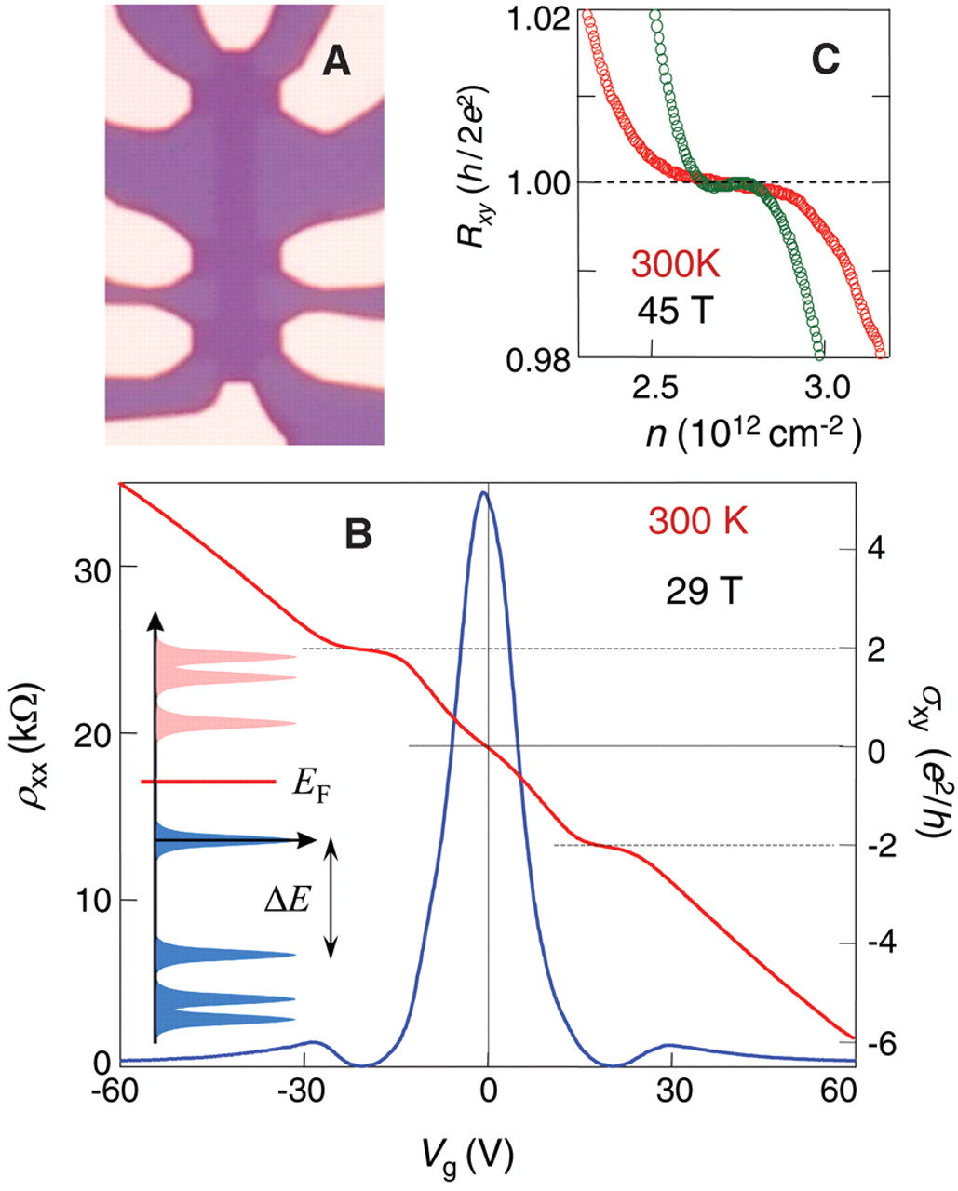
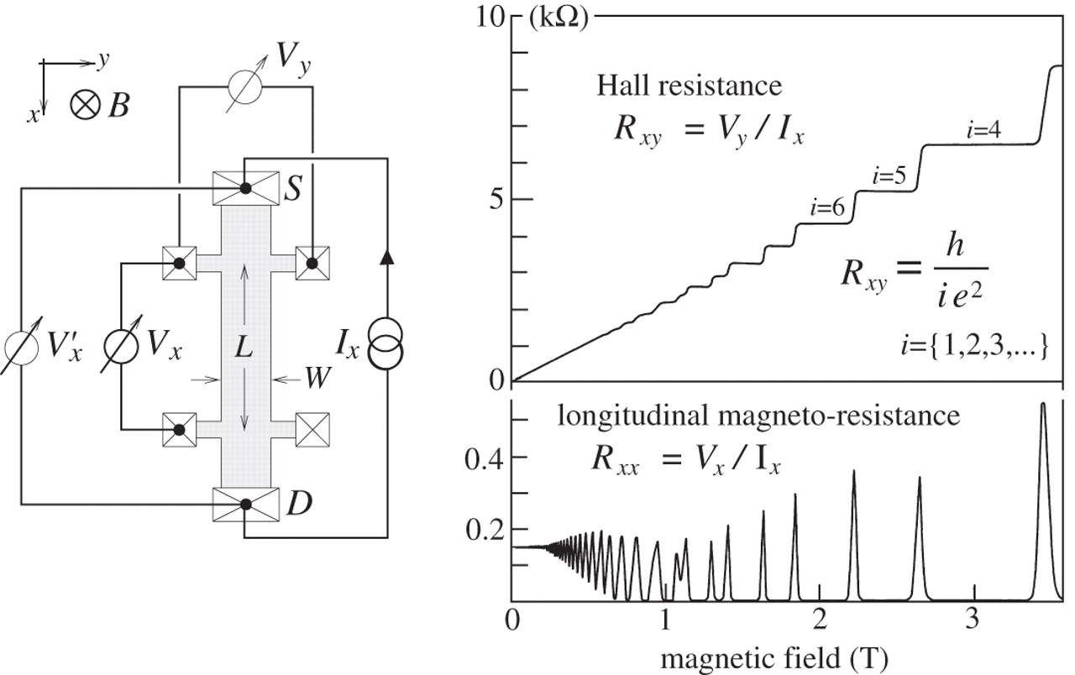
Transport Measurement
K. S. Novoselov, Science, 2009
Room Temperature QHE

Slide 9
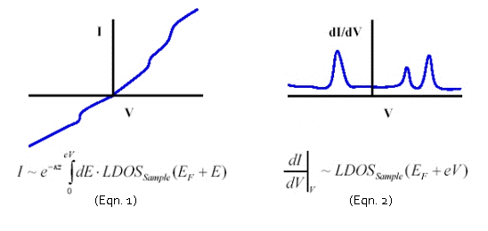
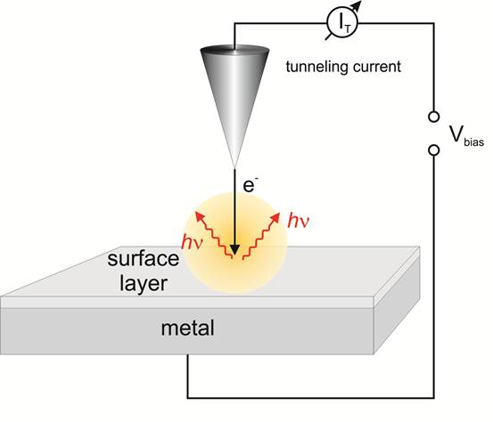
STM Spectroscopy
Eva Y Andrei et al, Rep. Prog. Phys. 2012
http://research.physics.berkeley.edu/crommie/research:stm

Slide 10
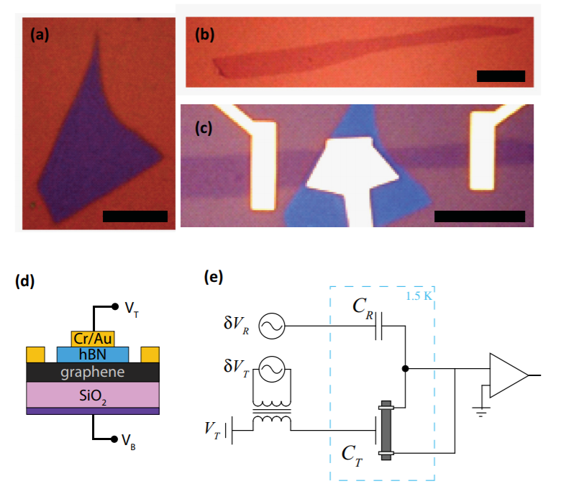
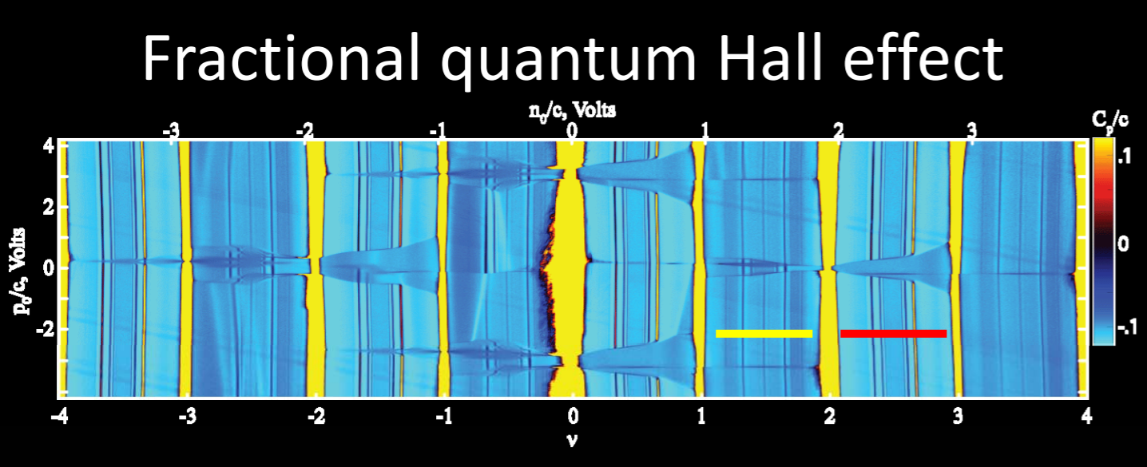
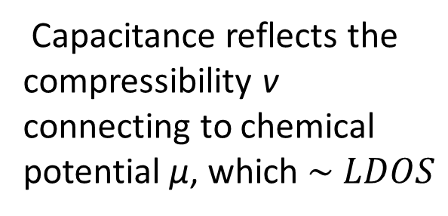

Direct Probe
A. F. Young, PRB, 2012
Z. Z. Zibrov, Nature, 2017
Differential Capacitance within the Plate Capacitor:
$$C=∂n/∂V$$
$$C^{−1}=C_{0}^{−1}+{(e^{2}Av)}^{−1}$$
Capacitance reflects the compressibility v connecting to chemical potential μ, which $\sim LDOS$
Notes:
In a parallel plate capacitor made up of imperfect conductors, adding charge n to the plates costs the sum of the classical electrostatic energy, the kinetic energy due to the resulting change in the chemical potential μ, and the potential energy of Coulomb interactions between the charge carriers.
reflects this finite electronic compressibility by manifesting a lowered effective capacitance

Slide 11
Thank you!

