Slide 1


PROBLEM DEFINITION
With an aim to enhance the education and its system in our country, various measures are being taken by the government. But for the education to be of a better quality, there needs to be a good amount of resources to support the education which can in turn provide in-depth knowledge on a specific topic.
Currently, there is a lack of enough resources, especially for poor students, who can’t afford to purchase the necessary resources which can help them with their studies. They find it difficult to cope up and cover up with the syllabus, other than what is being taught in the school or college. This causes a drop in their academic performance, which sometimes also affects their mental health.

Slide 2



Solution
The solution planned is to build a platform for such students, where the needy students can get the required resources and books donated by others who have previously used those resources. A feature can also be added where a specific person donates a specific amount of funds or money, which is collected by the platform, and can be redeemed by the needy to purchase certain books not available in the donation claim section.
Back to Agenda

Slide 3

Tech Stack
UI/UX(Figma)
HTML5
CSS
JavaScript

Slide 4

How my idea is unique?
The uniqueness of the idea lies in its support and easiness for the students who come from a financially poor background. Currently there is no such platform which supports the growth of the education of the needy students, and with this platform, a sense of hope and support can be arisen in them.
Having a platform uniquely built for such students where they would get the necessary resources, can bridge a major gap in the current education system and lead to have a better literacy rate as well as give a boost to the youth power and knowledge and awareness of the society and the country.

Slide 5
Challenges
Considering the platform being hosted on the internet and being open to all, the facility of such a feature for the needy can be exploited by the students and people who aren’t needy and still can afford to get the resources.
To bridge this gap, an extra step is added where, the order which was placed after claiming the donation or purchasing with the donated fund, will be delivered to the pickup stores which would be located in some specific regions where there is a higher population of the needy students like slum areas, etc.
Also, when a particular student arrives for claiming the delivery, his/her financial bacground would be verified before confirming the delivery of the order.

Slide 6
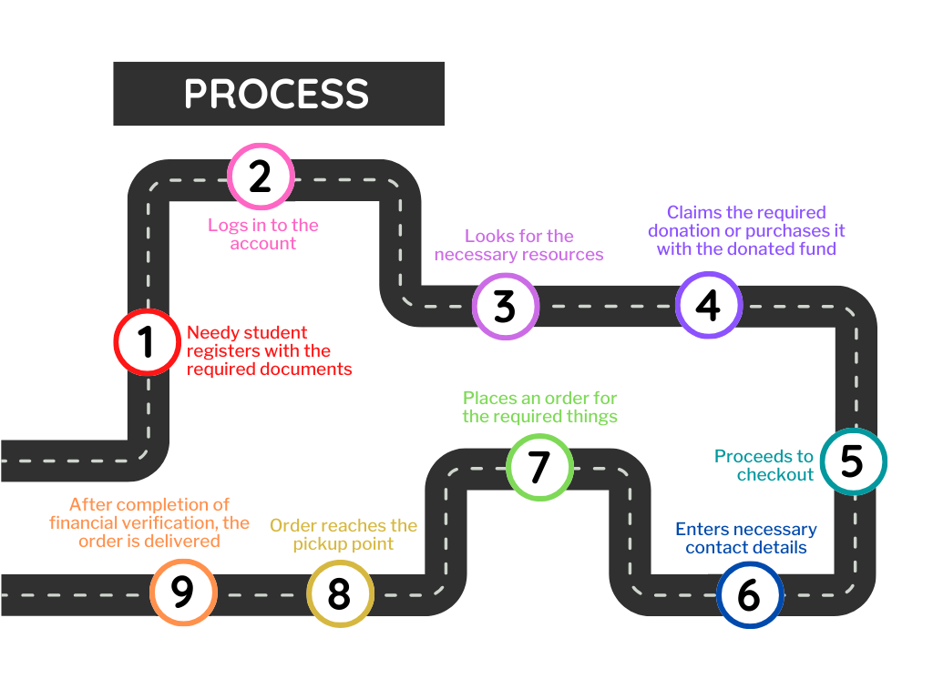
Architecture of Idea

