Slide 1

Stock Price Prediction
Group Members :-
Gudiya Pavan Kumar Sahu
Jagtap Vaibhavi Ramdas
Nagaranjani.C.Bhat
Mateen Ahmad Muddebihal
Rahul khandait
Asghar Abbas M
under the guidance of Aishwarya Mate, Kishore R

Slide 2
CONTENT
Introduction
Objectives
Project Flow:
1. Data Collection
2. EDA
3. Data Preprocessing
4. Data Visulization
5. Feature Engineering
6. Model Building and Validation
Methodologies
Evaluation Metrics
Result
Conclusion

Slide 3
INTRODUCTION
Stock market is an aggregation stockbrokers and traders who can buy and sell shares of stocks.
Since statistical approaches are linear in nature, it hampers prediction performances in case of sudden rise or fall of prices of the stocks.
This presentation focuses on the use of time series forecasting techniques to predict Stock prices.
Time series forecasting aims to predict future values based on historical trends.
We will explore various forecasting methods and tools that can be used to analyze historical data and make predictions for future trends in Stock prices.
In modern days of artificial intelligence, machine learning plays an important role in time series predictions.

Slide 4
OBJECTIVES
The main objective is to predict the future stock price and then invest accordingly which reduces the cost and time.
Stock market prediction is the act of trying to determine the future price of a company stock or other financial instrument traded on a financial exchange. The successful prediction of a stock’s future price will maximize investor’s gains.
To find a better approach, which predicts prices of the stocks more accurately.
A neural networks based model have been used in predicting of the stock market.

Slide 5
PROJECT FLOW
Data Collection
EDA ,Visulization
and preprocessing
Feature Extraction
Train, Test
Validate the Model
Building Prediction Models
Evaluation of Model
Model Deployment

Slide 6
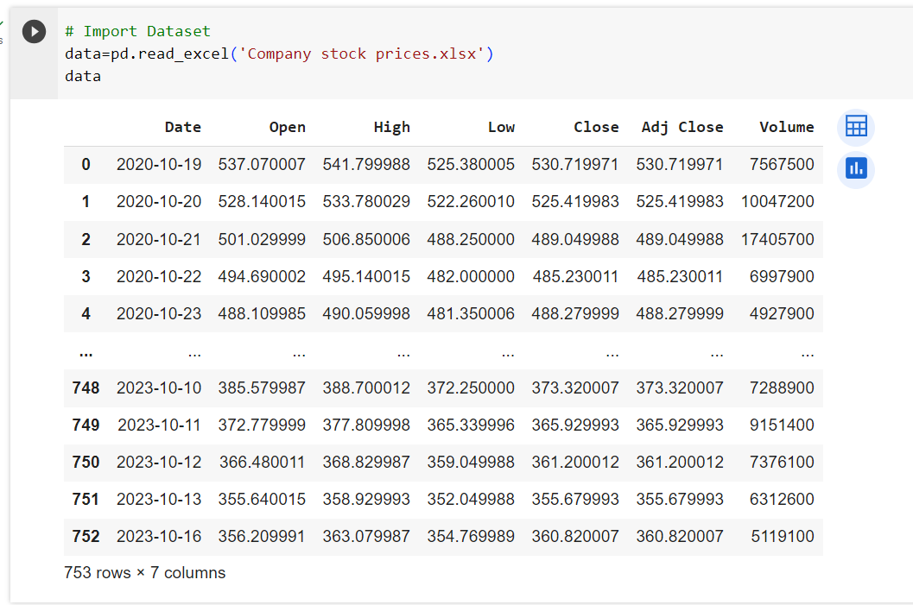
DATASET

Slide 7
DATA DESCRIPTION
We collect data of company stock prices from 2020-2023.
Our data consists of 753 rows and 7 columns.
Each row represents the information of a single day.
There are 7 columns for each row.
1st column :- the date
2nd column :- the opening price of that day
3rd column :- the highest price of that day
4th column :- the lowest price of that day
5th column :- the closing price of that day
6th column :- the adjusted close price of that day
7th column :- the volume of shares traded on that day

Slide 8

EDA
(Exploratory Data Analysis)

Slide 9





DATA PREPROCESSING
1. Data Understanding : Checking out for missing values.
2. Data Cleaning : Drop out unnecessary information in the dataset.
3. Data Exploring : We observed that Date column have 'object' datatype. So, we convert object datatype to datetime and set it to an index.
4. Data Analysis : After the above processing, we checked for the null values and no null values were present in the dataset.
5. Uncover Insights : Finally, we checked that the dataset does not contain any duplicate values.

Slide 10
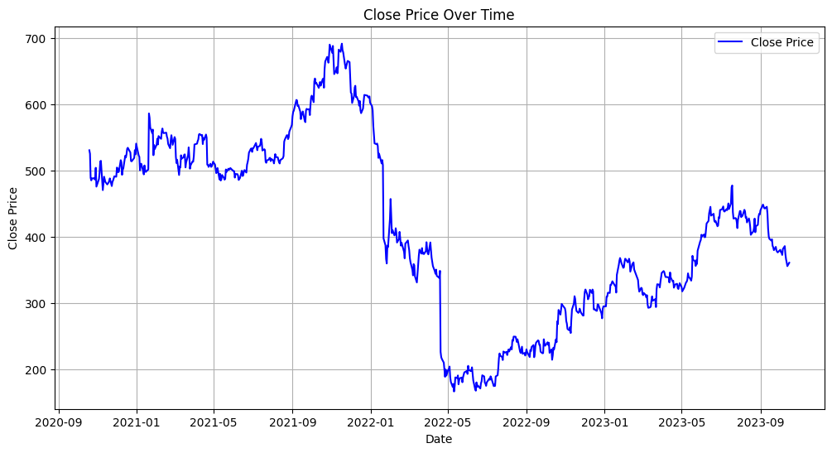
DATA VISUALIZATION
Observation:-
As noticed, around NOV 2021- MAY 2022 there is a sudden drop in price after which it reports a growth.

Slide 11
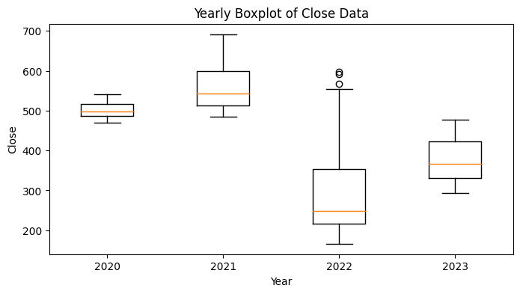
BOXPLOT
Observation:
For the year 2020 we see that the spread is less which implies the data set contains fewer values for 2020.
For 2022, the whiskers is upper stating it is right skewed and have few outliers
.

Slide 12
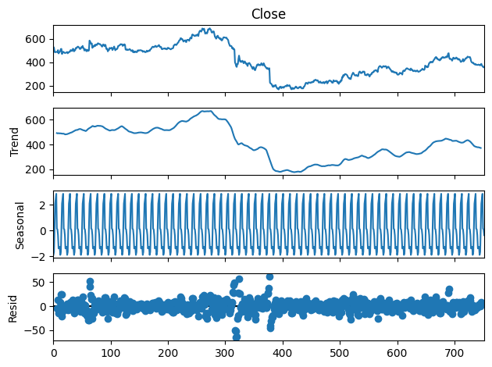
TIME SERIES DECOMPOSITION PLOT
Observation:-
We observe the seasonality in the data

Slide 13

FEATURE ENGINEERING

Slide 14
FEATURE SELECTION
For time series prediction, selection of features is an important task.
Because selection of worst features can direct the prediction to a wrong way.
In this system, only one feature has been selected for further analysis.
1.Closing Price

Slide 15
DATA SPLITTING
The dataset has been split into two parts as training data and testing data.
After Preprocessing and filling the missing values, the data should be 1093 rows and1 column.
Split the data into training and testing part:
Training Data (874 days) : 19-10-2020 to 11-03-2023
Testing Data (219 days) : 12-03-2023 to 16-10-2023

Slide 16
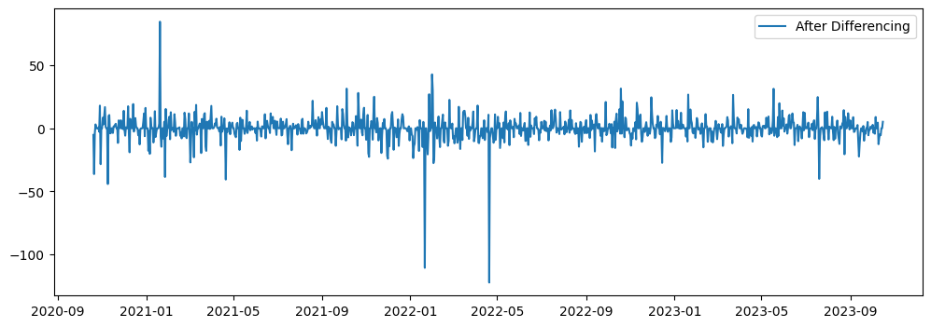
DATA TRANSFORMATION
We find out that our data is non-stationary by using Ad-Fuller Test(Augmented Dicky Fuller Test).
We can convert non-stationary data into stationary using differencing.
ADF Test p-value: 5.581568201854549e-12 The p-value is less than or equal to 0.05. Reject the null hypothesis. The data is likely stationary.

Slide 17

MODEL BUILDING AND VALIDATION

Slide 18
METHODOLOGIES
Linear Model
Exponential Model
Quadratic Model
Simple Exponential Smoothing
Double Exponential Smoothing
Holt’s Winter Exponential Smoothing with additive seasonality
Holt’s Winter Exponential Smoothing with Multiplicative seasonality
ARIMA Model
SARIMA Model
Prophet Model
LSTM Model

Slide 19



EVALUATION METRICS
Mean Squared Error (MSE)
Root Mean Squared Error(RMSE)
Mean Absolute Percentage Error (MAPE)

Slide 20
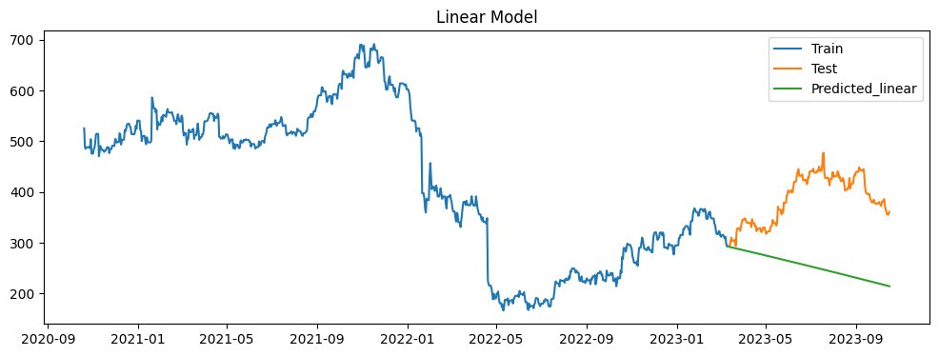
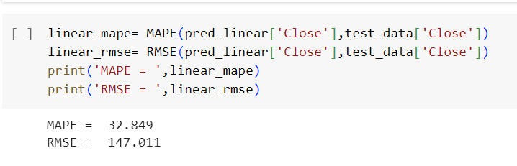
LINEAR MODEL
Simple linear regression algorithm is one of the fundamental supervised machine learning algorithms used for regression.

Slide 21
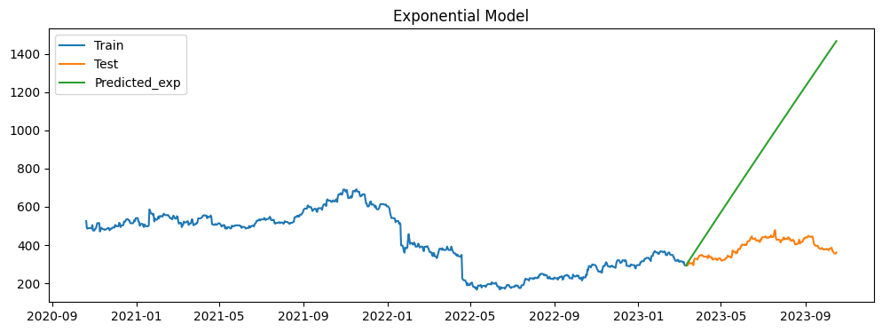
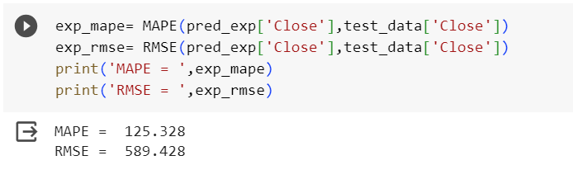
EXPONENTIAL MODEL
Exponential Smoothing Methods is also another forecasting models. They use weighted averages of past observations to forecast new values. The idea is to give more importance to recent values in the series. Thus, as observations get older in time, the importance of these values get exponentially smaller.

Slide 22
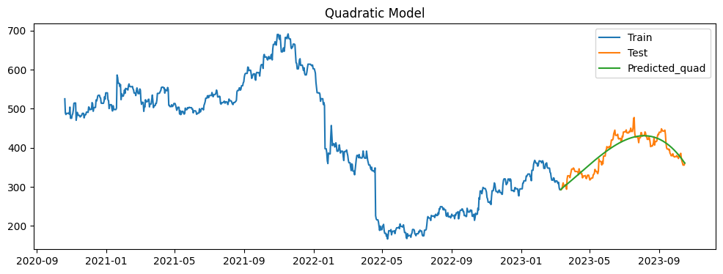
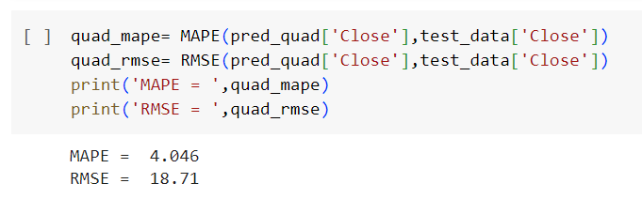
QUADRATIC MODEL
With a quadratic trend, the values of a time series tend to rise or fall at a rate that is not constant; it changes over time. As a result, the trend is not a straight line. The trend is expressed as. The corresponding regression equation is. The following figure shows a time series with a quadratic trend

Slide 23
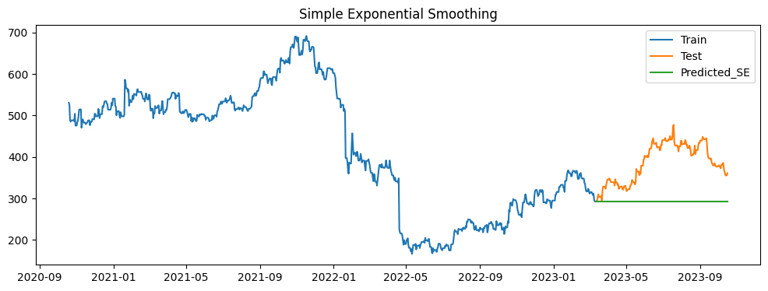
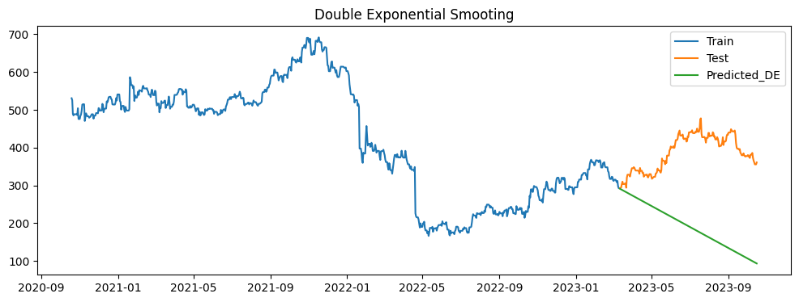
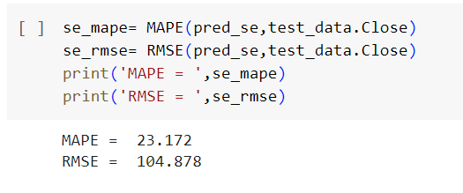
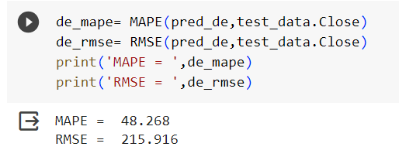
EXPONENTIAL SMOOTHING
Exponential Smoothing Methods are a family of classic forecasting algorithms.
They work well when the time series shows a clear trend and/or seasonal behavior.
Exponential Smoothing Methods combine Error, Trend, and Season.

Slide 24
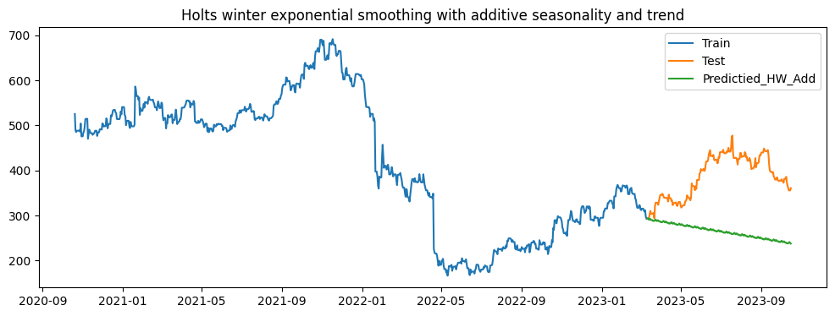
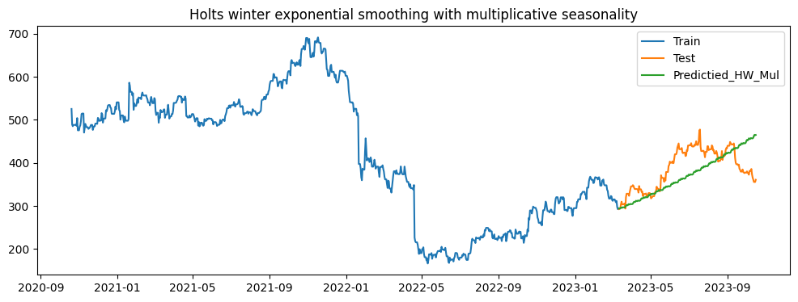
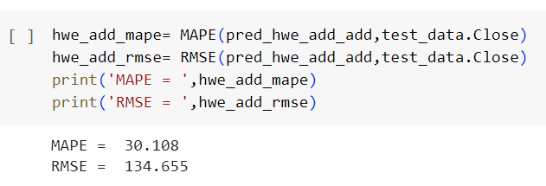
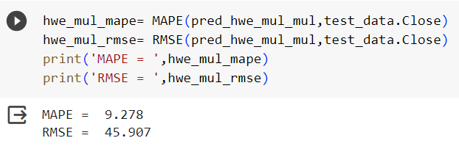
HOLT’S WINTER SMOOTHING
The Holt-Winters algorithm is a time-series forecasting method that uses exponential smoothing to make predictions based on past observations. The method considers three components of a time series: level, trend, and seasonality, and uses them to make forecasts for

Slide 25

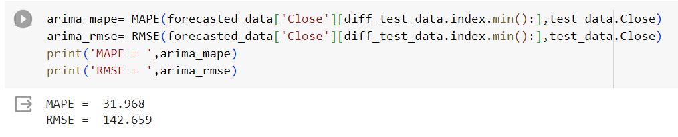
ARIMA MODEL
ARIMA is composed of 3 terms:
(Auto Regression(p) + Integrated (d) + Moving Avg (q))
ARIMA model is good only on stationary dataset.
It can not perform good on non-stationary dataset.
First, we need to find out the order of ARIMA model.

Slide 26
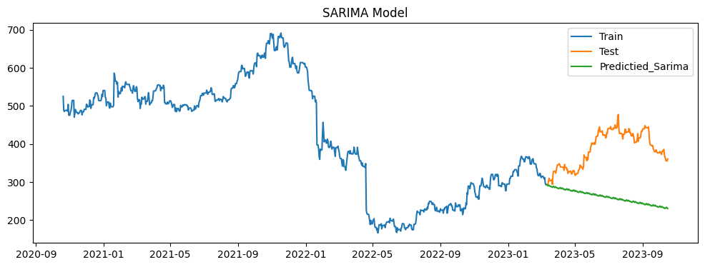
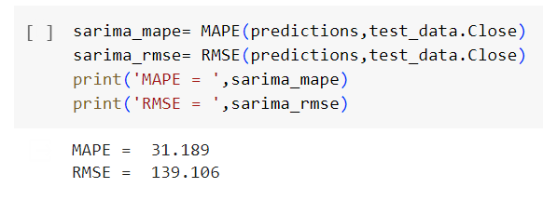
SARIMA MODEL
SARIMA is composed of 4 terms:
(Auto Regression(p) + Integrated (d) + Moving Avg (q)) and (Seasonality)
SARIMA model is good only on stationary dataset.
It can not perform good on non-stationary dataset.
First, we need to find out the order of SARIMA model.

Slide 27
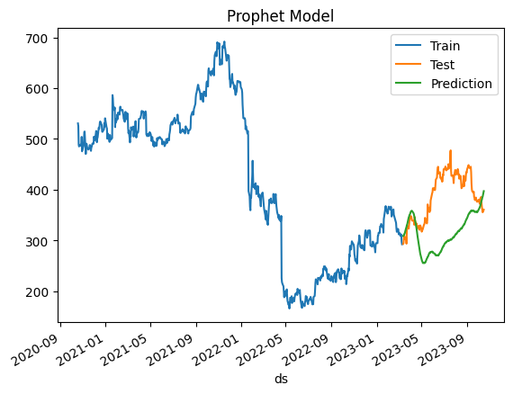
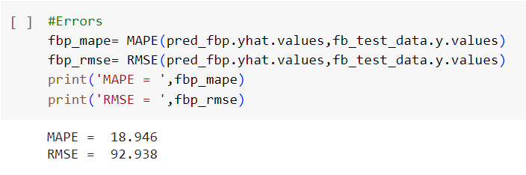
PROPHET MODEL
Prophet is a time series forecasting model package that works best on data with seasonal effects. Prophet was also considered a robust forecast model because it could handle missing data and outliers.

Slide 28
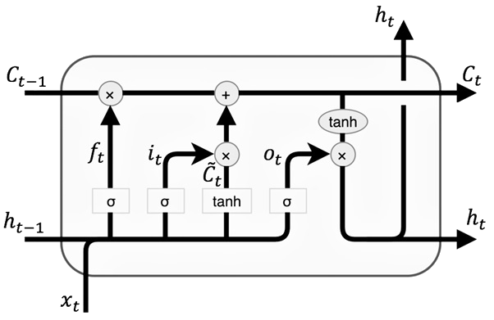
LSTM MODEL
LSTM is one of the most successful RNN’s Architectures.
LSTM introduces the memory cell, a unit of computation that replaces traditional artificial neurons in the hidden layer of the network.
LSTM networks are well suited to classifying, processing and making predictions based on time series data.
Fig. LSTM

Slide 29
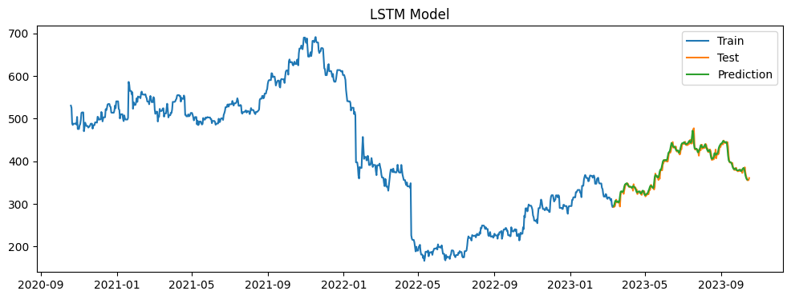
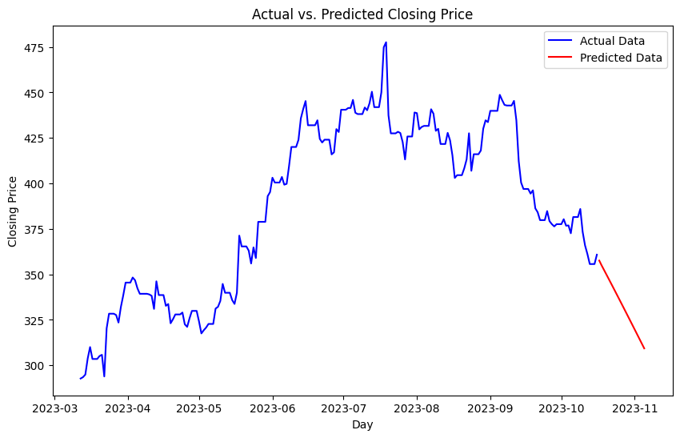
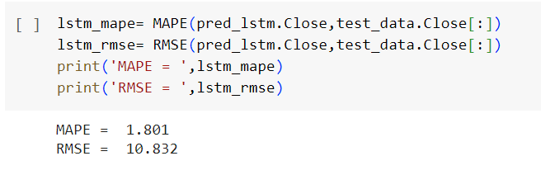

Slide 30
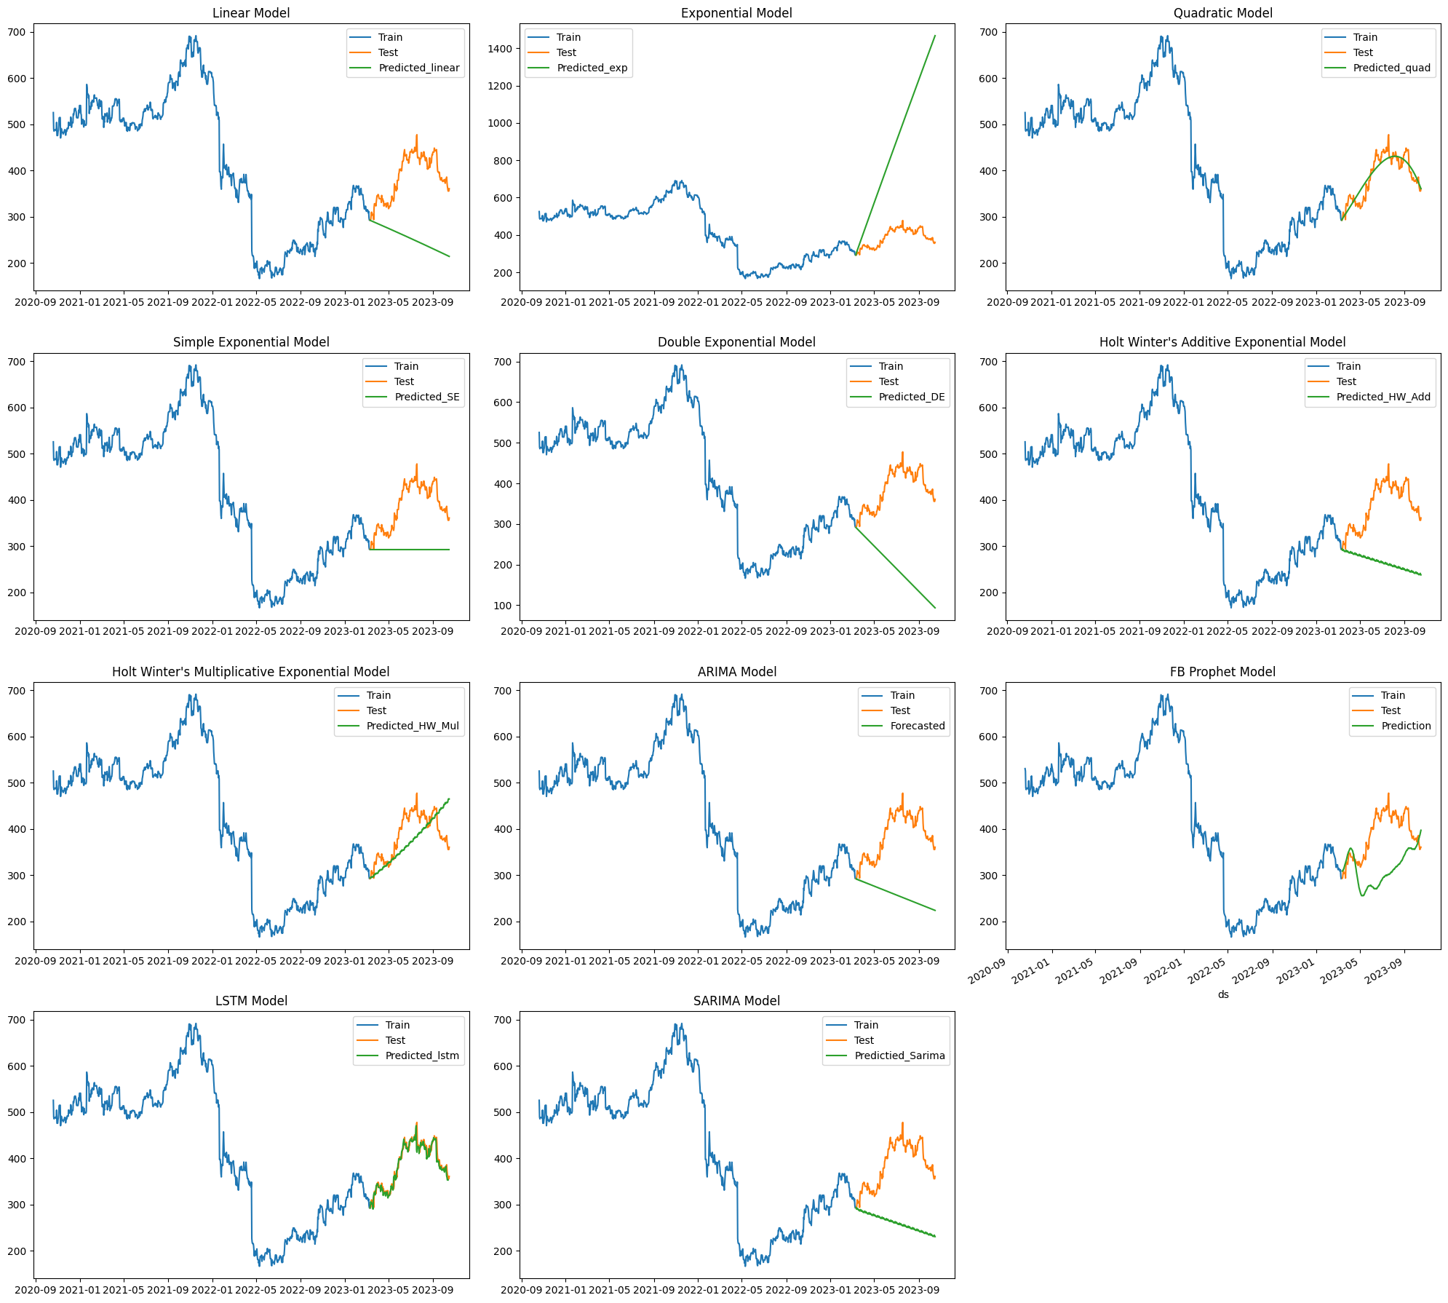
COMPARISION

Slide 31
RESULTS
Sr.no | Model | RMSE | MAPE
0 | LSTM | 10.832 | 1.801
1 | Quadratic | 18.710 | 4.046
2 | Holt Winter's Multiplicative | 45.907 | 9.278
3 | Prophet | 92.938 | 18.946
4 | Simple Exponential | 104.878 | 23.172
5 | Holt Winter's Additive | 134.655 | 30.108
6 | SARIMA | 139.106 | 31.189
7 | ARIMA | 142.659 | 31.968
8 | Linear | 147.011 | 32.849
9 | Double Exponential | 215.916 | 48.268

Slide 32
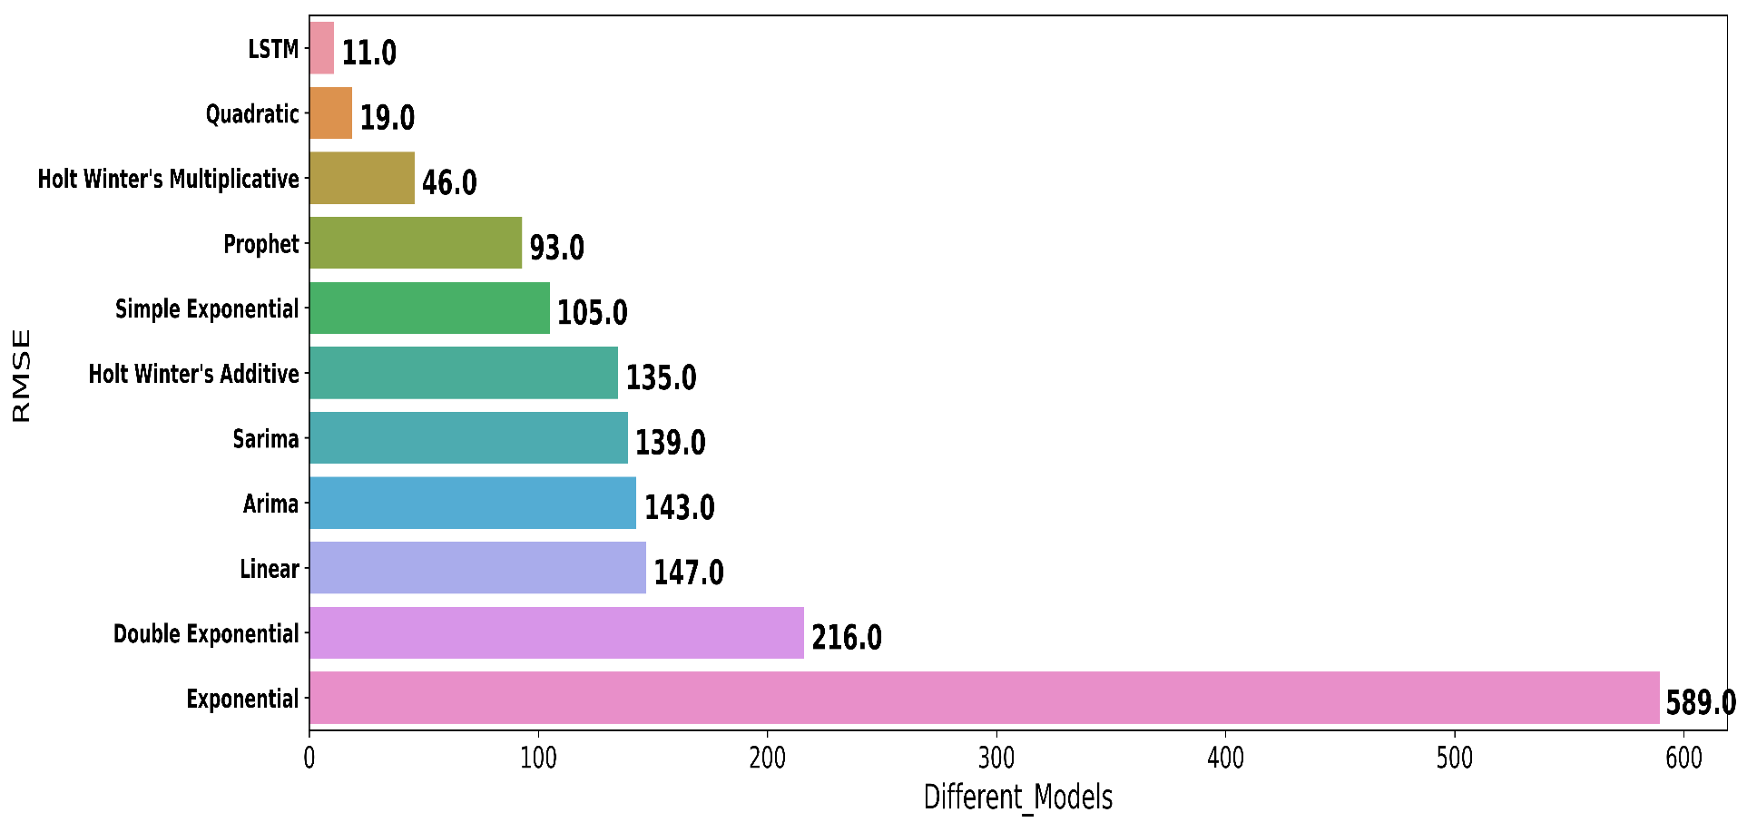
PREDICTIONS
The model which gives lower RMSE and MAPE that model should be better for prediction purpose.
After calculating RMSE and MAPE, the LSTM model is better.

Slide 33

DEPLOYMENT

Slide 34
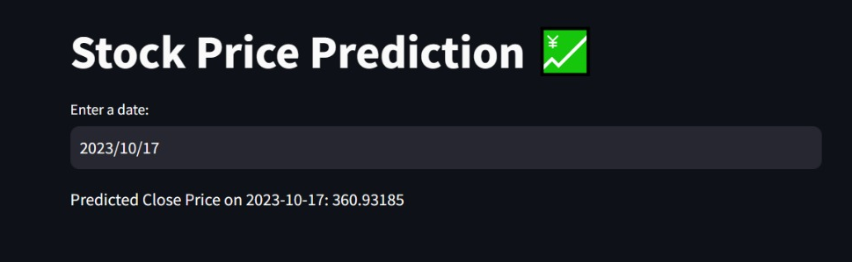
MODEL DEPLOYMENT USING STREAMLIT
Deployment is the method by which you it is one of the last stages in the machine learning life cycle and it can be deployed by using STREAMLIT in local servers of our pc

Slide 35
CONCLUSION
By doing data pre-processing, we can convert the original data into clean and understandable data.
It will help for shareholders to predict the future.
The best model we have got so far with the lowest RMSE and lowest MAPE is LSTM and Quadratic. This proposed method and technique we can easily and accurately predict the future price of the market.
LSTM are found to be the most accurate to predict stock prices.

Slide 36
SUMMARY
Keep in mind that stock price forecasting carries inherent risks, and financial decisions should not rely solely on forecasts.
Diversify your investments, consider risk management strategies, and consult with financial experts.
The financial markets are dynamic, and models may require periodic recalibration to remain accurate.
Time series forecasting for stocks is a complex and dynamic field, and success in this area depends on the quality of data, the choice of the right forecasting model, and a thorough understanding of financial markets and their associated risks.

Slide 37
REFERENCES
https://github.com/campusx-official
https://www.youtube.com/@SerranoAcademy
https://www.youtube.com/@krishnaik06
https://www.youtube.com/@3blue1brown
https://www.kaggle.com/code/shivamb
https://machinelearningmastery.com/blog/

Slide 38
THANK YOU

