Slide 1

I.D.E.A.
Innovazione Digitale E Accessibilità per il patrimonio culturale Caproni

Slide 2
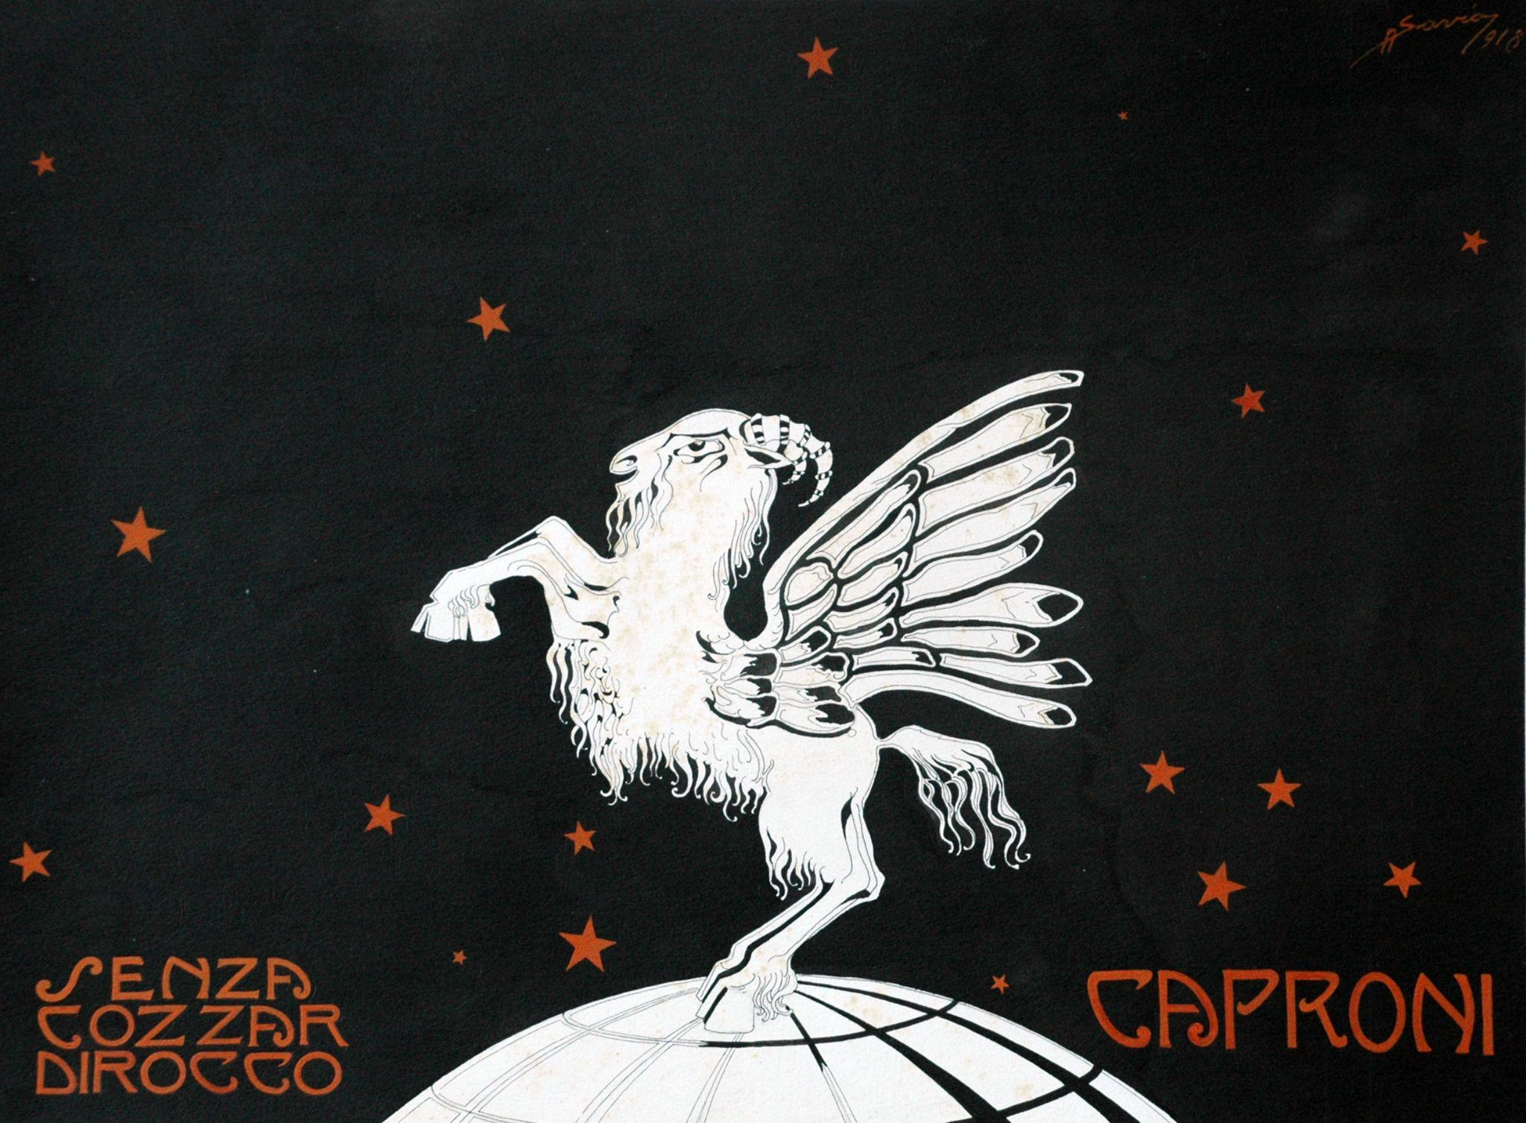
Caproni Collection
Lots and lots of phototypes (~ 200,000)
No annotations
Difficult to be explored, at the actual state

Slide 3



Objectives
How?
Oh
Leveraging AI:
Thematic subdivision
Metadata extraction:
subject
content
captioning
Damage assessment
To make Caproni collection great:
make it a cultural heritage
make it easily accessible to the public
According to I.C.C.D. a cultural heritage, to be such, needs to meet certain criteria, among which:
cataloguing
determine its state of conservation
* in red the non-officially required tasks we deliberately decided to tackle

Slide 4
Thematic Subdivision

Slide 5
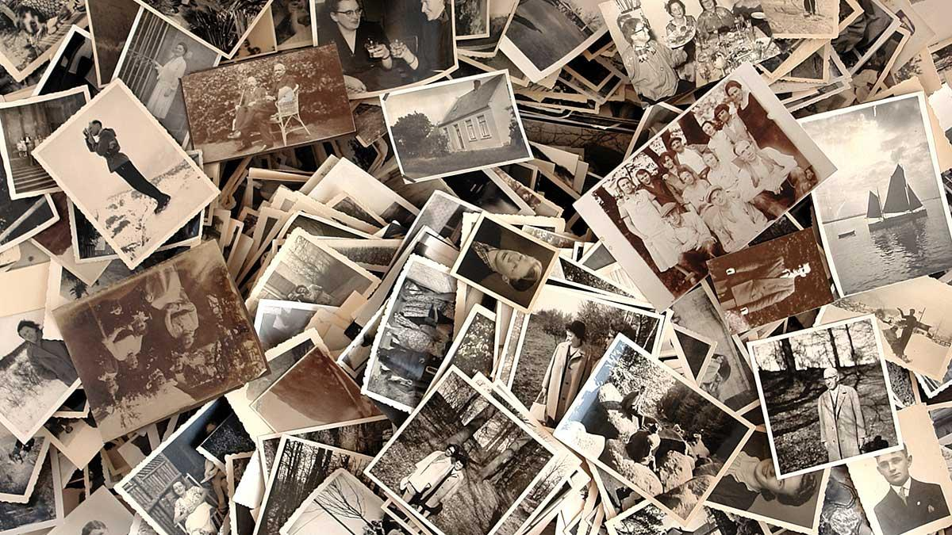
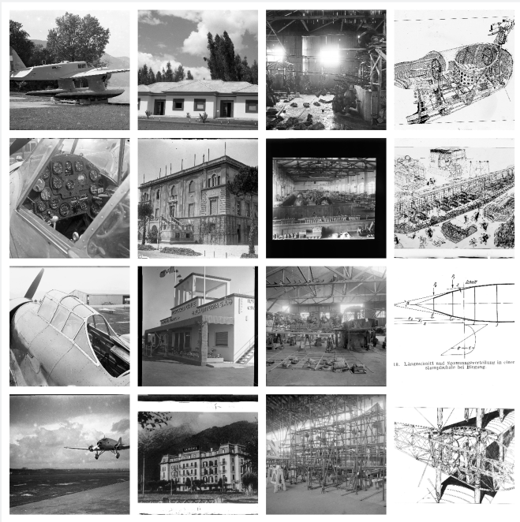
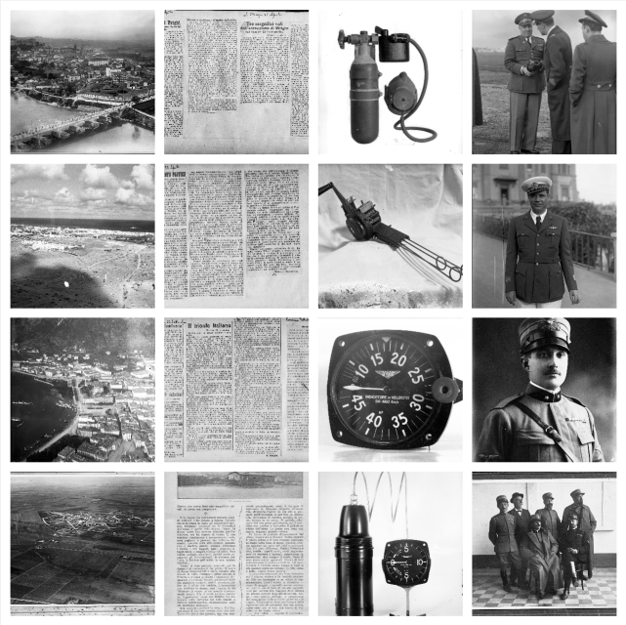
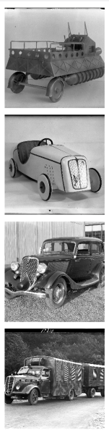
Thematic subdivision
Tidying up:
~ 100 labeled images per class were sufficient to reach 92% accuracy on Caproni
ViT (Vision Transformer) has been fine-tuned for this task
airplane
building
factory
figure
landscape
newspaper
object
people
vehicle
An Image is Worth 16x16 Words: Transformers for Image Recognition at Scale, arXiv, 2020

Slide 6
Metadata Extraction

Slide 7
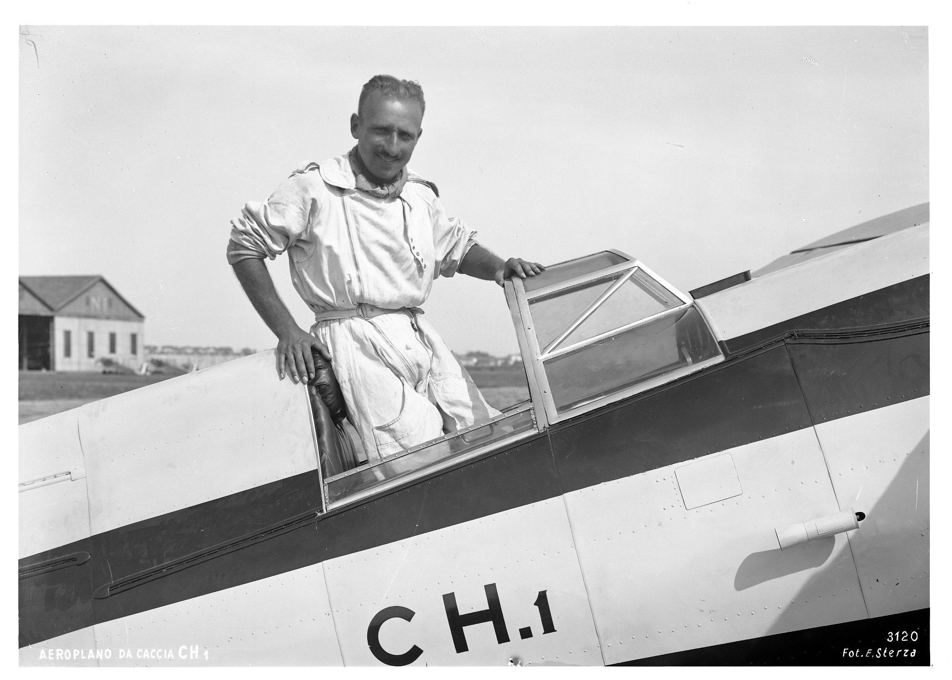

Metadata extraction
a scan from the Caproni Collection
Accuracy:
Subject
Content
Caption
Airplane
0.93
Airplane, People
Content
NA
0.92
A man standing in the cockpit of an airplane
Caption
ViT
Swin
OFA
Swin Transformer: Hierarchical Vision Transformer using Shifted Windows, arXiv, 2021;
OFA: Unifying Architectures, Tasks, and Modalities Through a Simple Sequence-to-Sequence Learning Framework, arXiv, 2022

Slide 8
Damage Assessment

Slide 9
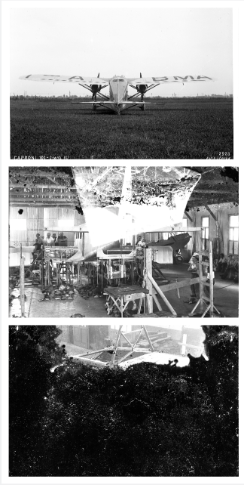
Damage assessment (first approach)
Per-class accuracy:
no/few damage
0.85
Swin
some/several damages
0.84
Multi-class classification
completely damaged
0.86
Notes:
adv: directly trained on Caproni (inevitable generalization)
dis: not punctual results, but overall good

Slide 10
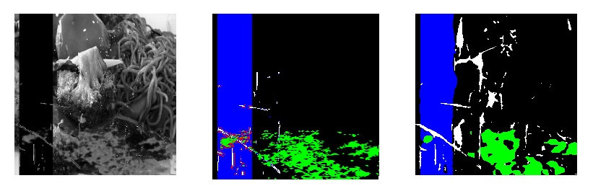
Damage assessment (second approach)
Custom Dataset (81,434 images in rev. 4) with injected damages
Overall mIOU:
0.31
DeepLabV3Plus
possible damages:
bands
stains
scratches
Semantic Segmentation
Microsoft-model
False Positive tendant
Bringing Old Photos Back to Life, arXiv, 2020;
Encoder-Decoder with Atrous Separable Convolution for Semantic Image Segmentation, arXiv, 2018
Notes:
adv: punctual results, output overall damaged surface
dis: not trained on Caproni, hard to generalize

Slide 11
All-in-one Solution

Slide 12

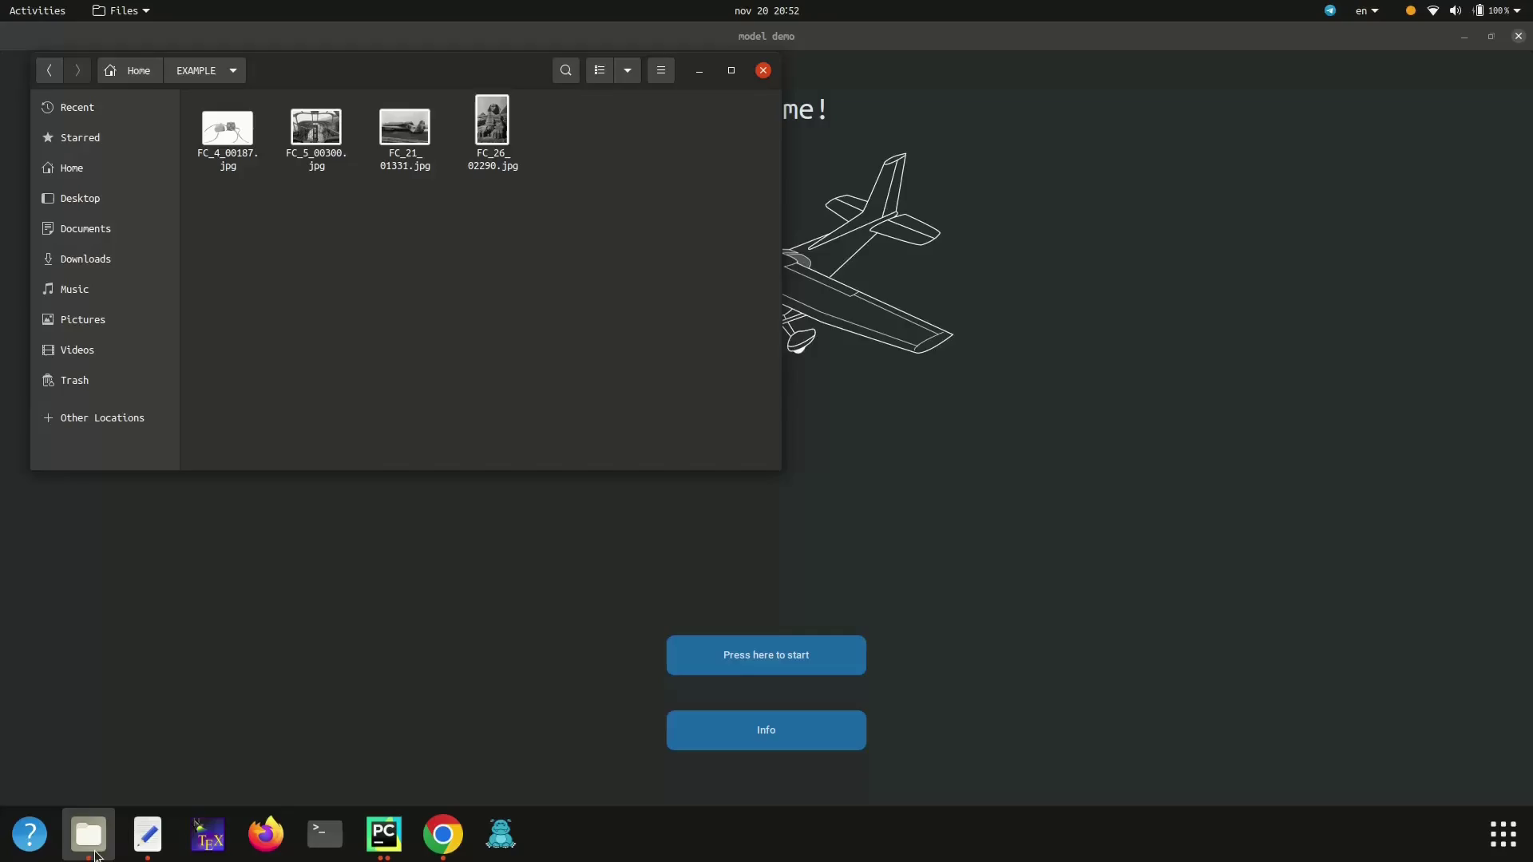
All-in-one solution

Slide 13

Thanks for your attention

Slide 14



The team
Ludovico Maria Valenti
Alessia Meloni
Shaker Mahmud Khandaker

