Slide 1


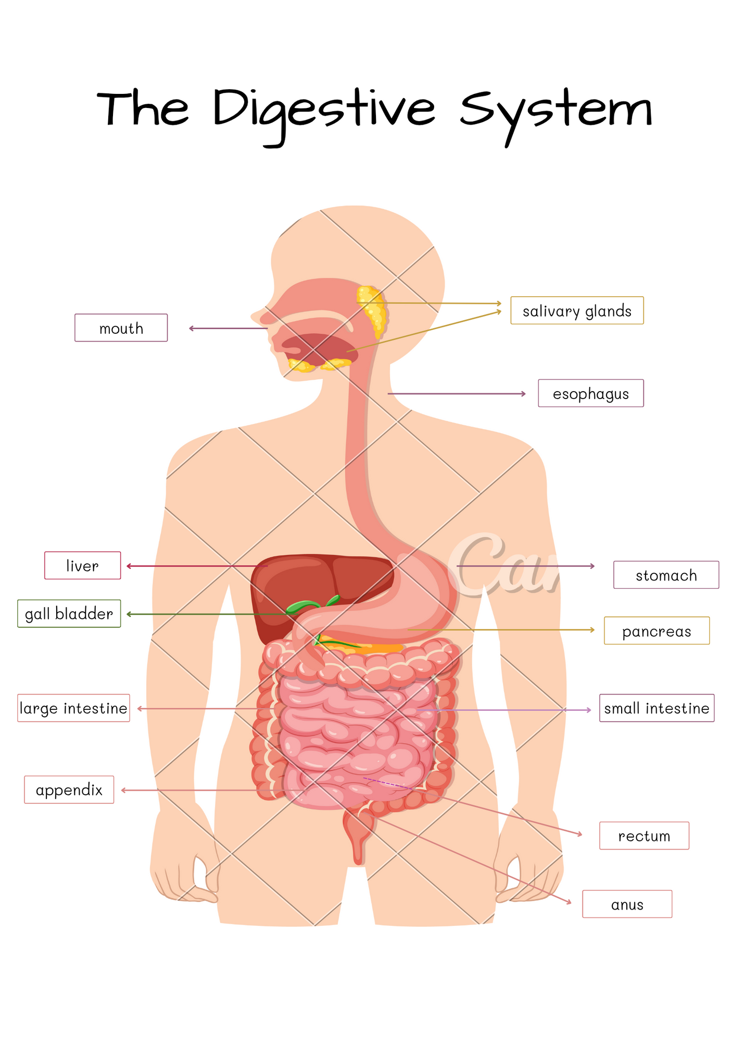
DIGESTIVE SYSTEM
PRESENTED BY MISS MUNAZZA

Slide 2

INTRODUCTION
Word History
The word digestion is derived from word "Digestio" which means separation
DEFINITION
Digestion is the process by which food and drink broken down into smaller parts so the body can use them to build and nourish cells and to provide energy
MECHANISM
Digestion involves mixing food with digestive juices, moving it through the digestive tract and breaking down the large molecules of food into smaller molecules
START OF DIGESTION
Digestion begins in the mouth when we chew and swallow and completed in the small intestine
COMPOSITION
The digestive tract, or alimentary canal, is a long tube that runs from the mouth to the anus. It helps break down food, absorb nutrients, and remove waste. The main parts are the mouth, pharynx, esophagus, stomach, small intestine, large intestine, rectum, and anus. Two solid organs, the liver and pancreas, also help in digestion. The liver makes bile to digest fats, and the pancreas makes enzymes to break down food.

Slide 3
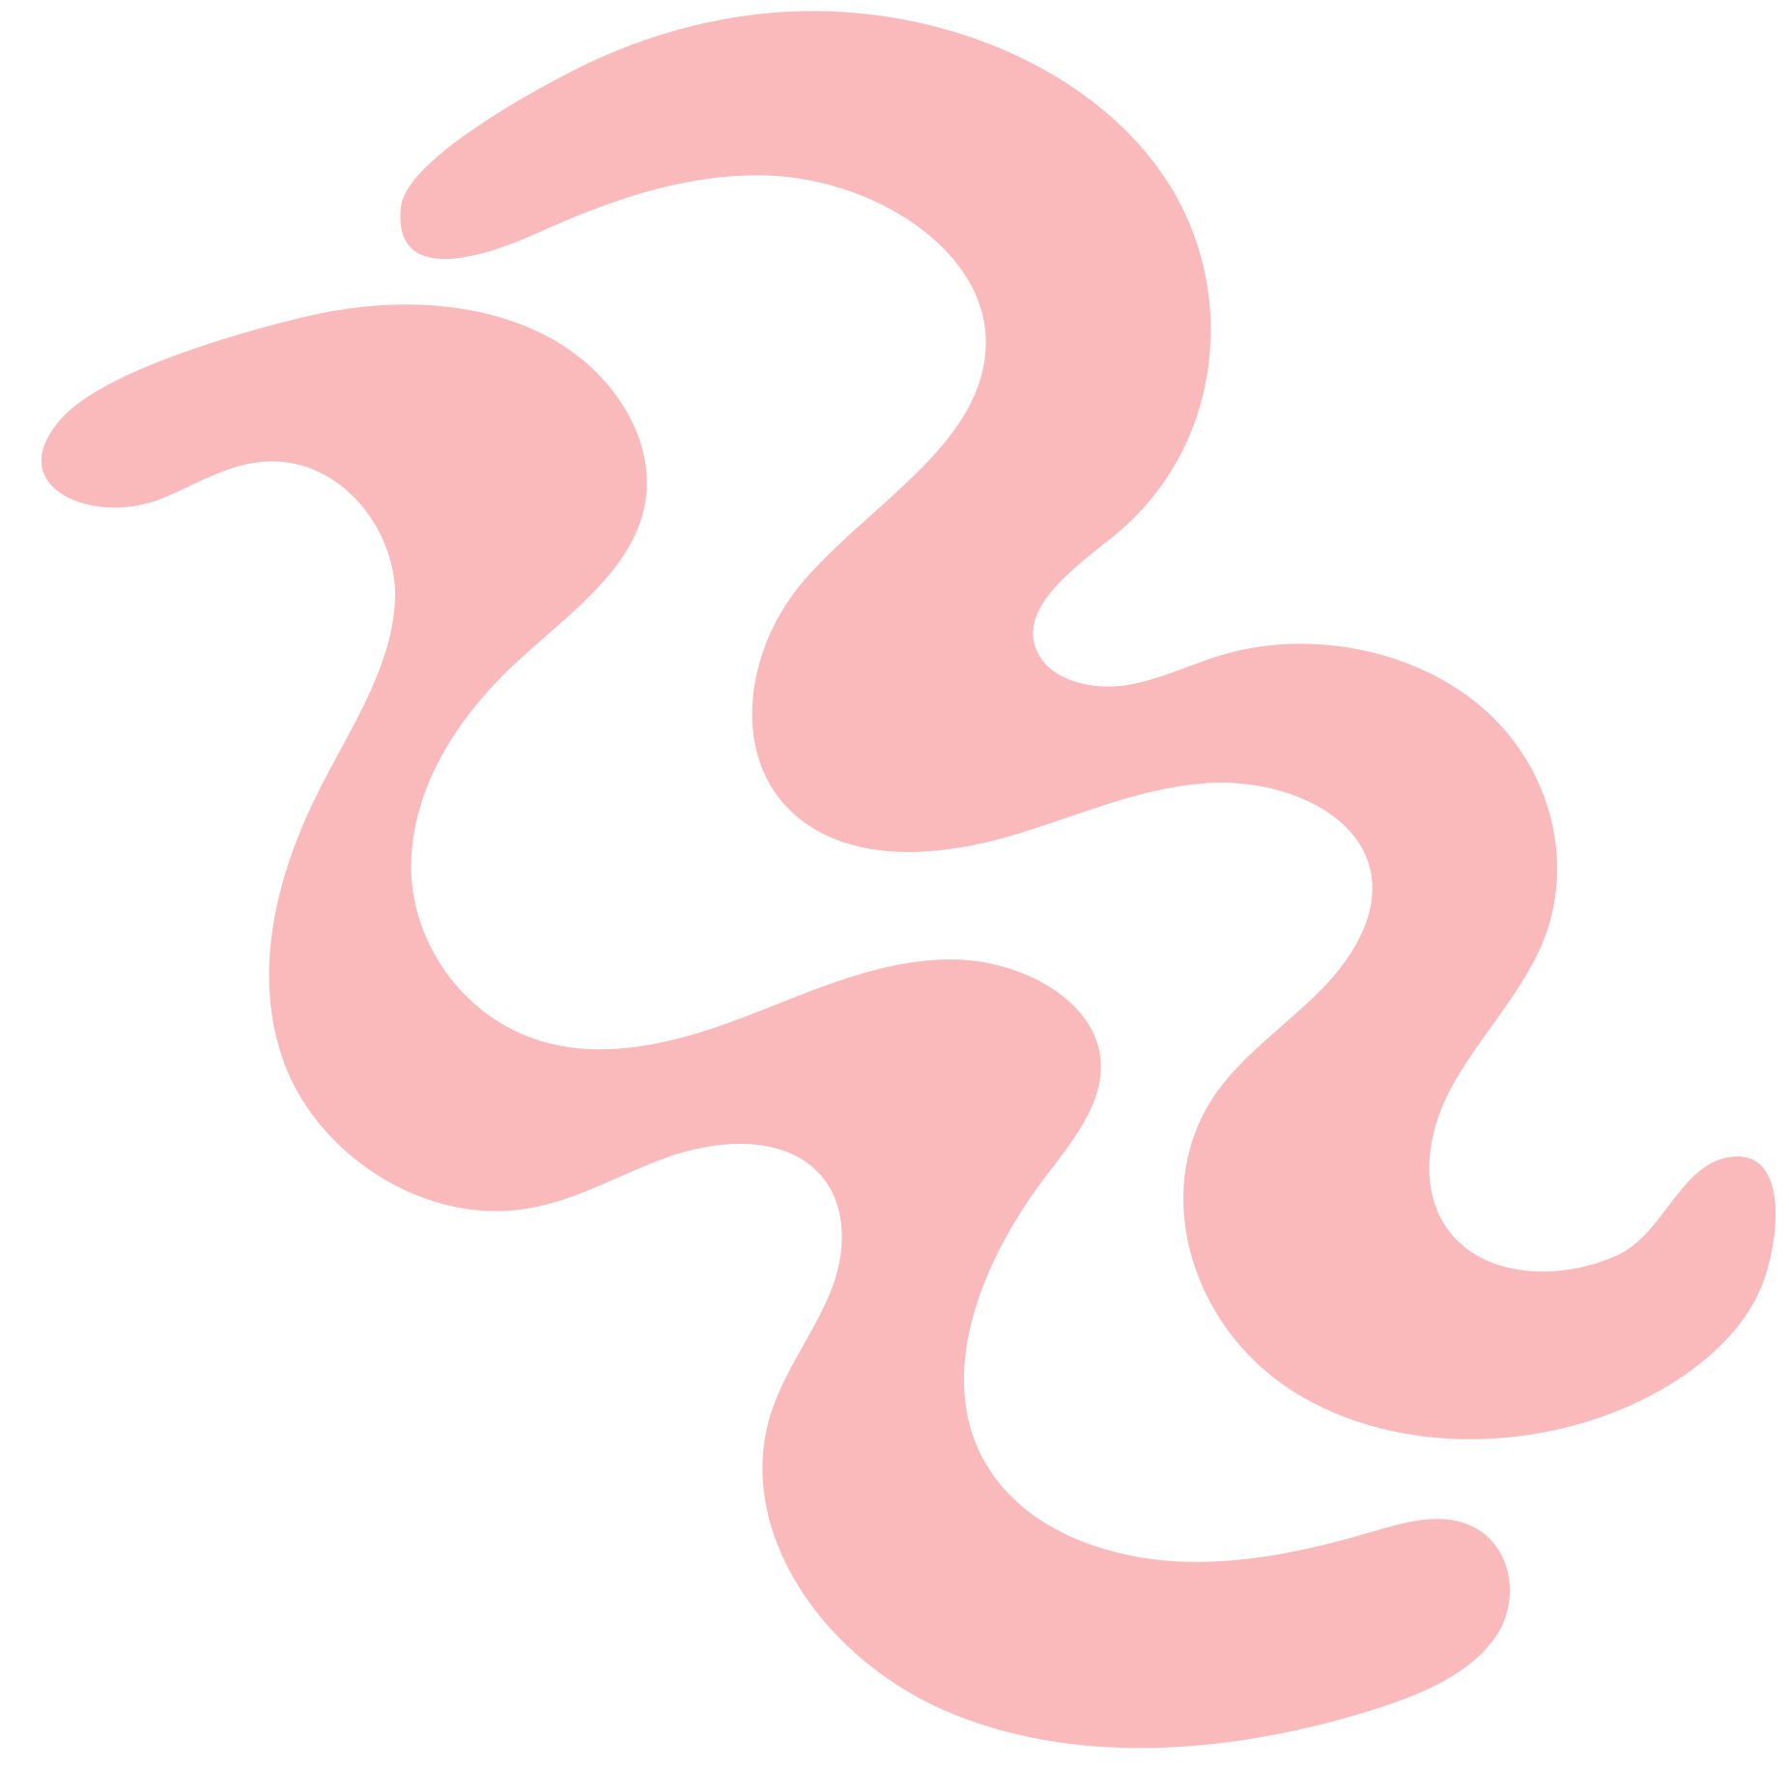
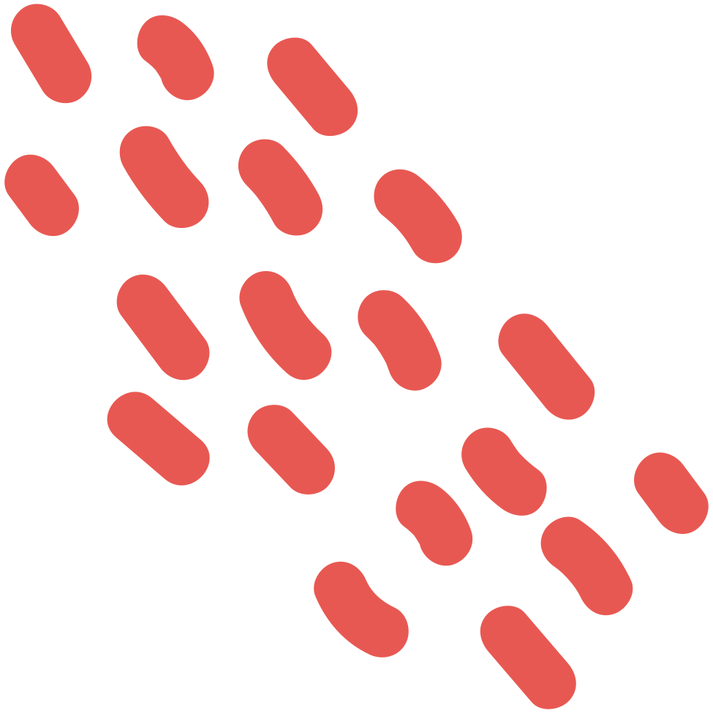
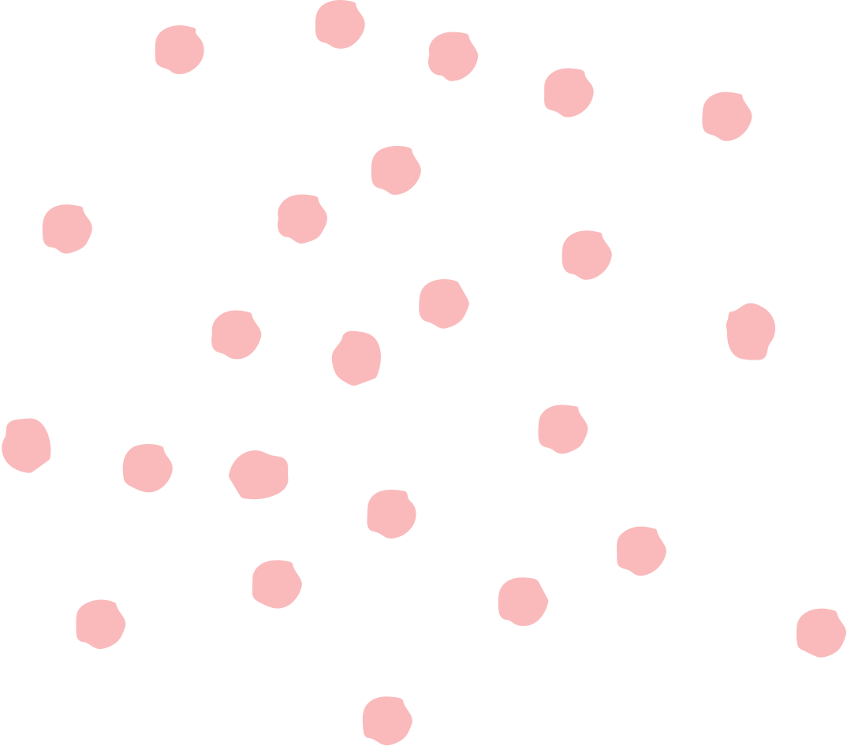
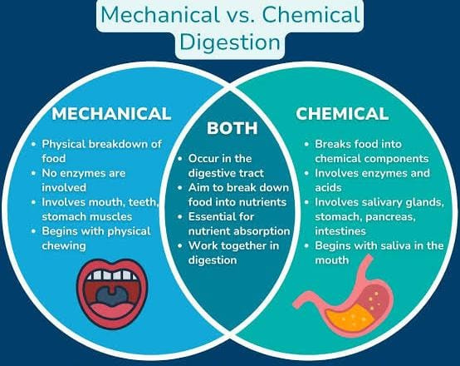
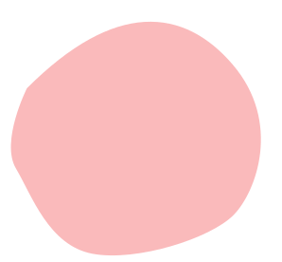
Chemical and Mechanical Digestion
Mechanical Digestion
Mechanical digestion is the physical breakdown of large pieces of food into smaller pieces.
Example: Chewing food in the mouth or mixing food in the stomach.
Chemical Digestion
Chemical digestion is the breaking down of food using enzymes and digestive juices into smaller, soluble molecules that the body can absorb.
Example: Amylase breaking down starch into sugar, or pepsin breaking proteins into amino acids.

Slide 4

Parts Of Digestive System
SMALL INTESTINE
The small intestine is a long, coiled tube where most digestion and nutrient absorption occur.
Enzymes from the pancreas and bile from the liver help digest fats, proteins, and carbohydrates.
LARGE INTESTINE
The large intestine absorbs water and minerals from undigested food.
It helps form solid waste (faeces) by removing excess water before the waste leaves the body.
Rectum and Anus
The rectum is the storage area for waste before it leaves the body.
The anus is the opening through which the waste (faeces) is released during egestion.
MOUTH
OESOPHAGUS
STOMACH
The oesophagus is a muscular tube that connects the mouth to the stomach.
It moves food downward through peristalsis, which means wave-like muscle movements that push food toward the stomach.
The stomach is a muscular organ where food is mixed with gastric juices.
These juices contain hydrochloric acid (which kills germs) and enzymes like pepsin (which break down proteins).
The stomach’s walls contract to mix and soften the food.
Digestion begins in the mouth. Teeth break food into smaller pieces. Saliva contains amylase enzyme that breaks down starch

Slide 5
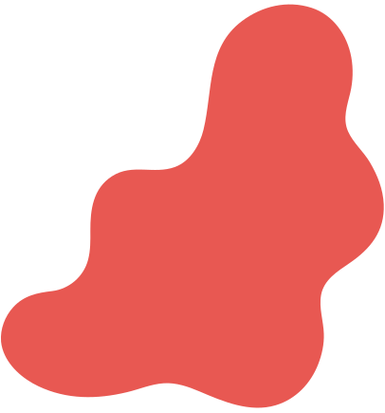
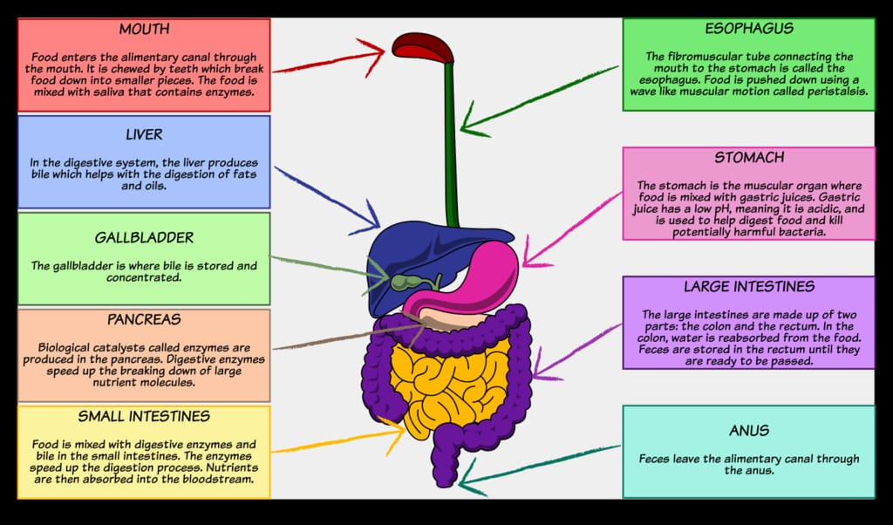

Slide 6

THANK YOU

