Slide 1
Airline Ticket Price Model
Presented by Swapnil Khandare and Shivaji Shendge.

Slide 2
Overview :-
Introduction
Objective
Basic Requirement
Needs
About Project
Technology Stack
Database Diagram
ER Diagram
Future Scope

Slide 3
Introduction :-
Nowadays, the airline corporations are using complex strategies for the flight ticket fare calculations. This highly complicated methods makes the flight ticket fare difficult to guess for the customers, since the fare changes dynamically.
Our project Improved Flight Price Prediction System which resolve this problem and provide a facility where people will be able to predict the flight-ticket price before purchasing the ticket.

Slide 4
Objective :-
The objective of the Airline Ticket Price Model project is to analyze and predict airline ticket prices to help users find the best deals and understand price fluctuations. By considering factors like travel dates, destinations, and seat classes, the project aims to provide accurate price estimates and insights for travelers, making their booking process more efficient and cost-effective

Slide 5
Needs :-
Price Fluctuations:
Airline ticket prices can vary significantly based on factors like demand, timing, and seasons. A model helps predict these changes, empowering users to book at the right time.
Time-Saving:
Instead of manually comparing prices across multiple websites, the model provides quick and reliable predictions, saving users time.
Competitive Advantage for Businesses: Travel agencies, booking platforms, and airlines can use the model to offer personalized deals and stay competitive in the market

Slide 6
About Project :-
The Airline Ticket Price Model aims to analyze and estimate airline ticket prices based on key factors such as booking time, route, flight class, and airline type. This project provides a systematic approach to understanding price fluctuations and patterns without using machine learning algorithms. Instead, it relies on rule-based analysis, statistical methods, and data-driven insights to estimate ticket prices effectively.

Slide 7
Technology Stack
Technology
Core Java
JDK 1.8
JDBC
MySql
Tools
Eclipse IDE
Maven
GitHub

Slide 8
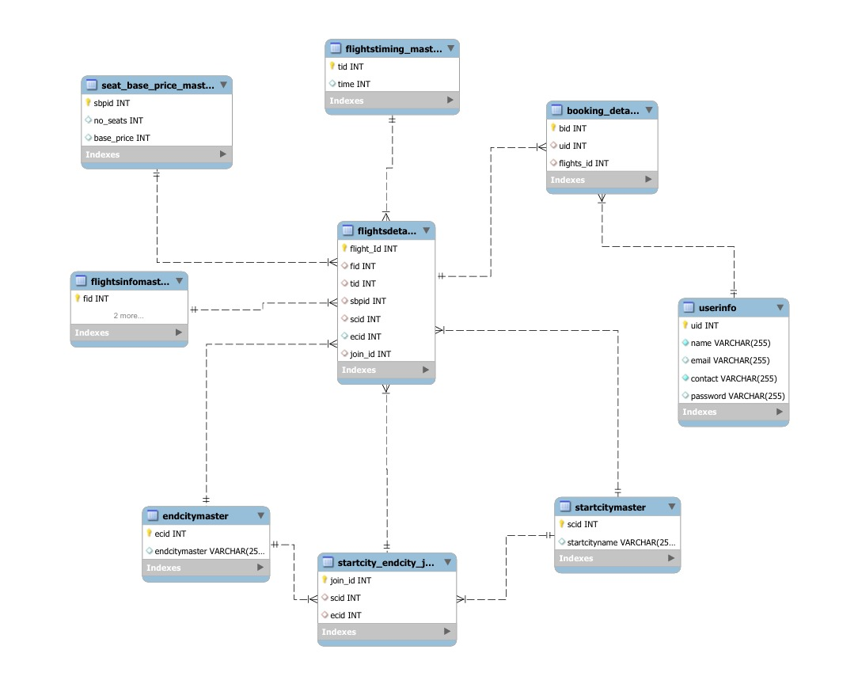
Database Diagram :-

Slide 9
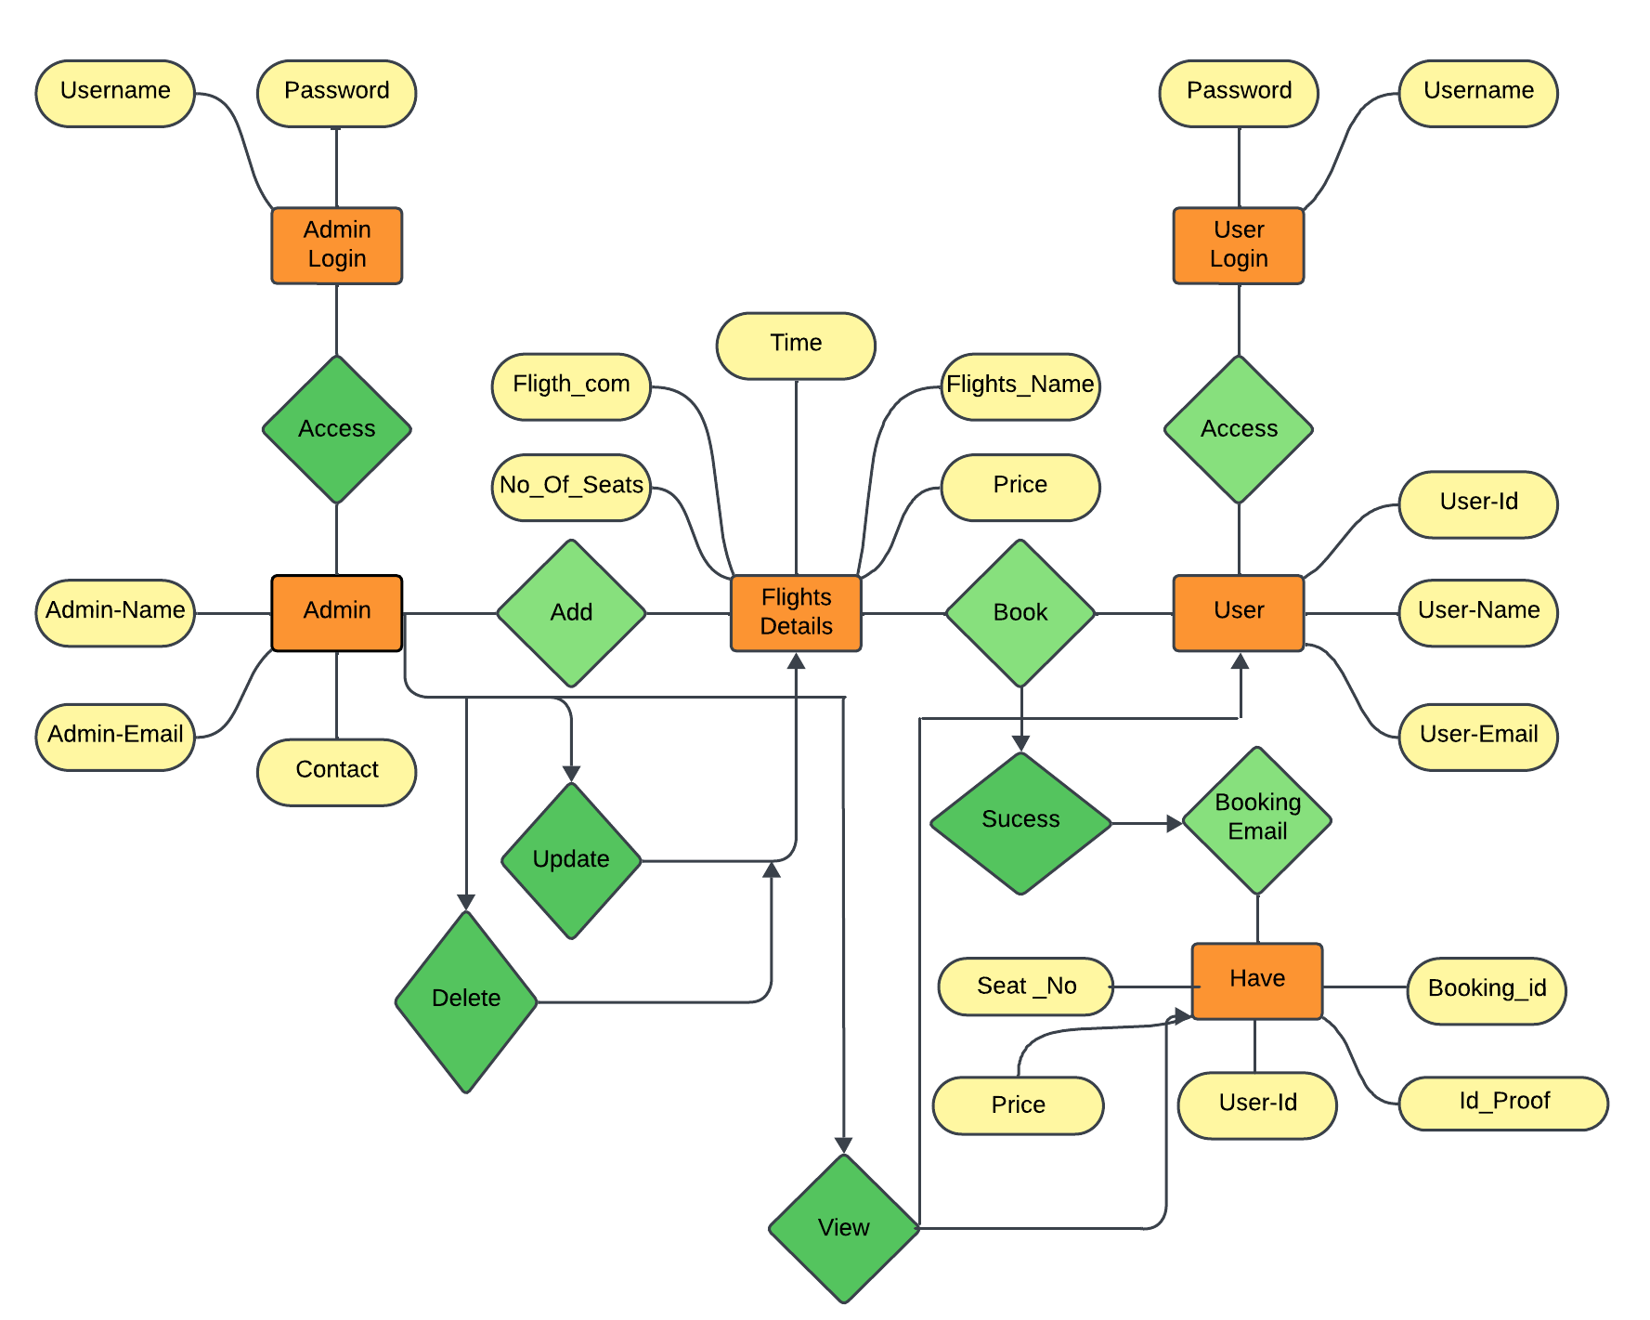
ER Diagram :-

Slide 10
Future Scope :-
The Airline Ticket Price Model has significant potential for expansion and improvements. As the travel industry continues to evolve, this project can be enhanced to meet growing demands and provide more accurate and dynamic solutions. Below are some areas for future development:
Integration with Real-Time Data
User-Focused Applications
Mobile and Web Application

Slide 11
Thank You

