Slide 1

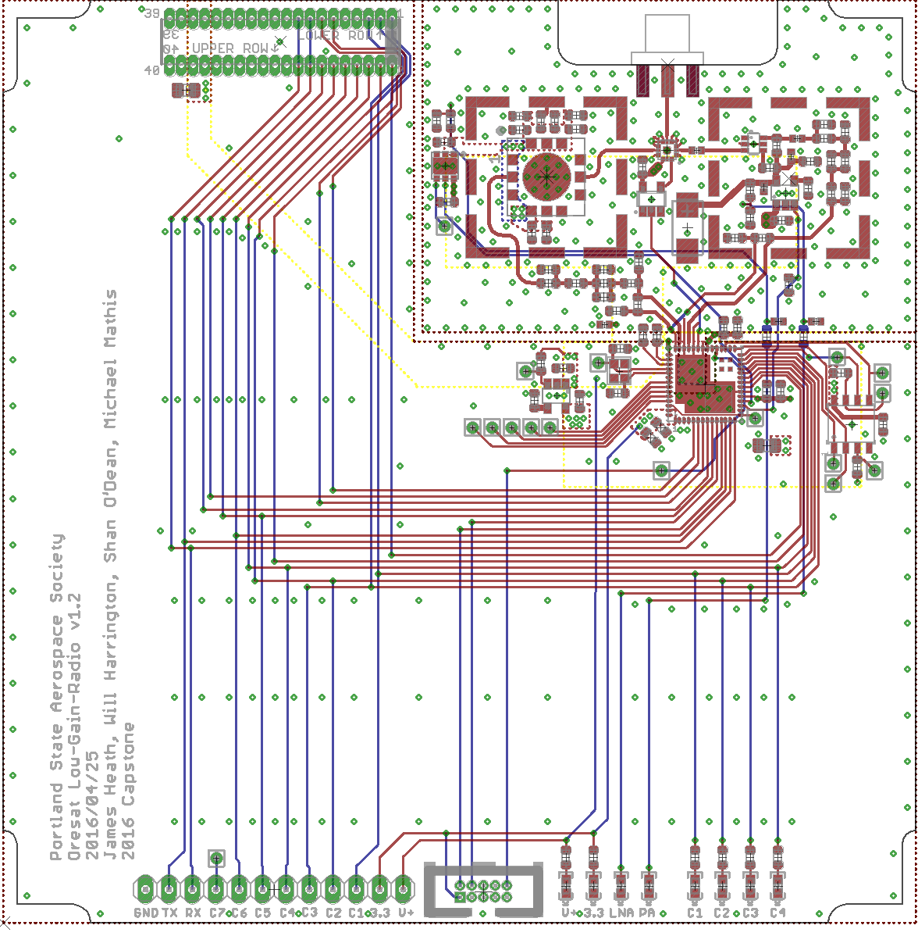
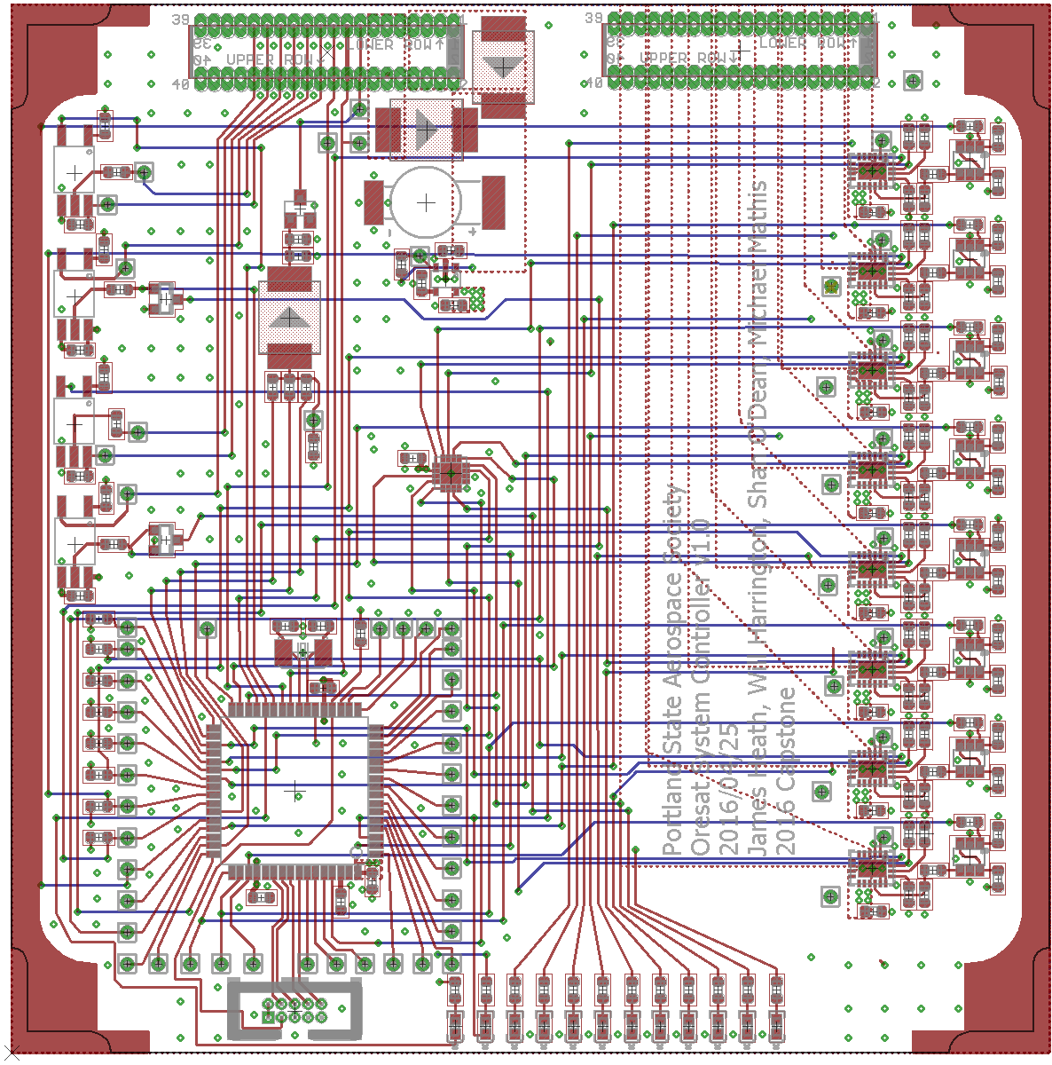
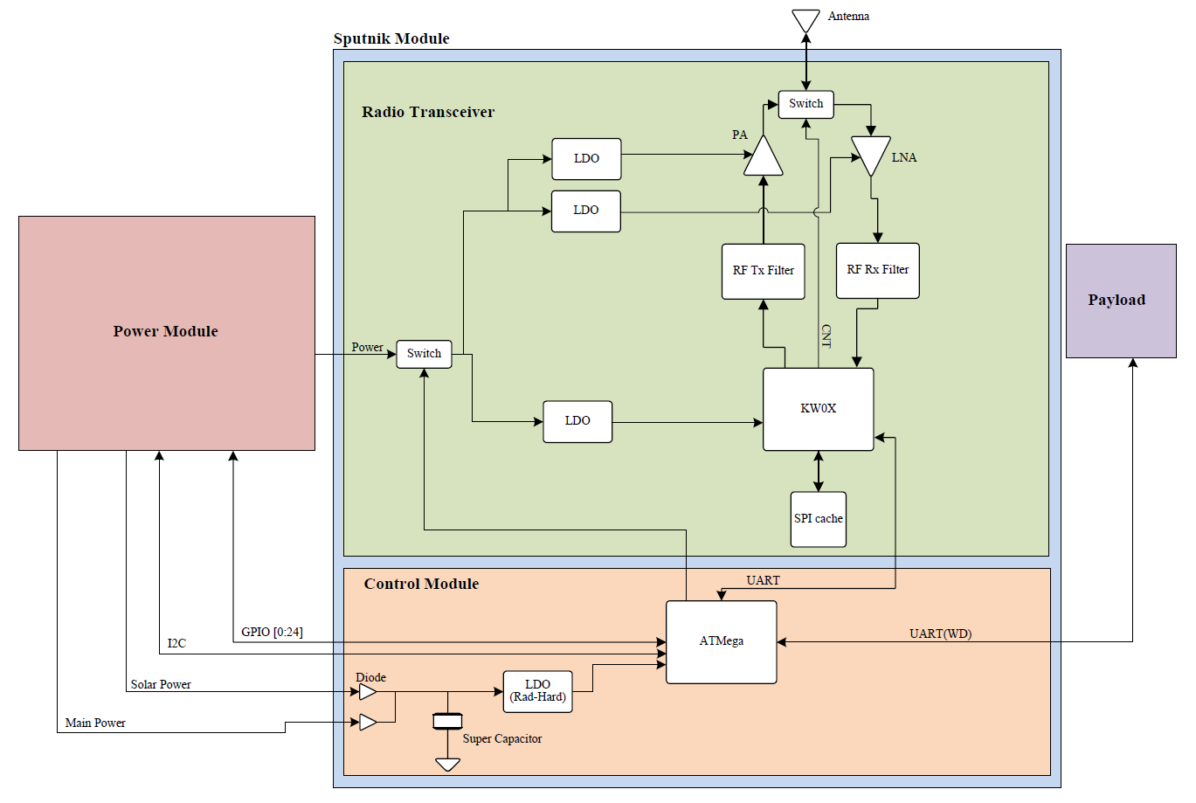
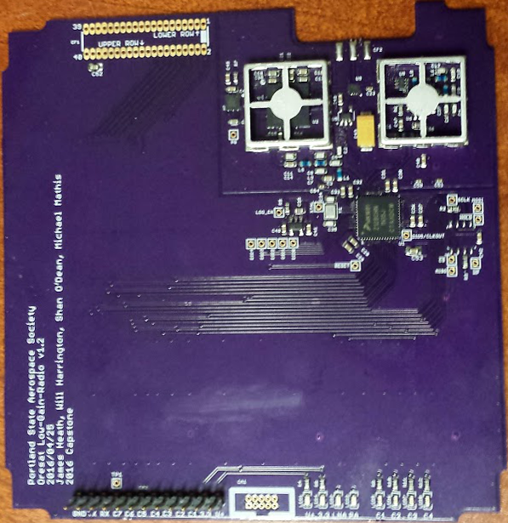
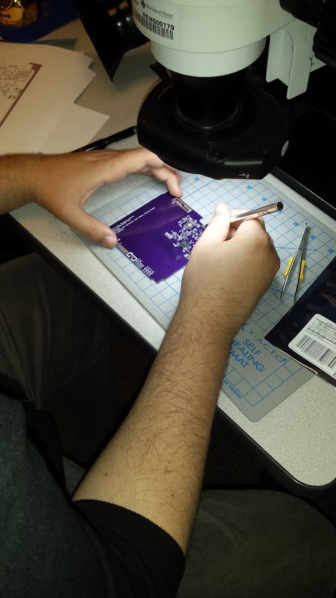

Special Thanks to:
Andrew Greenberg Theo
Glenn Dr. Teuscher
PSAS The LID
CubeSat Command Control and Communications System
Project Team:
Will Harrington
Jake Heath
Michael Mathis
Shan Quinney
Introduction
Development
The firmware team programmed Sputnik to check for errors caused by radiation or bugs. The LGR module sends an “I’m alive” signal to the SysCon periodically. If the SysCon doesn’t receive the signal in time, it performs a reset on the LGR. The SysCon module will also listen in via i2c to the payload and to the power system and reset those systems as needed.
They also wrote drivers for the essential peripherals of the microcontrollers and programmed the tricky configuration of the LGR’s microcontroller and transceiver.
Small educational satellites called CubeSats have been launched by dozens of universities and countries around the world, but so far Oregon has yet to join the elite club of states that have flown a home-grown CubeSat in space. The Portland State Aerospace Society (PSAS) would like to change that! PSAS has included several other Oregon schools in the ORESAT project to build a CubeSat and send it into orbit. Two NASA programs make that possible, the NASA CubeSat Launch Initiative and NASA’s Educational Launch of Nanosatellites program.
PSAS needed a command, control, and communications system for the CubeSat project. The project was fondly nicknamed Sputnik because it doesn’t have sensors, but has a radio. Sputnik will eventually be responsible for communications to and from a 400km low earth orbit. It will retrieve scientific data from the CubeSat’s payload of sensor modules and send the data back to earth. Sputnik will also relay commands like “Take a picture” or “Turn around”. In space it will need to be able to deal with a temperature range of -40C to 85C and radiation events that could cause components to latch up and cause shorts.
PSAS wanted a basic code base that future contributors could use to get up and running on the project as quickly as possible so user-friendliness and good documentation were key.
Development of the Sputnik project began last year during our practicum. We created a specialized breakout board for the microcontroller with the integrated radio. Having this initial board allowed the firmware team to begin work earlier. We were also able to de-risk some of the components that we used in the final product.
Results
In the end we were able to produce working prototypes that have been tested to our sponsor’s specifications and we provided our sponsor with the documentation necessary to bring future Sputnik teams up to speed on the project.
Our final boards contained a total of 180 individual components, 108 for the LGR and 72 for SysCon.
10km TEST RESULTS
QUOTE FROM ANDREW ABOUT HOW AWESOME WE ARE MAYBE
Design
The Sputnik project is composed of two separate modules: the low-gain radio module (LGR) and the system control module (SysCon). The LGR module is home to a microcontroller with an integrated radio transceiver. The system controller module will house a radiation hardened watchdog microcontroller that can reboot the payload and the radio module after a radiation event or other error causes systems to fail.
The prototype we are making will use off-the-shelf parts that have radiation hardened analogues so that when the time comes to build the final boards the off-the-shelf parts can be swapped out for the more robust components. This saves money during this early development stage
Spectrum analyzer
screenshot
Picture of us doing
the 10km test
The final board layouts for the LGR (left) and the SysCon (right)
The hardware team also spent extra time researching part because hey had to find components that had equivalent radiation hardened counter parts.
Part of that de-risking process was creating proto-boards. These are small and specific boards built for the sole purpose of testing the major sub-systems of Sputnik. The proto-boards were custom made and tested in the Laboratory for Interconnected Devices (LID) by the hardware team.
Graph showing SOMETHING HARDWARY (left)
Picture of MEMBERS OF TEAM performing a 10km communications test (right)
UPDATE WITH HOW THE BUILDING OF THE BOARDS GOES
Block diagram of the Sputnik project
Jake Heath works on an LGR module
Pictures of the finished boards LGR (left) and SysCon (right)
Department of Electrical and Computer Engineering

